Slide 1

Using Face-to-Face Strategies for Active Learner Engagement in Online and Hybrid Courses
Susan Fein & Rayne Vieger

Slide 2
LEARNING OBJECTIVES
By the end of this session, you will be able to:
Adapt proven, in-person, active learning strategies for a fully online or hybrid classroom.
Experiment with active learning modes and tools that can be applied in online or hybrid classes.
Evaluate the appropriateness and applicability of the demonstrated technologies.

Slide 3
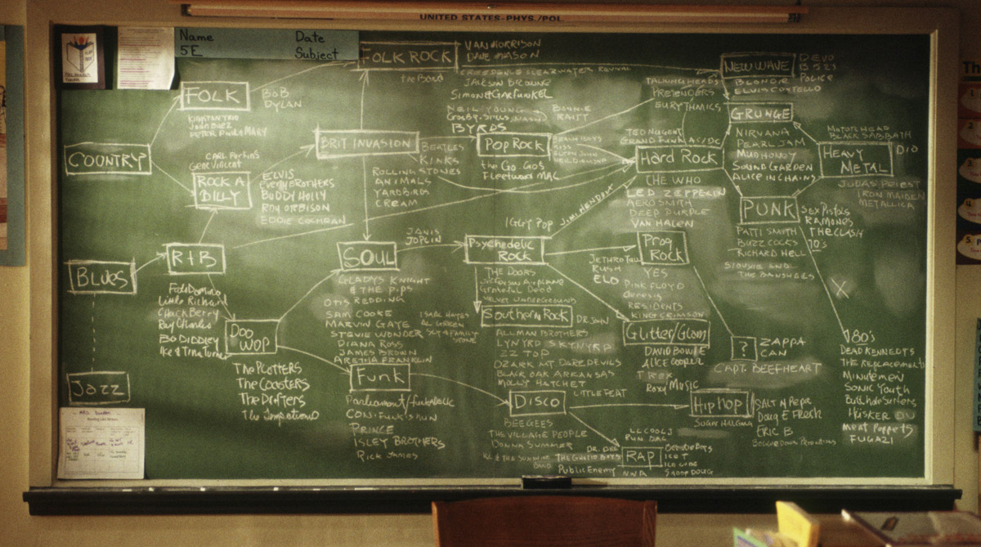
Fully-Online American History

Slide 4
FACE TO FACE APPROACH & CHALLENGES
Individual reading
In-class discussion
  Identifying important events and imagery
  Writing these on chalkboard
F2F environment lacked media and imagery

Slide 5
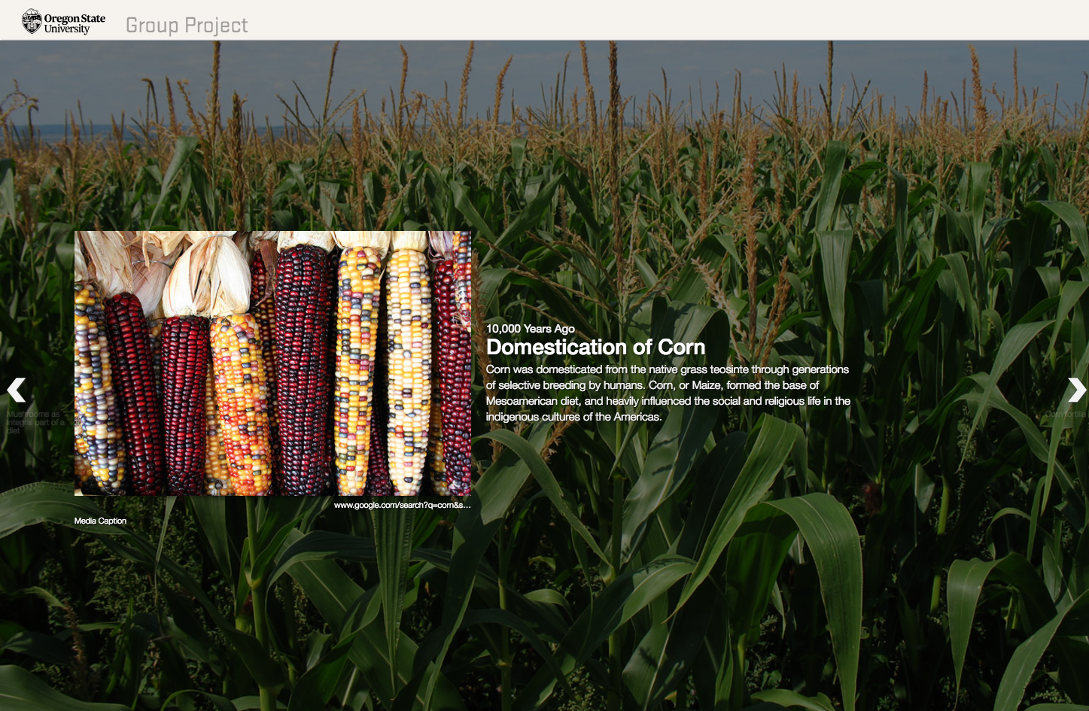
SOLUTION: TIMELINE JS
Benefit visual learners
Form connections, find patterns
Analyze non-linear relationships
Personal, emotional
Fun and motivating
Frederick, P. (1991). Active Learning in History Classes. Teaching History: A Journal of Methods, Vol. 16 (Fall 1991): 67–83.

Slide 6
“...allows students to develop a more well-rounded internal conception of what the topics and people being discussed in the reading actually look like...”
“…helps students understand the interrelation of topics and events more deeply…”

Slide 7
DEMO: TIMELINE JS
Visually based learning in a fully online or hybrid class

Slide 8
TIMELINE JS - PARTICIPATE
Instructions
Log in:
Login here to edit: https://tinyurl.com/QMtimeline1
Login here to view: https://tinyurl.com/QMtimeline2
How to Participate:
Form groups & delegate roles
Select an event related to the history of learning
Summarize event in your own words
Cite a credible source
Choose images or other media to visually represent your event
Fill out the google spreadsheet

Slide 9

65%
87%
125 million
students skipped buying a textbook because it was too expensive
students believe they achieve better grades with an interactive text
Decline in total number of print books sold in the US since 2007

Slide 10

Fully-Online Geography

Slide 11
FACE TO FACE APPROACH & CHALLENGES
Chapters assigned to be read outside of class time
Review chapter during class since many did not read as assigned
Provide supplemental reading to keep content timely and current
Lecture, questions and discussion

Slide 12
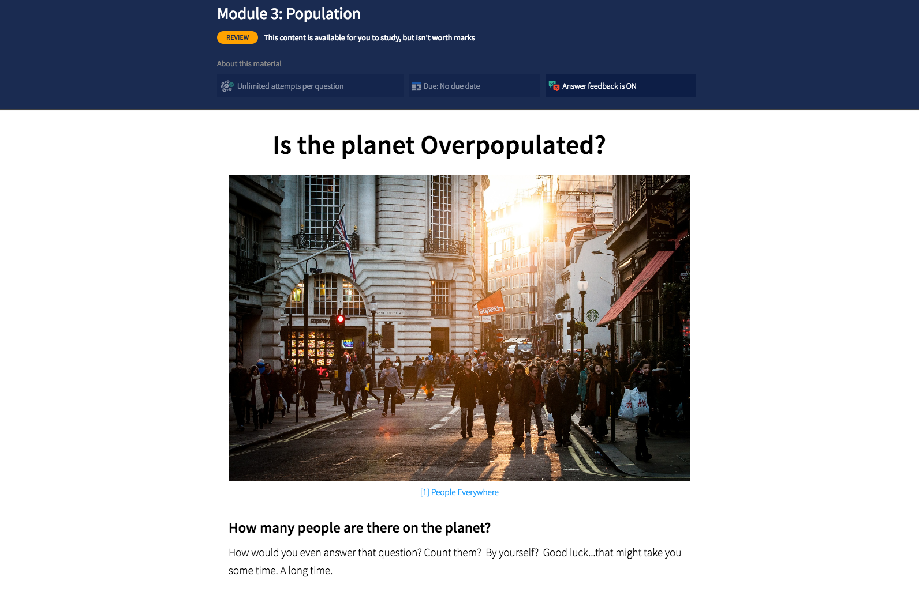
SOLUTION: TOPHAT
Enhances engagement
Offers rich collection of technologies
Promotes higher order thinking
Change and construct online artifacts
Fun and motivating
“Truly Interactive Textbooks for Computer Science Education”. Shaffer et al, Sixth Program Visualization Workshop.

Slide 13
“Qualitative feedback suggests that students enjoy this format.”
“Makes content more engaging.”
“Quantitative increase in student interest and performance.”

Slide 14
VIDEO & DISCUSSION: TOPHAT
https://tophat.com/success-stories/university-of-oregon/

Slide 15
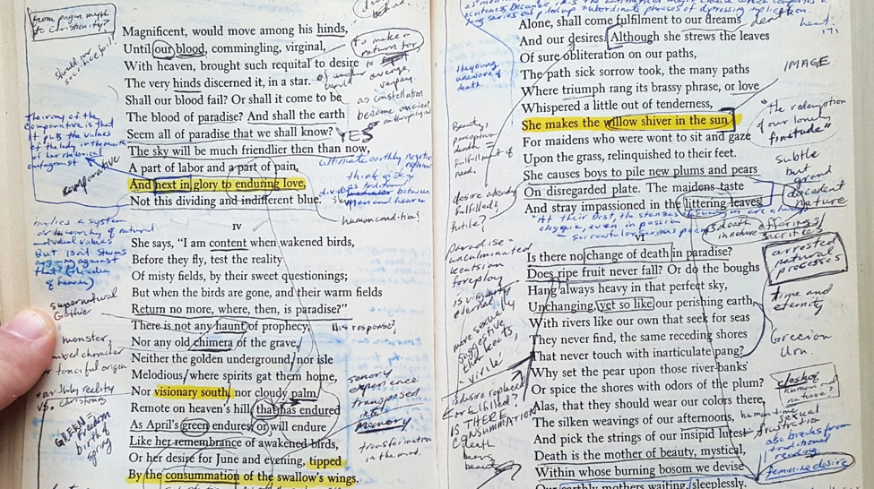
Fully-Online English Literature

Slide 16
FACE TO FACE APPROACH & CHALLENGES
Individual annotation
In-class discussion
Difficult to share annotations
Difficult to learn annotation skills from others

Slide 17
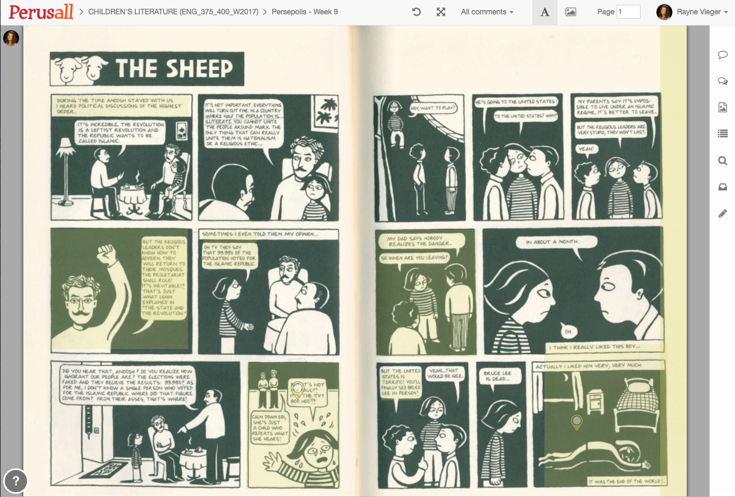
SOLUTION: PERUSALL
“Close reading 2.0”
Collaborative reading & discussion
Actively involved in construction of meaning
Aids in comprehension & analysis
Teacher is co-learner and coach
Nist, S., & Holschuh, J. (2000). Active learning: strategies for college success. Boston: Allyn and Bacon. 202-218.
Simpson, M., & Nist, S. (1990). Textbook annotation: An effective and efficient study strategy for college students. Journal of Reading, 34: 122-129.

Slide 18
“I think it improved my students' close reading skills, and it was good for them to get to learn from each other's reading.”
“It works really well for student-student interaction and for student-teacher interaction.”
“I think the tool is really useful for the students to be able to have conversations about the texts directly on the text.

Slide 19
DEMO: PERUSALL
Close reading and collective annotations
in a fully online or hybrid class

Slide 20
PERUSALL - PARTICIPATE
Instructions
Log in:
http://perusall.com/
Create free account, then add join code VIEGER-0446
OR experience from the Perusall Demo:
  https://app.perusall.com/demo
How to Participate:
Highlight text and note emotional reactions.
Select image and add a comment.
Pose questions to your peers using a “?”
Make connections to other texts or personal life.
Summarize difficult concepts.
Note patterns, themes and motifs.

Slide 21

Hybrid College Algebra

Slide 22
FACE TO FACE APPROACH & CHALLENGES
Lectures
Taking notes
Individual homework
Problems or worksheets for
limited in-class activities
Minimal support when students are working through problems independently

Slide 23
Increase student engagement through active learning
Reduce withdraw/failure rates in high enrollment gateway class
Improve performance and confidence
Improve readiness for science and engineering

Slide 24
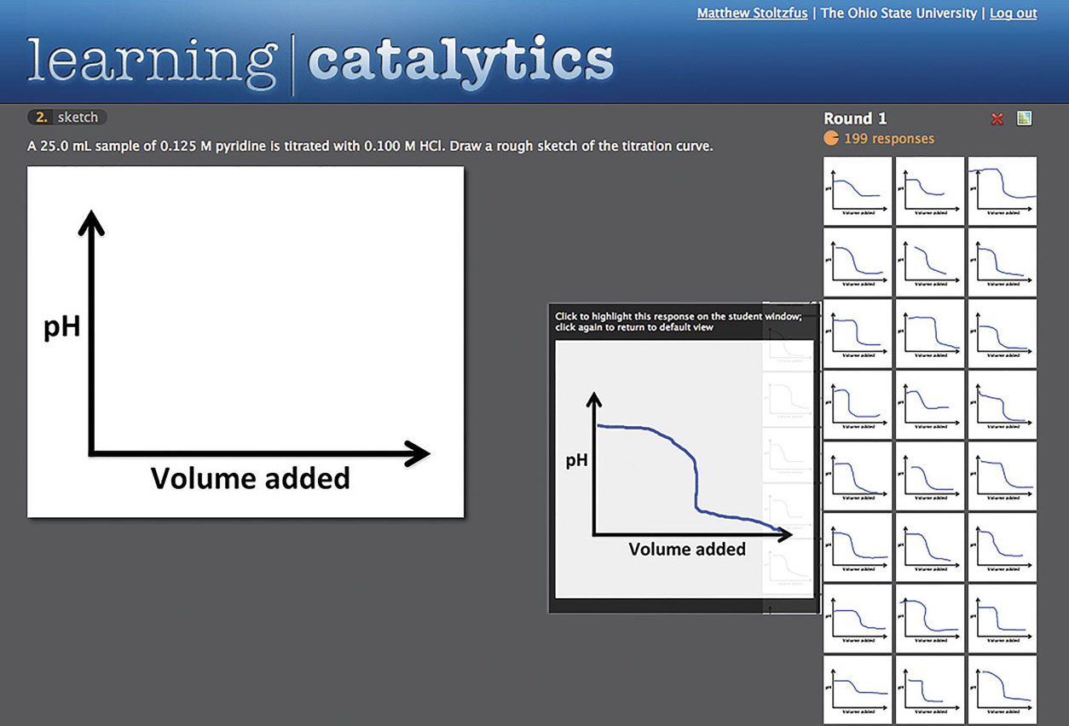
SOLUTION: LEARNING CATALYTICS
Encouraged student collaboration.
Fostered active engagement.
Increased student interaction.
Varied and relevant question types.
Focused on challenging concepts.

Slide 25
DEMO: LEARNING CATALYTICS
collaboration and student response in a hybrid class

Slide 26
LEARNING CATALYTICS - PARTICIPATE
Instructions
Log in:
https://learningcatalytics.com/demo
Enter your first name, last name, and email.
Select “I agree” and press START.
Enter join code 91055170 and click “Join.”
How to Participate:
Select your answer
Select “submit response,” if applicable
Discuss how this could be applied to your hybrid course

Slide 27

Fully-Online Photography

Slide 28
FACE TO FACE APPROACH & CHALLENGES
Complex assignment
  Use images from dominant and counter narratives in contemporary issues.
Difficult for students to explain and show connections to others
Subtleties of connotations and symbols

Slide 29
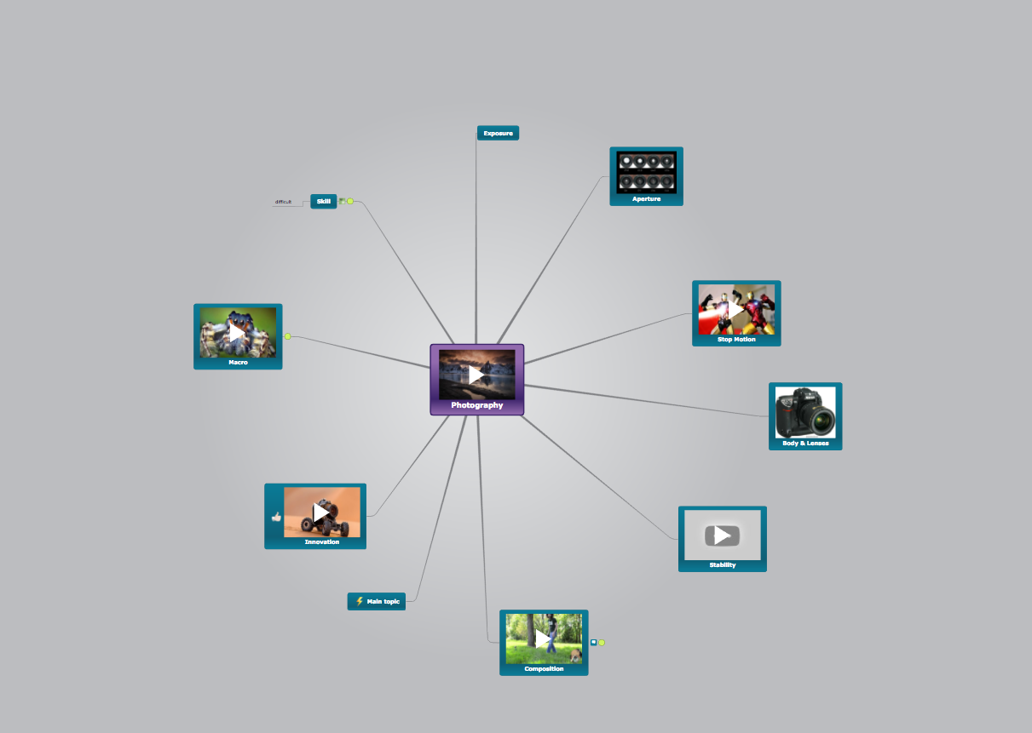
SOLUTION: MINDOMO
Mind mapping corresponds to how our brain stores and retrieves information.
Helps learner recognize and make connections.
Enables learner to see the “big picture.”
It’s fun and doesn’t feel like work!
“The Effect of Mind Mapping on Teaching and Learning: A Meta-Analysis”. Liuet al. Standard Research Journals
Mindmeister

Slide 30
“Allows students to (literally) draw connections between historical events, images, and contemporary issues.”
“Excellent tool to make connections between narratives and sociopolitical outcomes.”
“I appreciated the creative freedom the students had.”
“Students could clearly illustrate the complexity of interrelated topics.”

Slide 31
DEMO: MINDOMO
collaborative mind mapping in a fully online class

Slide 32
MINDOMO - PARTICIPATE
Instructions
How to Participate
https://tinyurl.com/QMPBJ
You can also create your own OR draw your mind map on paper
Additional Resources
Coggle - coggle.com
  The clear way to share complex information
MindMeister - mindmeister.com
  Collaborative mind mapping for creative work
Mindomo - mindomo.com
  The best way to understand and learn anything

Slide 33
THANKS!
Any questions?
Susan Fein
susan.fein@oregonstate.edu
Rayne Vieger
rayne.vieger@oregonstate.edu

