Slide 1
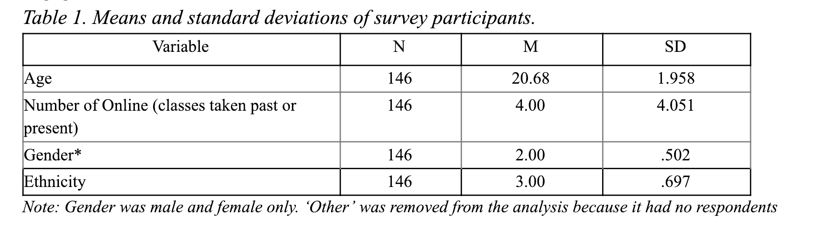
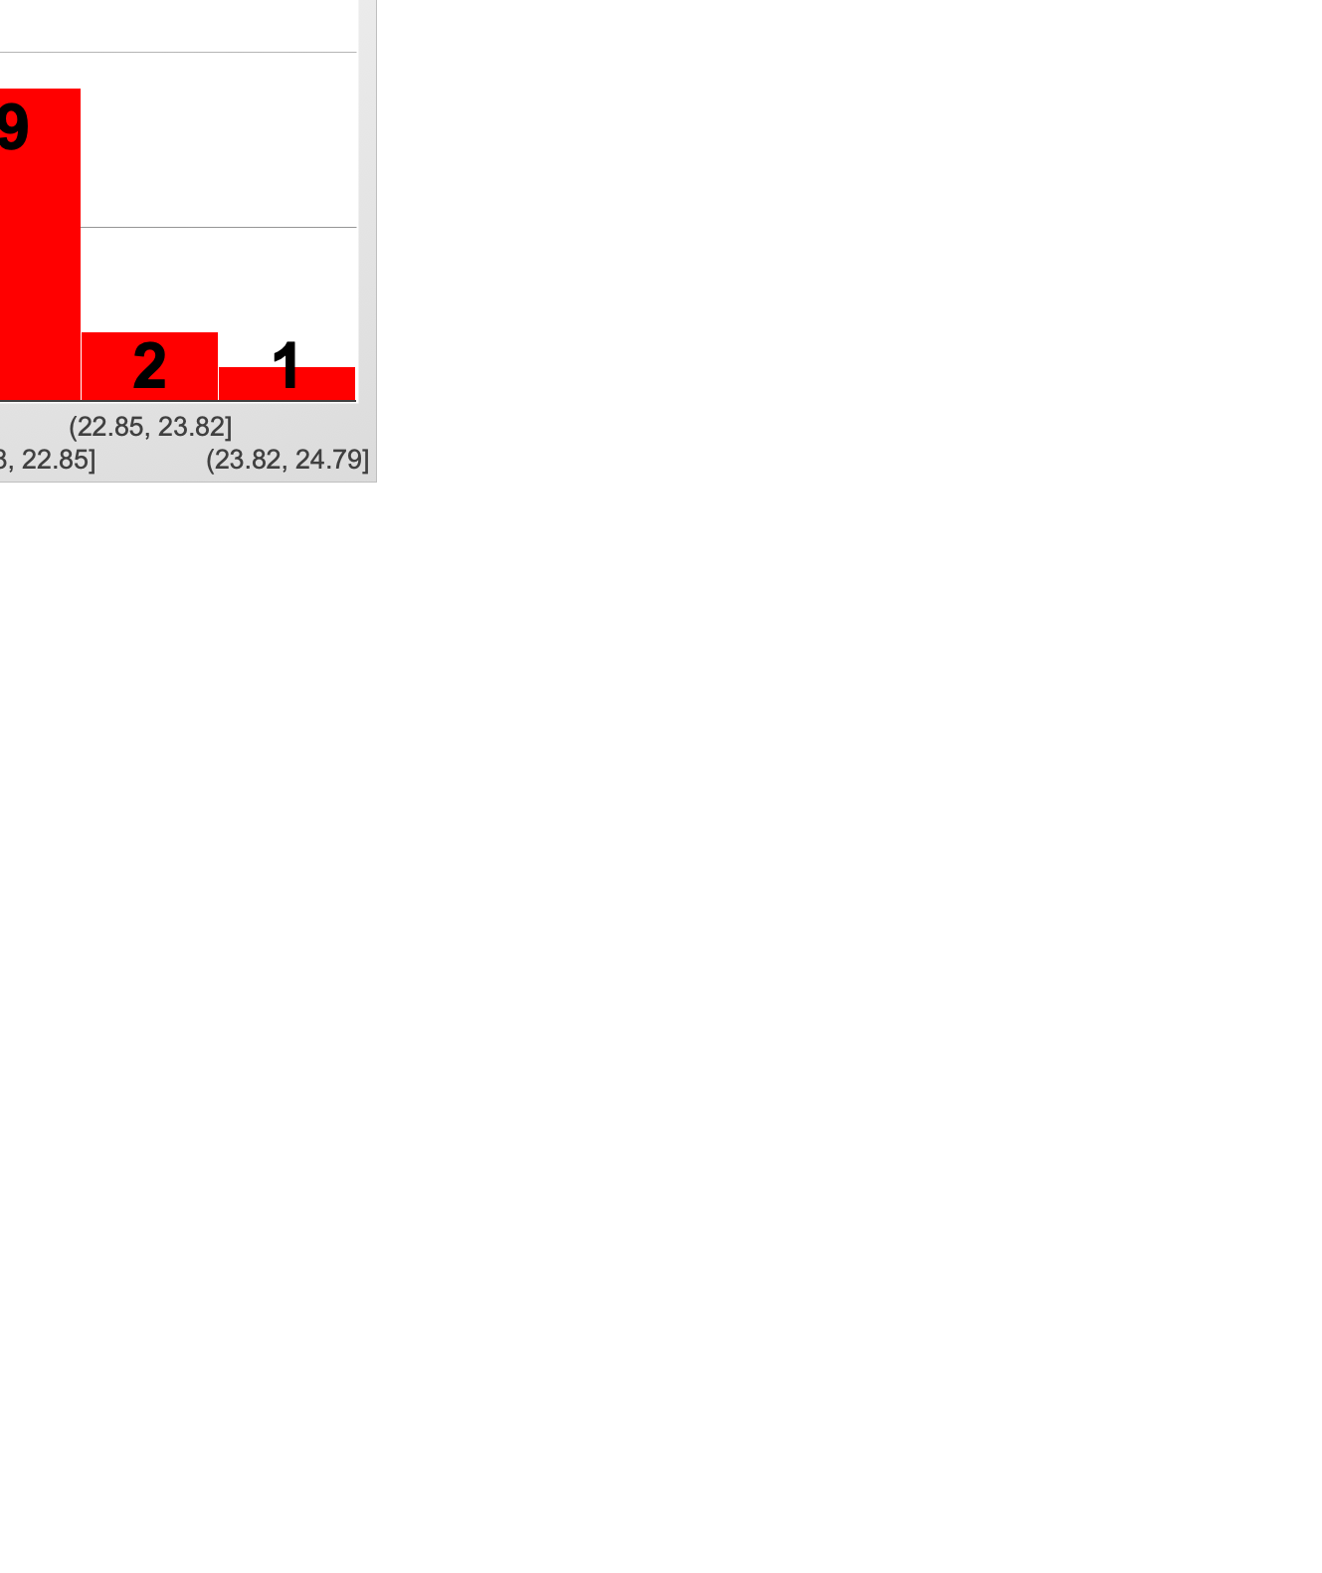
Student Perceptions of the Role of Learning Management Systems on their Engagement in Online Courses
Kizito Mukuni*, Jeeyoung Chun*
*Instructional Design and Technology, Ph.D. Candidates
Virginia Tech, Blacksburg, VA
Introduction
Demographics
Results
This study examined student perceptions of the role of a Learning Management System (LMS) on their engagement. A total of 146 undergraduate students at a large land-grant university in Southeastern part of the United States participated in this study. The research questions that guided this research are:
  Does a LMS play a vital role in student engagement?
  (2) What features of a LMS play a role in student engagement in an online learning environment?
Figure 3. Learner views on the role of LMS*
Figure 1. Gender of Participants*
Methods
The instrument that was used was developed from surveys that had been used by other researchers and grounded in the literature. Researchers also added other questions based on the contribution of students at the pilot stage.
The participants of this study were undergraduates who took consumer sciences courses at a land-grant university in the Southeastern part of the United States. The participants were 18 years or older.
The introduction of the survey and consent information was emailed to the students, and the information was posted on the announcements section in the LMS of the institution with the survey link.
The total number of participants who completed the survey was 146, of which 71 were males and 76 females. The average age of the participants was 21.
Majority of the participants were Caucasian, totaling 115. Asians were the second largest group with 12 participants, and there were 10 African American participants. The results of the analysis revealed that all the participants had experience in online learning.
Table 2. Participant quotes
Category | Quote
Discussion boards (with peers and instructor) | I think an online class can be more engaging when students have to respond to other students discussion questions.
Reminders and due dates | Friendly email reminders about deadlines from the Professor
User Friendliness/ accessibility/ convenience | I can find all the course materials in one place. It makes learning and completing my work easier.
Figure 2. Age of Participants*
Recommendations
Provide opportunities for learners to interact via discussion boards (Cheng et al., 2011)
Utilize due date and reminders within the LMS
Make the course site within the LMS accessible and user friendly
Reference
Cheng, C. K., Paré, D. E., Collimore, L. M., & Joordens, S. (2011). Assessing the effectiveness of a voluntary online discussion forum on improving students’ course performance. Computers & Education, 56(1), 253-261.
*Mukuni, K., & Asante, D. (2019, February). Student Perceptions of the Role of Learning Management Systems on
their Engagement in Online Courses. Conference on Academic Research in Education (CARE), Las Vegas, Nevada.

