Slide 1
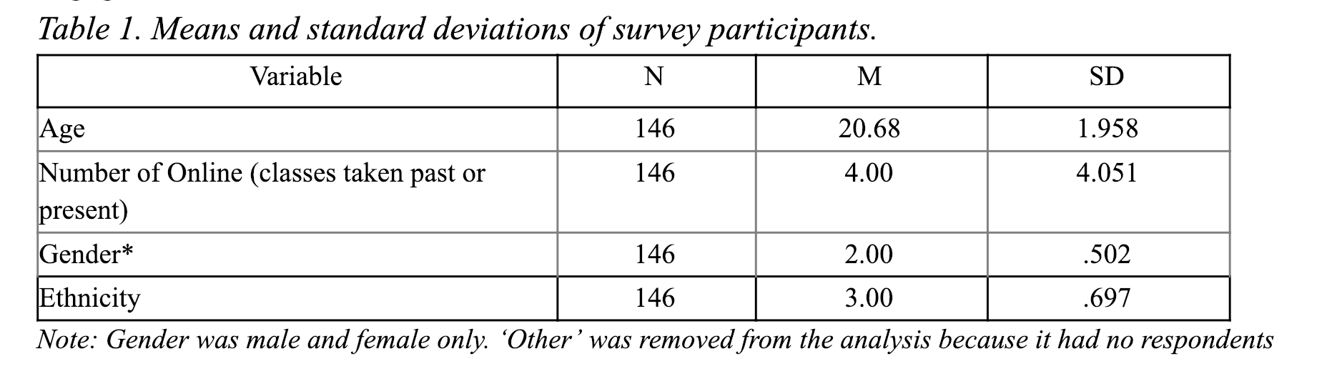
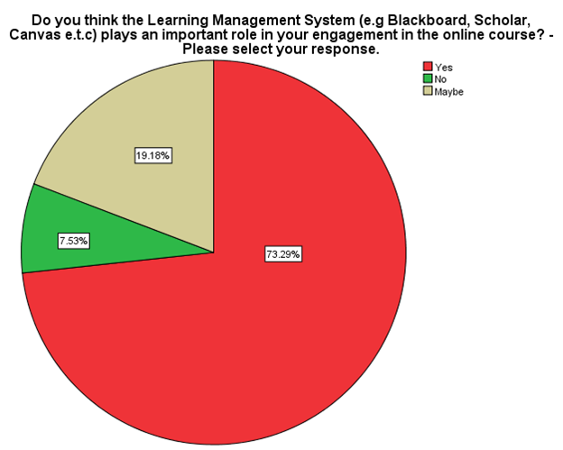
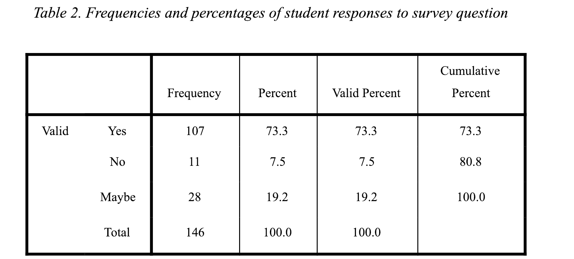
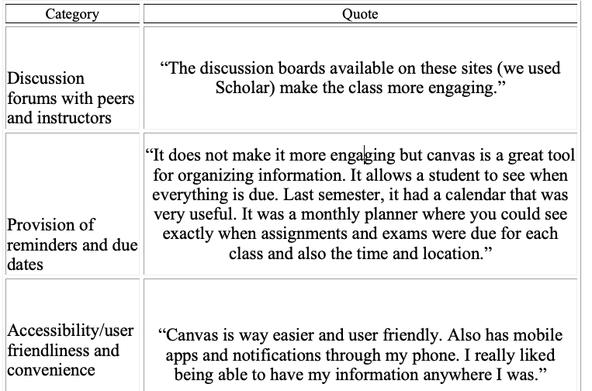
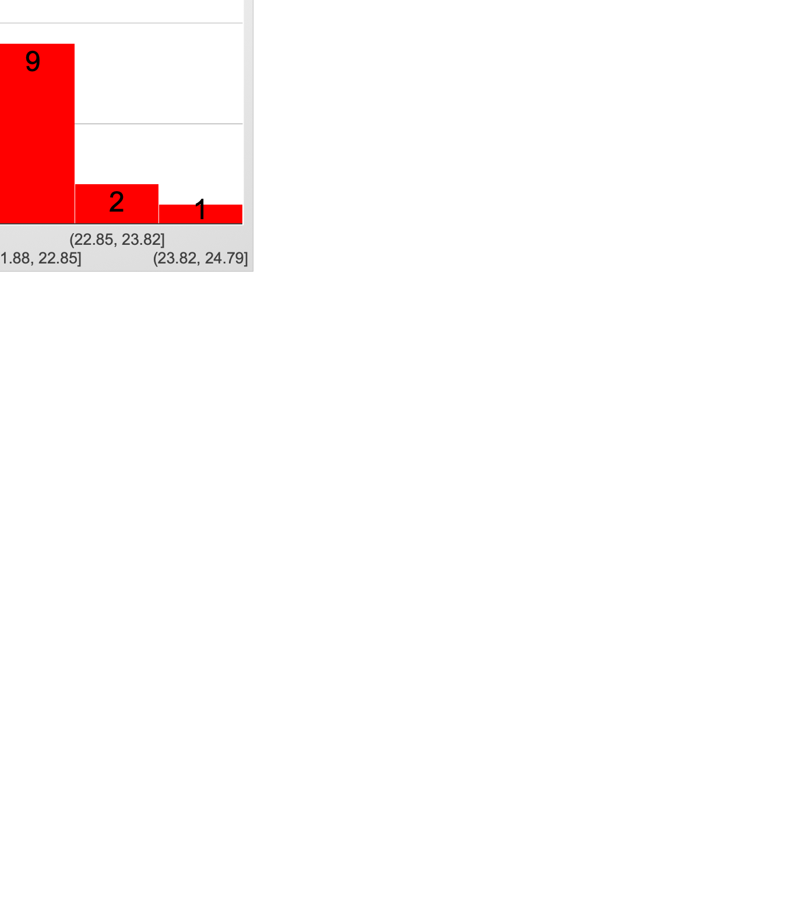
Using a Learning Management System to Engage Online Learners
Kizito Mukuni*, Jeeyoung Chun*
*Instructional Design Technology PhD students
Virginia Tech, Blacksburg, VA
Introduction
Demographics
Results
This research focuses on determining if learning management systems play a role in engaging students, and to determine what features of a learning management system play a role in engaging the students. This study also seeks to determine if gender differences exist between male and female students' views on the role of a learning management system in their engagement.
*
Figure 3. Learner views on the role of lms*
Figure 1. Gender of Participants*
Methods
*
The ‘Student Perception of Engagement in an Online Course’ survey was used
Undergraduates taking consumer sciences courses at a land-grant university in Southeastern of part of the United States participated in the study. The participants were at a minimum 18 years or older
An introduction of the survey and consent information were emailed to the students, and the information was posted on the announcements section in the Learning Management System of the institution with the survey link
A total of 146 students participated in the study. 71 were males and 76 females. The average age and mode of the participants was 21 and 20 respectively, of which the number was 44
Table 3. Participant quotes*
Figure 2. Age of Participants*
Recommendations
Enable an environment suitable for learner interactions via discussion boards (Cheng et al,2011)
Enable due dates and reminders within the LMS
Make sure the course site is accessible and user friendly
Reference
Cheng, C. K., Paré, D. E., Collimore, L. M., & Joordens, S. (2011). Assessing the effectiveness of a voluntary online discussion forum on improving students’ course performance. Computers & Education, 56(1), 253-261.
*Mukuni, K., & Asante, D. (2019, February). Student Perceptions of the Role of Learning Management Systems on their Engagement in Online Courses. Conference on Academic Research in Education (CARE), Las Vegas, Nevada.

