Slide 1

Curriculum Mapping for Alignment Based Course Development
LYNN WAHL
University of North Carolina, Charlotte
Center for Teaching & Learning

Slide 2


EXAMPLE
Rita

Slide 3

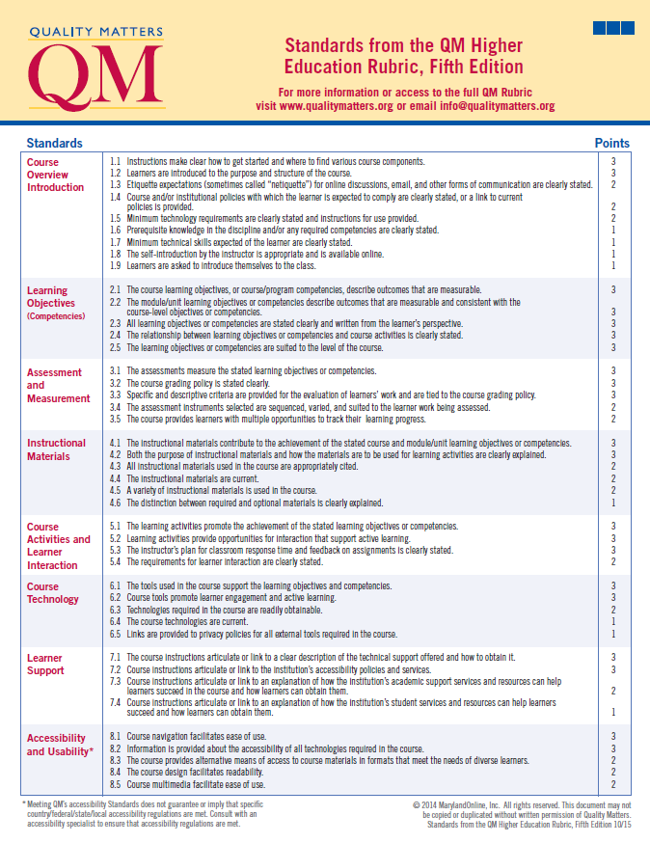









Slide 4


F
C-
C+
D

Slide 5
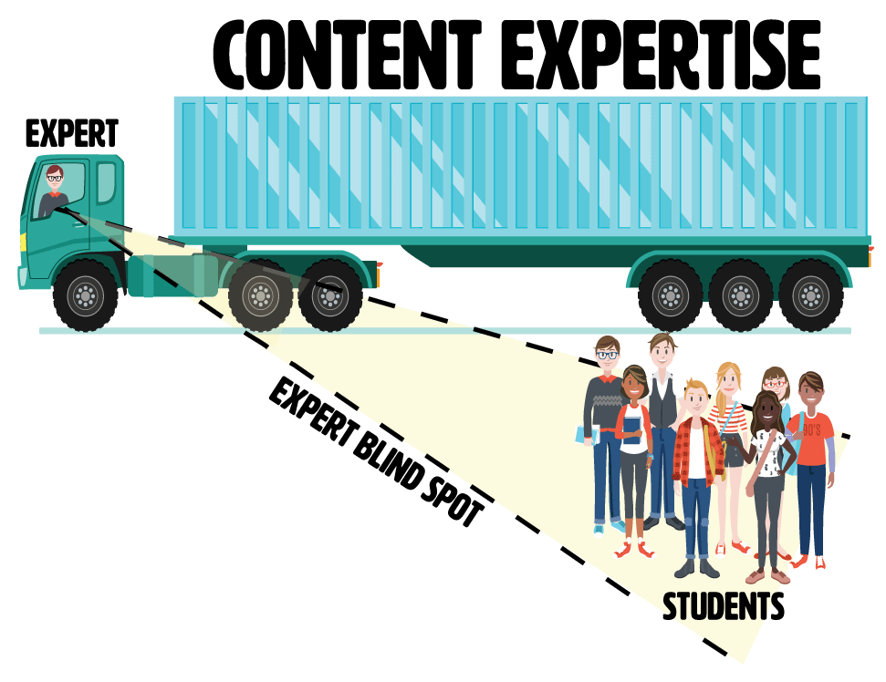
Expert Blind Spot
Can occur when an expert automatizes cognitive processes and cannot articulate the steps necessary for novices to learn the content (Nathan, Koedinger, & Alibali, 2001).

Slide 6







Sam

Slide 7

?

Slide 8
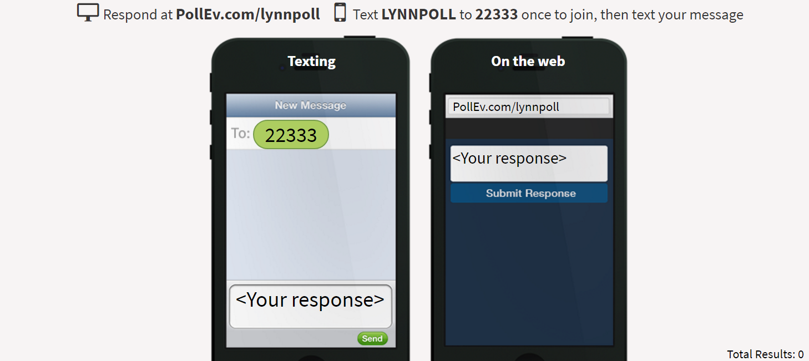
In an emoticon or word, summarize your experiences with QM Alignment. You may submit more than once!
LYNNPOLL

Slide 9
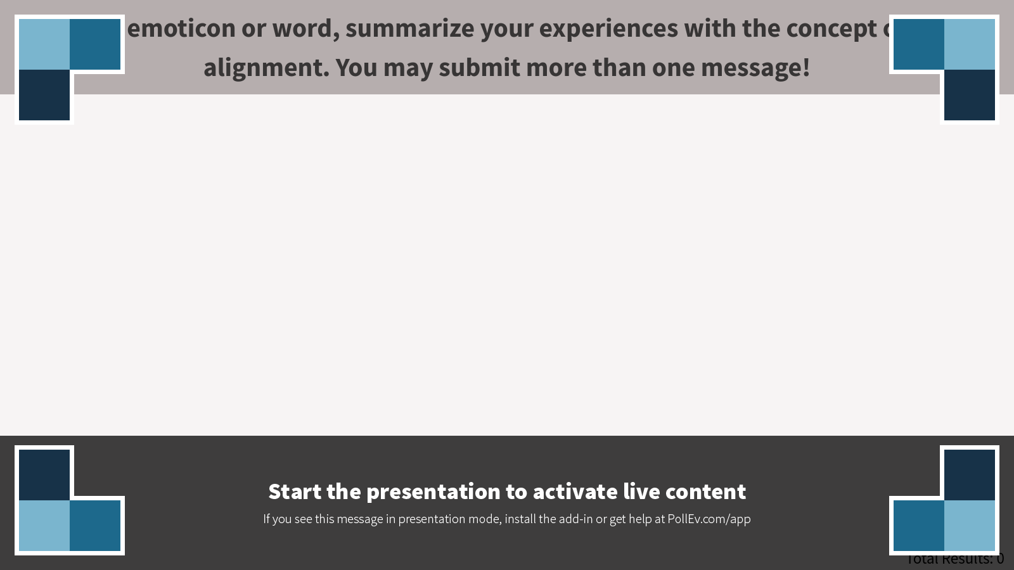
Notes:
Poll Title: In an emoticon or word, summarize your experiences with the concept of QM alignment. You may submit more than one message!
https://www.polleverywhere.com/free_text_polls/cu8SXEAxNfpW8pX

Slide 10

Alignment is hard!

Slide 11





Course Dev Process Comparisons
Example Faculty Dev Process
ASSESSMENTS
COURSE
OUTCOMES
MODULE
OBJECTIVES
MATERIALS
ACTIVITIES
1
2
3
4
5
In order of QM General Standards
COURSE
OUTCOMES
MODULE
OBJECTIVES
ASSESSMENTS
ACTIVITIES
MATERIALS
1
2
3
4
5
Backward Design
COURSE
OUTCOMES
MODULE
OBJECTIVES
ASSESSMENTS
ACTIVITIES
MATERIALS
1
2
3
4
5

Slide 12


2
ASSESSMENT
5
ACTIVITIES
Standard 3.1
Standard 5.1
Evidence that students have met learning goal
Practice opportunities for students
3
COURSE OUTCOMES
6
MATERIALS
1
GOALS
Standard 2.1
Standard 4.1
What students should be able to do by end of the course
Resources students need to be successful
What do Students Need to Learn?
Start with one course outcome
4
MODULE OBJECTIVES
REPEAT
Repeat for remaining course outcomes
Standard 2.2
Observable skills students can combine with other skills to demonstrate fulfillment of course outcomes

Slide 13

Helpful questions:
Answers:
Basic identification of vehicle parts: engine, tires, doors, etc.
Vehicle safety, regular vehicle maintenance, emergency maintenance
What do students already know from previous experience?
What do students need to know for future “courses”?
What are the most important concepts to teach in the time allowed?
1
GOALS
What do students need to learn?

Slide 14
To prove students have learned emergency vehicle maintenance, I need evidence of their ability to:
Change tires in emergency situations
Adapt supplies for repairs
Follow safety rules for vehicle maintenance while in traffic.
To prove students have learned __goal__, I need evidence of their ability to __action verb__object.
2
ASSESSMENT
How can students prove they’ve learned the goals?

Slide 15

+
By the end of this course, students will be able to:
Apply procedure for changing tires in emergency situations.
3
ONE COURSE OBJECTIVE
Create the statement of what students will be able to do by the end of the course

Slide 16

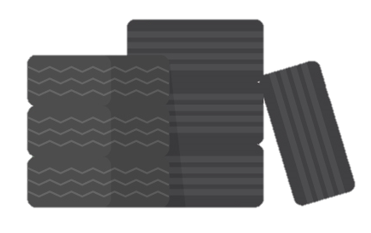

Start with what students already know.
=
Basic identification of vehicle parts
Basic road safety
Basic tool use
Now, list what they need to know:
4
MODULE OBJECTIVES
How do students learn the course objective?

Slide 17
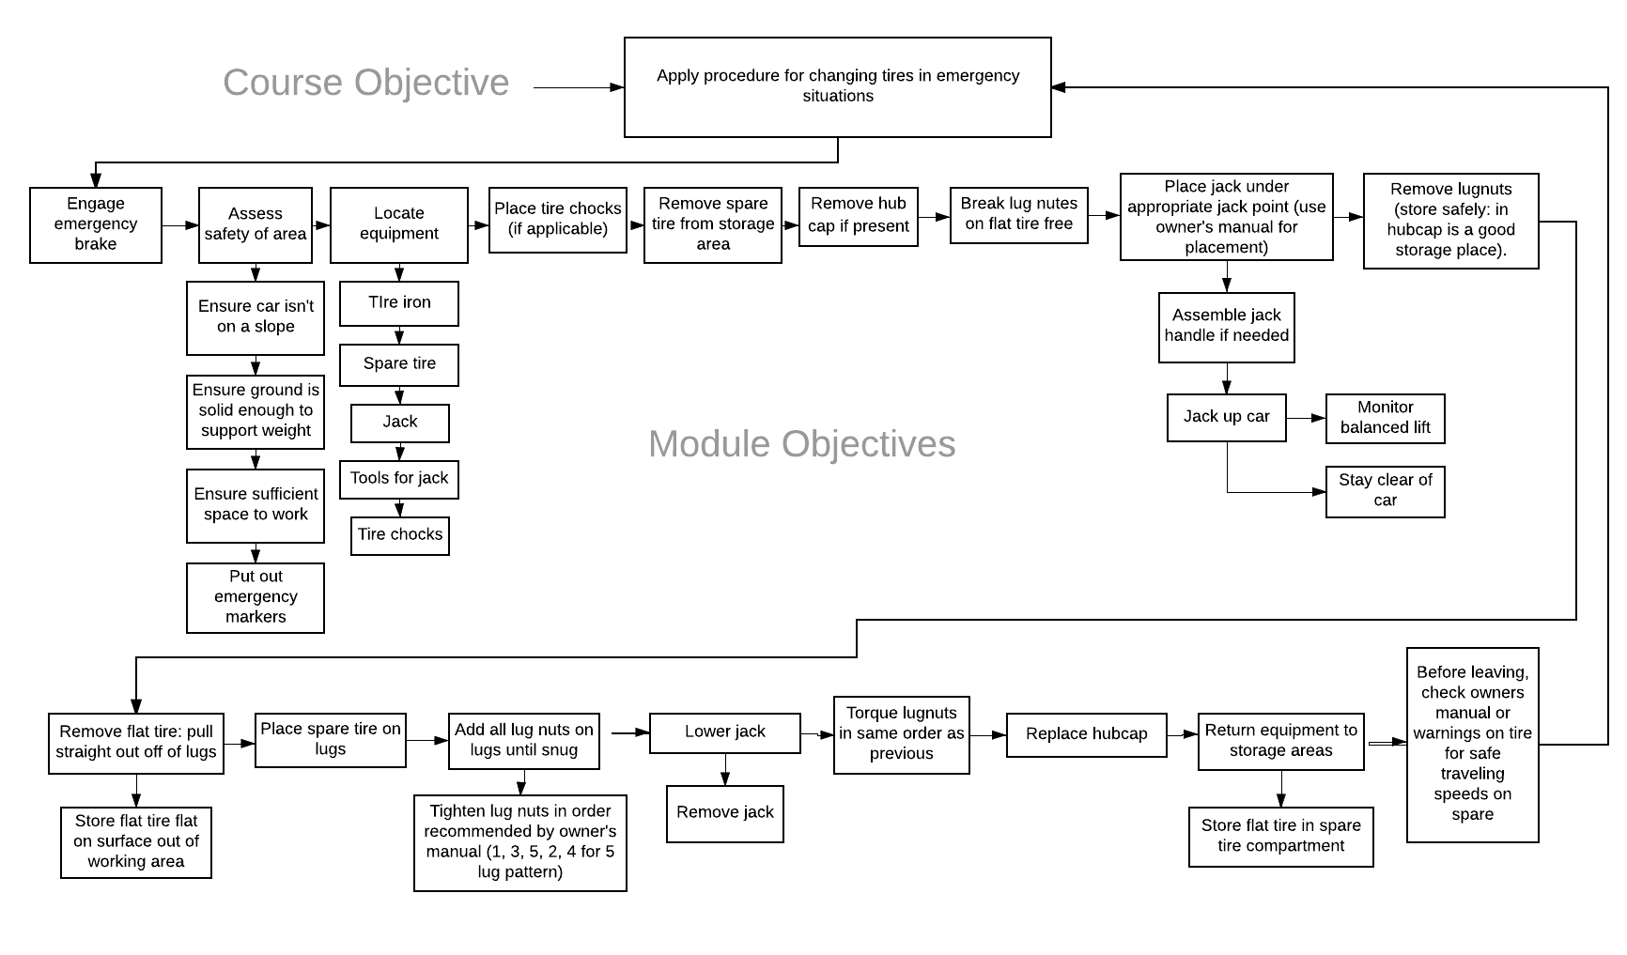

Slide 18

Students will need to practice how to:
Safely jack up vehicles
Locate jack points
Untighten and tighten lug nuts
5
ACTIVITIES
What do students need to practice?

Slide 19
Resources students will need:
6
Owner’s manuals
Highway safety guides
MATERIALS
6
What do students need to learn?
MATERIALS
What resources do students need to succeed at their activities and assessments?

Slide 20
2
ASSESSMENT
5
ACTIVITIES
Standard 3.1
Standard 5.1
Evidence that students have met learning goal
Practice opportunities for students
3
COURSE OUTCOMES
6
MATERIALS
1
GOALS
Standard 2.1
Standard 4.1
What do Students Need to Learn?
What students should be able to do by end of the course
Resources students need to be successful
4
MODULE OBJECTIVES
REPEAT
Repeat for remaining course outcomes
Standard 2.2
Observable skills students can combine with other skills to demonstrate fulfillment of course outcomes
Now You Try…

Slide 21

Use a different post-it note color for each element:
Goals
Assessments
Course Outcome
Module Objectives
Activities
Materials

Slide 22
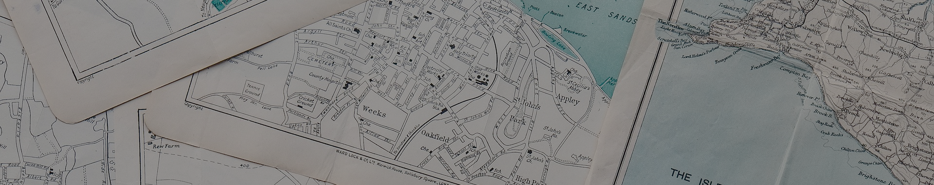
DEBRIEF
What sort of benefits do you see for learners if using this process for course development?
Did your group struggle with any part of this process? Why do you think that is?
What are some issues you think desginers might encounter with the order of how course elements are created in this process?

Slide 23
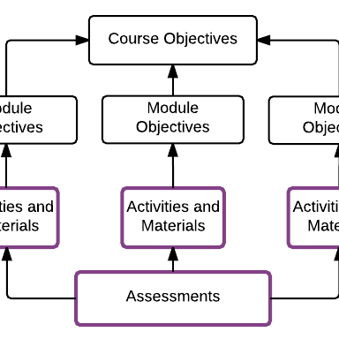
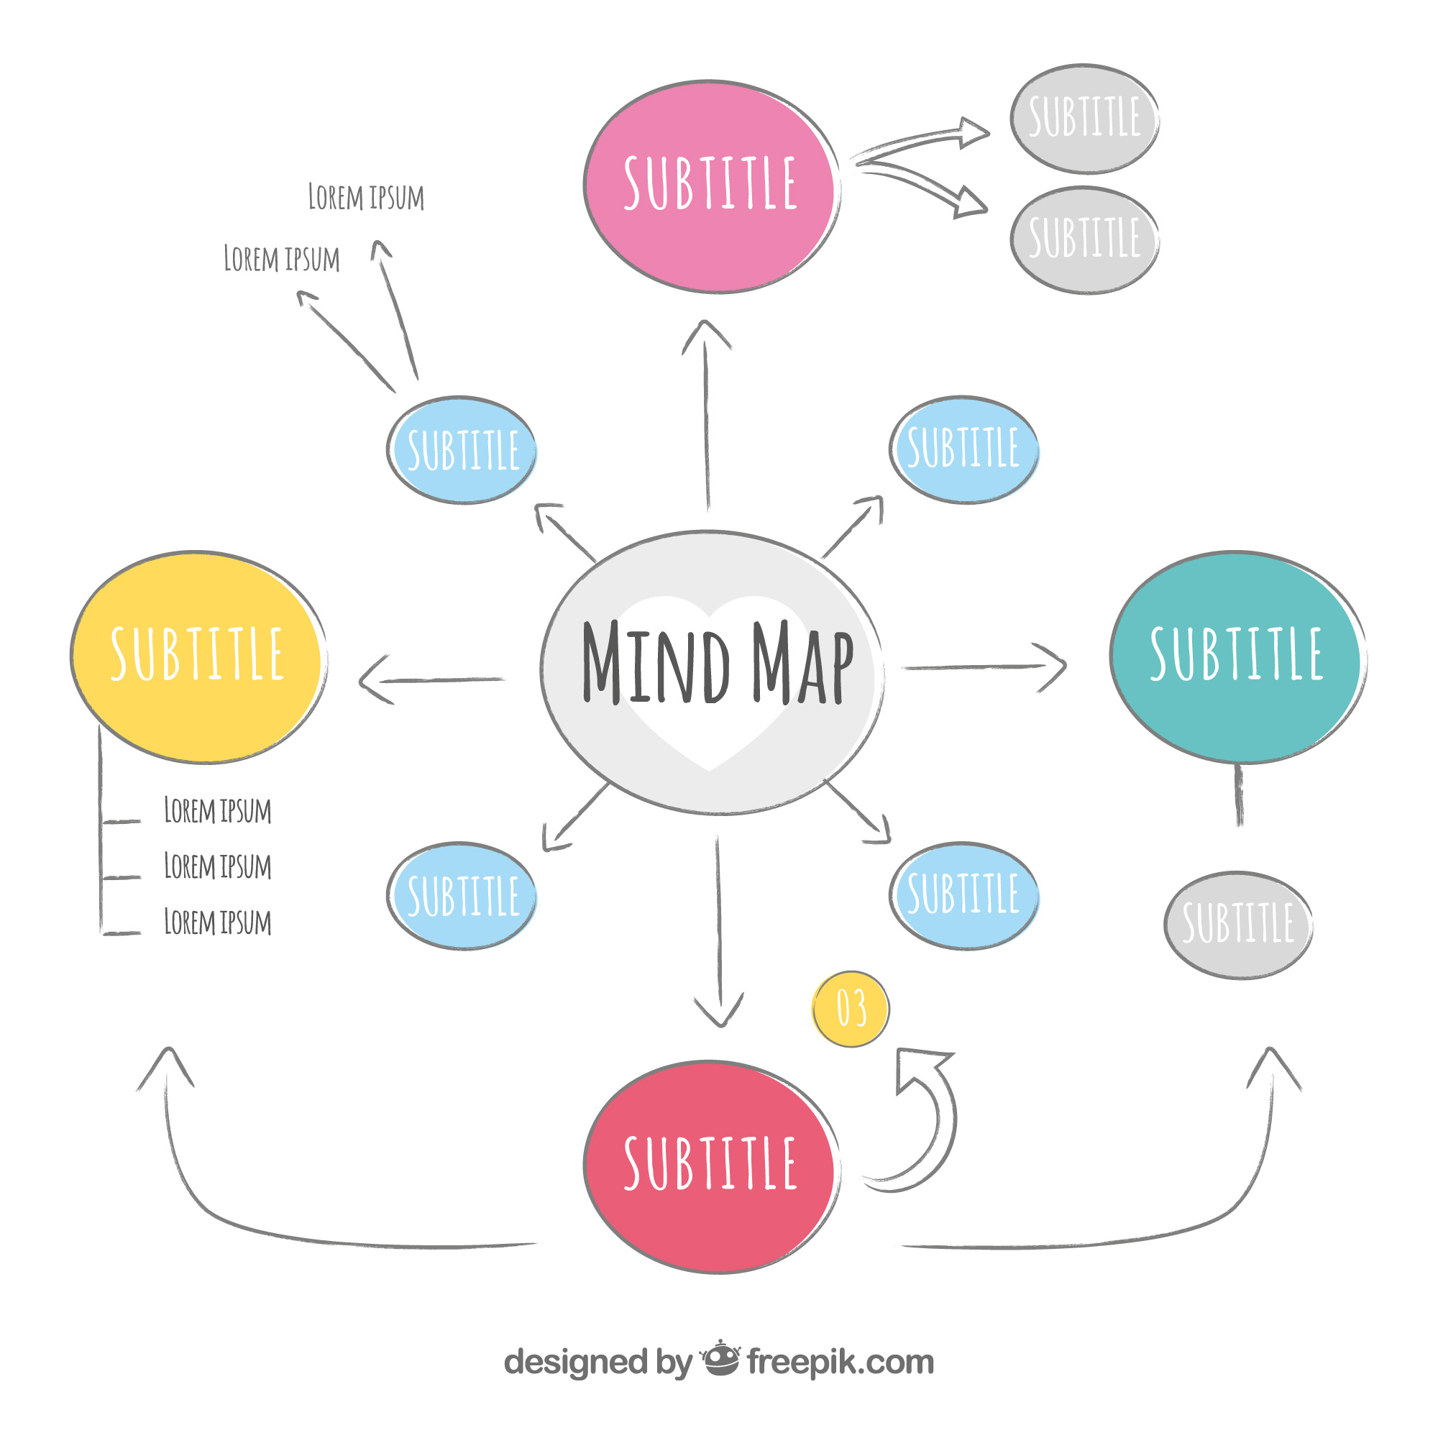
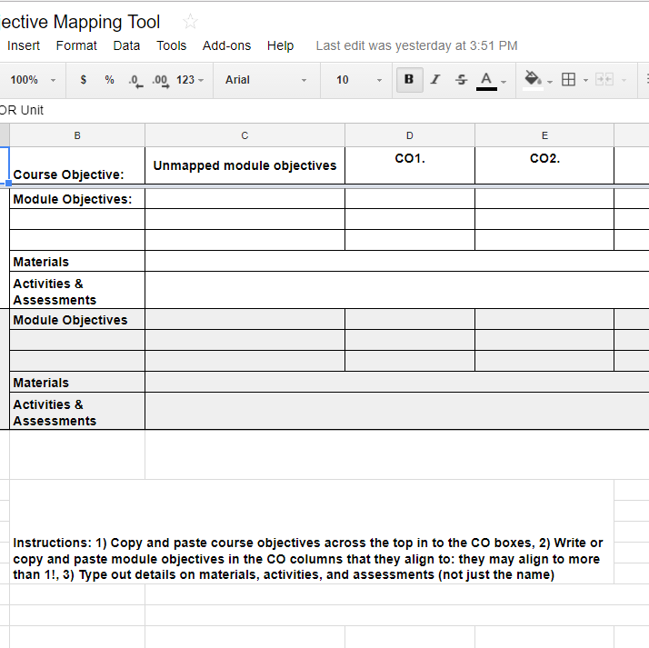
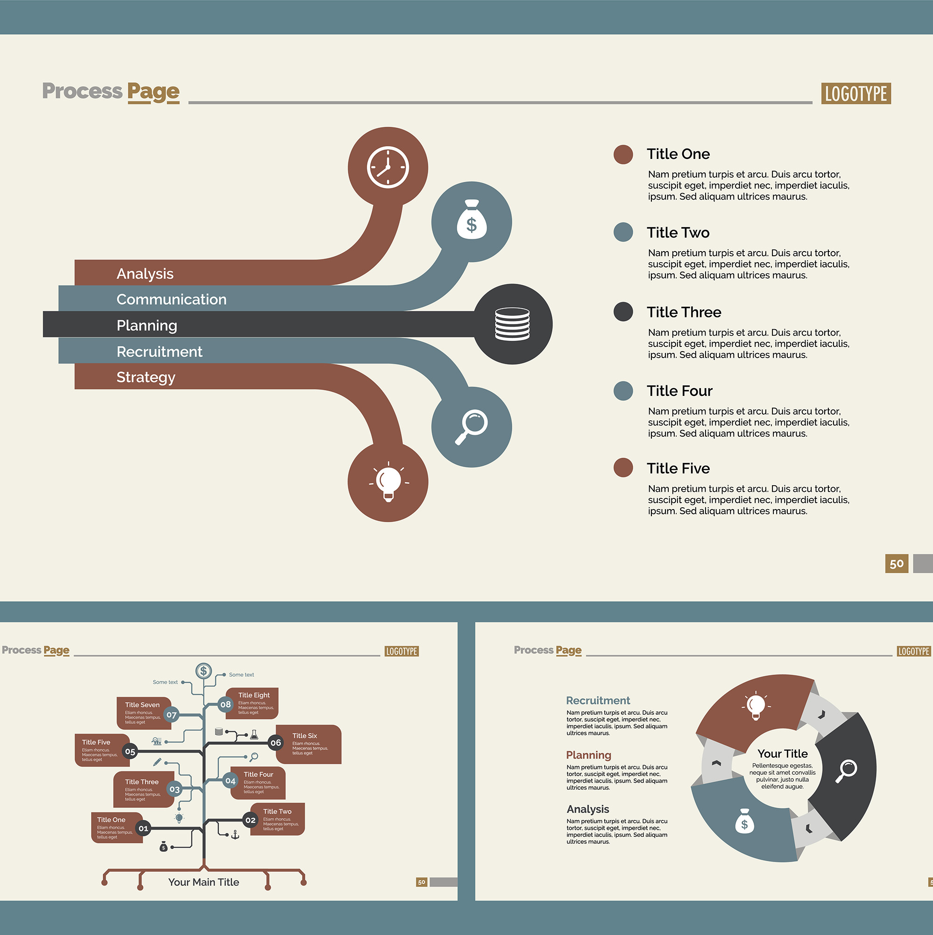
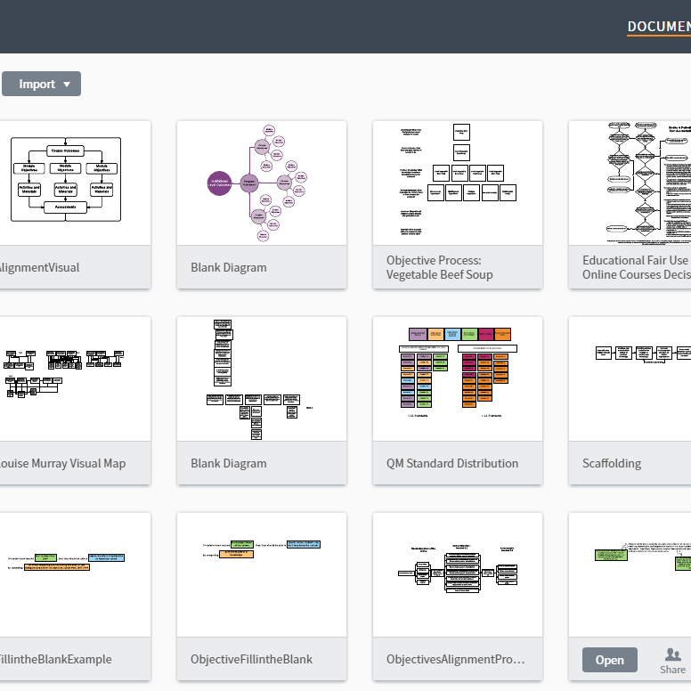
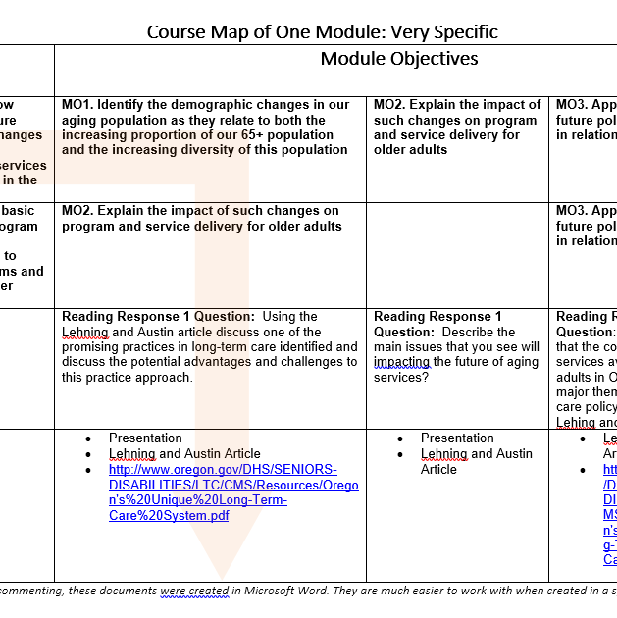
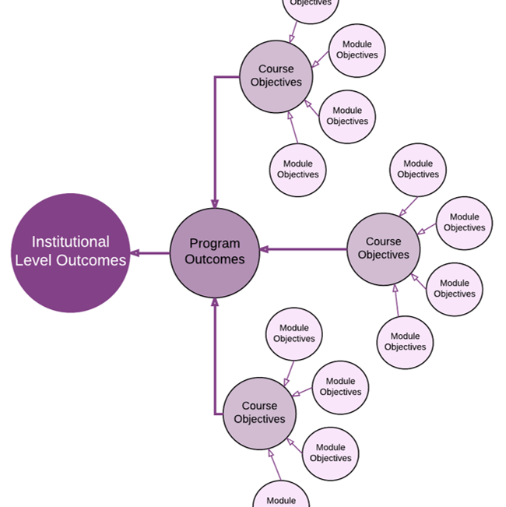
Useful Free Tools for Curriculum Mapping
Digital:
Lucidchart
Google sheets
Google docs
Physical:
Post-its
Notecards
Whiteboards

Slide 24
Questions?

Slide 25
References
http://pact.cs.cmu.edu/pubs/2001_NathanEtAl_ICCS_EBS.pdf

