Slide 1

Want to Be More Flexible? Stop In For An Alignment First
QM Connect 2024

Slide 2

Jennifer Nobles
jennifer.nobles@ncpublicschools.gov

Slide 3
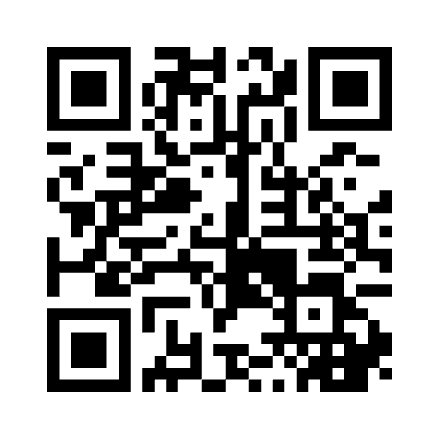
Let’s Get To Know The Room!

Slide 4

What is Alignment
How the elements of a course fit together to ensure objectives, assessments, and content are working in coordination to meet the standards and facilitate student learning.

Slide 5
The Benefits of Alignment
Increased efficiency
Improved student outcomes
Enhanced personalization
Better data-driven decision-making

Slide 6

Common Alignment Challenges
Overwhelming number of standards
Lack of clarity in learning objectives
Mismatched assessments
Limited resources

Slide 7
Let’s Explore Some Examples
Sample Sociology Scope and Sequence
Sociology Alignment Chart

Slide 8
The Alignment Chart Process – The 5 W’s
When?
What?
Who?
How?
Where?

Slide 9
Let’s Practice!
Notes:
From a standard, write a learning objective, and assessment

Slide 10

The Role of Alignment in Personalization
But how does alignment increase flexibility and help with personalization?
First: Identify pain point
Next: Check alignment
Next: Tailor instruction
Result: Flexible differentiated assessments that still meet alignment

Slide 11
Let’s Go Back to Our Examples
Sample Sociology Scope and Sequence
Sociology Alignment Chart

Slide 12

Strategies for Personalizing Content
Reduce answer choices
Revise reading level
Provide guided supports
Implement choice of activities
Consolidate assessments
Create alternate assignments

Slide 13

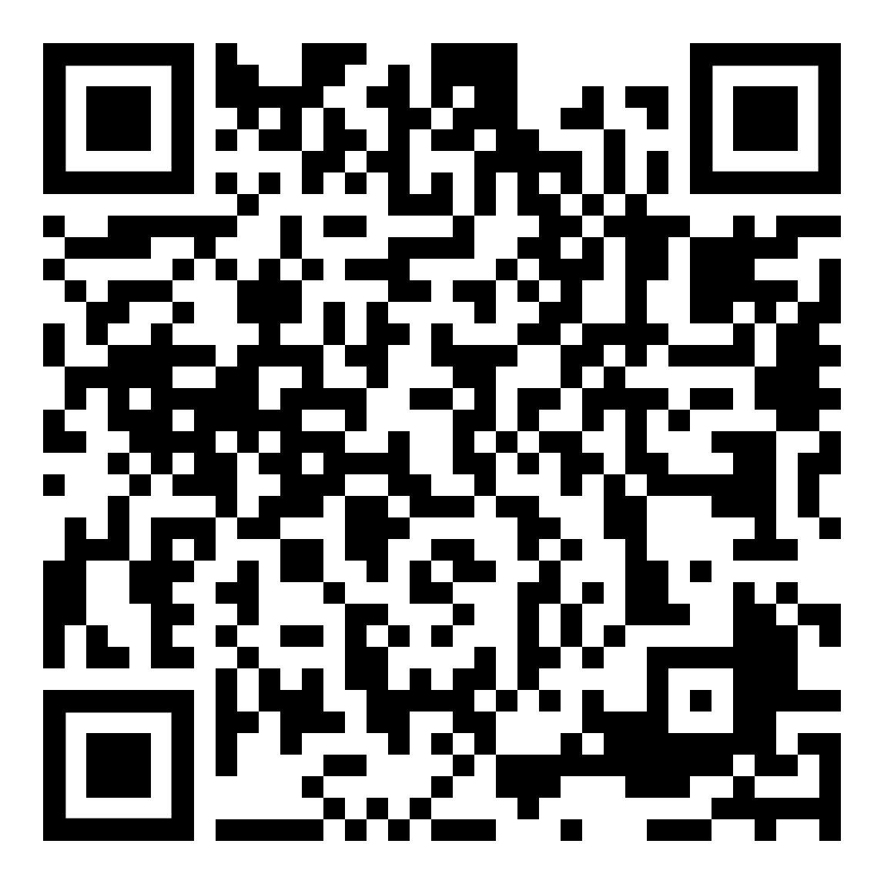
Questions and Thank You
Want to discuss more?
Reach out to Jennifer Nobles at jennifer.nobles@ncpublicschools.gov
This Photo by Unknown Author is licensed under CC BY-NC

Slide 14
References
Google. (2024) Gemini [Large language model]. https://gemini.google.com/app
Google. (2024) NotebookLM [Large language model]. https://notebooklm.google
Quality Matters. (n.d.). Course Design Rubric Standards. https://qualitymatters.org/qa-resources/rubric-standards/k-12-secondary-rubric

