Slide 1

Introduction to Wellness for Educators:
At the Intersection of
Trauma, Prolonged Stress, and Learning:
The Importance of Mental Health
and Wellbeing in Education

Slide 2

501c3 nonprofit
Founded in Maine
Serving educators worldwide
Our Mission: We are passionate about supporting educators worldwide with research-based, trauma- and equity-informed education, practices, and strategies for mental health and wellbeing as well as social and emotional learning through a variety of somatic (mind-body) disciplines (yoga, mindfulness, meditation, Qigong, art, dance, spoken word, and more).

Slide 3
Trauma is not always one extreme event…
unstable living environment
experiences of racism, sexism, homophobia, etc
prolonged hospital stays
non-life-threatening injuries
humiliation or shaming
emotional or verbal abuse
financial or legal difficulties
loss of a pet
bullying, being left out or not included
harassment or discrimination

Slide 4
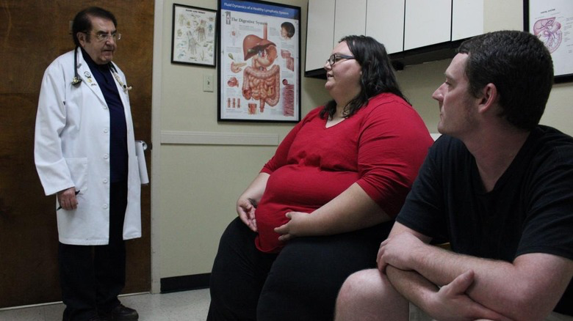
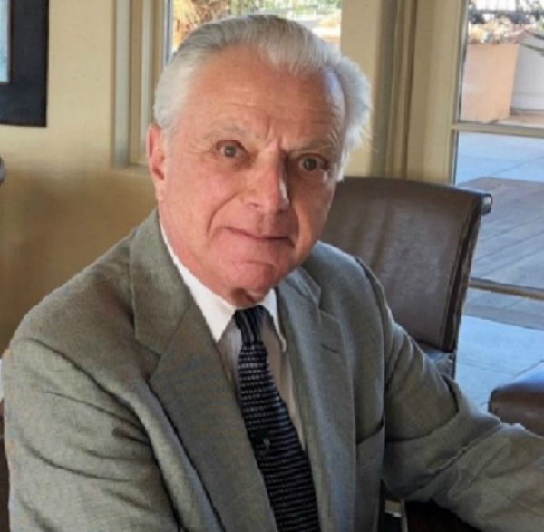
How it Started:

Slide 5
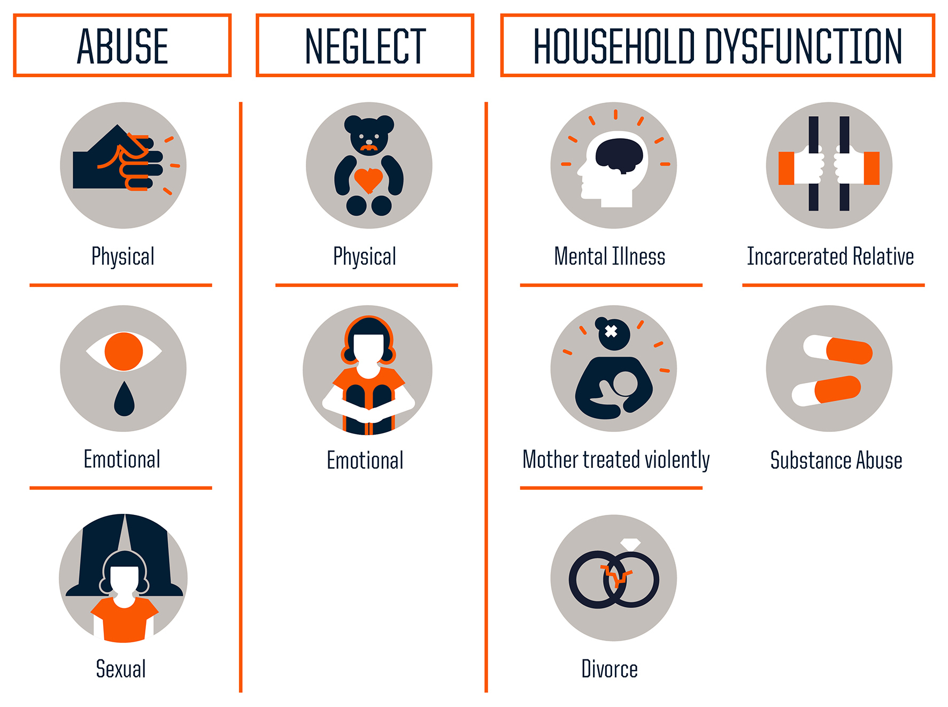
The Study:

Slide 6
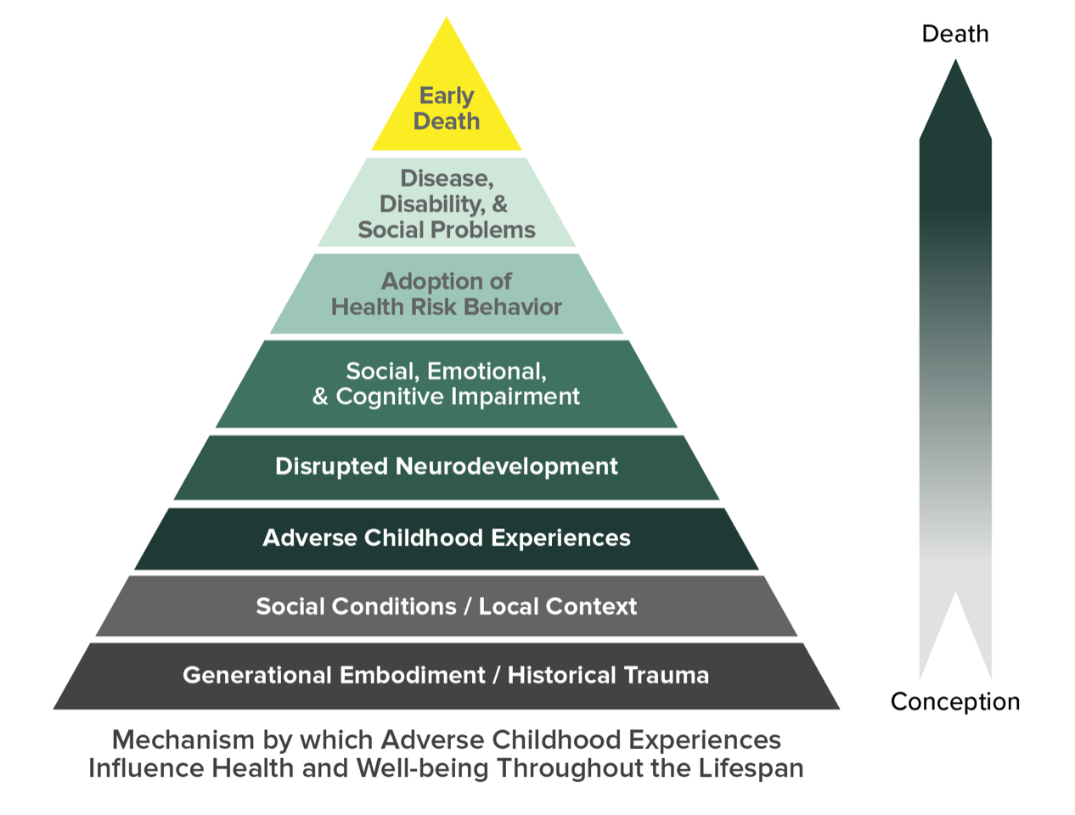
The Results:

Slide 7

Trauma and Prolonged Stress
as Bodily Experiences
“Trauma and prolonged stress are not just cognitive experiences. Everything that we’re learning from trauma and stress from the most recent advances in neuroscience, from research on the relationship between trauma, stress, and so many different bodily disorders, such as autoimmune disorders, digestive disorders, endocrine disorders, heart disease, and more, our level of trauma impacts our level of stress, trauma is a bodily experience not just a cognitive one.”
Dr. Albert Wong
Director of Somatic Psychology
John F. Kennedy University

Slide 8

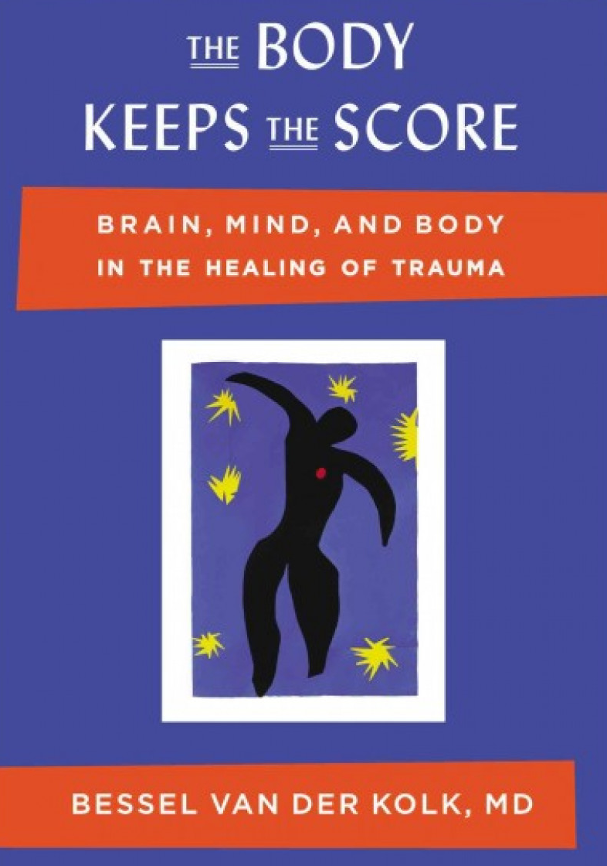
Trauma and prolonged stress can lead to “issues in our tissues”
After we experience trauma and prolonged stress, “the world is experienced with a different nervous system.”
Dr. Bessel van der Kolk
Professor of Psychiatry
Boston University
President
Trauma Research Foundation

Slide 9
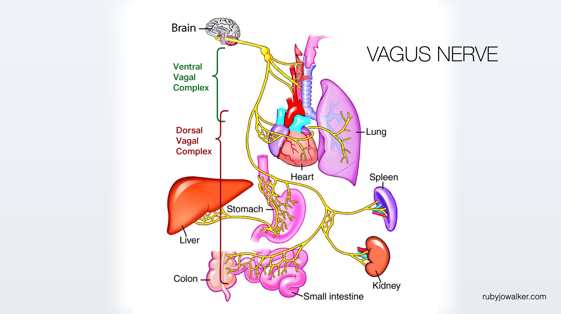

Slide 10
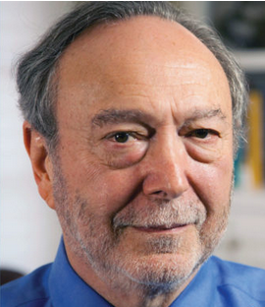
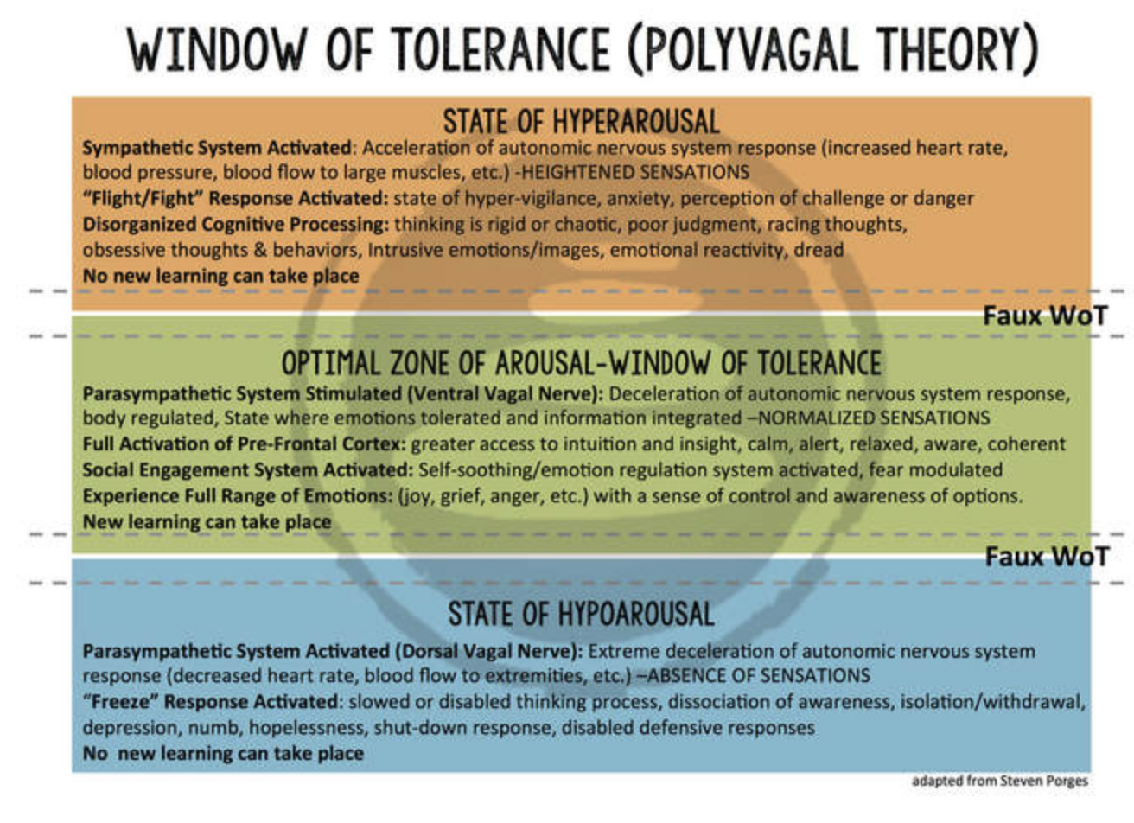
Polyvagal Theory & Our Window of Tolerance
Dr. Stephen Porges
Distinguished University Scientist
Indiana University
Founding Director of the
Traumatic Stress Research Consortium Kinsey Institute

Slide 11





Trauma & Prolonged Stress
“The body of research sparked by the ACE Study makes it clear that adverse childhood experiences in and of themselves are a risk factor for many of the most common and serious diseases in the United States (and worldwide), regardless of income or race or access or care.”
– Dr. Nadine Burke Harris
“Trauma is not what happens to you – Trauma is what happens inside you as a result of what happened to you.”
– Dr. Gabor Maté
“Trauma compromises our ability to engage with others by replacing patterns of connection with patterns of protection.”
– Deb Dana
“We think of trauma as things like rape, robbery, and car accidents. But there’s also the slow grind of living within systems of multiple oppressions, the slow grind of microaggressions and macroaggressions, the constant emphasis on production and working and never resting. That overwhelming trauma is the norm in North American culture.”
– Nkem Ndefo
“PTSD [Post Traumatic Stress Disorder] occurs when we don’t have the resources and supports to process what happens in our body. When symptoms of prolonged stress or trauma persist beyond four weeks, that’s when we start to experience PTSD.”
– Dr. Arielle Schwartz
Dr. Nadine
Burke Harris
Dr. Gabor Maté
Deb Dana
Nkem Ndefo
Dr. Arielle Schwartz

Slide 12
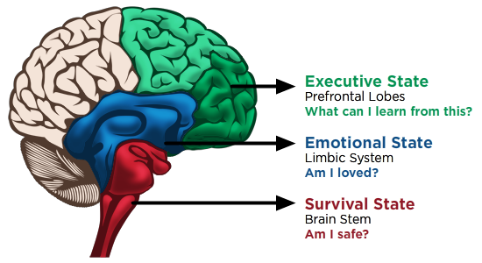
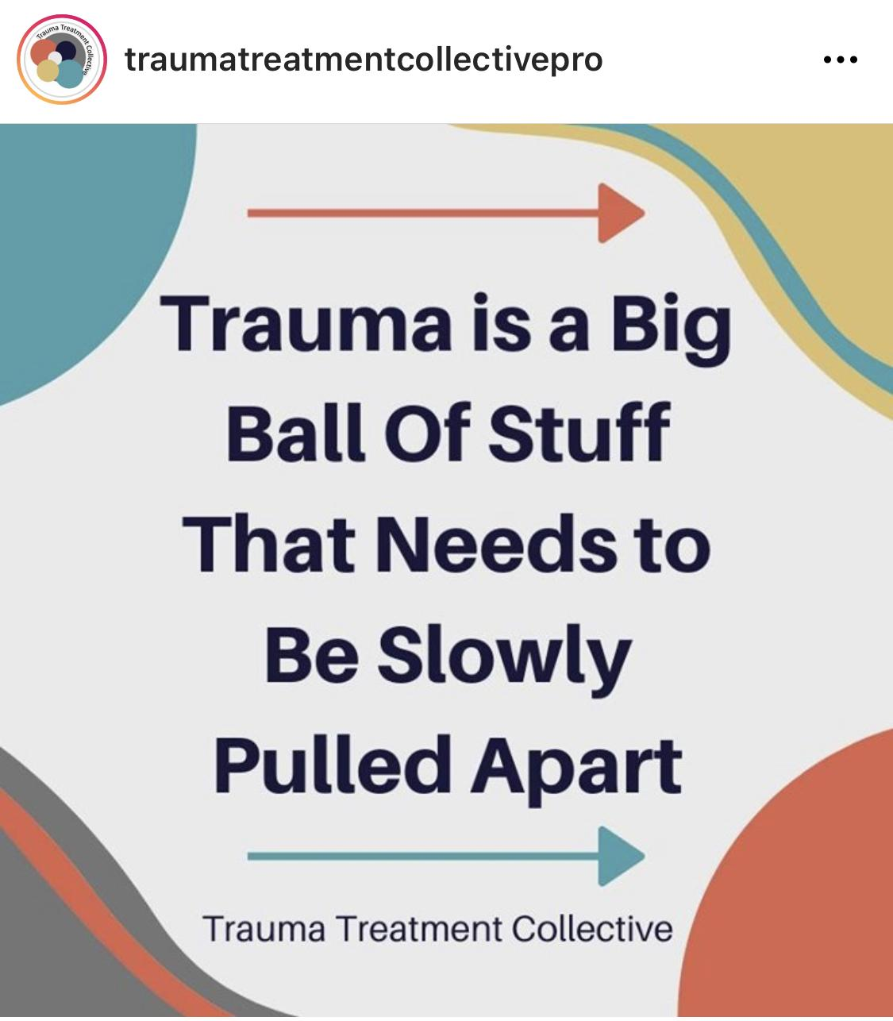
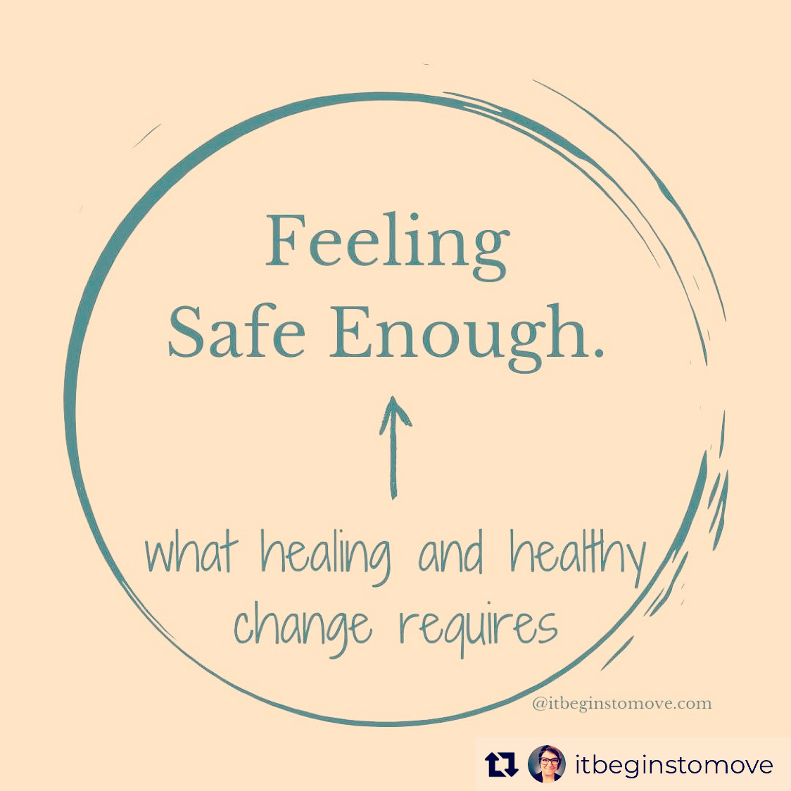
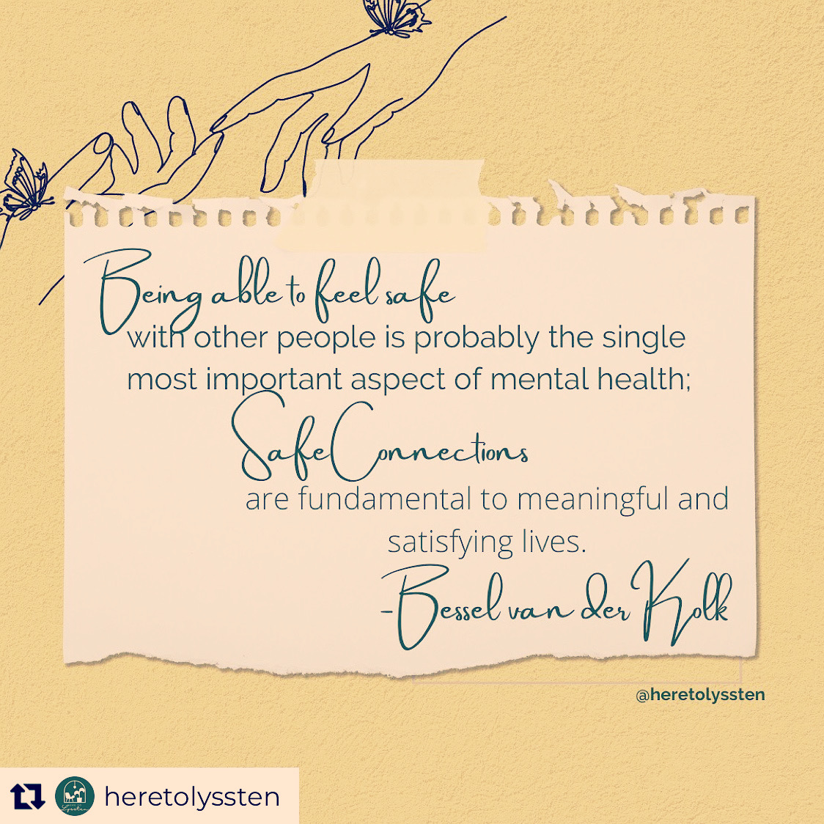
3-part Brain & What We Need to Heal
LEARNING
Empowerment
Agency
Choice
Voice
CONNECTIONS
Safe, trusting relationships
Sense of belonging
Inclusion
SAFETY
Internal safety
External safety
Present moment
Patience
Self-compassion
Grace

Slide 13
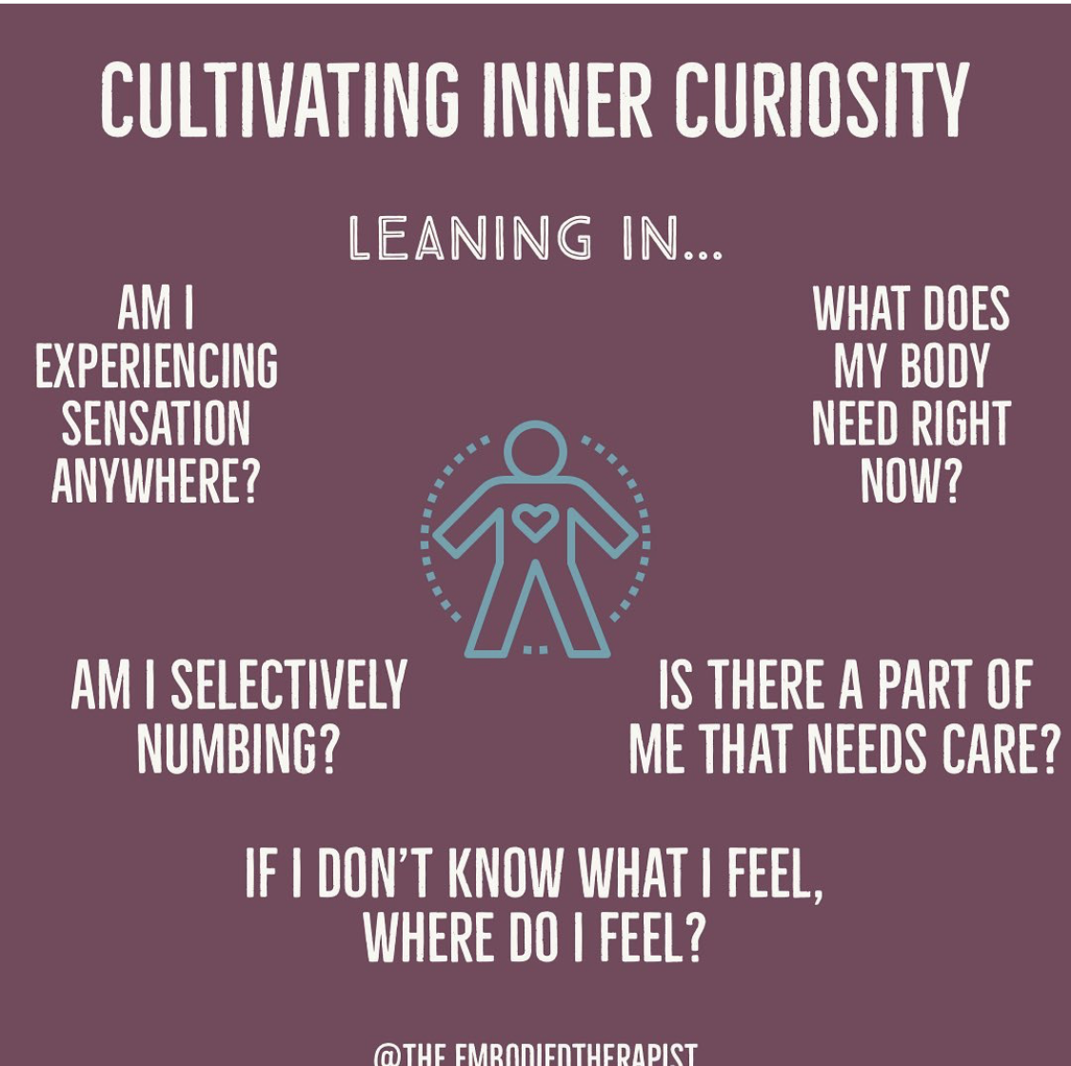
Mind-body practices → Somatics → Embodiment
Embodiment = Combining…
our sensations (external info using the five senses),
our movement impulses (location of body in space at present moment = proprioception),
and our emotions (internal info from how we feel = interoception)
Embodiment allows us to understand how a certain situation feels inside our body. When we pay attention to feelings in the body, we have markers to indicate what is okay and not okay for us. It helps us
consciously pay attention to feelings in the body;
guide our decisions;
guide our emotional regulation;
guide how we tend to ourselves;
guide our relationships; an
guide how we communicate with others.

Slide 14

Notes:
What does this mean for you as administrators?

Slide 15


Slide 16
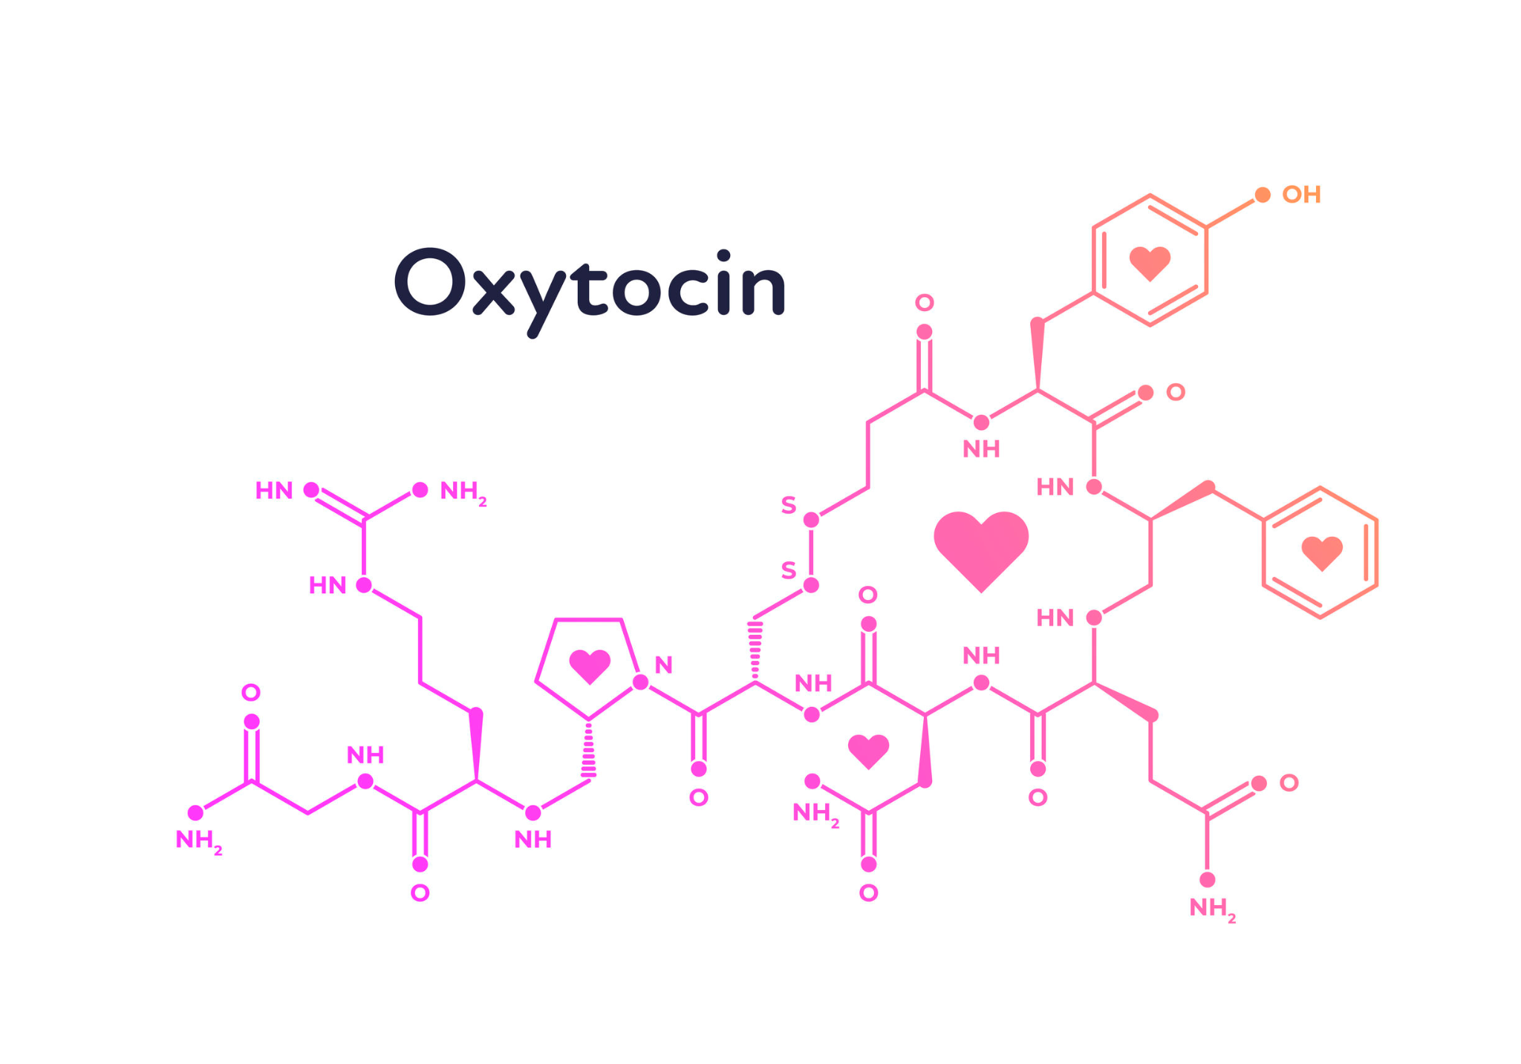

Slide 17




Thank you!
well4edu.org
@well4edu

