Slide 1

What the WCAG? Learning about the New Title II Accessibility Standards
Mary Rice, PhD
maryrice@unm.edu
Associate Professor of Literacy
University of New Mexico

Slide 2
What is promised in this session?
Learn about the Title II revisions, specifically the WCAG standards required for digital materials for courses and mobile applications.
Discuss what it means to meet the A and AA parts of WCAG and how these standards are different from UDL and the QM Rubric.
Ask questions about digital materials evaluation, processes for leaders to support teachers and instructional designers, and what Title II updates mean overall for K-12 schools.

Slide 3
What is the premise of U.S. federal accessibility guidance?
Qualified persons should not be denied the benefits of services programs, or activities from public entities or be subjected to discrimination due to disability.
-Americans with Disabilities Act, 42 U.S.C. 12101 et seq. (1990).
-Section 504 of the Rehabilitation Act of 1973
(29 U.S.C. “Code of Federal Regulations, Title 28, (2002): 516-544.

Slide 4
What are the key changes in the ADA Title II revisions?
All digital materials and mobile apps available through public entities—including public educational institutions—must meet the technical standard (WCAG 2.1 AA).
This requirement cannot be waived merely for the fact of being purchased or provided by a third party.
A ‘program or activity’ includes educational institutions, such as a college, university, or postsecondary institution, and LEA or vocational school, partnership, or private organization. (ADA, 1991, Civil Rights Restoration Act, 1987)

Slide 5
What is the exact language of the revision?
“Web content and mobile apps that the public entity provide or makes available directly or through contractional licensing, or other arrangements, comply with Level A and Level AA success criteria and conformance requirements specified in WCAG 2.1 unless the public entity can demonstrate that compliance with this section would result in a fundamental alternation in the nature of the service, program, or activity, or in undue financial or administrative burdens.”
-HHS Section 504 (45 CFR 84.84)
-ADA Title II Regulations (28 CFR 35.200)

Slide 6
Are there any exceptions?
Archived web content
Preexisting ... documents, unless such documents are currently used to apply for, gain access to, or participate in the public entity’s services, programs, or activities
Content posted by a third party that is on a discussion thread
Documents that are about a specific individual ... that are password-protected or otherwise secured (e.g., a medical report)
Preexisting social media posts

Slide 7
How soon do these changes go into effect?
Title II ADA
•0-49,999* persons April 26, 2027
•Special district governments April 26, 2027
•50,000 or more persons* April 26, 2026
Section 504 HHS
•15 or fewer employees May 10, 2027
15 or more employees May 10, 2026
*These are census numbers and not enrollment figures

Slide 8
How can I test my school’s websites?
It is important to understand that checkers will miss items, but they are a start.
o WebAIM WAVE
o Deque axe DevTools
o Google Lighthouse
o TPGi ARC Toolkit
o Microsoft Accessibility Insights for Web
o IBM Equal Access Accessibility Checker
o Siteimprove Accessibility Checker

Slide 9
Should my school pay for an overlay?
No.
About Overlays: https://overlayfactsheet.com/en/

Slide 10
What is a VPAT? How does it help?
Accessibility Conformance Reports (ACRs) and Voluntary Product Assessment Templates (VPATs)
Templates available at: https://www.itic.org/policy/accessibility/vpat
VPAT Types: WCAG, 508, EU, and INT

Slide 11
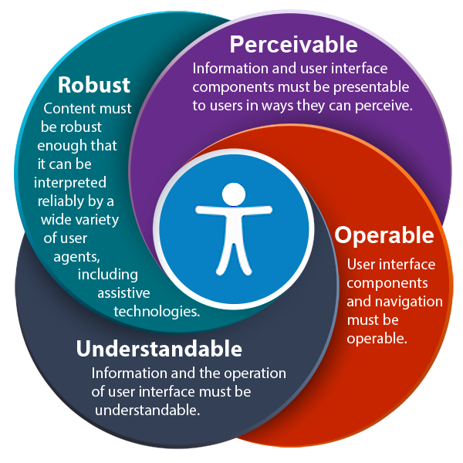
Where are the WCAG Standards?
https://www.w3.org/TR/WCAG21/#sign-language-prerecorded

Slide 12
Why can’t we just use Universal Design for Learning? And/or Quality Matters Rubrics?
UDL: Multiple means of representation, engagement, expression. Some WCAG items might be included (e.g., captions), but alone, it will not be enough specific guidance.
QM: Covers the whole of the pedagogy and design of the course. They do ask for courses to be accessible, but it is not enough technical guidance.
There is nothing exclusionary from adhering to WCAG 2.1 A/AA and using UDL and/or QM.

Slide 13
Won’t this all go away in the sociopolitical fracas in which we find ourselves?
Probably not.
Enforcement might look different. OCR might do monitoring for specific complaints. The DoJ has pointed to “private enforcement.”
Reporting and testing might look different.
Funding seems like it will look different.
Schools need to decide how to ensure that all children have access to digital educational content if most content is going to be delivered digitally in the current era of massive educational technology infusion.
The best protection for your school is to have an internal process where people resolve problems — a grievance process, identifying the ADA Coordinator (might be good to have that person also available to handle Section 504 complaints). 504 already required institutions to identify, annually, a 504 coordinator.

Slide 14
National Standards for Quality Online Courses
The course, developed with universal design principles in mind, addresses Section 504 of the Rehabilitation Act of 1973 and Title II of the Americans with Disabilities Act (ADA) by following (Web Content Accessibility Guidelines) WCAG 2.1 AA standards. This does not guarantee or imply that particular country/federal/state/local accessibility regulations are met. Please consult with an accessibility specialist to ensure that all required accessibility regulations are met.

Slide 15

Questions?
Email
maryrice@unm.edu
Thank you for coming.

