Slide 1


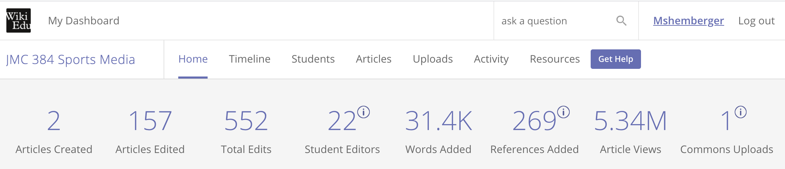
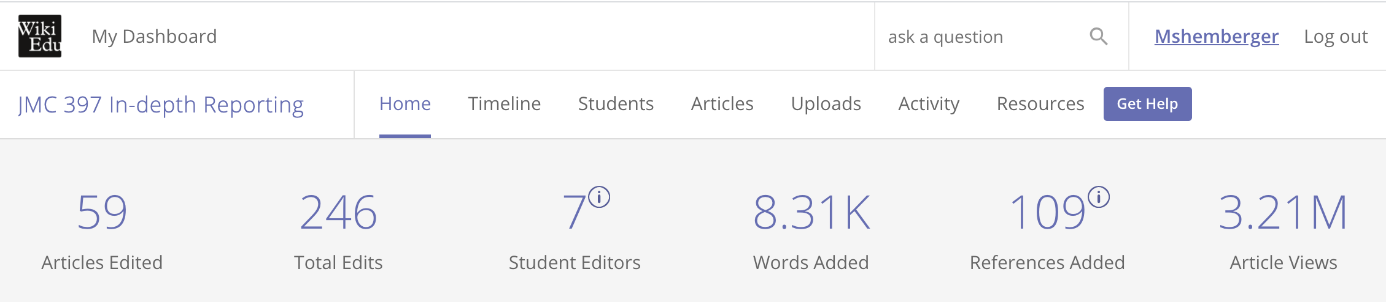
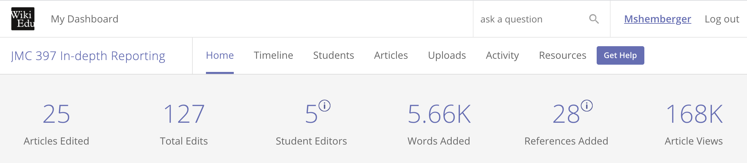
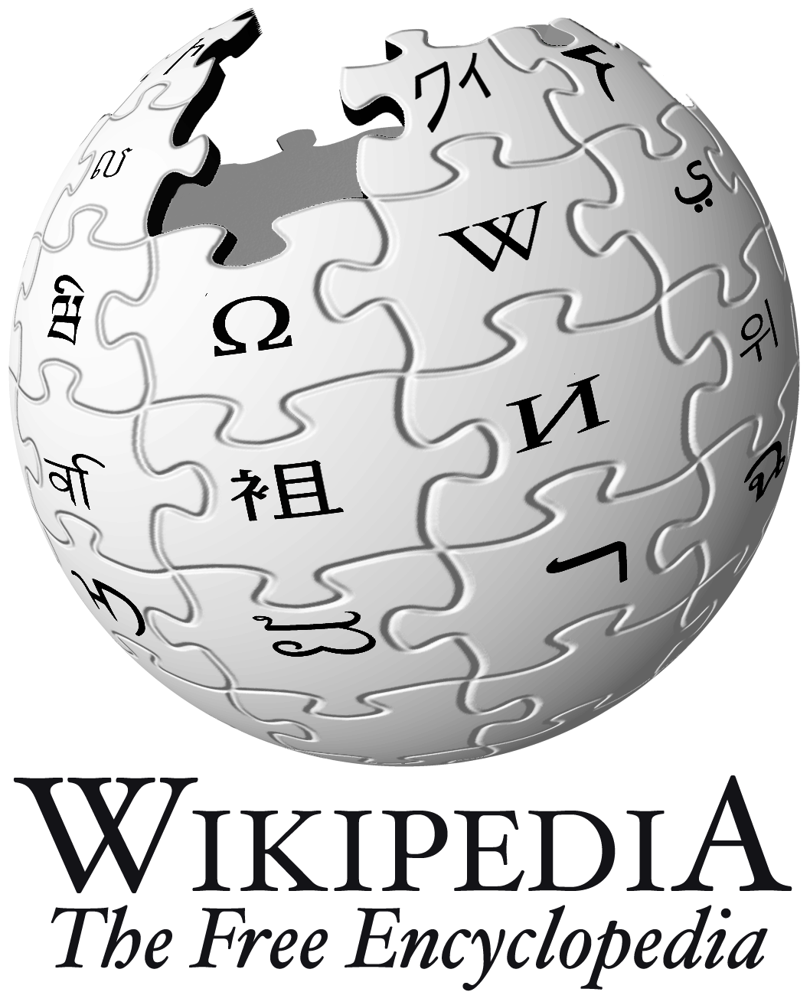
USING WIKIPEDIA as a TEACHING STRATEGY
in an ONLINE COURSE
Melony Shemberger, Ed.D.
Associate Professor, Mass Communication
Quality Matters Peer Reviewer
INTRODUCTION
PROJECT DETAILS
OUTCOMES
The crowd-sourced site Wikipedia historically is disregarded by the academic community as unreliable. However, online college courses can help improve Wikipedia.
This poster explains how journalism and mass communication courses taught online applied subject-matter concepts according to Quality Matters standards to edit Wikipedia articles.
Wiki Education Classroom Program (course set-up, 12-week format)
wikiedu.org
JMC 384 Sports Media
Sport or focus area selected by students
Module in Canvas set up according to WikiEdu Dashboard
Reflection assignments
JMC 397 In-depth Reporting
News beats selected by students
Module in Canvas set up according to WikiEdu Dashboard
Reflection assignments
APPLICATION OF QM RUBRIC
General Standard 2 (MLOs)
General Standard 3 (Assessment)
General Standard 4 (Instructional Materials)
General Standard 5 (Learning Activities)
General Standard 6 (Course Technology)
SUGGESTIONS
Wikipedia is an experiential learning activity for any course.
Frequent student interaction with Wikipedia is essential for meaningful contributions.
Module design is ideal in aligning Wikipedia assignments to learning objectives and content.
Handling disappointments with article revisions and rejections should be discussed.
Students should be encouraged to continue writing and/or editing their articles after course ends.

