Slide 1

“You want me to do what?”
How to Create Amazingly Clear and Impactful Assignments with QM Standards
Notes:
Brief Description:
Assignments are a key component within a course. This presentation will discuss the challenges students and faculty face with course assignments. Participants will be provided with strategies for improving assignments with a focus on QM Standards as they relate to assignment instructions.

Slide 2

“Students can do no better than the assignments they are given.”
Kati Haycock, The Education Trust

Slide 3

Agenda
Interpret common challenges and concerns with assignment instructions.
Identify ways to improve assignment instructions to align with QM Standards.
Evaluate examples of effective and ineffective assignment instructions.

Slide 4
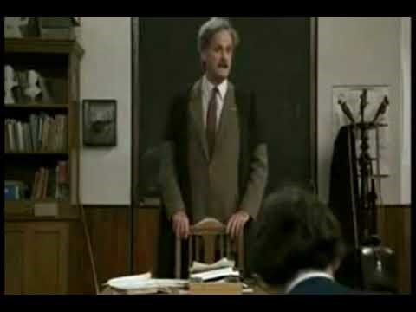
It’s simple, right?
Notes:
Learning Objectives:
Interpret common challenges and concerns with assignment instructions.
Identify ways to improve assignment instructions to align with QM Standards.
Evaluate examples of effective and ineffective assignment instructions.

Slide 5

Assignment Challenges
Faculty Issues
Student Issues
Notes:
Assignment challenges instructors often see:
Student work doesn’t respond to the assignment
Unclear, overwhelming, or vague instructions
The work responds to the assignment but lacks depth, original thought, insight, or appears hastily composed.
Lack of connection or interest in the assignment
The work contains plagiarism.
Lack of authentic assignments

Slide 6

How can we improve through QM standards?

Slide 7
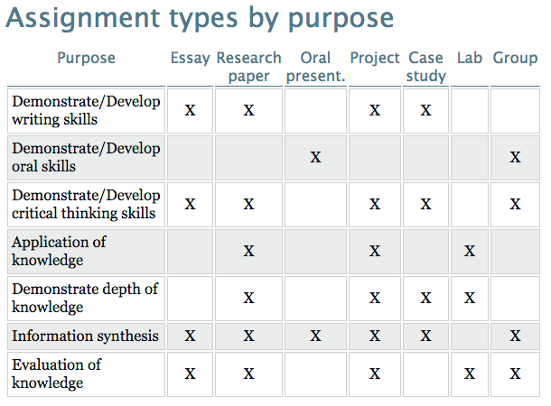
#1 Design with the End in Mind
https://facultyinnovate.utexas.edu/teaching/check-learning/methods/assignments
Notes:
Design with the end in mind.
Purpose and meaning through objectives/alignment
How does the assignment fit with the objectives for the course/unit?
What do you want students to show based on the assignment?
Do the objectives match the assignment type?

Slide 8


QM Higher Education Rubric
Specific Review Standards from the QM Higher Education Rubric, Sixth Edition

Slide 9
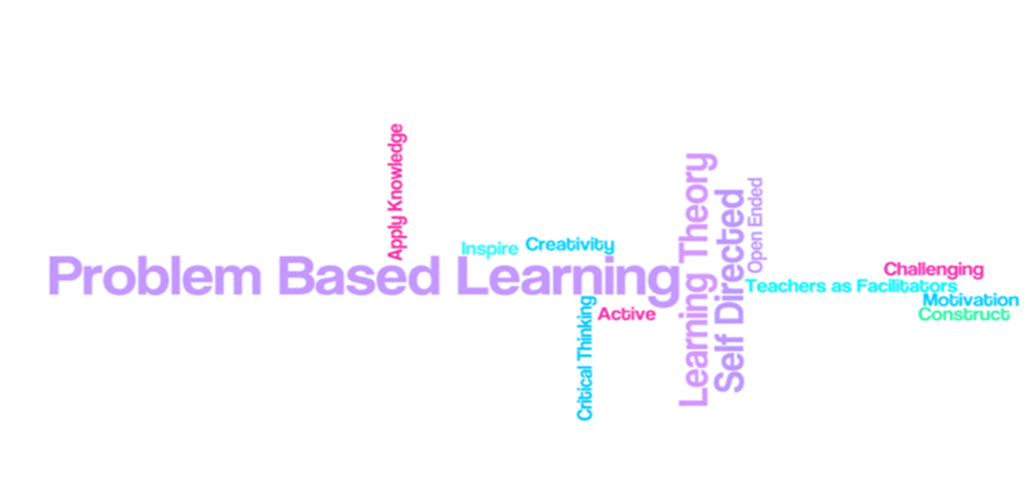
#2 Design Assignments YOU Want to Read
Inauthentic:
Create a model of an ecosystem and describe the lifecycle and food-chain relations to it.
Authentic:
A local building contractor is planning to bulldoze all of the trees in a nearby copse. These are some local groups appealing to save the trees. Your job is to identify one type of tree indigenous to the area and design a presentation to convince the contractor to spare the trees based on the impact it will have on the local ecosystem (Sulla, 23).
Notes:
Design assignments you want to read.
Problem-based
Application based

Slide 10
QM Higher Education Rubric
Specific Review Standards from the QM Higher Education Rubric, Sixth Edition

Slide 11
#3 Think Like a Student
Length requirements
Formatting Requirements
Research?
Audience?
Notes:
Clear and direct regarding expectations
Length requirements
Formatting requirements
Amount and type of research expected (if any)
The students role as a writer (audience?)
Provide assignment examples /resources/templates/models

Slide 12
QM Higher Education Rubric
Specific Review Standards from the QM Higher Education Rubric, Sixth Edition

Slide 13
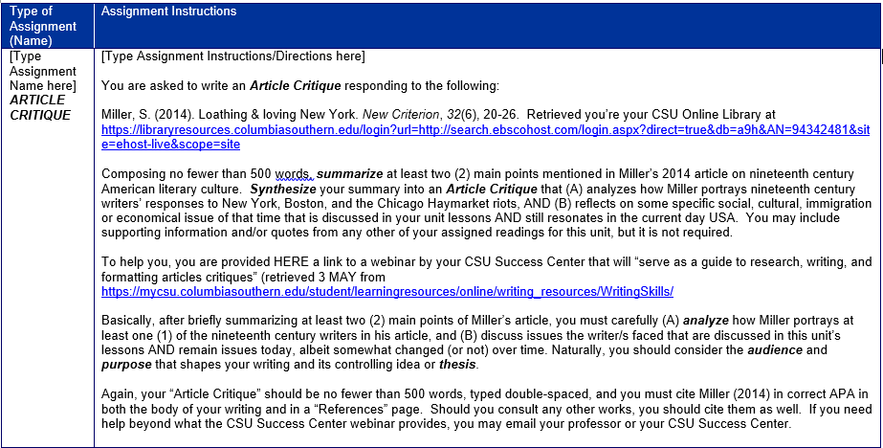
Assignment Draft
Notes:
Clear and direct regarding expectations
Length requirements
Formatting requirements
Amount and type of research expected (if any)
The students role as a writer (audience?)
Provide assignment examples /resources/templates/models

Slide 14
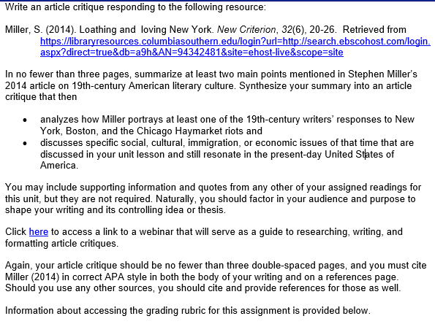
Assignment Finalized
Notes:
Clear and direct regarding expectations
Length requirements
Formatting requirements
Amount and type of research expected (if any)
The students role as a writer (audience?)
Provide assignment examples /resources/templates/models

Slide 15


Slide 16
How can we improve through QM standards?
Design with the End in Mind
Design Assignments you want to read
Think like a Student

Slide 17
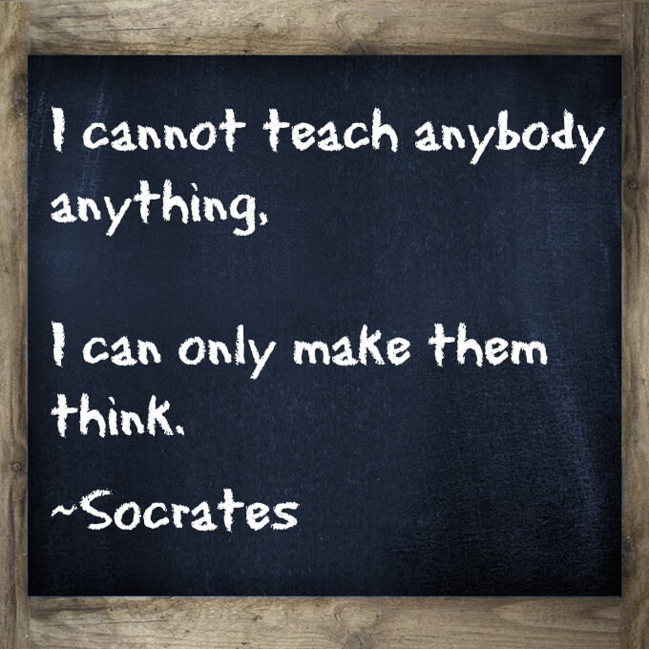

Slide 18


