Slide 1
Accessibility Solutions in a Digital Learning Environment
Dr. Crystal Guiler - National Curriculum Manager, Florida Virtual School
Patrick Intravichit - Quality Assurance Team lead, Florida Virtual School

Slide 2

Session Objectives
Understand the impact of the Web Content Accessibility Guidelines 2.0 (WCAG2.0) on all students.
Apply Web Content Accessibility Guidelines 2.0 to differentiated populations.
Evaluate the effectiveness of a learning asset using evaluation tools.

Slide 3

Accessibility Basics
Accessible design is a design process in which the needs of people with disabilities are specifically considered.
Web accessibility refers to the inclusive practice of removing barriers that prevent interaction with, or access to websites, by individuals with disabilities.

Slide 4
Accessibility Guidelines
Legal
Technical Guidelines
American with Disabilities Act of 1990
Section 508-1998 Amendment to Rehabilitation Act of 1973
Web Content Accessibility Guidelines (WCAG)

Slide 5
The W3C and WCAG
World Wide Web Consortium (W3C)
  International Community
  Responsible for developing web standards
Web Content Accessibility Guidelines (WCAG)
  Comprehensive list of approximately 60 success criteria
    Use of Text Alternatives
    Assist with browser compatibility including screen readers
    Consistent navigation and function
    Use of Color
    Future Proofing

Slide 6
Why WCAG?
The Web Content Accessibility Guidelines help us develop content that is adaptable
Adaptable content empowers the student.
An empowered student can access the content in a way that best fits their needs using the most familiar tools and methods.

Slide 7
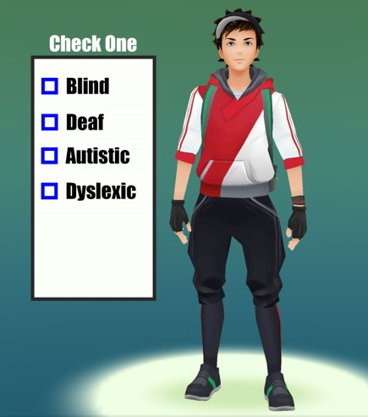
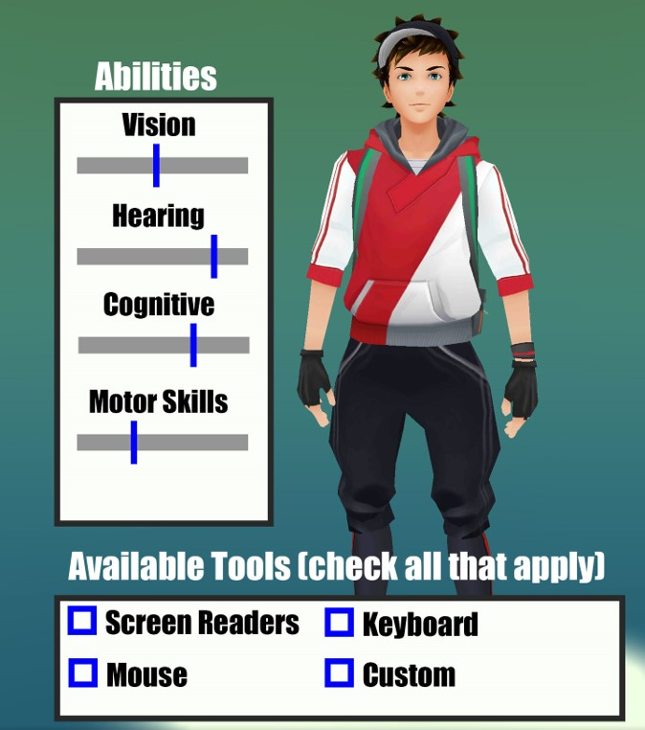
This helps us …
… avoid designing boxes for students to fit into …
...and instead allows us to design for every student.

Slide 8
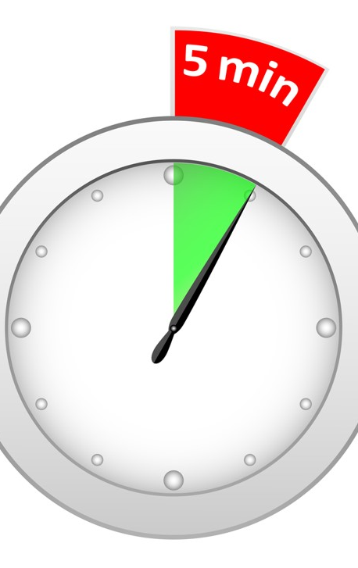
Let’s stop for 5 minutes
Describe your experience?

Slide 9

“Only 2% of the population will benefit from conforming to accessibility standards.”

Slide 10

2% of the population has vision impairments which require accessibility consideration.
20-36% (depending on age of participants in the study) of the population has diagnosed accessibility needs.
100% of the population can benefit from accessibility guidelines.
An undetermined percent of the population has undiagnosed cognitive challenges.

Slide 11

What is in your Toolbox?

Slide 12
Testing an OER on a Screen Reader
Windows
  NVDA: http://www.nvaccess.org/download/
  Window Eyes – 40 Minutes
  JAWS – Trial versions
Mac
  VoiceOver
Browser tools
  Firefox:FANGS
  Chrome:Chromevox

Slide 13
Adding Closed Captioning to Videos
Youtube
  Adding subtitles and closed captions to YouTube Videos
Vimeo
  Introducing the New Vimeo Player
Notes:
Site Title: Youtube
Link Title: Adding subtitles and closed captions to YouTube Videos –
Link URL: https://support.google.com/youtube/answer/2734796?hl=en
Site Title:
Link Title: Vimeo Introducing the New Vimeo Player
Link URL:https://vimeo.com/blog/post/introducing-the-new-vimeo-player

Slide 14
Common Keyboard Concerns
Windows and Mac Basics
Tab Order
The Keyboard trap

Slide 15
Other Resources
Color contrast
  Site: WebAim Color Contrast Checker
  Chrome Extension: WCAG Luminosity Contrast Ratio Analyzer
  Chrome Extension Color Contrast Analyzer
  Firefox Extenstion: WCAG Contrast Checker
Photosensitivity
  Site: Photosensitive Analysis Tool (PEAT)
Notes:
Color contrast
Site: WebAim
Link Title: WebAim Color Contrast Checker
Link URL: http://webaim.org/resources/contrastchecker/
Chrome Extension: WCAG Luminosity Contrast Ratio Analyzer
Link Title: WCAG Luminosity Contrast Ratio Analyzer
Link URL https://chrome.google.com/webstore/detail/wcag-luminosity-contrast/lllpnmpooomecmbmijbmbikaacgfdagi
Chrome Extension: Color Contrast Analyzer
Link Title: Color Contrast Analyzer
Link URL: https://chrome.google.com/webstore/detail/color-contrast-analyzer/dagdlcijhfbmgkjokkjicnnfimlebcll
Firefox Extension: WCAG Contrast Checker
Link Title: WCAG Contrast Checker
Link URL: https://addons.mozilla.org/en-US/firefox/addon/wcag-contrast-checker/?src=ss
Photosensitivity
Site: University of Maryland
Link Title: Photosensitive Analysis Tool (PEAT)
Link URL: http://trace.umd.edu/peat

Slide 16
What is a good text alternative?
When is this alternative ideal?
A text version must provide the user with the same experience as an interactive asset.
If the functionality behind the interactive OER is required to ensure student learning outcomes are met, the functionality of the OER must be described in the text version.

Slide 17
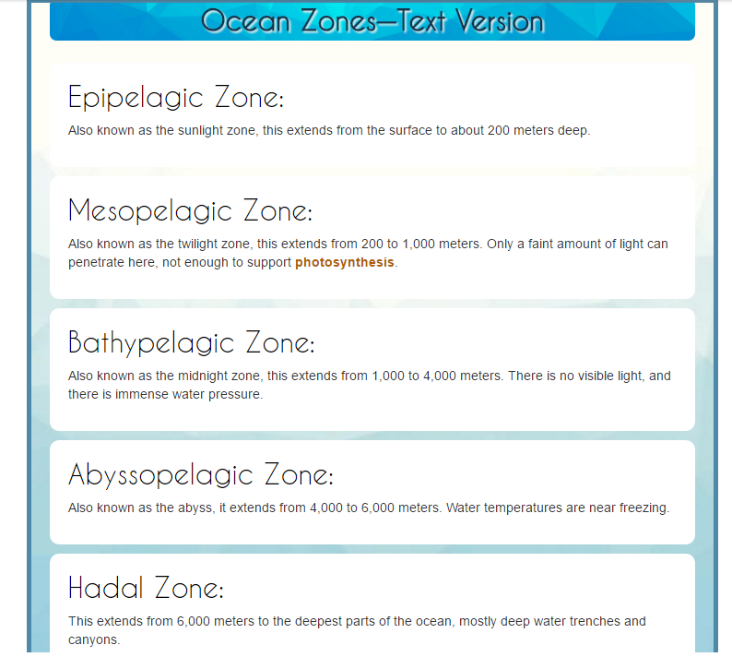
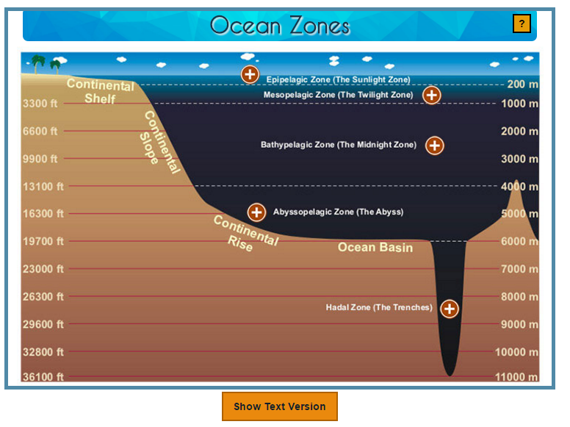
Focus on the Learning
Interactive Asset
Text Version
FLVS Example Text Version Slide
Notes:
The action of the interactive is to click on the + signs to see more information on the various zones.
The action is not communicated to the screen reader, nor is the visual representation, only the depths and some characteristics of the various zones, because that is what the student needs to know.

Slide 18
Questions/Contact
Dr. Crystal Guiler
  Email: cguiler@flvs.net
  813.446.6215
Patrick Intravichit
  Email pintravichit@flvs.net
  727.244.2593

