Slide 1

Atta Girl/Boy: Acing your Accreditation Review
Karen Arcangelo, PhD
Dorothy Anthony, DC, DACBN

Slide 2
As a result of this session the learner will:
analyze the current state of institutional policies surrounding the use of QM
compare and contrast policies, processes and procedures from the best practice case study to his or her own institution
generate a plan of action to position his or her institution for success during the accreditation process

Slide 3

Accreditation

Slide 4

In the beginning...........
Business, Management and Technology
http://pixabay.com/p-15704/?no_redirect

Slide 5
Our Goals...............
Quality Instruction
Smooth Administration
Interdepartmental Collaboration

Slide 6
Our Path........
-Searches for Best Practices
-Quality Matters Rubric
-Faculty Development
-Online Learning Committee
-Division Coordinators for E- Learning
-Internal QM Reviews
-COAT

Slide 7
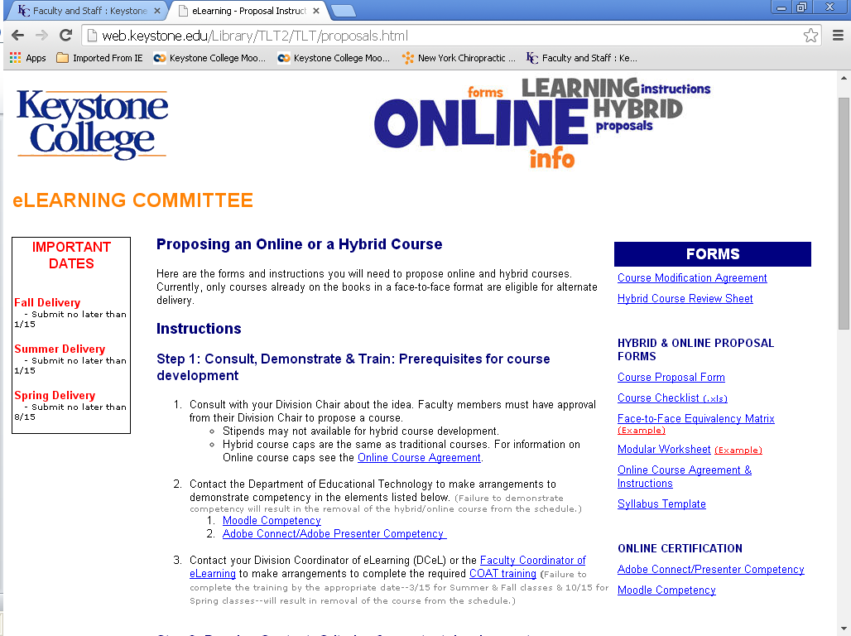

Slide 8
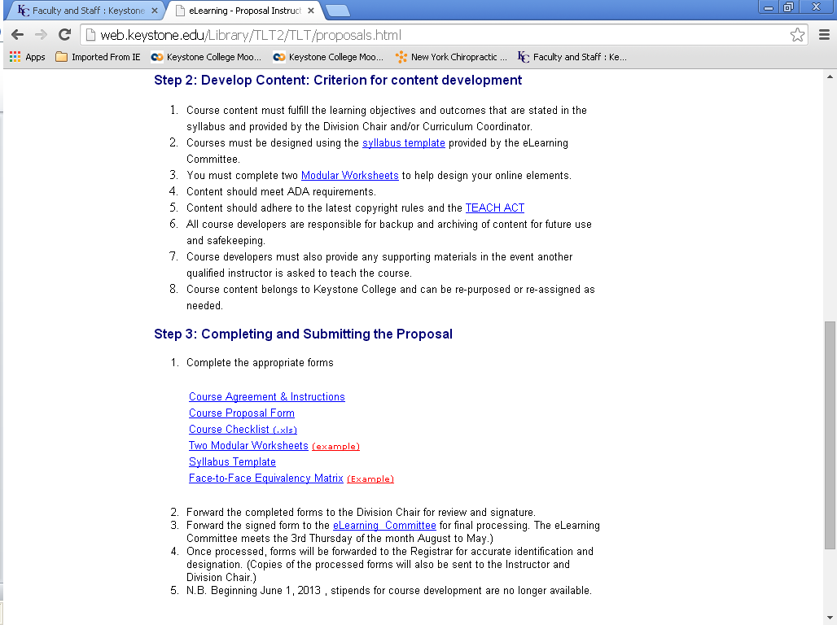

Slide 9
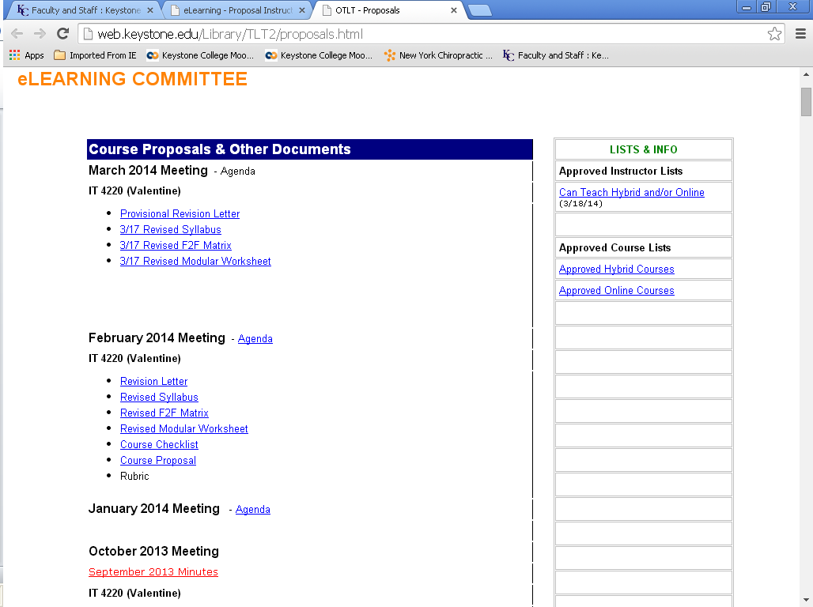

Slide 10
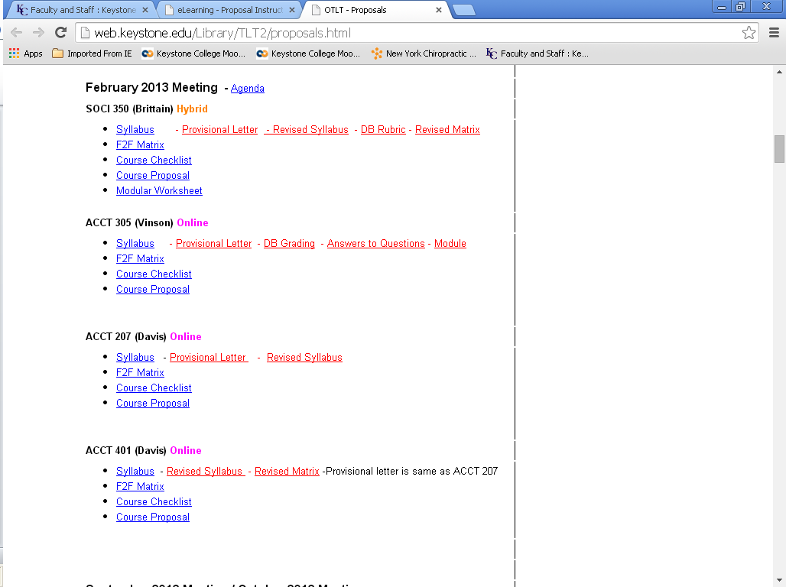

Slide 11
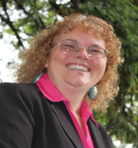

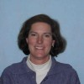




The Dcels
(Divisional Coordinators for e-Learning)
Faculty Co - Coordinator E-Learning
Natural Sciences and Mathematics Education Division
Communications and Humanities
Division
Faculty Co - Coordinator E-Learning
Education Division
Business, Management and Technology Division
Fines Arts Division
Social and Behavioral Sciences Division
Natural Sciences and Mathematics Division

Slide 12
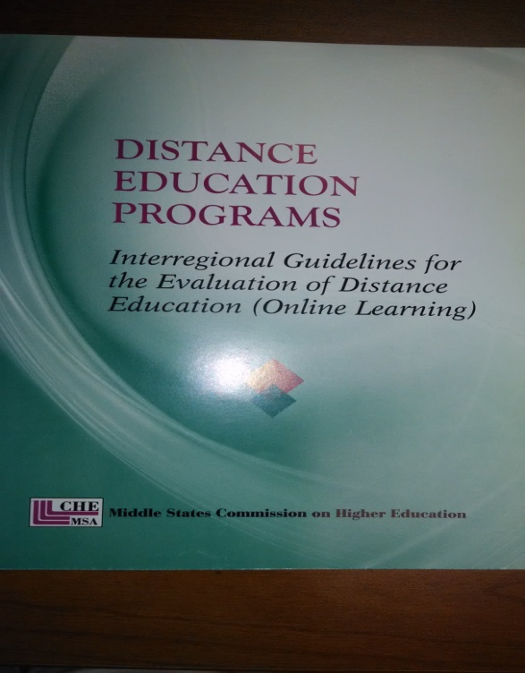
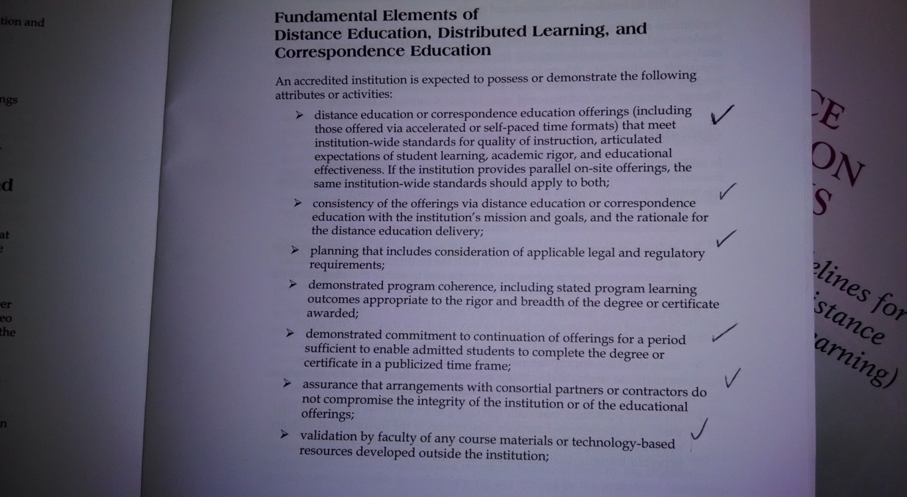
Use the book as a checklist…
Accreditors emphasize it is not a checklist in trainings for evaluators.

Slide 13
Checklist for Accreditors
1 | Self study addresses distance education
2 | Programs are consistent with the mission and vision of the college
3 | Budgets reflect investment in online learning
4 | Courses are comparable in rigor, content and resources
5 | Documented process for verifying student identification *******
6 | Evidence of capacity and resources
7 | Qualified faculty are teaching online

Slide 14
Clear Processes and Assessment
8 | Supervision of program
 | A | integrated into the curriculum
 | B | governance
 | C | planning
 | D | administrative processes
 |  | i | Courses go to Academic committee
 |  | ii | Courses go to committee for online delivery approval
 |  | iii | Instructors are trained to teach online specifically
 |  | iv | Courses are reviewed (using QM of course!)
9 | Assessment of student learning

Slide 15
Adequate
Infrastructure
Student
Services
10 | Adequate technical infrastructure
11 | Adequate student services
 |  | Admissions
 |  | Advising
 |  | Financial Aid
 |  | Orientation
 |  | Registration
 |  | Tutoring
 |  | Assessment and testing
 |  | Bookstore
 |  | Career Services
 |  | Course program catalog
 |  | Disability Services
 |  | Communication
 |  | Library
 |  | Personal Counseling
 |  | Placement Services
 |  | Schedule of Classes
 |  | Student Accounts
 |  | Student Activities
 |  | Student Population Segments
 |  | Technical Support

Slide 16
Grading Your Student Services
From WCET
The information is presented from the institution's point of view, using terminology and organization that mirror the physical organization and processes of the institution. | The information is channeled for population segments. For example, there are separate paths for prospective and matriculating students to various student services. These services are distinct entities, however, still reflecting their physical organization. | New "one-stop" services - like enrollment services - aggregate and integrate a range of related services to provide personalized and customized service from the student's point of view. Transaction services, portals, and communication tools enhance the student's experience. | Services are designed to establish and nurture a relationship between the student and the institution. Some of the identifying features include process orientation from the student's point of view, decision-making tools, personal recommendations, proactive communications, and real-time interaction with the institution.

Slide 17
An Evaluation Team Representing the Middle States Commission on Higher Education
Significant Accomplishment:
Keystone is applauded for its clear processes and careful oversight of its online offerings.

Slide 18
References
Find the forms and processes for Keystone College mentioned in this program:
http://web.keystone.edu/Library/TLT2/TLT/proposals.html
Check out the article on online student services.
http://wcet.wiche.edu/wcet/docs/beyond/overview.pdf
Quality Matters
https://www.qualitymatters.org/
Coat Certificate for Online Adjunct Training
http://marylandonline.org/coat/
Middle States Commission on Higher Education
www.msche.org/
Special thanks to Mari Flynn.

