Slide 1


Adding QM to Your Community College Landscape:
From Strategic Planning to Introducing QM to Your Faculty
Tammy Powers, Director of Library & Learning Technology
Krista MacDonald, Online Education Coordinator
Doña Ana Community College
QM Southwest Regional Conference
Friday April 25th, 2014

Slide 2
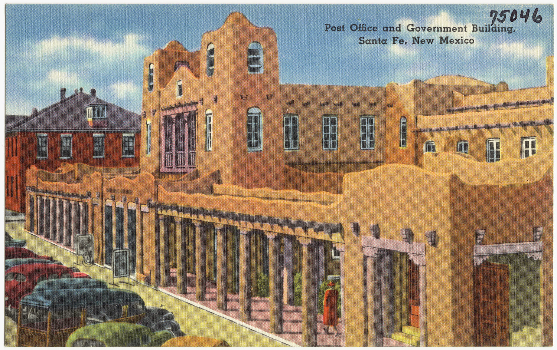
Welcome!

Slide 3
In our session we will discuss:
DACC demographics
DACC assessment of online learning and teaching
DACC online learning and teaching
  Learning Management System
  Institutional Structure
  Course Delivery
  Student Readiness
  Faculty Readiness
  Course Design
  Course Content
DACC goals for continued growth and improvement

Slide 4
DACC Service Area
All data from the Doña Ana County US Census
  Doña Ana County Population 2012 Estimate: 213,952
  Las Cruces Population 2012 Estimate: 101,047
 | USA | New Mexico | Doña Ana County
Per Capita Money Income 2008-2012 | $28,051 | $23,749 | $19,517
Median Household Income 2008-2012 | $53,046 | $44,886 | $38,462
Person’s Below Poverty Level % 2008-2012 | 14.9% | 19.5% | 25.8%

Slide 5
FALL 2011 DACC Student Profile
 | Head Count | Full Time Enrollment
Spring 2013 | 8, 136 | 4, 881
Fall 2012 | 9,330 | 5,547
Spring 2012 | 8,825 | 5,193

Slide 6
Student Placement

Slide 7
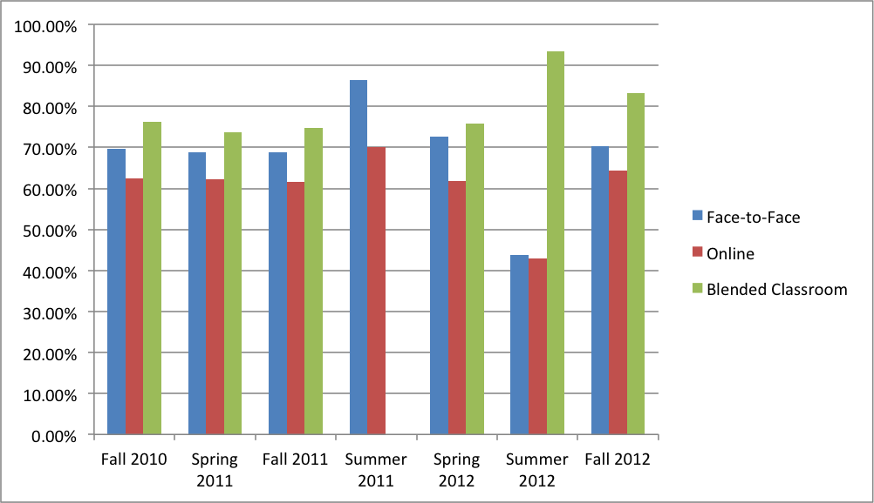
DACC Assessment of Online and Blended Courses
 | Face-to-Face |  | Online |  | Blended Classroom
Semester | Pass Rate | Count of Student BannerID | Pass Rate | Count of Student BannerID | Pass Rate | Count of Student BannerID
Fall 2010 | 69.70% | 8613 | 62.47% | 3797 | 76.19% | 126
Spring 2011 | 68.86% | 7958 | 62.13% | 3367 | 73.68% | 114
Fall 2011 | 68.91% | 9156 | 61.64% | 3999 | 74.81% | 135
Summer 2011 | 86.36% | 990 | 70.11% | 813
Spring 2012 | 72.58% | 8096 | 61.73% | 3528 | 75.86% | 87
Summer 2012 | 43.68% | 847 | 42.97% | 512 | 93.33% | 15
Fall 2012 | 70.37% | 8880 | 64.31% | 3830 | 83.33% | 90

Slide 8
VLIT Online Education Student Survey Spring 2013
Assessed student perceived learning outcomes and satisfaction with the Doña Ana Community College Online Education program.
The survey is based on the commonly administered IDEA (Individual Development & Educational Assessment) student rating system created by Kansas State University.
The 24 survey questions were hosted by Survey Monkey. The survey URL and instructions were sent to all 2903 student email addresses. We collected 214 valid responses from the survey (10% response rate).
We received permission to use the survey for our assessment. It was published in “The Determinants of Students’ Perceived Learning Outcomes and Satisfaction in University Online Education: An Empirical Investigation” July 2006 Volume 4 Number 2 by Sean B. Eom, H. Joseph Wen, and Nicholas Ashill in the Decision Sciences Journal of Innovative Education.

Slide 9
Results VLIT Online Education Student Survey Spring 2013
Course Structure
  A majority of students either strongly agreed or agreed regarding:
  the overall usability of the course web site was good (76%, 163 students),
  the course objectives and procedures were clearly communicated (74%, 159 students)
  the course material was organized into logical and understandable components (66%, 142 students).
Student Feedback
A majority of student respondents strongly agreed or agreed regarding:
  their instructor was responsive to student concerns (66%, 142 students),
  their instructor provided timely feedback on assignments, exams, or projects (65%, 140 students),
  their instructor provided helpful feedback on assignments, exams, or projects (70%, 150 students),
  they felt as if the instructor cared about their individual learning in the course (64%, 137 students).
Self-motivation
A majority of student respondents strongly agreed or agreed regarding:
  I am goal directed, if I set my sights on a result, I usually can achieve it (87%, 186 students).
  I put forth the same effort in online courses as I do in a face-to-face course (84%, 179 students).
Learning Style
The proportion of student respondents that strongly agreed or agreed regarding:
  I prefer to express my ideas and thoughts in writing, as opposed to verbally (49%, 105 students),
  I understand the directions better when I see a map than when I receive verbal directions (57%, 123 students).

Slide 10
Results VLIT Online Education Student Survey Spring 2013
Interaction
  A majority of student respondents strongly agreed or agreed regarding:
  I frequently interacted with the instructor in this online course (55%, 117 students)
Instructor knowledge and facilitation
A majority of student respondents marked either strongly agree or agree regarding:
  the instructor was very knowledgeable about the course (79%, 170 students),
  the instructor was actively involved in facilitating the course (71%, 152 students),
  the instructor stimulated students to intellectual effort beyond that required by face-to-face courses (64%, 136 students).
User Satisfaction
  A majority of student respondents strongly agreed or agreed regarding:
  the academic quality was on par with face-to-face courses they have taken (62%, 133 students),
  they would recommend this course to other students (70%, 149 students),
  they would take another online course at DACC (76%, 163 students).
Learning Outcomes
A majority of students strongly agreed or agreed regarding:
  they learn as much from this course as they would have in a face-to-face version of the course (61%, 130 students)
  the quality of the learning experience in online courses is equal to or better to than in face-to-face courses (55%, 118 students).

Slide 11
VLIT Online Education Faculty Survey Spring 2013
Assessed faculty perceived barriers to online education with the Doña Ana Community College Online Education program.
The survey is based on an instrument developed by the North Georgia College and State University.
The 36-item questionnaire was constructed, distributed, and collected using Survey Monkey.
Forty-five faculty participated in the survey, representing a 35% response rate. The participants were predominantly at the academic rank of instructor (41%), part-time (56%) faculty, having taught online courses for ten or more semesters (60%), and having designed online courses (98%).
All faculty ranks were represented and all divisions were represented.
We received permission to use the survey for our assessment. Steven A. Lloyd, Michelle M. Byrne, and Tami S. McCoy published their survey March 2012 in the Merlot Journal of Online Learning and Teaching Volume 8 Number 1, article “Faculty Perceived Barriers of Online Education.”

Slide 12
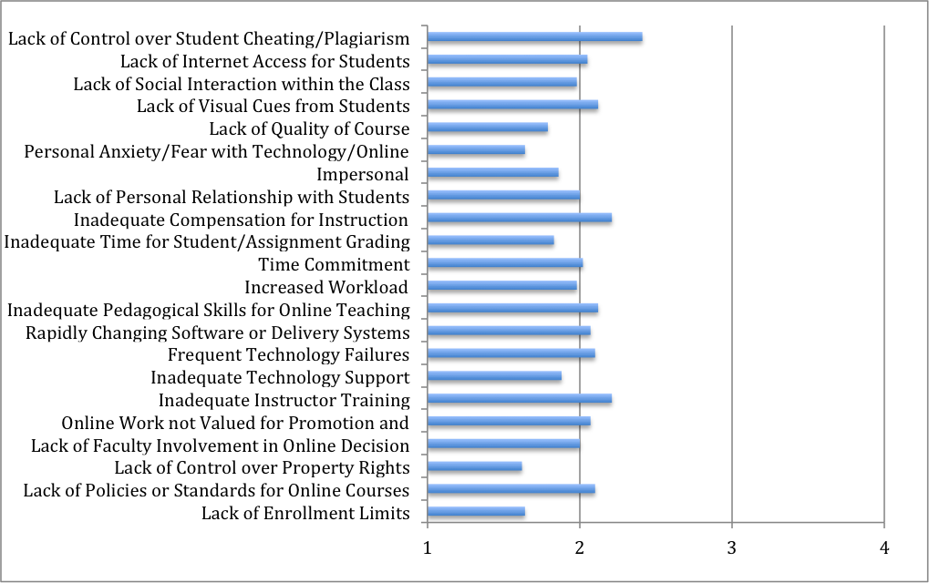
VLIT Online Education Faculty Survey Spring 2013
The faculty on average in this study indicated that they did not perceive any interpersonal, institution, training and technology, or cost/benefit analysis barriers.
Not a Barrier
Somewhat
of a Barrier
A Barrier
Significant
Barrier

Slide 13
Factors Affecting Online Course Quality

Slide 14
Learning Management System

Slide 15
DACC LMS
DACC uses Instructure Canvas.
We have experienced WebCT, Blackboard and Canvas was implemented two years ago.
The multiplicity of tools in Canvas seems to assist our faculty in thinking about course improvement overall.

Slide 16
Institutional Infrastructure

Slide 17
NMSU System Campuses
NMSU
New Mexico State University – Doña Ana Community College
New Mexico State University – Alamogordo
New Mexico State University – Carlsbad
New Mexico State University – Grants
The relationship between campuses is evolving.

Slide 18
Course Delivery

Slide 19
DACC Course Delivery
Online courses are delivered using Instructure Canvas.
Faculty publish their courses the first day of the semester.
Types of courses
  Face to Face
  Fully online
  Blended
Evaluation
  Faculty are currently evaluated on their course delivery.
  A tool has been piloted this semester.

Slide 20
Student Readiness

Slide 21
Student Canvas Training
From May 2012 -Sept 2013, VLIT has trained 802 students to use Canvas.
In Fall 2014, DACC will pilot a pre-enrollment, Canvas training for students as part of the “First Year Experience” student orientation by DACC Student Services.

Slide 22
Student Readiness Survey
Before students begin their online courses, they are encouraged to complete the online Student Readiness Survey located on VLIT’s webpage titled “Student Resources.” The survey is eleven questions long. A student can view the results of the survey immediately after submitting it. The Student Readiness Survey is a tool used by advisors, faculty, and students.
http://dabcc.nmsu.libguides.com/vlit-student-resources

Slide 23
Student Preparation
In addition to including a “When are Online Classes a Good Choice?” page within the spring schedule, VLIT has also created and published a checklist for students to help prepare them for their online courses. The checklist reminds students to:
Order their textbook and supplies early so they have what they need at the beginning of the course.
Be sure to meet any technology skills prerequisites. This is a good time to brush up on the applications you will be using.
Have all required hardware and software. Check your equipment and software and make sure everything is functioning properly.
Have your Internet service active with the fastest connection that is affordable for you. The faster your internet connection, the more enjoyable and productive your online education will be.

Slide 24
Faculty Readiness

Slide 25
Canvas, Tools, and Technology
Currently, it is mandatory for DACC online faculty to complete a Canvas Certification Course. DACC currently has over 260 faculty members, both full and part time, certified to use Canvas.
Faculty can attend workshops at DACC through VLIT or the NMSU Teaching Academy to learn about current online teaching tools and technologies. VLIT began offering QM training in Fall 2012.

Slide 26
Professional Development in Online Teaching and Learning Pedagogy
VLIT Book Club: Semester discussions of current books and best practices in online pedagogy (Fall 2012-current)
VLIT First Thursdays: Monthly faculty led trainings on best practices in online education (Fall 2012- current)
DACC QM Standards Workshops (Fall 2013-current)
A majority of faculty have participated in NMSU Teaching Academy sessions for online teaching and learning and/or online training for online education and course design.
DACC faculty members have attended a regional or national conference for online teaching and learning.
DACC faculty members have earned an NMSU Masters Certificate in Online Teaching and Learning (OTL).
DACC faculty are working with faculty from across the state to form the New Mexico Distance Learning Association (NMDLA), a state chapter of the United States Distance Learning Association (USDLA).

Slide 27
Course Content

Slide 28
DACC Online Course Content
Online course curriculum is determined by individual faculty and their departments.
All online DACC courses include:
  DACC Home Page Branding
  Course syllabus and schedule
  DACC Student Resources

Slide 29
Course Design

Slide 30

DACC Selected Quality Matters because:
QM addresses the key areas for improvement found in our assessment
QM is a faculty driven, peer review process for improving online and hybrid courses
The QM rubric is a well-researched faculty support tool
QM provides valuable professional development opportunities
Other state and NMSU system campuses have become subscribers
QM is award winning: Sloan-C, USDLA, WCET

Slide 31
QM Professional Development
QM Course Reviews
QM Course Reviewers

Slide 32
QM Professional Development
Applying the QM Rubric
Peer Reviewer Training
Designing Your Online Course
Designing Your Blended Course
www.qualitymatters.org
Quality Matters Workshops
VLIT First Thursdays
VLIT Book Club
VLIT Canvas Trainings

Slide 33
Quality Matters Course Reviews
Formal Quality Matters Course Reviews
Informal Quality Matters Course Reviews
Self Review
Peer Review
Informal Review by a QM Certified DACC Instructor or VLIT Staff.
QM-Managed Course Reviews
DACC Managed Course Reviews

Slide 34
DACC Quality Matters Course Reviewers
The QM Peer Reviewer certification process is rigorous and time intensive. QM Certified Peer Reviewers are eligible to serve on both QM-managed and DACC-managed formal course reviews. They are paid $150 for each course they review at DACC and through QM.
To become a QM Certified Peer Reviewer:
Successful completion of the Applying the QM Rubric Workshop and the Peer Reviewer Course (40 hours of training).
Current for-credit online teaching experience (within the last 18 months).
Completed Application and Memo of Understanding submitted to QM.

Slide 35
Where We Are At Now

Slide 36
Currently at DACC
Current Achievements
  Over 42% of our online faculty have participated in a form of Quality Matters professional development.
  We have had eight courses officially QM certified, with one underway.
  Provision of online APPQMR training for DACC instructors.
Goals
  We will start subscriber-led course reviews in the fall semester.
  Continued QM training for all online instructors, particularly our adjunct faculty.
  We have had a great beginning and look forward to our next steps.

Slide 37
Questions?

Slide 38
Thank you!
For more information please contact us at:
Krista MacDonald, kkozel@nmsu.edu
Tammy Powers, tpowers@dacc.nmsu.edu

