Slide 1
Addressing Universal Design
Beyond Standard 8
Dr. Betsy Stringam, New Mexico State University

Slide 2

Disclaimers

Slide 3
Disclaimers

Slide 4
QM Poster Child

Slide 5

EDLT-579-M70-UNIVERSAL DESIGN ONLINE
Dr. Sharon Lalla!

Slide 6

General Standard 8: The course design reflects a commitment to accessibility and usability for all students.
The course design reflects a commitment to accessibility, so that all learners can access course content and activities, and to usability so that all learners can easily navigate and interact with course components

Slide 7

Vision impairment.
About 1 in 1,000 are considered visually impaired or blind. Estimates at correctiveness reduce that number significantly.

Slide 8


Slide 9

Impairing hearing loss
1.2 in a thousand

Slide 10


Slide 11
Developmental Disabilities
About 1 in 6 children in the United States had a developmental disability in 2006-2008, ranging from mild disabilities such as speech and language impairments to serious developmental disabilities, such as intellectual disabilities, cerebral palsy, and autism.
Centers for Disease Control and Prevention, 2013

Slide 12
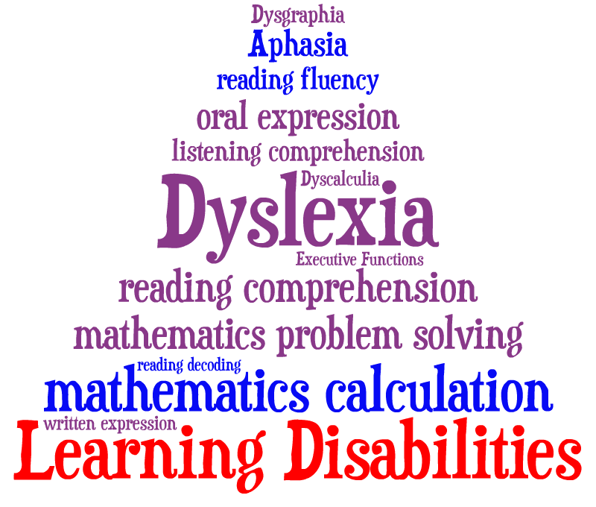

Slide 13

Increasing number of students with a disability are college bound.
Estimates are that anywhere from 1 in 10 to 1 in 5 have some learning disability.

Slide 14

Biggest increase is “hidden disabilities” (Wolf, 2001).
  Less visible, not readily apparent to the observer.

Slide 15
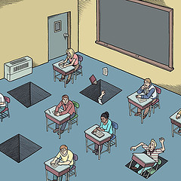
Retention and graduation rates
for students with disabilities
are lower (Wolf, 2001).
Students with disabilities
are more likely to drop out
of college (Wolf, 2001).

Slide 16

Students may have more than one learning difference. Often physical, psychological and or learning disabilities overlap (Wolf, 2001).

Slide 17
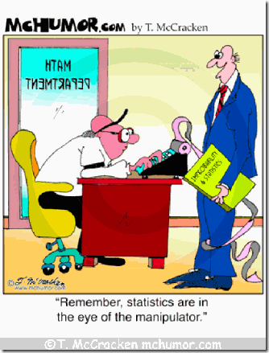

Slide 18
Universal Design

Slide 19
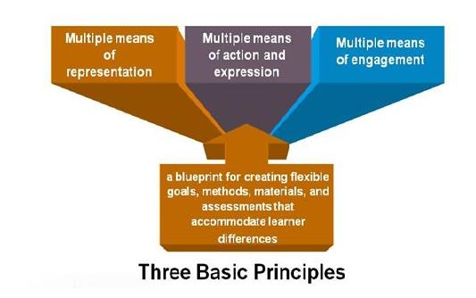
Universal Design for Education

Slide 20
Universal Design for Learning is an educational approach with three primary principles:
Multiple Means of Representation
To tap into learners interests, offer appropriate challenges, and increase motivation
To give diverse learners options for acquiring information and knowledge
Multiple Means of Action and Expression
To provide learners options for demonstrating what they know
Multiple Means of Engagement

Slide 21
Example: Non Verbal Learning Disorders

Slide 22
Non Verbal Learning Disorders
About 1 in 68 children has been identified with autism spectrum disorder (ASD) according to estimates from CDC's Autism and Developmental Disabilities Monitoring (ADDM) Network
Centers for Disease Control and Prevention, 2013

Slide 23
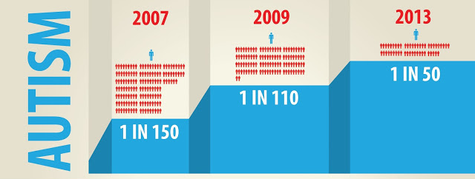
National Autism Society reports

Slide 24
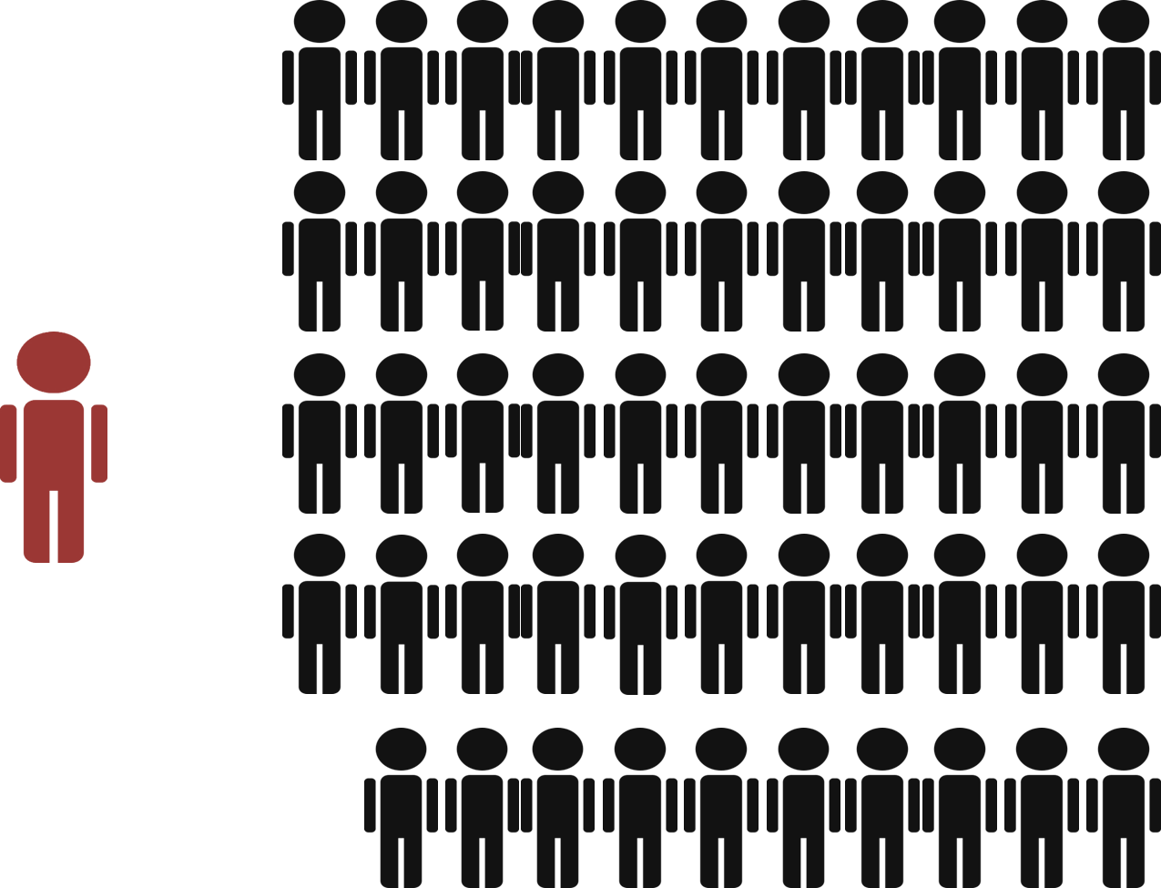

Slide 25
Remember
Not all NVLD are alike
Unique
  Profile
  Personalities
  Experience
  Learning Styles
No single approach works best for all!

Slide 26
Provide Multiple Means of Representation,
Need for more information, links to additional sources,
Some difficulties processing visual sequences, require additional audio
Step by step instructions to fall back to, when unsure.
Clear grading rubrics to provide structure.
Provide as much detail in the course syllabus as possible
Providing links to additional resources for navigating campus and college concerns
Provide multimodal approach to information: handouts, lectures, and visual representations.
When possible refer and build off of previous information.
Prefer sameness, repetition, predictable routines
Need clear updated schedules
Advance notice of large projects

Slide 27
Provide Multiple Means of Action and Expression
People with NVLD, require additional time to translate what they want to say to the process of speech. Therefore requiring students to do a video recording or audio recording would be terrifying to a child with NVLD (Wenzel & Rowley, 2010).
Can be effective tutors to less skilled students
Provide discussion forums for students to ask questions of one another, and of the instructor.
Clear Demarcation of roles and responsibilities
Opportunities for Social Interaction in fairly structured and supervised activities
Difficulty interpreting nonverbal behavioral cues
Opportunity to work alone or in group
Presentations can be “private” or viewed only by instructor.

Slide 28
Provide Multiple Means of Engagement
Difficulty Developing Peer Relationships:
Since those with NVLD often excel in certain activities, allow students to volunteer for leadership roles
Specific set office hours and instructions on how to specifically contact the instructor during those office hours.
Small Work Groups
Provide a buddy system to help with assurance and allow them a safe space to ask questions of a few peers.
Teach students how to work in groups, group role expectations

Slide 29
Which standards meet these needs?
Handout/Group Work

Slide 30
Provide Multiple Means of Representation,
Need for more information, links to additional sources,
Some difficulties processing visual sequences, require additional audio
Step by step instructions to fall back to, when unsure.
Clear grading rubrics to provide structure.
Provide as much detail in the course syllabus as possible
Providing links to additional resources for navigating campus and college concerns
Provide multimodal approach to information: handouts, lectures, and visual representations.
When possible refer and build off of previous information.
Prefer sameness, or repetition
General Standard 1: The overall design of the course is made clear to the student at the beginning of the course.
The course introduction sets the tone for the course, lets students know what to expect, and provides guidance to ensure they get off to a good start.
STANDARD 1.1 Instructions make clear how to get started and where to find various course components.
STANDARD 1.3 Etiquette expectations (sometimes called “netiquette”) for online discussions, email, and other forms of communication are stated clearly.

Slide 31
People with NVLD, require additional time to translate what they want to say to the process of speech. Therefore requiring students to do a video recording or audio recording would be terrifying to a child with NVLD (Wenzel & Rowley, 2010).
Can be effective tutors to less skilled students
Provide discussion forums for students to ask questions of one another, and of the instructor.
Clear Demarcation of roles and responsibilities
Opportunities for Social Interaction in fairly structured and supervised activities
Difficulty interpreting nonverbal behavioral cues
Provide Multiple Means of Action and Expression
STANDARD 1.8 Learners are asked to introduce themselves to the class

Slide 32
Provide Multiple Means of Action and Expression
People with NVLD, require additional time to translate what they want to say to the process of speech. Therefore requiring students to do a video recording or audio recording would be terrifying to a child with NVLD (Wenzel & Rowley, 2010).
Can be effective tutors to less skilled students
Provide discussion forums for students to ask questions of one another, and of the instructor.
Clear Demarcation of roles and responsibilities
Opportunities for Social Interaction in fairly structured and supervised activities
Difficulty interpreting nonverbal behavioral cues
General Standard 3: Assessments are integral to the learning process and are designed to evaluate learner progress in achieving the states learning objectives or mastering the competencies.
Assessment is implemented in a manner that corresponds to the course learning objectives or competencies and not only allows the instructor a broad perspective on the learners’ mastery of the content, but also allows the learners to track their learning progress throughout the course.

Slide 33
Provide Multiple Means of Representation,
Need for more information, links to additional sources,
Some difficulties processing visual sequences, require additional audio
Step by step instructions to fall back to, when unsure.
Clear grading rubrics to provide structure.
Provide as much detail in the course syllabus as possible
Providing links to additional resources for navigating campus and college concerns
Provide multimodal approach to information: handouts, lectures, and visual representations.
When possible refer and build off of previous information.
Prefer sameness, or repetition
STANDARD 3.2 The course grading policy is stated clearly.
STANDARD 3.3 Specific and descriptive criteria are provided for the evaluation of learners’ work and participation and are tied to the course grading policy.

Slide 34
Provide Multiple Means of Representation,
Need for more information, links to additional sources,
Some difficulties processing visual sequences, require additional audio
Step by step instructions to fall back to, when unsure.
Clear grading rubrics to provide structure.
Provide as much detail in the course syllabus as possible
Providing links to additional resources for navigating campus and college concerns
Provide multimodal approach to information: handouts, lectures, and visual representations.
When possible refer and build off of previous information.
Prefer sameness, or repetition
STANDARD 3.4 The assessment instruments selected are sequenced, varied, and appropriate to the learner work being assessed.
STANDARD 3.5 The course provides learners with multiple opportunities to track their learning progress.

Slide 35
Provide Multiple Means of Representation,
Need for more information, links to additional sources,
Some difficulties processing visual sequences, require additional audio
Step by step instructions to fall back to, when unsure.
Clear grading rubrics to provide structure.
Provide as much detail in the course syllabus as possible
Providing links to additional resources for navigating campus and college concerns
Provide multimodal approach to information: handouts, lectures, and visual representations.
When possible refer and build off of previous information.
Prefer sameness, or repetition
STANDARD 4.5 A variety of instructional materials is used in the course.

Slide 36
Provide Multiple Means of Engagement
Small Work Groups
Since those with NVLD often excel in certain activities, allow students to volunteer for leadership roles
Provide a buddy system to help with assurance, and allow them a safe space to ask questions of a few peers.
Specific set office hours and instructions on how to specifically contact the instructor during those office hours.
STANDARD 5.2 Learning activities provide opportunities for interaction that support active learning.
STANDARD 5.4 The requirements for student interaction are clearly articulated.
not being sure of how to join a group or initiate social interaction

Slide 37
Provide Multiple Means of Action and Expression
People with NVLD, require additional time to translate what they want to say to the process of speech. Therefore requiring students to do a video recording or audio recording would be terrifying to a child with NVLD (Wenzel & Rowley, 2010).
Can be effective tutors to less skilled students
Provide discussion forums for students to ask questions of one another, and of the instructor.
Clear Demarcation of roles and responsibilities
Opportunities for Social Interaction in fairly structured and supervised activities
Difficulty interpreting nonverbal behavioral cues
STANDARD 5.4 The requirements for student interaction are clearly articulated.

Slide 38
Provide Multiple Means of Engagement
Small Work Groups
Since those with NVLD often excel in certain activities, allow students to volunteer for leadership roles
Provide a buddy system to help with assurance, and allow them a safe space to ask questions of a few peers.
Specific set office hours and instructions on how to specifically contact the instructor during those office hours.
STANDARD 6.2 Course tools promote learner engagement and active learning.

Slide 39
Provide Multiple Means of Representation,
Need for more information, links to additional sources,
Some difficulties processing visual sequences, require additional audio
Step by step instructions to fall back to, when unsure.
Clear grading rubrics to provide structure.
Provide as much detail in the course syllabus as possible
Providing links to additional resources for navigating campus and college concerns
Provide multimodal approach to information: handouts, lectures, and visual representations.
When possible refer and build off of previous information.
Prefer sameness, or repetition
General Standard 7: The course facilitates learner access to institutional support services essential to learner success.
It is important to ensure online learners know they have access to and are encourages to use the services that support learners at the institution. In the learner support standard, four different kinds of support services are addressed: technical support, accessibility support, academic services support, and student services support.
STANDARD 7.1 The course instructions articulate or link to a clear description of the technical support offered and how to obtain it.

Slide 40
Provide Multiple Means of Representation,
Need for more information, links to additional sources,
Some difficulties processing visual sequences, require additional audio
Step by step instructions to fall back to, when unsure.
Clear grading rubrics to provide structure.
Provide as much detail in the course syllabus as possible
Providing links to additional resources for navigating campus and college concerns
Provide multimodal approach to information: handouts, lectures, and visual representations.
When possible refer and build off of previous information.
Prefer sameness, or repetition
STANDARD 7.2 Course instructions articulate or link to the institution’s accessibility policies and services.
STANDARD 7.3 Course instructions articulate or link to an explanation of how the institution’s academic support services and resources can help learners succeed in the course and how learners can obtain them.
STANDARD 7.4 Course instructions articulate or link to an explanation of how the institution’s student services and resources can help learners succeed and how learners can obtain them.

Slide 41
References
Adreon, D. & Durocher, J. (2007). Evaluating the college transition needs of individuals with high-functioning autism spectrum disorder. Intervention in School and Clinic, 42(5), 271-279.
Autism Spectrum Disorder (2013). Centers for Disease Control and Prevention. Accessed 9 April 2014 at: http://www.cdc.gov/ncbddd/autism/data.html
Gobbo, K., & Shmulsky S. (2011). Classroom needs of Community College students with Asperger’s disorder and autism spectrum disorders. Community College Journal, 36(1), 40-46.
Horowitz, S. H. (2014). Learning Disabilities and Asperger’s Syndrome. National Center for Learning Disabilities. Accessed 6 February 2014 at: http://www.ncld.org/types-learning-disabilities/adhd-related-issues/autism-spectrum-disorders/learning-disabilities-aspergers-syndrome?start=1
Kin, A., & Volkmar, F. (1995). Asperger’s Syndrome: guidelines for treatment and intervention. New Haven, Connecticut: Yale Child Study Center.
Lane, J. & Kelly, R. (2012). Autism and Asperger’s Syndrome in the Law Student – Making Accommodations in Academic Assessments. In: 47th Annual Conference (re) assessing Legal Education. 1st April – 3rd April 2012, Lady Margaret Hall, Oxford, UK.
National Institute on Deafness and other Communication Disorders (2014). Accessed 9 April 2014 at http://www.nidcd.nih.gov/health/statistics/Pages/quick.aspx
Strichter, J., O’Connor, K, Herzog, M, Lierheimer, K., & McGhee, S. (2012). Social Competence Intervention for Elementary Students with Aspergers Syndrom and High Functioning Autism. Journal of Autism and Developmental Disorders, 42, 354-366.
VanBergeijk, E., Klin, A., & Volkmar F. (2008). Supporting more able students on the Autism Spectrum: College and beyond. Journal of Autism and Developmental Disorders, 38(7) 1359-1370.
Visual Impairment and Blindness (2014). World Health Organization. Accessed 9 April 2014 at: http://www.who.int/mediacentre/factsheets/fs282/en/
Wenzel C. & Rowley, L. (2010). Teaching social skills and academic strategies to college students with Asperger’s syndrome. Teaching Exceptional Children, 42(5), 44-50.
Wolf, L. (2001) College students with ADHD and other hidden disabilities. Annals of the New York Academy of Sciences. 931(1), 385-395.

