Slide 1
ALIGN AND REDESIGN

Slide 2

Dr. Roseann Torsiello, Chair, School of Liberal Arts, Online
Professor Barbara Monaghan, Associate Chair, English and Humanities, Online.

Slide 3
ALIGNMENT
Alignment is the connection between learning objectives, learning activities and assessment.

Slide 4
PRELIMINARY ACTIONS
Measure
Assess
Determine
Consider
Predict

Slide 5
BEFORE YOU BEGIN:
Measure Course Objectives
Assess Instructional Strategies
Determine Learning Activities And Supplementary Support
Consider Demonstrations Of Student Knowledge
Predict Instructor Feedback

Slide 6

LEARNING OBJECTIVES
COURSE GOALS
2-5 Total
vs.
Notes:
Course goals are the "big ideas" you are going to teach your students AT TH END of your course. Generally, a course will have 2-5 course goals, but it can have more. A learning objective is an outcome statement (one sentence) that describes specifically the knowledge, skills, or attitudes a learner should exhibit after experiencing instruction.
On the other hand, a learning objective is not a statement of what the instructor or the course will do ("I will teach them about structure fires"), and it is not a statement of what the student will do in the learning activity itself ("The student will watch a video"). It is a statement of the behavior the student will exhibit after he or she experiences the instruction, and that behavior should be reflected in the assessment ("The student will list the five stages of a structure fire after viewing the structure fire video").
COURSE OBJECTIVES ARE DERIVED FROM COURSE GOALS

Slide 7
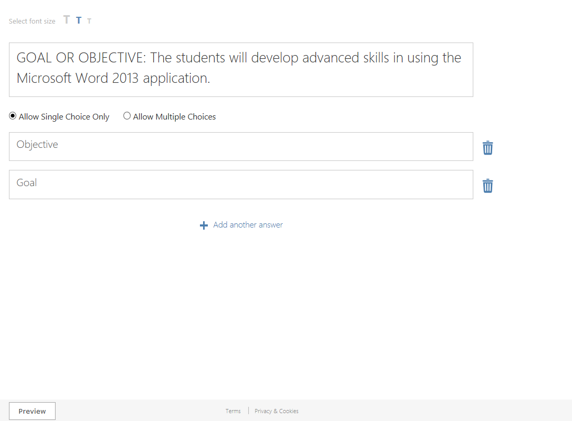
Bullet Slide
Bullet point
Bullet point
  Sub Bullet
Notes:
goal

Slide 8
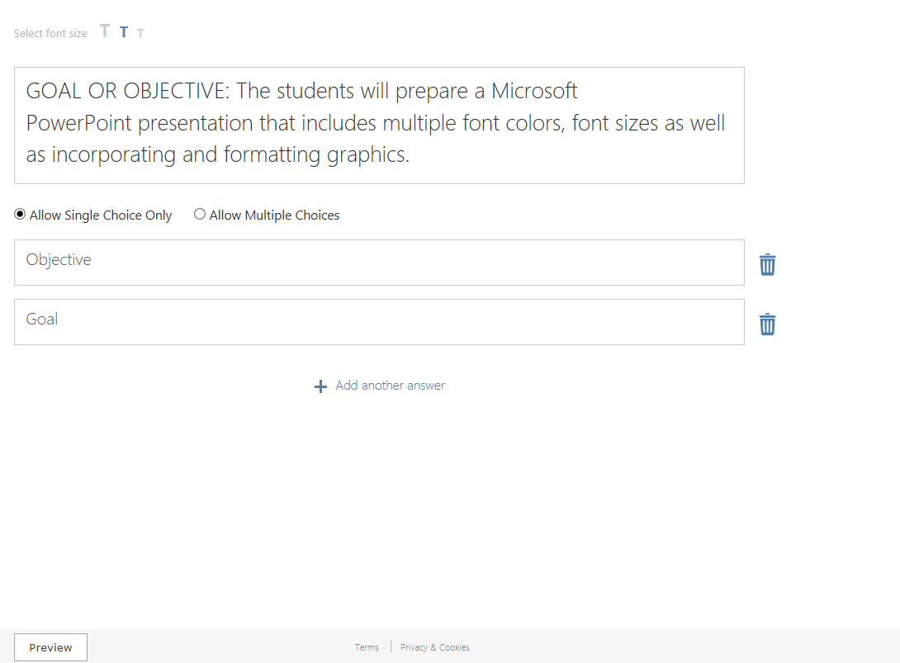
Bullet Slide
Bullet point
Bullet point
  Sub Bullet
Notes:
objective

Slide 9
MEASURABLE COURSE GOALS/OBJECTIVES
All course goals and objectives must be measurable.
Notes:
All course/learning objectives should be measurable (Mager, 1984), which means that it is easy to observe when/if students succeed or fail to learn a specific task. When all course objectives are met, their corresponding goal is said to be achieved.

Slide 10
WRITING GOALS/OBJECTIVES
Be specific about the audience, the action verb, and the conditions and criteria | Write learning objectives from the student's point of view
Objectives must align with at least one of your course goals | Be sure the objectives are appropriate for the level of the course
Objectives must be measurable | Use one verb per objective
Notes:
Be specific about the audience, the action verb, and the conditions and criteria under which the action will be performed.
Objectives must align with at least one of your course goals.
Write learning objectives from the student's point of view ("the student/learner will . . . ") and use language that ensures they can understand the objective before they experience the instruction.
Be sure the objectives are appropriate for the level of the course. This does not necessarily mean that you cannot cover all six levels of Bloom's taxonomy in your learning objectives. It simply means that you need to make sure the learning objectives are written for the expected level of content mastery for the audience in the discipline--for example, 100-level students, upper classman in the discipline, or graduate students in the discipline.
Make absolutely sure your objectives are measurable, i.e., can you observe the behavior in the objective? Again, use an action verb in an appropriate level of Bloom's taxonomy for the level at which the learner should be performing.
Generally, it's best to try to use just one verb per objective, i.e., don't put yourself in a position where you have to observe and measure two separate behaviors from one objective. That may cause problems later.

Slide 11
BEWARE
Measuring the Unmeasurable
To know
To understand
To be aware of
To appreciate
To realize
To learn
To comprehend
To gain knowledge of
To be familiar with
Notes:
Verbs for which no measuring stick exists . . .
How would you measure the verbs below? With these verbs, how could you make your method of measurement (the behavior you expect) clear to the student? In other words, how can I observe my student "knowing"? How do I measure "appreciation"? You might be able to come up with some interesting responses to those questions. However, if you are heading for a QM review, it is probably best to avoid the following verbs because they are not considered measurable (refer to Standards 2.1 and 2.2):

Slide 12

Notes:
LiveSlide
http://community.wvu.edu/~lsmong/Articulate%20Blooms%20Wheel/blooms_wheel.html

Slide 13
Notes:
LiveSlide
https://teachonline.asu.edu/objectives-builder/

Slide 14
INSTRUCTIONAL STRATEGIES
Development of the activities in and out of class that will reinforce the learning objectives and prepare students for assessments.

Slide 15
TYPES OF INSTRUCTIONAL STRATEGIES
Lectures
Annotated Readings
Presentations
Simulations
Role Play
Case Studies
Laboratory
Fieldwork

Slide 16
ASSESSMENTS
Measurement of how well students have learned the course material. These must reinforce the learning objectives and instructional strategies.
Notes:
Assessments should reveal how well students have learned what we want them to learn while instruction ensures that they learn it. For this to occur, assessments, learning objectives, and instructional strategies need to be closely aligned so that they reinforce one another.

Slide 17
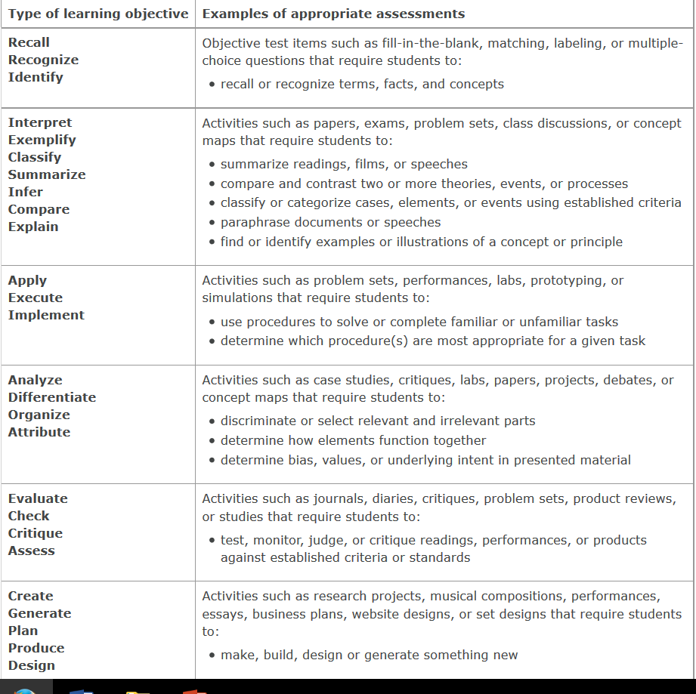

Slide 18

ORIGINAL COURSE LEARNING
OBJECTIVES
To know
To understand
To be aware of
To appreciate
To realize
To learn
To comprehend
To gain knowledge of
To be familiar with

Slide 19
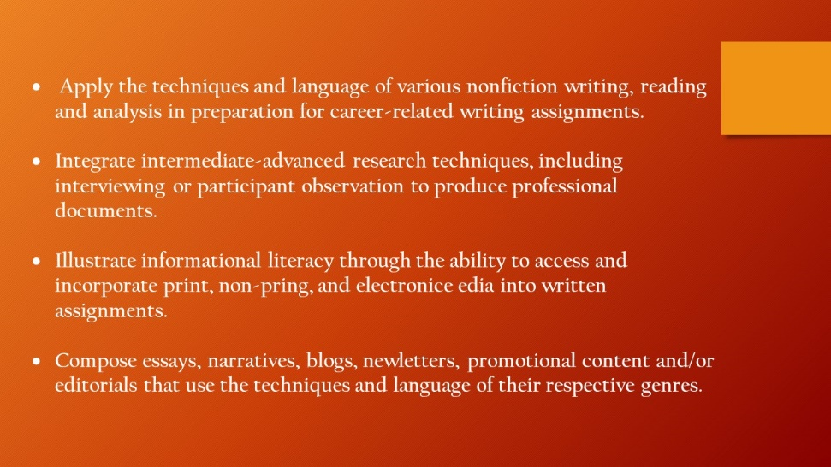
REVISED COURSE LEARNING
OBJECTIVES

Slide 20
ALIGNMENT PROCESS
GOALS
&
OBJECTIVES
INSTRUCTIONAL
STRATEGIES
ASSESSMENT

Slide 21
THE MATRIX

Slide 23

Backward Course Design

Slide 24
PLANNING
How does the design help:
Students to know what is expected and where the unit is going?
Hook all students and hold their interest?
Prepare them to experience key ideas and explore issues?
Provide opportunities to rethink and revise their understandings?
Allow them to evaluate their work and its implications?
Meet the needs, interests and abilities of learners?
Students organize to sustain engagement and effective learning?

Slide 25
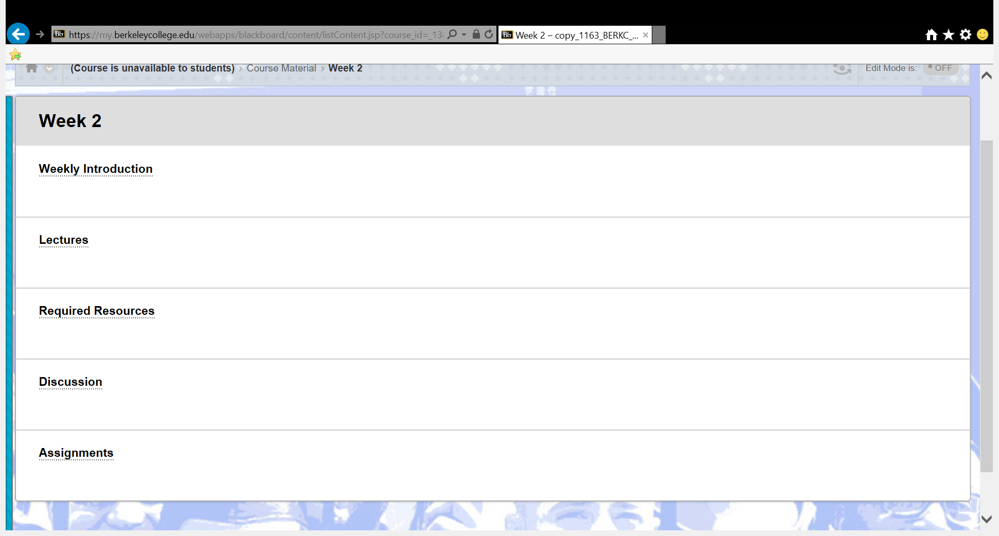
ORIGINAL COURSE

Slide 26
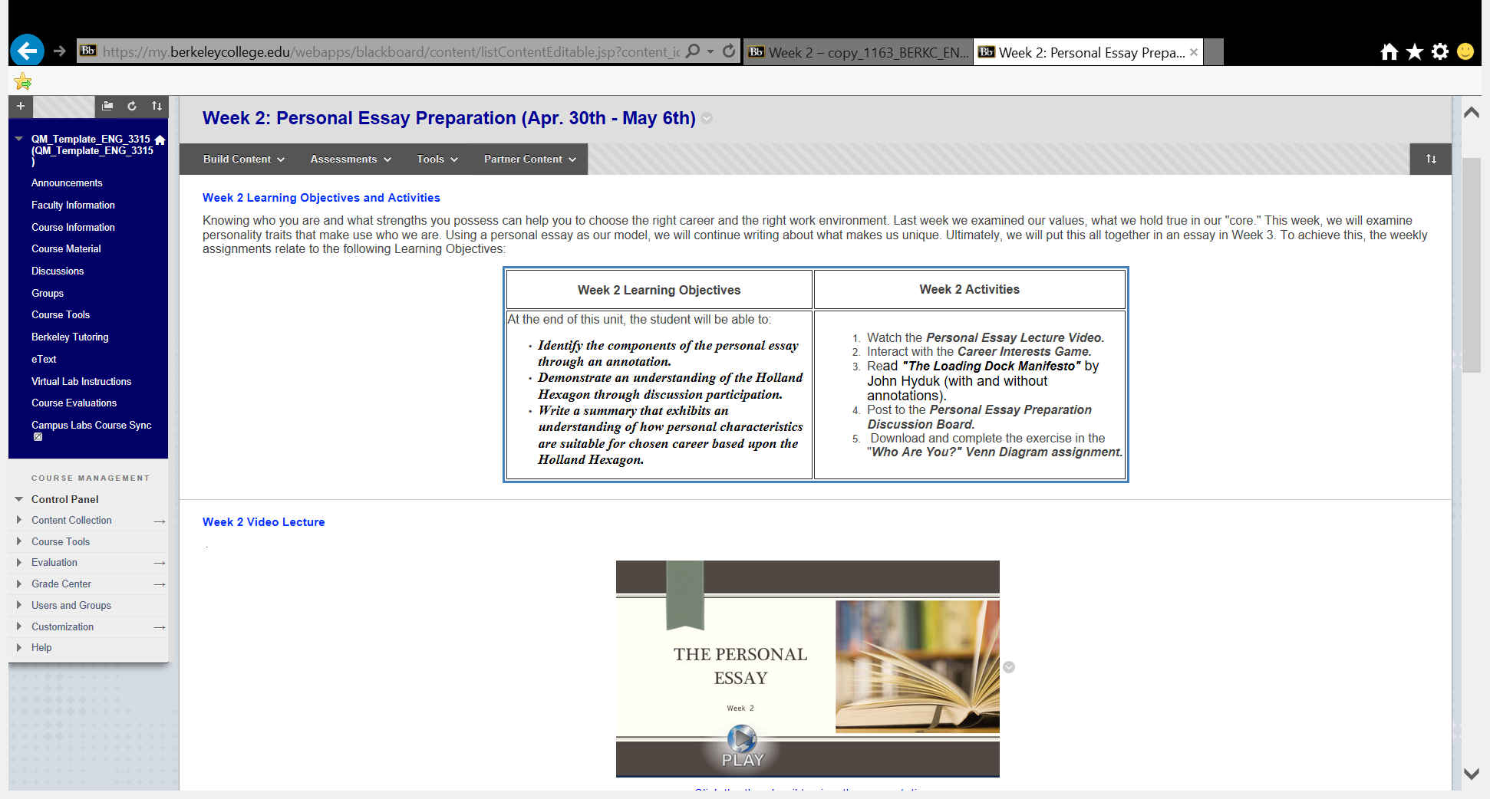
QM COURSE

Slide 27
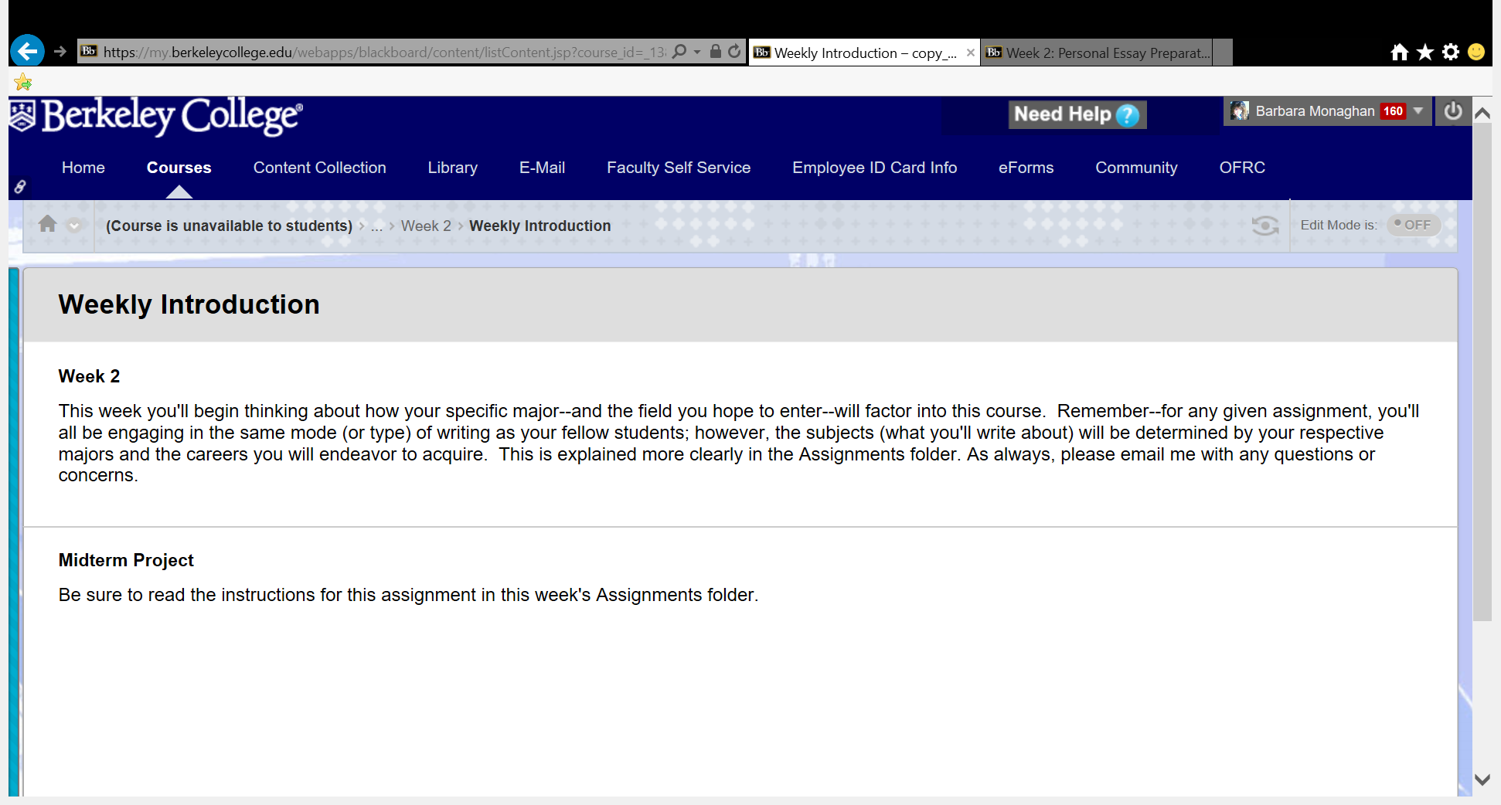
ORIGINAL COURSE

Slide 28
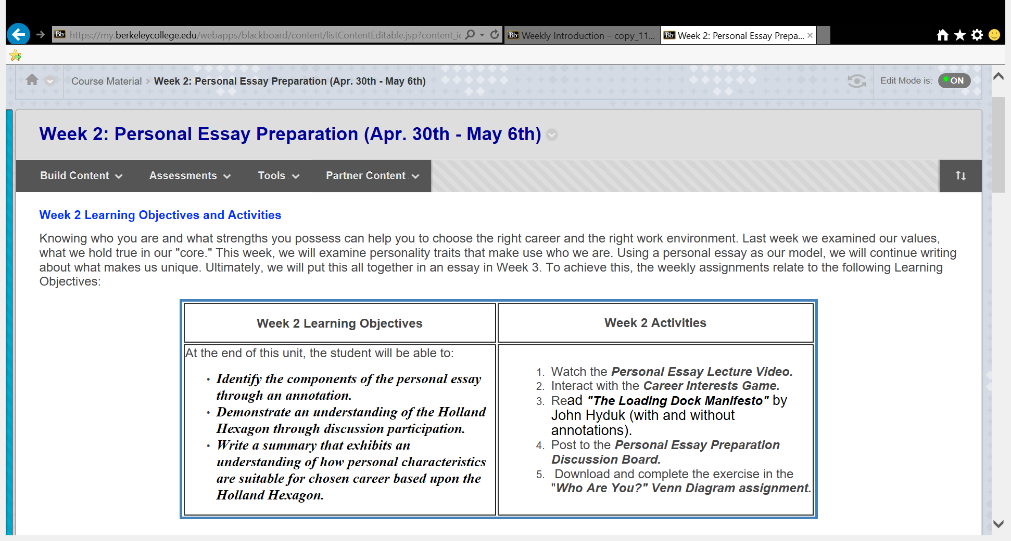
QM COURSE

Slide 29
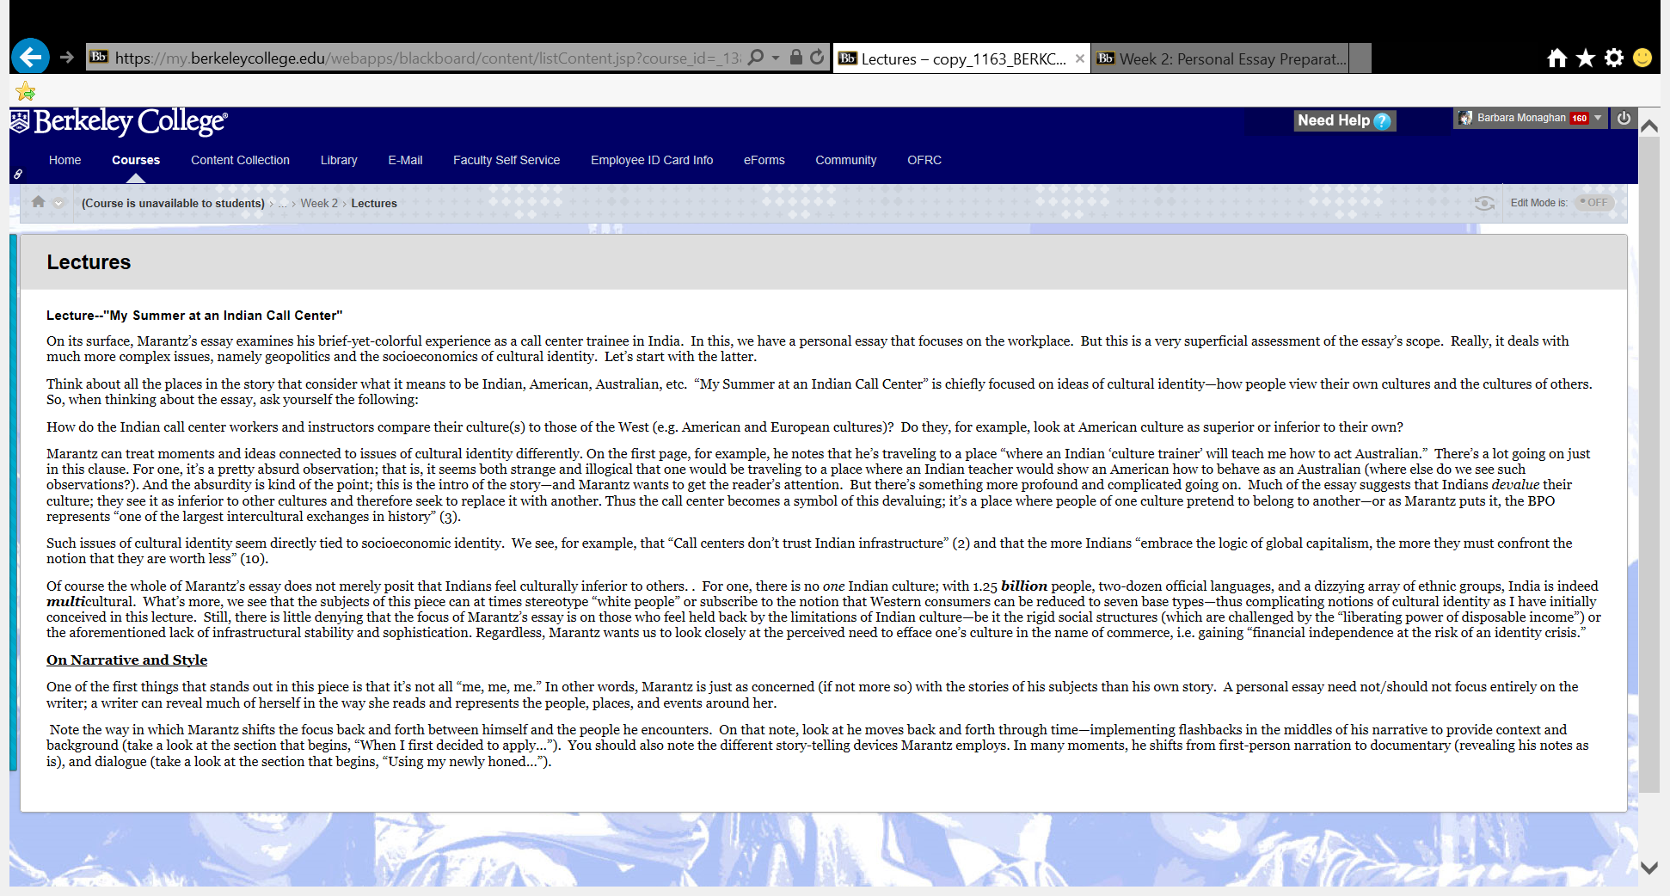
ORIGINAL COURSE

Slide 30

QM COURSE

Slide 31
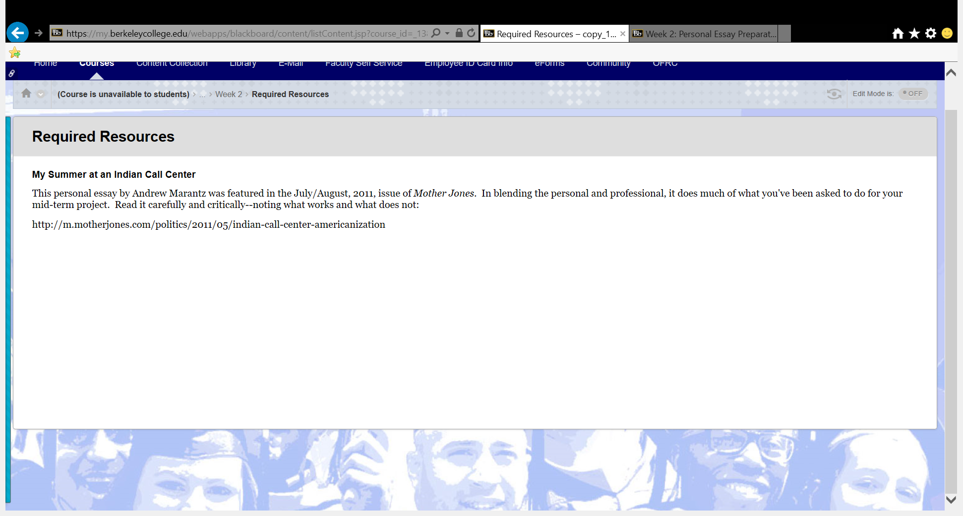
ORIGINAL COURSE

Slide 32
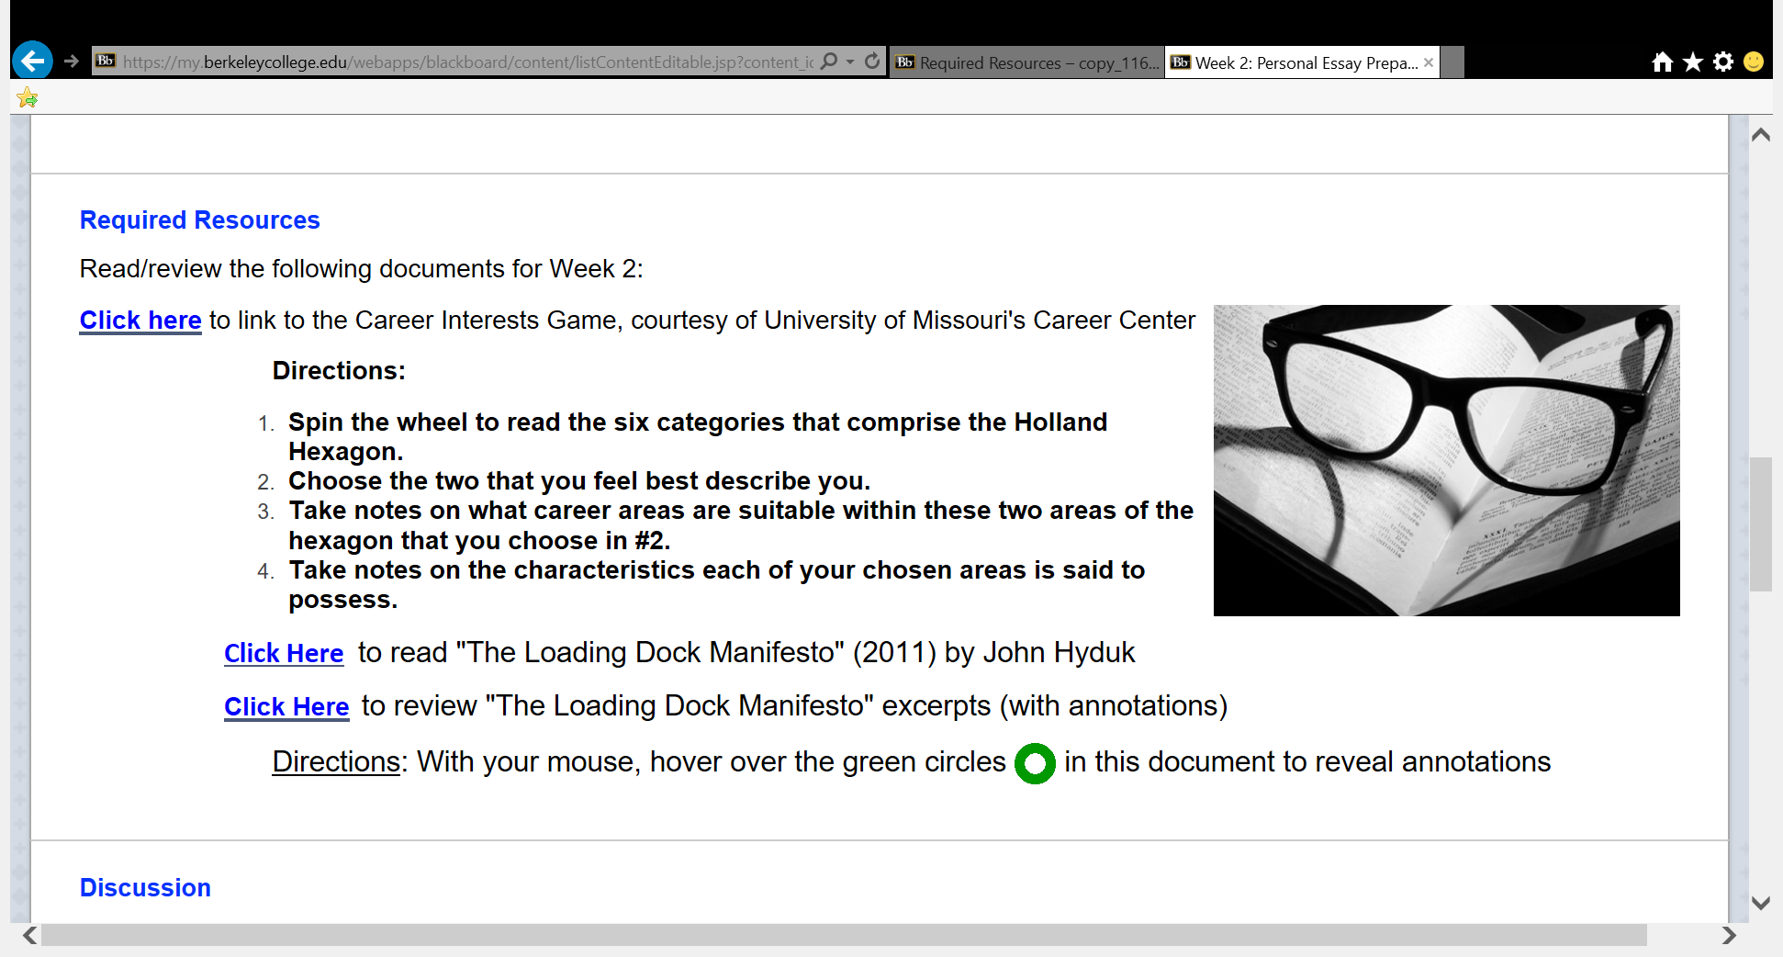
QM COURSE

Slide 33
ORIGINAL COURSE

Slide 34
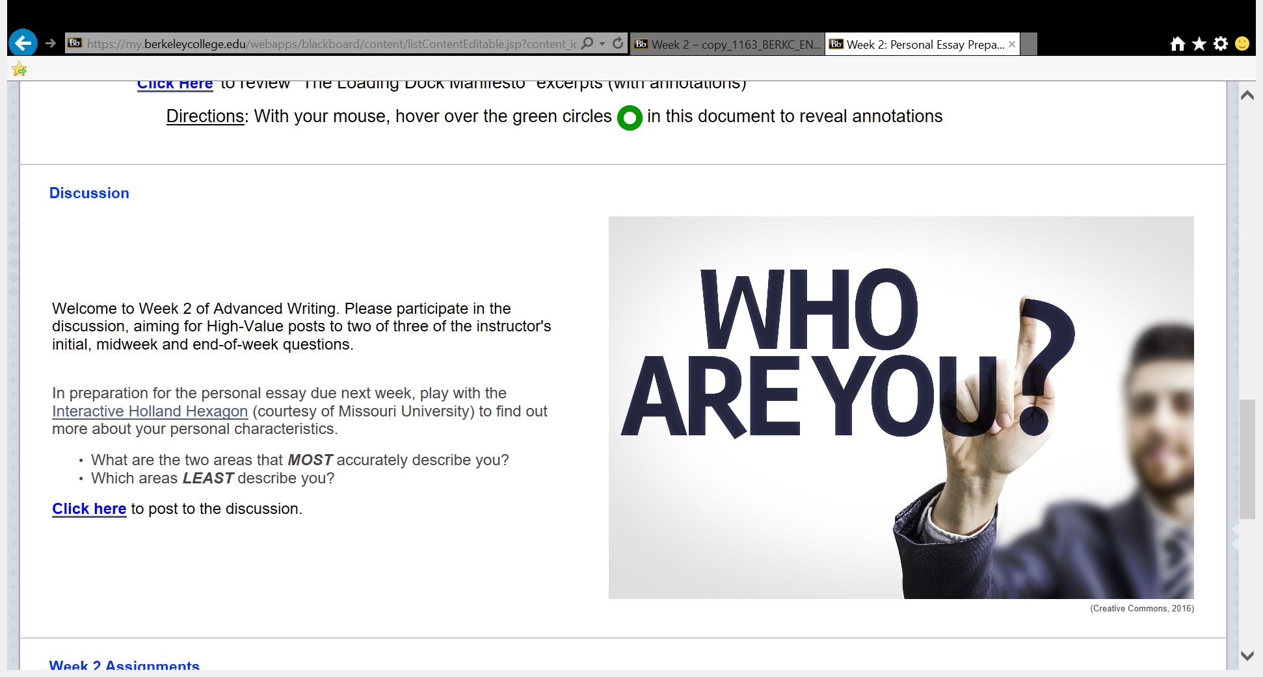
QM COURSE

Slide 35
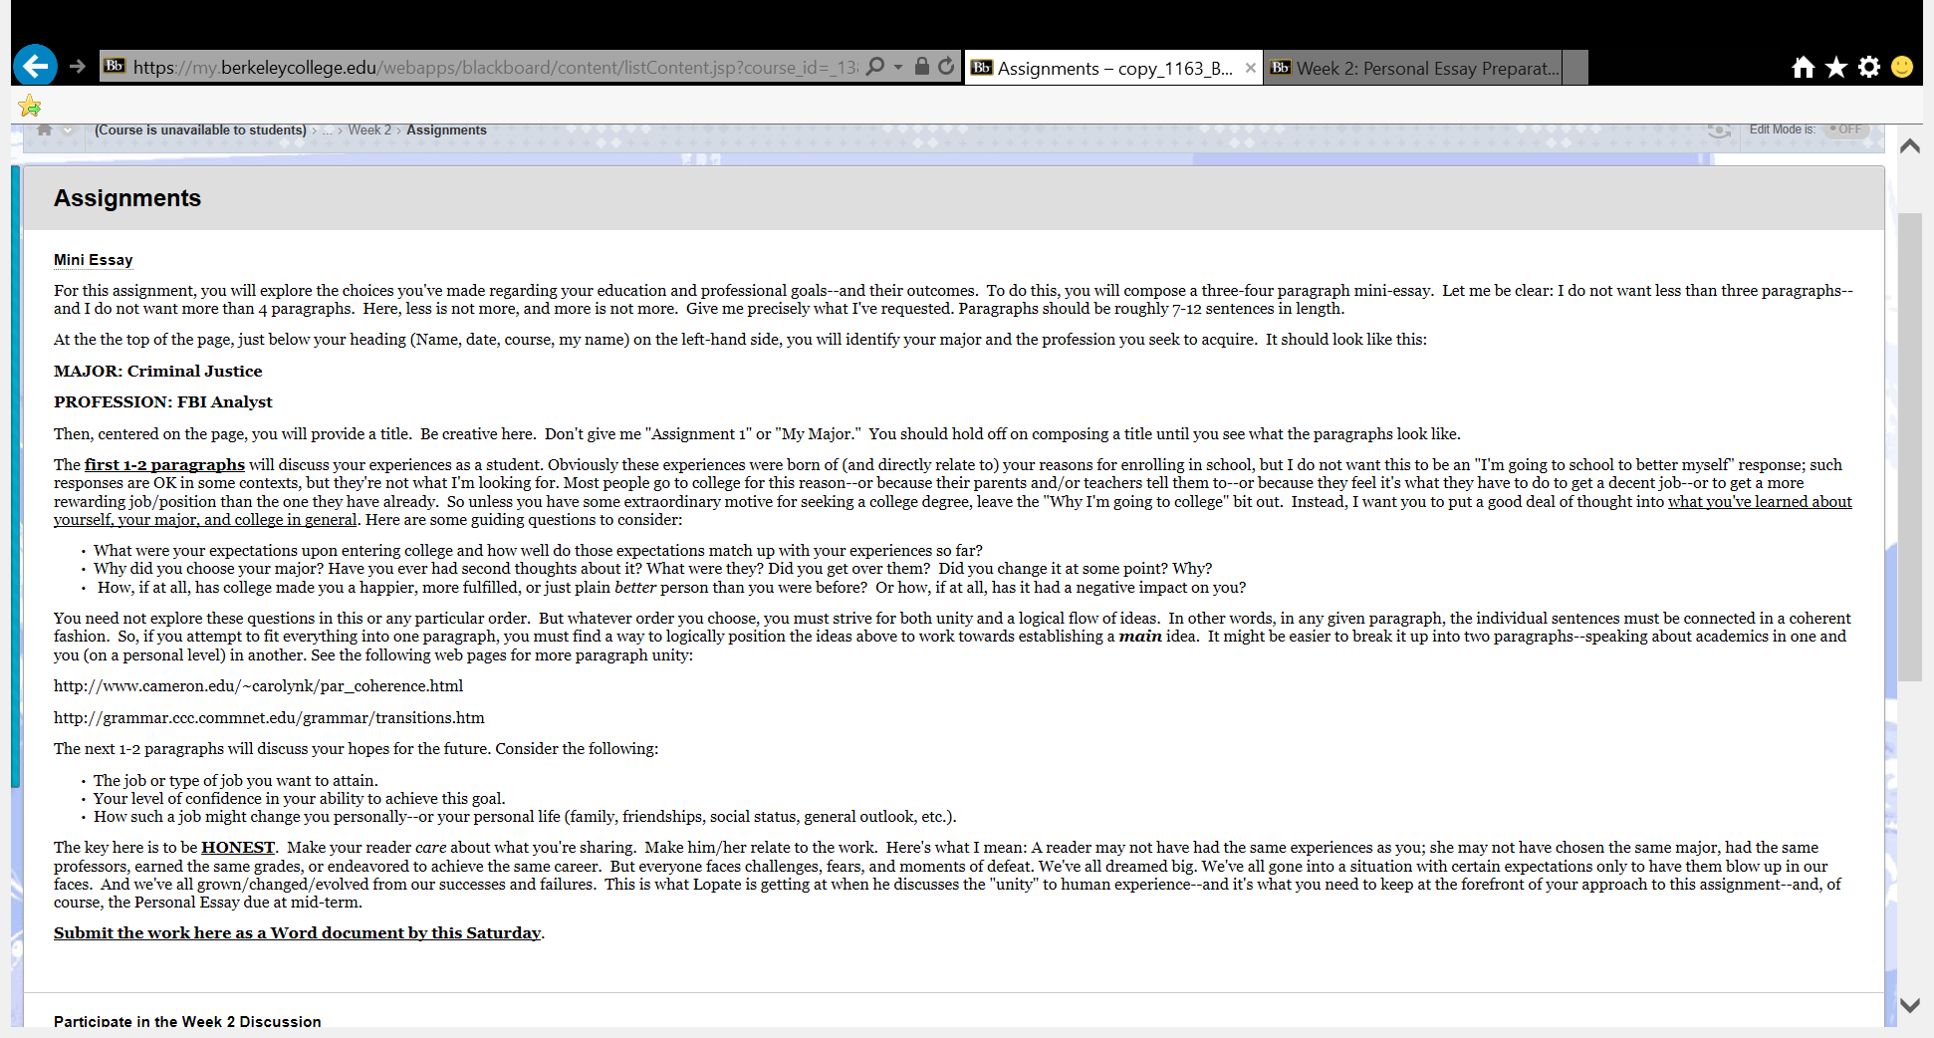
ORIGINAL COURSE

Slide 36
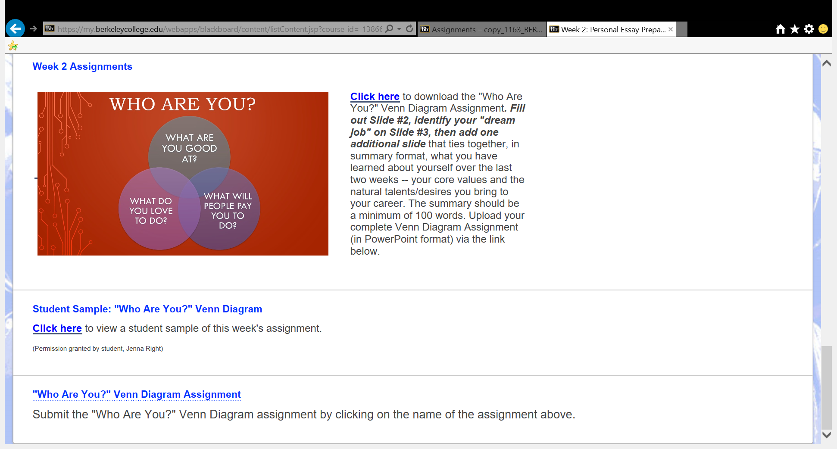
QM COURSE

Slide 37
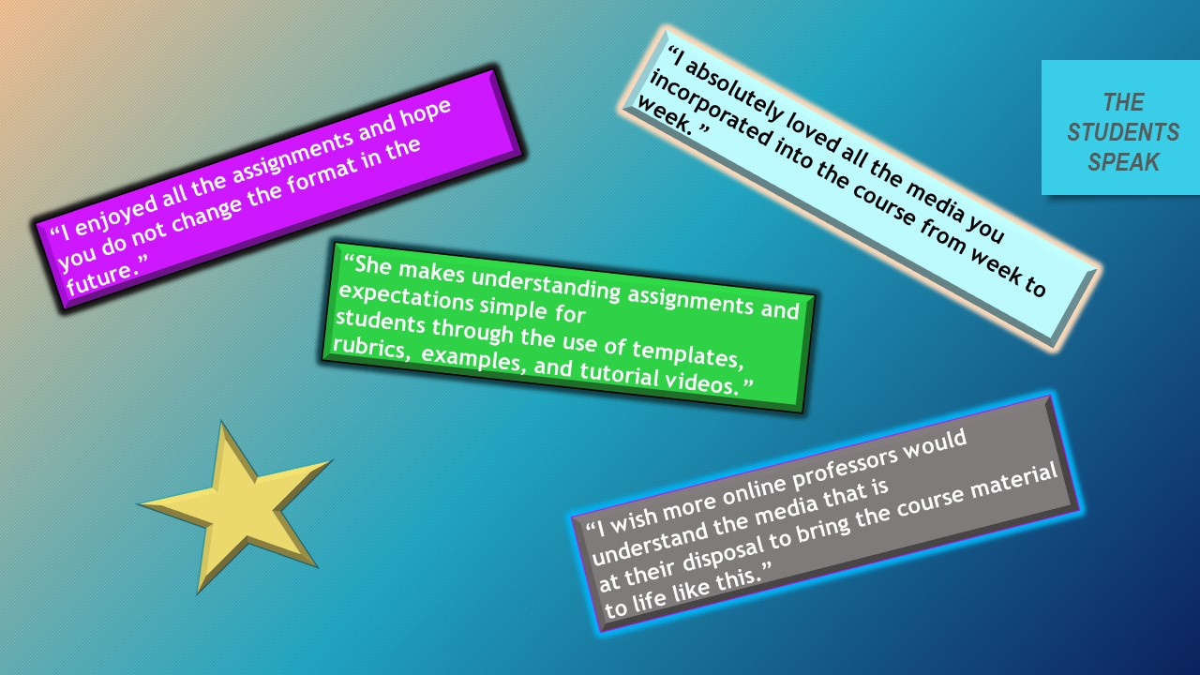
LESSONS
LEARNED
  Planning is key.
  Templates are required.
  Keep instructions general.
  Instructional strategies come before the technology.
  Revision is continuous and ongoing.
  Accumulate student samples
  Peer review is recommended.
  Repetition is good.
  STUDENTS FIRST!

Slide 38


Slide 39

CONTACTS
Roseann Torsiello: rtt@berkeley college.edu
Barbara Monaghan: bam@berkeleycollege.edu

Slide 40
Notes:
LiveSlide
https://teachonline.asu.edu/objectives-builder/

