Slide 1
Benefits of a Course Alignment Matrix: Avoid Ending up Someplace Else
Dr. Maria Christian,
Assistant Professor of Higher Education Leadership
Jerol Skinner,
Coordinator of Academic Services and Instructional Designer

Slide 2

Overview
Justification for NSU’s Online Educator Certificate Courses
Discussion of QM Standards 2, 3 and 4 Review of Revised Bloom’s Taxonomy
Introduction to the Course Alignment Matrix for objectives, assessment, and instructional materials
Source: https://mosaicprojects.wordpress.com/tag/pmo/
Notes:
Though the 5th edition QM Rubric (2014) is available, these courses were built using the Standards as presented in the QM 2011-2013 Rubric.

Slide 3
Justification
NSU’s Online Educator Certificate (2013) Policy
  Level 1: LMS training implemented 2013
  Level 2: Course Design implemented 2014
  Mentor & Course Reviewer: continuous improvement process implemented 2016
OSHRE - 3.16.5.A.1:
    Faculty should receive training and faculty development to achieve competency in the technology required for teaching at a distance.
NC-SARA & HLC expectations - Uses Council of Regional Accrediting Commissions’ (C-RAC) Interregional Guidelines for the Evaluation of Distance Education 2011:

Slide 4
Justification
3. Online Learning is incorporated into the institution’s
systems of governance and academic oversight
(MSCHE Standard 4).
    The institution’s faculty have a designated role in the design and implementation of its online learning offerings
    The institution ensures the rigor of the offerings and the quality of the instruction
    Approval of online courses and programs follows standard processes used in the college or university
    Online learning courses and programs are evaluated on a periodic basis

Slide 5
Justification
6. Faculty responsible for delivering the online learning
curricula and evaluating the students’ success in
achieving the online learning goals are appropriately
qualified and effectively supported.
  Online learning faculties are carefully selected, appropriately trained, frequently evaluated, and are marked by an acceptable level of turnover
  The institution’s training program for online learning faculty is periodic, incorporates tested good practices in online learning pedagogy, and ensures competency with the range of software products used by the institution
  Faculty are proficient and effectively supported in using the course management system
  Faculty members engaged in online learning share in the mission and goals of the institution and its programs and are provided the opportunities to contribute to the broader activities of the institution

Slide 6





Online Educator Courses (OEC 1, OEC 2, ROC)
Dr. Sophia Sweeney, Assistant Professor Teacher Education
Jerol Skinner, Coordinator of Academic Services (Center for Teaching and Learning)
Rick Shelton, Coordinator of Academic Services (Center for Teaching and Learning)
Chad McLane, Director of Center for Teaching and Learning

Slide 7
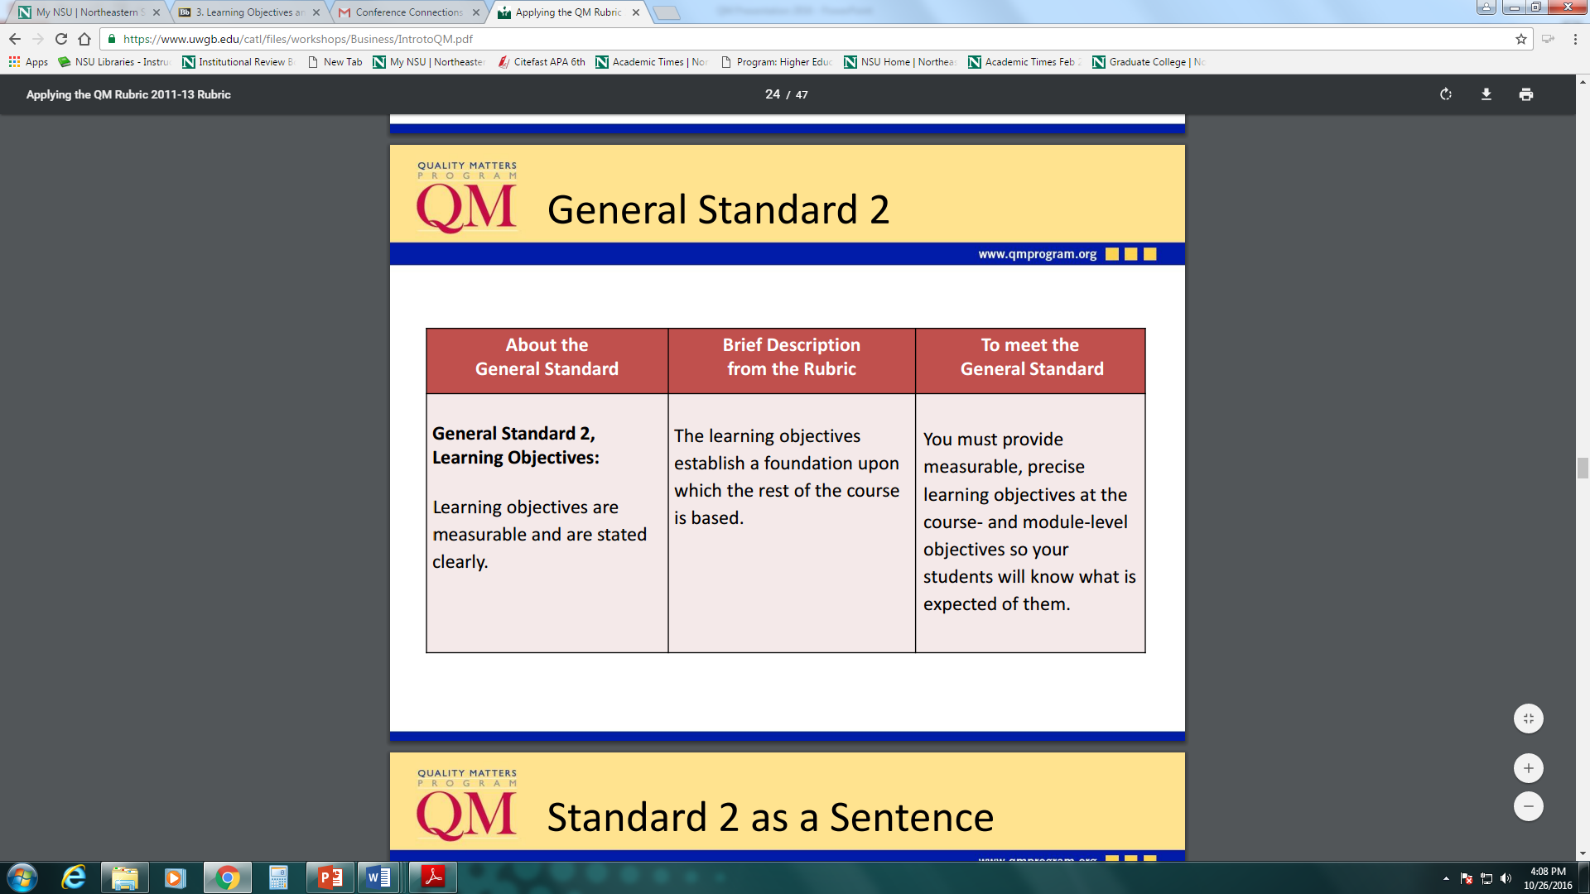
Source: Applying the QM Rubric 2011-2013, Quality Matters Workshop pdf

Slide 8
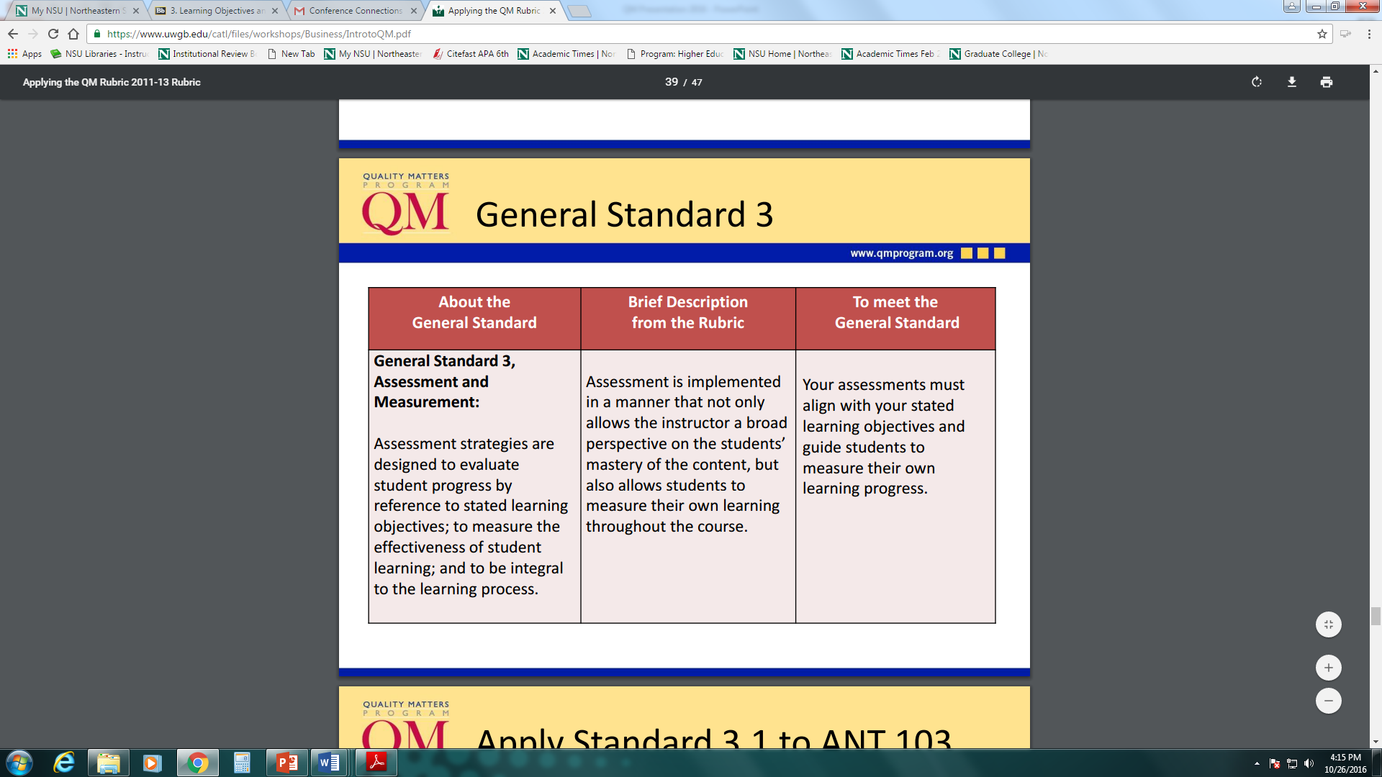
Source: Applying the QM Rubric 2011-2013, Quality Matters Workshop pdf

Slide 9
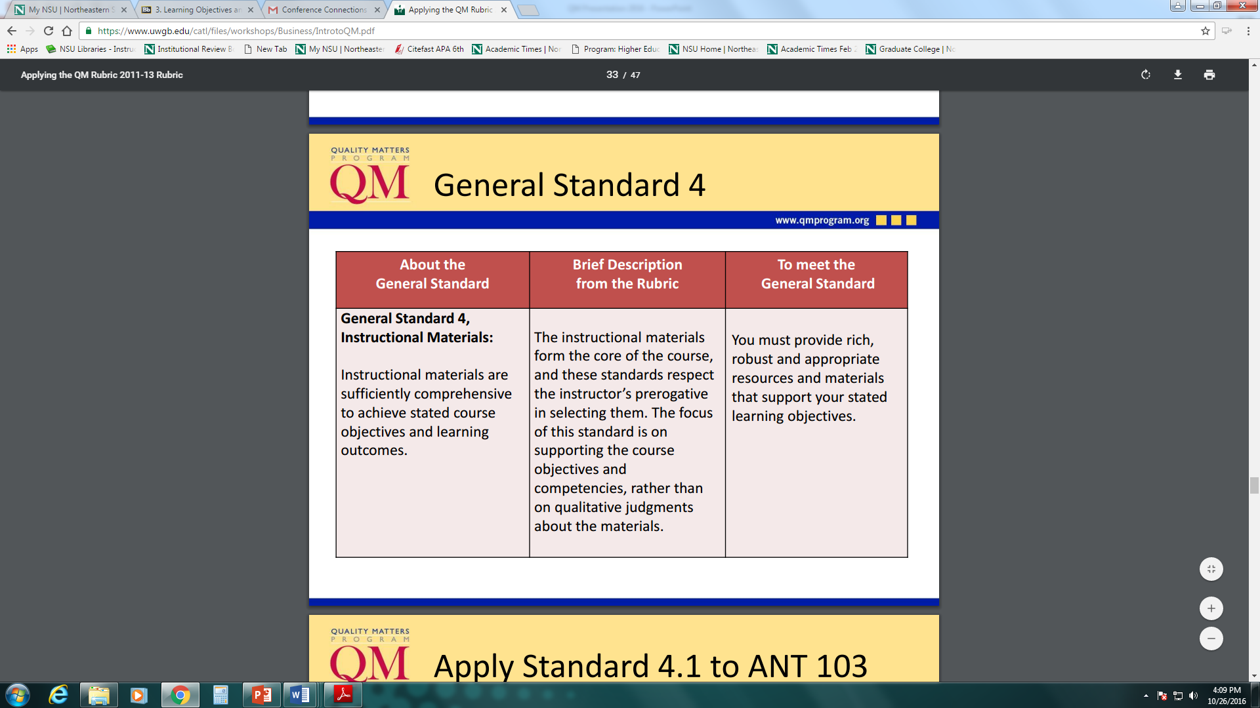
Source: Applying the QM Rubric 2011-2013, Quality Matters Workshop pdf

Slide 10
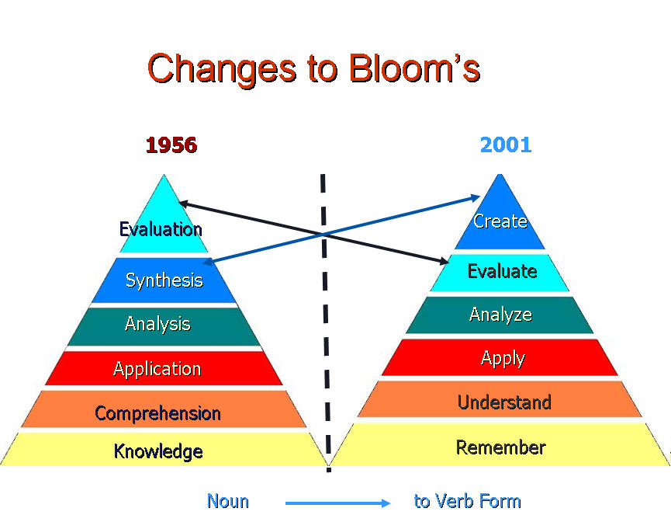
Before we can understand a concept, we have to remember it
Before we can apply the concept, we must understand it
Before we analyze it, we must be able to apply it
Before we can evaluate its impact, we must have analyzed it
Before we can create, we must have remembered, understood, applied, analyzed, and evaluated (OEC 2, 2015).

Slide 11
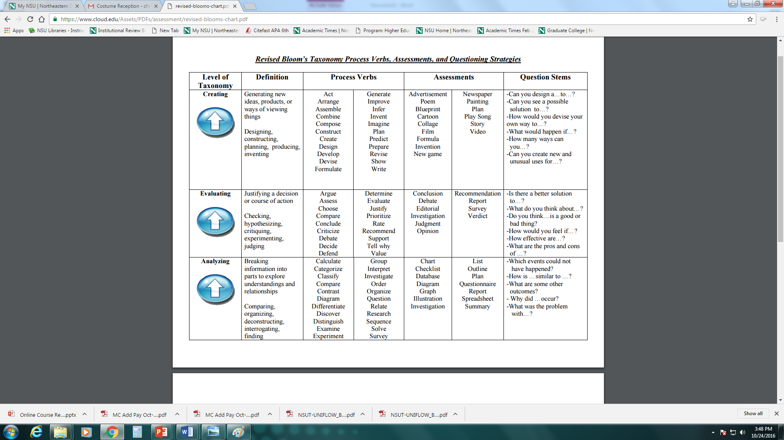

Slide 12
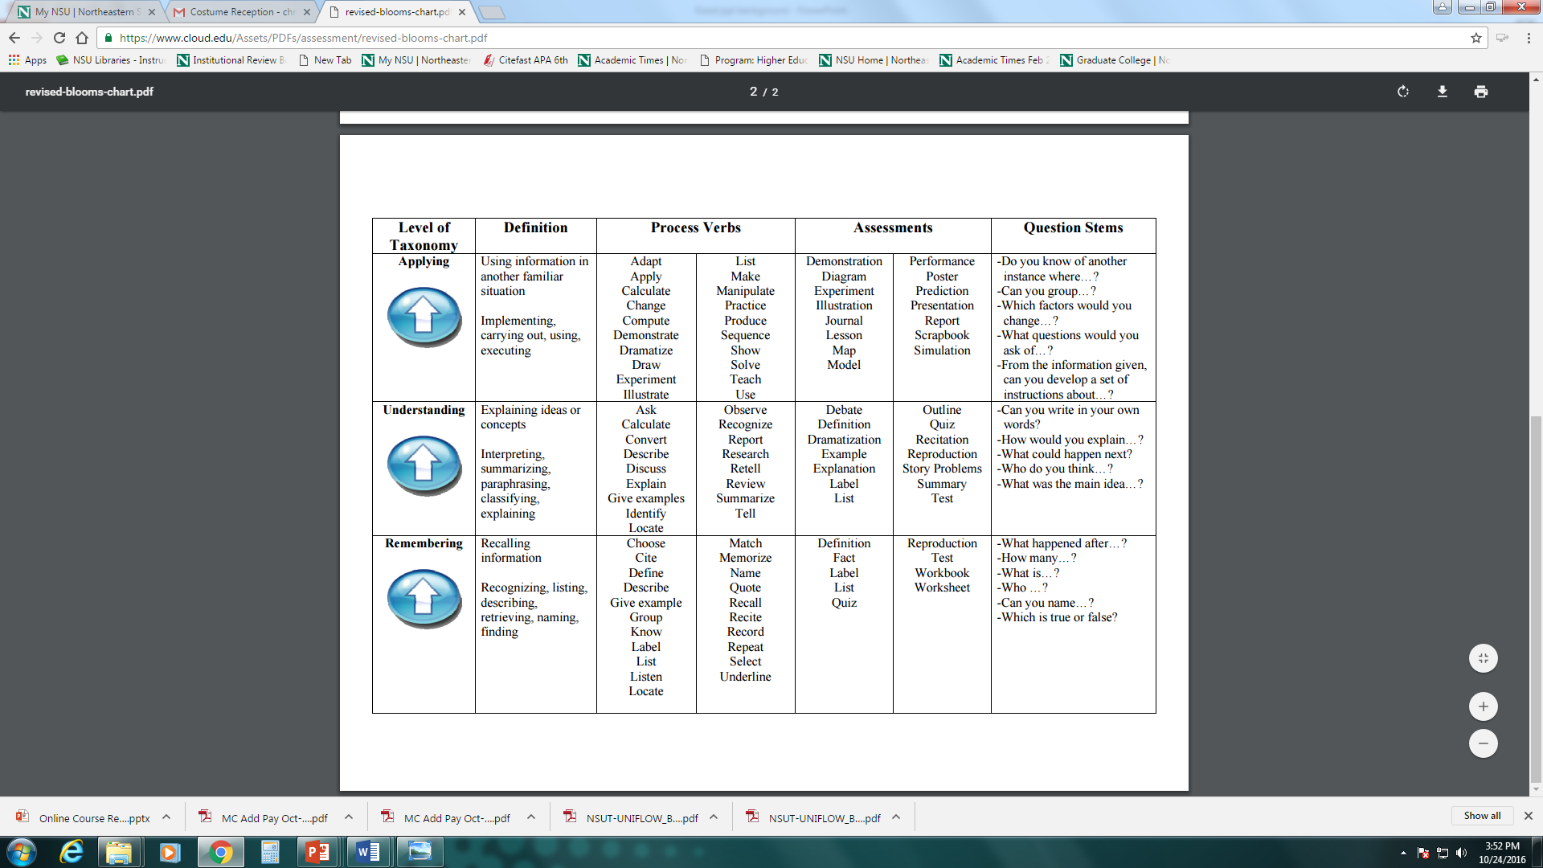

Slide 13
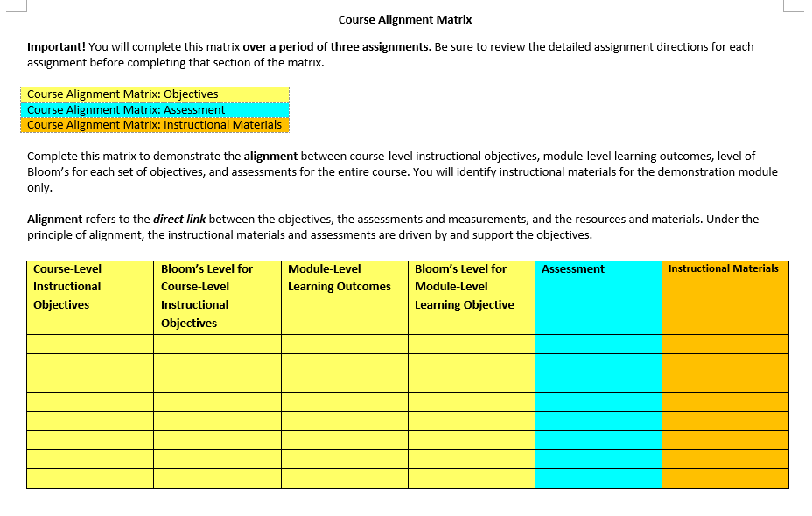

Slide 14
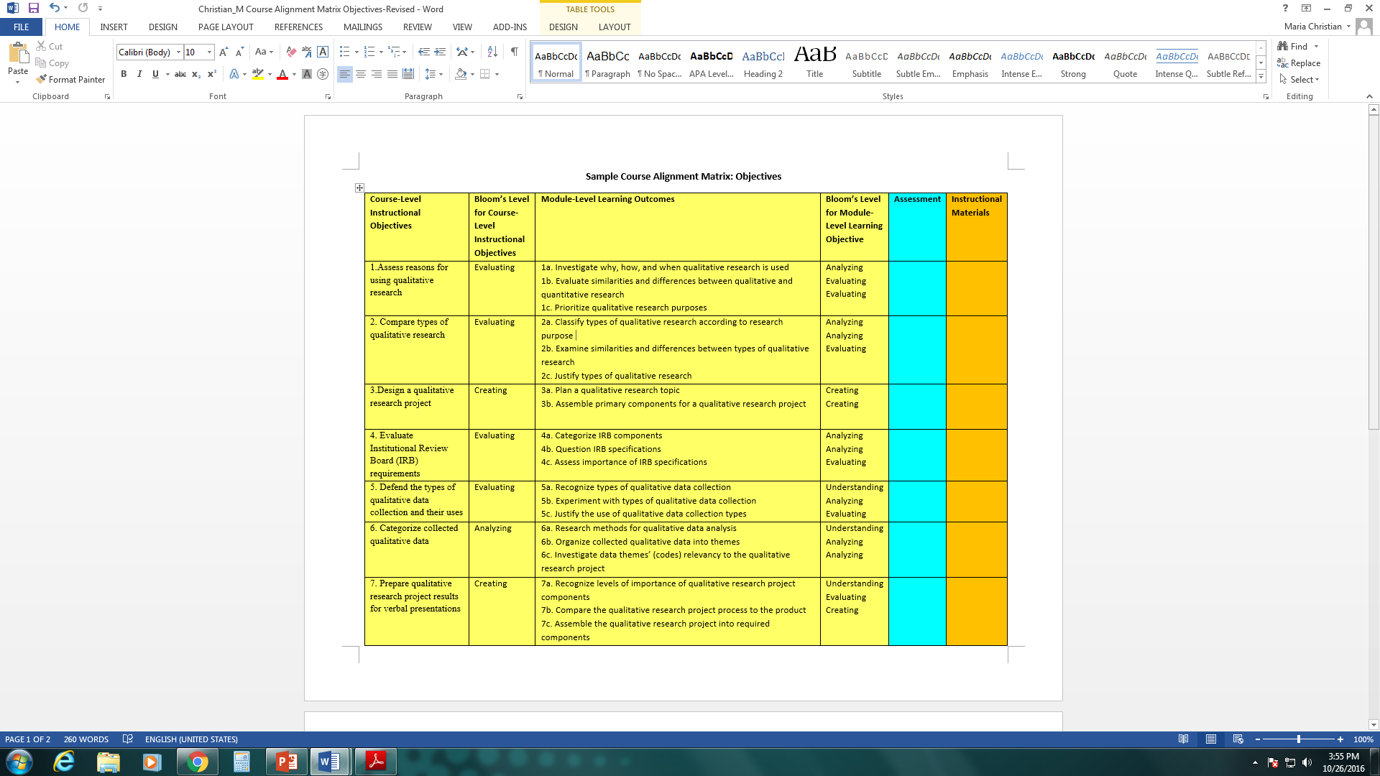

Slide 15
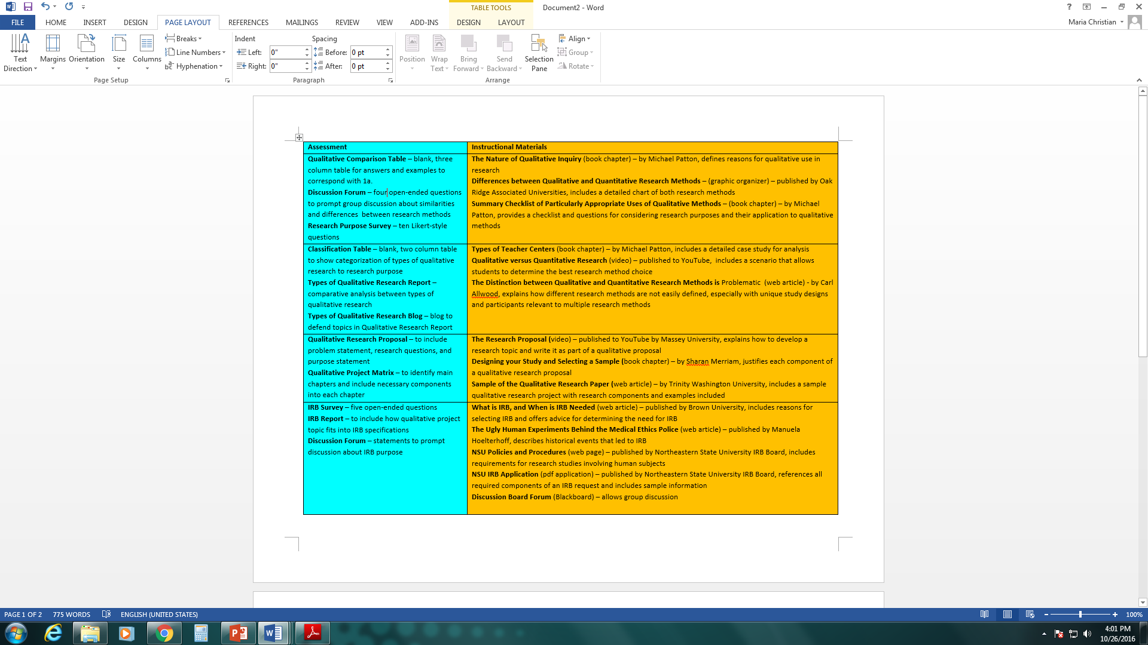

Slide 16

Clear direction is good
Notes:
"Yogi" Berra lived from 1925 until 2015. He was an American professional baseball player who played 19 seasons in Major League Baseball for the New York Yankees.

Slide 17
Questions and Comments?
Maria Christian, Ed.D. P: 918-449-6522
Assistant Professor of Higher christ32@nsuok.edu
Education Leadership
Department of Educational Leadership
________________________________________________________
3100 E. New Orleans
Broken Arrow, OK 74014 www.nsuok.edu
Jerol Skinner P: 918-444-5851
Coordinator Of Academic Services, skinnerj@nsuok.edu
Instructional Designer
Center for Teaching and Learning
__________________________________________________
W. Roger Webb Educational Technology Center 618
Tahlequah, OK 74464 www.nsuok.edu

