Slide 1

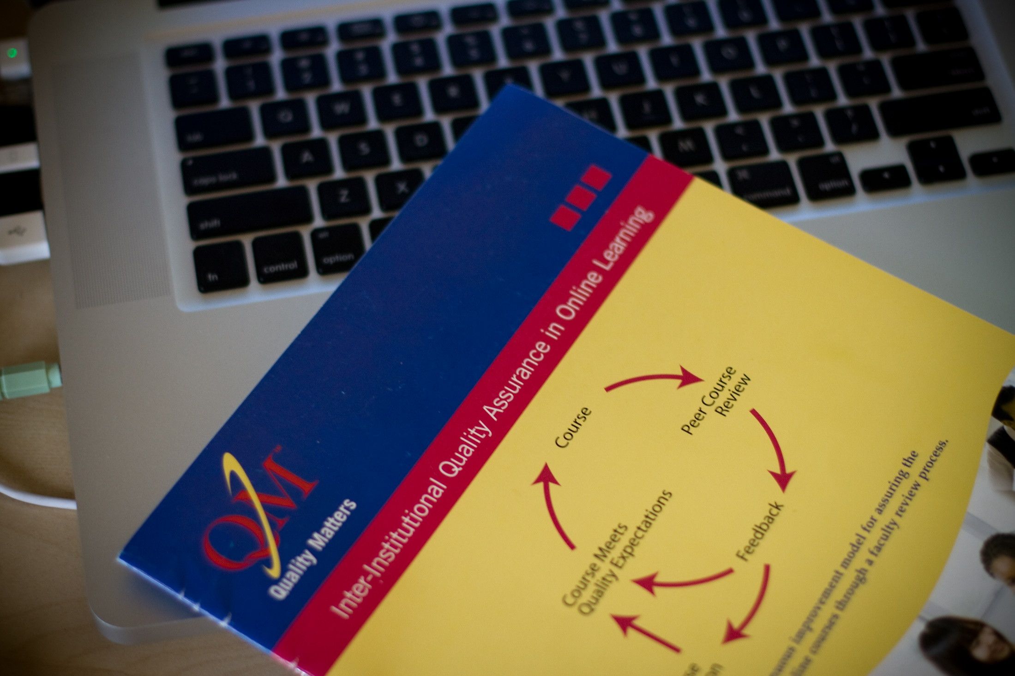
Beyond APPQMR
Providing Customized Training on Quality Online Design and Delivery

Slide 2




Presenters
Stephanie Richter
Assistant Director
srichter@niu.edu
@slrichter
Tracy Miller
Online Teaching Coordinator
tracy.miller@niu.edu
@TracyMiller256
Connect with Online Program Development & Support
@niuopds
facebook.com/niuopds

Slide 3
Session Objectives
Discuss factors affecting professional development planning
Discuss factors that impact institutional culture/acceptance of QM and how professional development can increase adoption
Distinguish between learning about the QM Rubric and process from learning about online course design and delivery

Slide 4

Background of NIU & QM Implementation
Mid-sized, Public, 4 Year Institution
QM implementation began Sept, 2014
Coordinated effort of the Online Program Development & Support Office

Slide 5
First APPQMR Nov, 2014
Outside presenter, Face-to-Face
Participants from Faculty Development & Instructional Design Center, eLearning Services, OPDS, and key faculty
Faculty were overwhelmed, didn't know how to get started with creating courses

Slide 6
Factors affecting our professional development planning
Faculty needed more time to understand each of the standards
Faculty needed examples of the standards in action to implement them into their own courses
Faculty needed more support so they would not feel overwhelmed
Faculty needed development opportunities for online teaching / delivery
Notes:
Faculty still didn’t understand what the standards were - QOC
How to implement them in their course – Design Academy
Faculty didn’t feel supported, overwhelmed by the level work they’d have to do. – Online Teaching Circle
Can’t attend all day – QOC and Informal Training
APPQMR is not the best introduction to QM
Doesn’t fit our culture
It’s long
It doesn’t get at the why we want to do this
Doesn’t connect personally to faculty
They still worry about the teaching /delivery side

Slide 7
Factors that impact institutional acceptance of QM
APPQMR is not the best introduction to a system of quality standards
  Questions about why we are adopting quality standards and why that is important to me
Full-day training is a big time commitment
Program Prioritization at NIU is leading to fatigue around new initiatives and assessments

Slide 8
Professional Development Plan

Slide 9
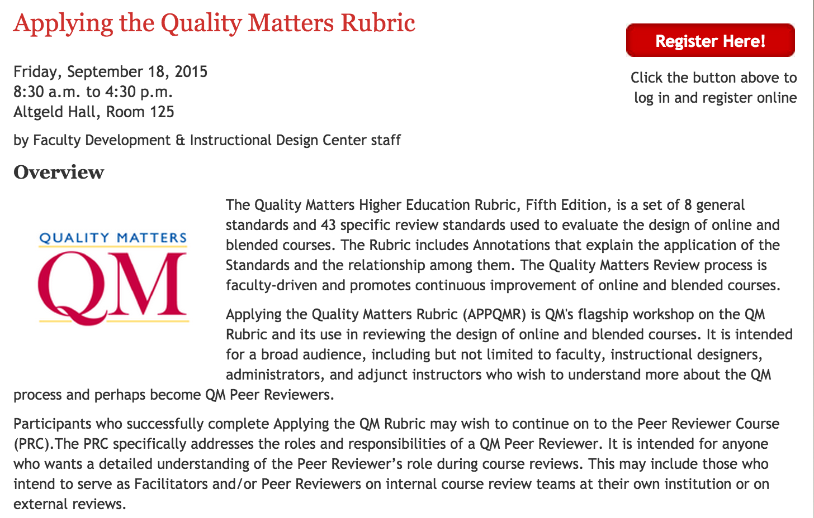
Applying the QM Rubric
5x / year
Initially invite only
Notes:
2 spring, 1 summer, 2 fall

Slide 10

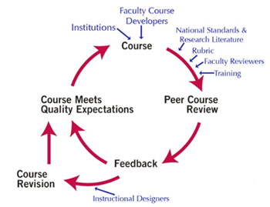
Peer Review Course
Paid for by OPDS
Encouraged to all faculty who attended APPQMR
Notes:
Paid for by OPDS
Encouraged to all faculty who attended APPQMR

Slide 11
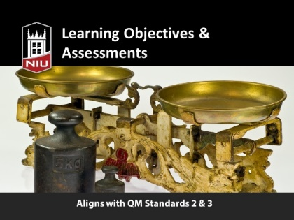
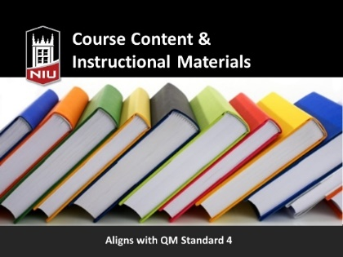

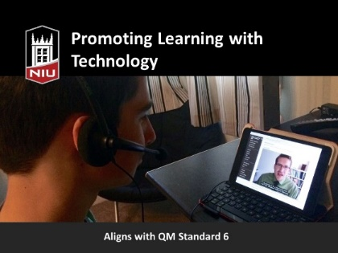
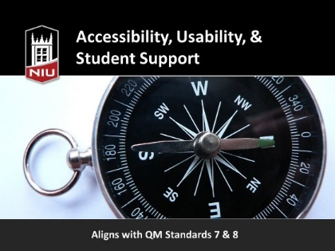
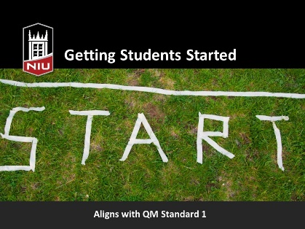
Quality Online Course Series
  Purpose: deeper discussion of actual standards
Notes:
Attributes
Online workshops, 1-2 general standards each, 1 overview of QM
Standard 1 was last
Recorded them to have an archive
7 sessions delivered over 4 months
Repeating for 2015-16, 1 per month

Slide 12
Informal Rubric & Reviewer training
Title | Length | Format | Content | Prerequisite
Implementing Quality in an Online Course | 3 hours | Face-to-face | The Quality Matters rubric, the process of a review, and conducting a self-review | None
Reviewing for Quality at NIU | 3 hours | Face-to-face | The review process, examples of courses and implementation, and providing helpful feedback | Extensive familiarity with QM standards
  Purpose: increase internal capacity for course development & review
Notes:
Alternative to APPQMR for those who aren't going forward with QM PRC
Half-day each

Slide 13
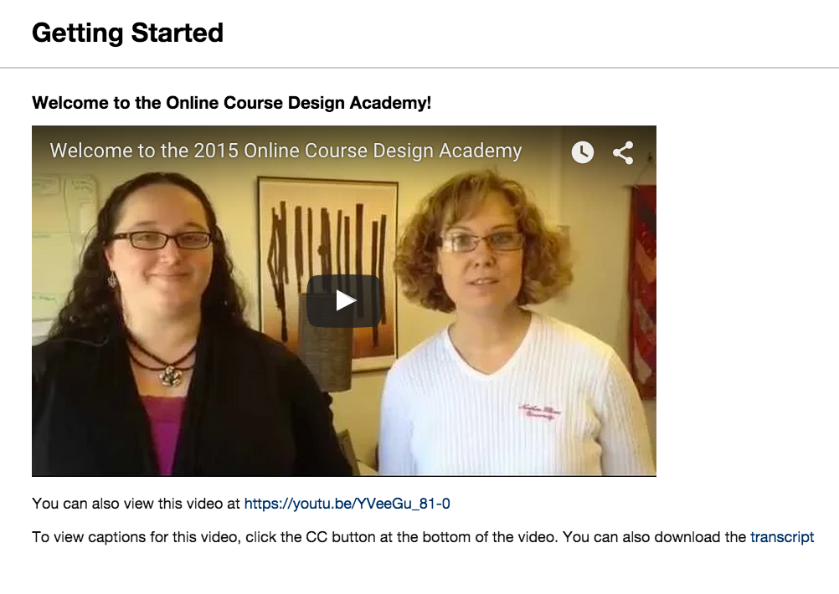

Online Course Design Academy
  Purpose: provide an intensive online experience & introduction to course design principles and practices
Notes:
Online Course Design Academy
Purpose: intensive online learning experience & introduction to course design principles & practices
Summer, 6 weeks
Attended APPQMR after the Academy
Aligned with QM standards
Invite only
Stipended

Slide 14
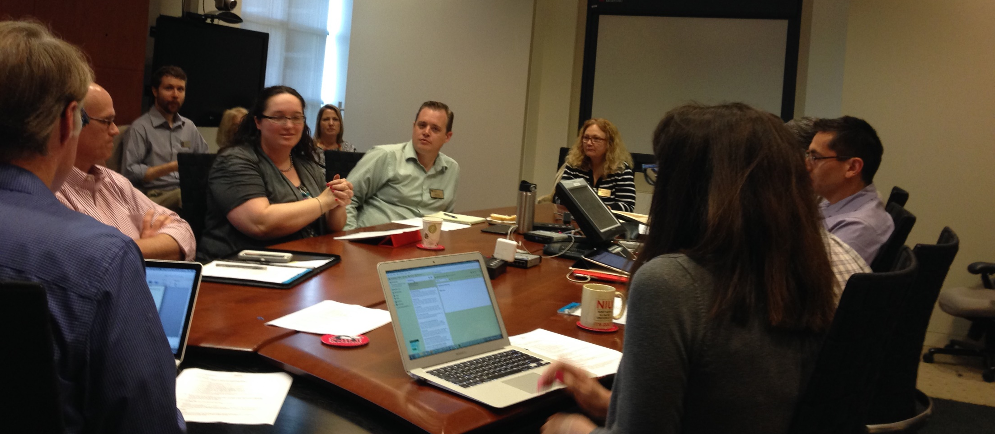
Online Teaching Circle
  Purpose: connect faculty with one another and build an institutional fund of knowledge around online teaching
Notes:
Factor which would influence cultural acceptance around QM
Monthly informal meetings
Groups would set topics and format
Envisioned sharing examples of course design, providing feedback on course design, inviting speakers on particular online teaching topics

Slide 15
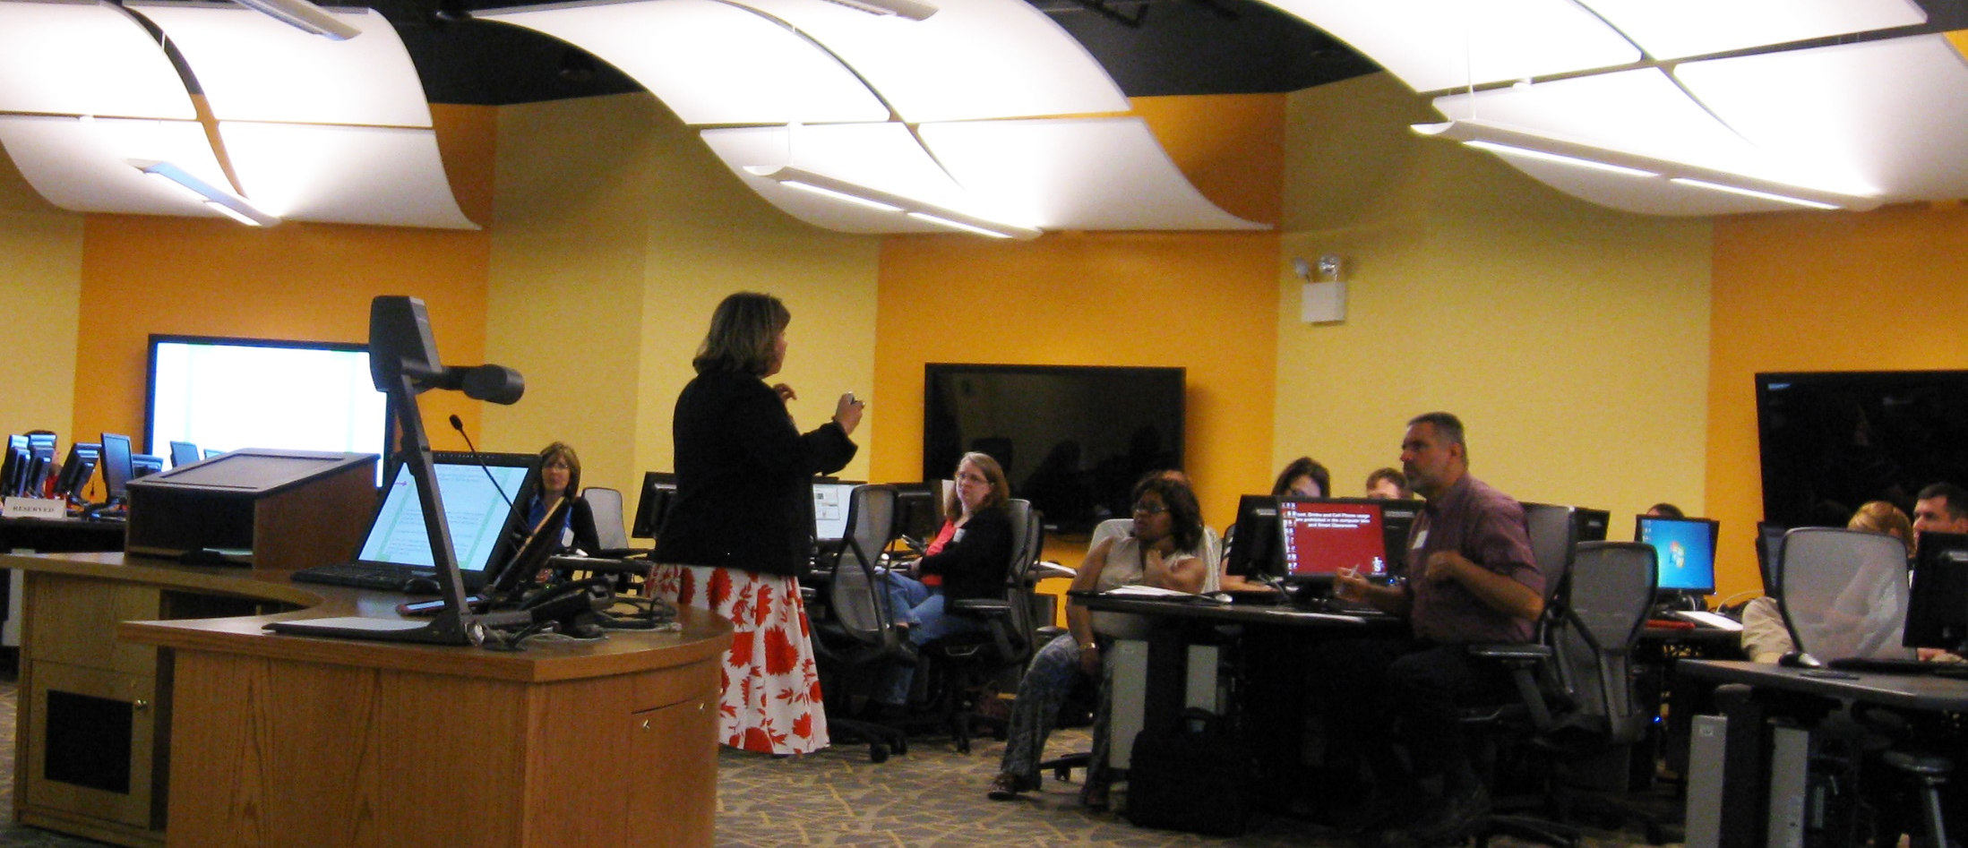
Online Teaching Conference
  Purpose: facilitate sharing of best practices and recognize achievement
Notes:
Primarily for NIU faculty
2-3 years into OPDS
Faculty and instructional designer presentations

Slide 16
Outcomes

Slide 17
APPQMR & Peer Review Course
APPQMR
4 Internally-led Workshops
36 Participants
PRC
1 Faculty member completed
  ~5 more interested
Notes:
While every response was positive from confidence in what they learned to satisfaction with the workshop with the majority strongly agreeing. Two areas were lower in confidence by only agreeing.
26 responses
2/24 - 10
4/15 - 9
7/9 - 11
9/18 - 6

Slide 18
APPQMR & Peer Review Course
The workshop was effective in introducing me to the QM Rubric
84% Strongly Agreed – 16% Agreed
I can define alignment and explain why it is critical to course design
50% Strongly Agreed – 50% Agreed
I can apply standards from the 5th Edition QM Rubric to review online courses
46% Strongly Agreed – 54% Agreed
Notes:
While every response was positive from confidence in what they learned to satisfaction with the workshop with the majority strongly agreeing. Two areas were lower in confidence by only agreeing.
26 responses
2/24 - 10
4/15 - 9
7/9 - 11
9/18 - 6

Slide 19
APPQMR & Peer Review Course
What information, activity, or other aspect(s) of this workshop was most useful to you?
“The alignment elements of the standards was very helpful.”
“Writing the recommendations was the most useful to me.”
Notes:
While every response was positive from confidence in what they learned to satisfaction with the workshop with the majority strongly agreeing. Two areas were lower in confidence by only agreeing.
26 responses
2/24 - 10
4/15 - 9
7/9 - 11
9/18 - 6

Slide 20
Quality Online Course Series
The concepts/techniques covered in this program are applicable in my teaching or other student-related activities | Strongly Agree/Agree | 100%
My participation in this program has potential benefit to students | Strongly Agree/Agree | 100%
9 Sessions
61 participants
146 views on YouTube Playlist
Notes:
9 sessions
61 of participants
Playlist 146 Views of YouTube

Slide 21
Online Course Design Academy
6 faculty completed
“I loved interacting with other faculty, and learn from others, and think about others’ problems in online courses.”
“. . .it is imperative that I am able to help students understand why content is relevant to them allowing them to develop a greater understanding of the content. Won’t only help my online teaching, my offline teaching as well.”
“learning the structures to meet the expectations of QM (thanks for that!).”
Notes:
OCDA
6 people completed
Eval results
Idea 1
Idea 2
Be organized
Be proactive
Keep everything consistent within each module
Make sure all material is accessible to students, including videos
Directly aligning the class content with learning objectives
Using discussion boards to foster community for the class
The particular alignment format used in the Academy will help to get QM approval for the course.
A variety of methods can be used to teach online
I can do this!! I can do better than before!
I learned how to organize the module better

Slide 22
Online Course Design Academy
Idea 1 | Idea 2
Be organized | Be proactive
Keep everything consistent within each module | Make sure all material is accessible to students, including videos
Directly aligning the class content with learning objectives | Using discussion boards to foster community for the class
The particular alignment format used in the Academy will help to get QM approval for the course. | A variety of methods can be used to teach online
I can do this!! I can do better than before! | I learned how to organize the module better
Notes:
OCDA
6 people completed
Eval results
Idea 1
Idea 2
Be organized
Be proactive
Keep everything consistent within each module
Make sure all material is accessible to students, including videos
Directly aligning the class content with learning objectives
Using discussion boards to foster community for the class
The particular alignment format used in the Academy will help to get QM approval for the course.
A variety of methods can be used to teach online
I can do this!! I can do better than before!
I learned how to organize the module better

Slide 23
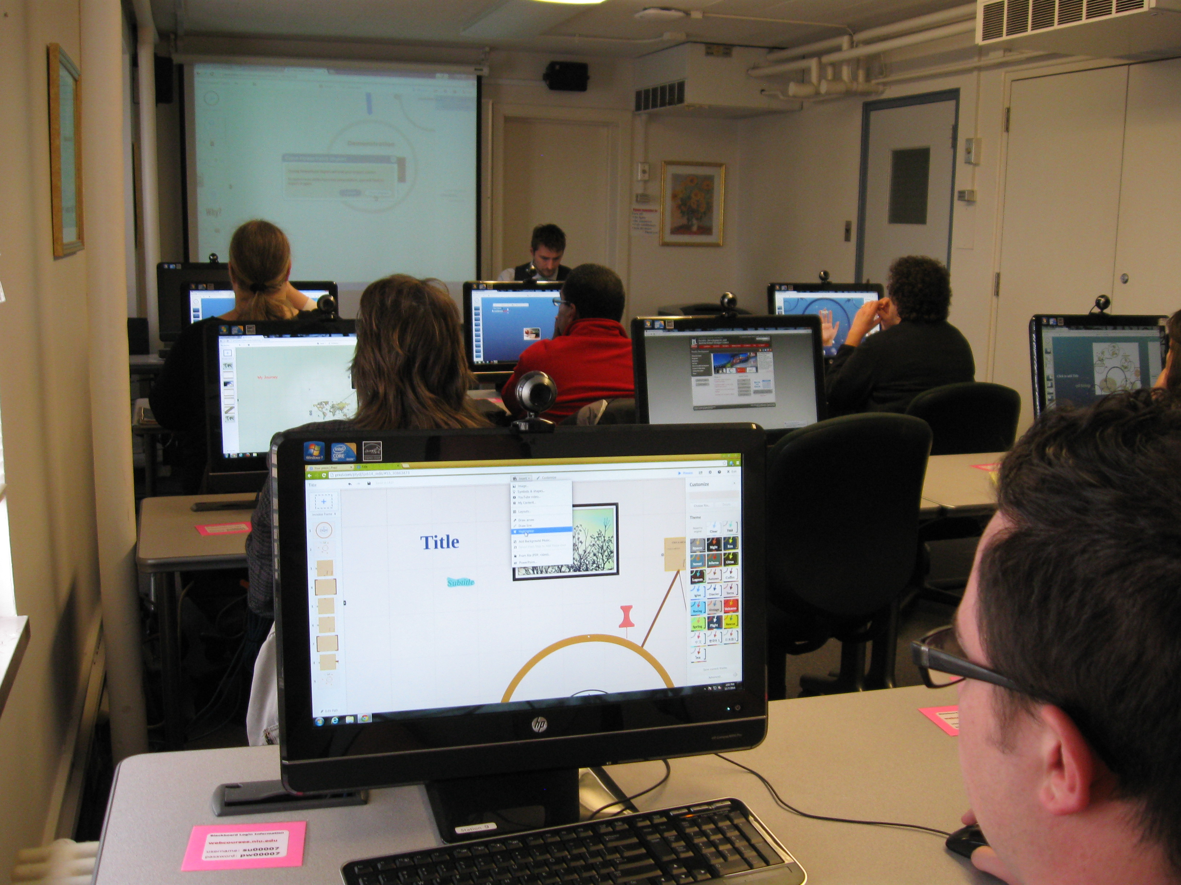
Informal Rubric & Reviewer training
Notes:
Never offered
Politically difficult (program prioritization)
Reviewer training may be offered due to difficulty in getting commitment for PRC

Slide 24
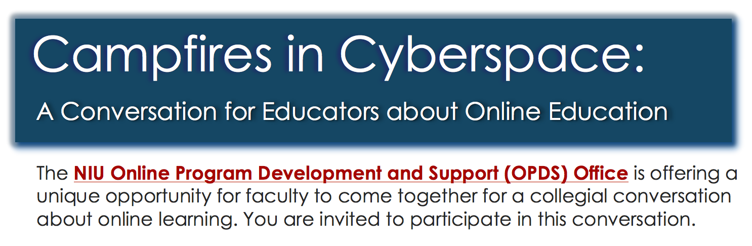
Online Teaching Circle
Notes:
Online Teaching Circle
Deferred to another team member
No interest, but continue to hear comments from faculty about loneliness, isolation, lost-ness, that this would alleviate
Continue to plan to offer, when the climate clears

Slide 25
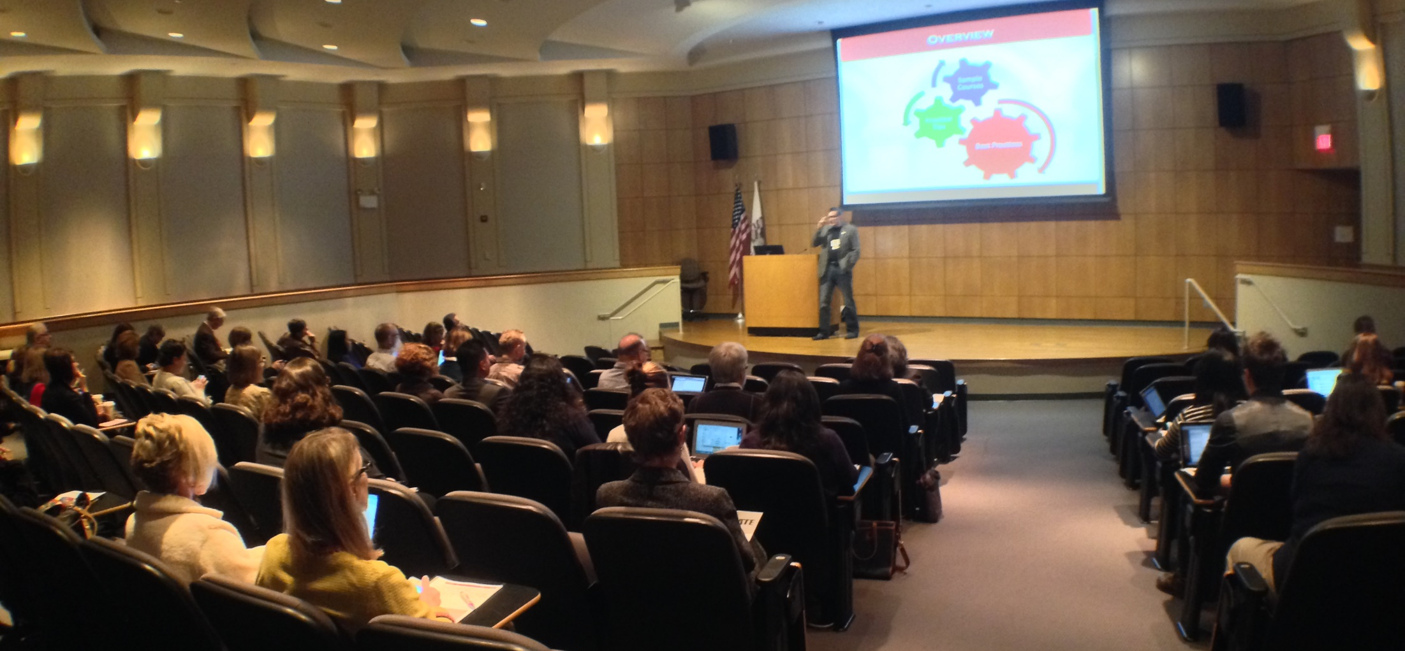
Online Teaching Conference
Summer of 2016 – Keep your fingers crossed

Slide 26
Summary
Provide additional professional development to supplement APPQMR
  Deeper understanding of individual standards
  Additional support
  Online learning immersion
Be flexible – change your plan based on climate

Slide 27
Questions?
Stephanie Richter
Assistant Director
srichter@niu.edu
@slrichter
Tracy Miller
Online Teaching Coordinator
tracy.miller@niu.edu
@TracyMiller256
Connect with Online Program Development & Support
@niuopds
facebook.com/niuopds

