Slide 1
Universal Design
Beyond Standard 8

Slide 2

General Standard 8: The course demonstrates a commitment to accessibility for all students.
The accessibility standard incorporates the principles of Universal Design for Learning (UDL) and is consistent with Web Content Accessibility Guidelines (WCAG).

Slide 3

Vision impairment.
About 1 in 1,000 are considered visually impaired or blind. Estimates at correctiveness reduce that number significantly.

Slide 4
Impairing hearing loss
1.2 in a thousand

Slide 5
Disability
About 1 in 6 children in the United States had a developmental disability in 2006-2008, ranging from mild disabilities such as speech and language impairments to serious developmental disabilities, such as intellectual disabilities, cerebral palsy, and autism.
Centers for Disease Control and Prevention, 2013

Slide 6
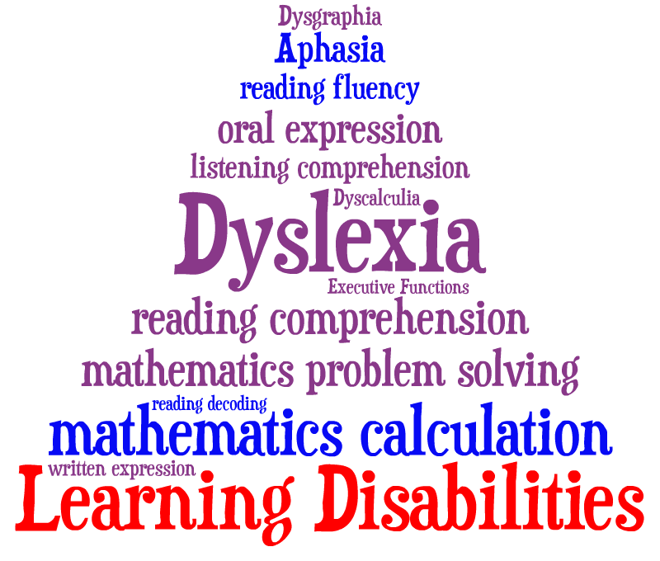

Slide 7


Slide 8
Non Verbal Learning Disorders
About 1 in 68 children has been identified with autism spectrum disorder (ASD) according to estimates from CDC's Autism and Developmental Disabilities Monitoring (ADDM) Network
Centers for Disease Control and Prevention, 2013

Slide 9
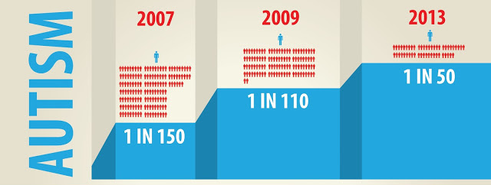
National Autism Society reports

Slide 10
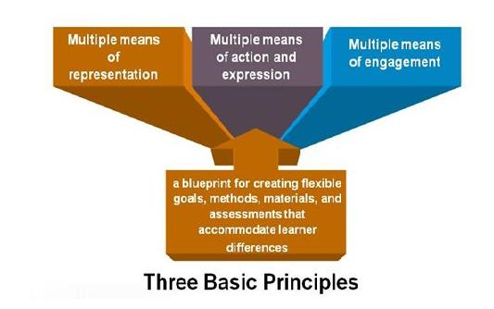
Universal Design for Education

Slide 11
Universal Design for Learning is an educational approach with three primary principles:
Multiple Means of Representation
To tap into learners interests, offer appropriate challenges, and increase motivation
To give diverse learners options for acquiring information and knowledge
Multiple Means of Action and Expression
To provide learners options for demonstrating what they know
Multiple Means of Engagement

Slide 12
Example: Non Verbal Learning Disorders

Slide 13
Provide Multiple Means of Representation,
Need for more information, links to additional sources,
Some difficulties processing visual sequences, require additional audio
Step by step instructions to fall back to, when unsure.
Clear grading rubrics to provide structure.
Provide as much detail in the course syllabus as possible
Providing links to additional resources for navigating campus and college concerns
Provide multimodal approach to information: handouts, lectures, and visual representations.
When possible refer and build off of previous information.
Prefer sameness, or repetition

Slide 14
Provide Multiple Means of Representation,
Need for more information, links to additional sources,
Some difficulties processing visual sequences, require additional audio
Step by step instructions to fall back to, when unsure.
Clear grading rubrics to provide structure.
Provide as much detail in the course syllabus as possible
Providing links to additional resources for navigating campus and college concerns
Provide multimodal approach to information: handouts, lectures, and visual representations.
When possible refer and build off of previous information.
Prefer sameness, or repetition
General Standard 1: The overall design of the course is made clear to the student at the beginning of the course.
The course introduction sets the tone for the course, lets students know what to expect, and provides guidance to ensure they get off to a good start.

Slide 15
Provide Multiple Means of Representation,
Need for more information, links to additional sources,
Some difficulties processing visual sequences, require additional audio
Step by step instructions to fall back to, when unsure.
Clear grading rubrics to provide structure.
Provide as much detail in the course syllabus as possible
Providing links to additional resources for navigating campus and college concerns
Provide multimodal approach to information: handouts, lectures, and visual representations.
When possible refer and build off of previous information.
Prefer sameness, or repetition
General Standard 1: The overall design of the course is made clear to the student at the beginning of the course.
The course introduction sets the tone for the course, lets students know what to expect, and provides guidance to ensure they get off to a good start.
STANDARD 1.1 - (3 Points)
1.1 Instructions make clear how to get started and where to find various course components.
STANDARD 1.3 - (2 Points)
1.3 Etiquette expectations (sometimes called “netiquette”) for online discussions, email, and other forms of communication are stated clearly.

Slide 16
Provide Multiple Means of Representation,
Need for more information, links to additional sources,
Some difficulties processing visual sequences, require additional audio
Step by step instructions to fall back to, when unsure.
Clear grading rubrics to provide structure.
Provide as much detail in the course syllabus as possible
Providing links to additional resources for navigating campus and college concerns
Provide multimodal approach to information: handouts, lectures, and visual representations.
When possible refer and build off of previous information.
Prefer sameness, or repetition
STANDARD 3.2 - (3 Points)
3.2 The course grading policy is stated clearly.
STANDARD 3.3 - (3 Points)
3.3 Specific and descriptive criteria are provided for the evaluation of students’ work and participation and are tied to the course grading policy.

Slide 17
Provide Multiple Means of Representation,
Need for more information, links to additional sources,
Some difficulties processing visual sequences, require additional audio
Step by step instructions to fall back to, when unsure.
Clear grading rubrics to provide structure.
Provide as much detail in the course syllabus as possible
Providing links to additional resources for navigating campus and college concerns
Provide multimodal approach to information: handouts, lectures, and visual representations.
When possible refer and build off of previous information.
Prefer sameness, or repetition
STANDARD 3.4 - (2 Points)
3.4 The assessment instruments selected are sequenced, varied, and appropriate to the student work being assessed.
STANDARD 3.5 - (2 Points)
3.5 Students have multiple opportunities to measure their own learning progress.

Slide 18
Provide Multiple Means of Representation,
Need for more information, links to additional sources,
Some difficulties processing visual sequences, require additional audio
Step by step instructions to fall back to, when unsure.
Clear grading rubrics to provide structure.
Provide as much detail in the course syllabus as possible
Providing links to additional resources for navigating campus and college concerns
Provide multimodal approach to information: handouts, lectures, and visual representations.
When possible refer and build off of previous information.
Prefer sameness, or repetition
STANDARD 4.5 - (1 Point)
4.5 The instructional materials present a variety of perspectives on the course content.

Slide 19
Provide Multiple Means of Representation,
Need for more information, links to additional sources,
Some difficulties processing visual sequences, require additional audio
Step by step instructions to fall back to, when unsure.
Clear grading rubrics to provide structure.
Provide as much detail in the course syllabus as possible
Providing links to additional resources for navigating campus and college concerns
Provide multimodal approach to information: handouts, lectures, and visual representations.
When possible refer and build off of previous information.
Prefer sameness, or repetition
General Standard 7: The course facilitates student access to institutional support services essential to student success.
In the learner support standard, four different kinds of support services are addressed: technical support, accessibility support, academic services support, and student services support.
STANDARD 7.1 - (3 Points)
7.1 The course instructions articulate or link to a clear description of the technical support offered and how to access it.

Slide 20
Provide Multiple Means of Representation,
Need for more information, links to additional sources,
Some difficulties processing visual sequences, require additional audio
Step by step instructions to fall back to, when unsure.
Clear grading rubrics to provide structure.
Provide as much detail in the course syllabus as possible
Providing links to additional resources for navigating campus and college concerns
Provide multimodal approach to information: handouts, lectures, and visual representations.
When possible refer and build off of previous information.
Prefer sameness, or repetition
STANDARD 7.3 - (2 Points)
7.3 Course instructions articulate or link to an explanation of how the institution’s academic support services and resources can help students succeed in the course and how students can access the services.
STANDARD 7.4 - (1 Point)
7.4 Course instructions articulate or link to an explanation of how the institution’s student support services can help students succeed and how students can access the services.

Slide 21
Provide Multiple Means of Action and Expression
People with NVLD, require additional time to translate what they want to say to the process of speech. Therefore requiring students to do a video recording or audio recording would be terrifying to a child with NVLD (Wenzel & Rowley, 2010).
Can be effective tutors to less skilled students
Provide discussion forums for students to ask questions of one another, and of the instructor.
Clear Demarcation of roles and responsibilities
Opportunities for Social Interaction in fairly structured and supervised activities
Difficulty interpreting nonverbal behavioral cues

Slide 22
Provide Multiple Means of Action and Expression
People with NVLD, require additional time to translate what they want to say to the process of speech. Therefore requiring students to do a video recording or audio recording would be terrifying to a child with NVLD (Wenzel & Rowley, 2010).
Can be effective tutors to less skilled students
Provide discussion forums for students to ask questions of one another, and of the instructor.
Clear Demarcation of roles and responsibilities
Opportunities for Social Interaction in fairly structured and supervised activities
Difficulty interpreting nonverbal behavioral cues
STANDARD 1.8 - (1 Point)
1.8 Students are asked to introduce themselves to the class
General Standard 3: Assessment strategies are designed to evaluate student progress by reference to stated learning objectives; to measure the effectiveness of student learning; and to be integral to the learning process.
Assessment is implemented in a manner that not only allows the instructor a broad perspective on the students’ mastery of the content, but also allows students to measure their own learning throughout the course.

Slide 23
Provide Multiple Means of Action and Expression
People with NVLD, require additional time to translate what they want to say to the process of speech. Therefore requiring students to do a video recording or audio recording would be terrifying to a child with NVLD (Wenzel & Rowley, 2010).
Can be effective tutors to less skilled students
Provide discussion forums for students to ask questions of one another, and of the instructor.
Clear Demarcation of roles and responsibilities
Opportunities for Social Interaction in fairly structured and supervised activities
Difficulty interpreting nonverbal behavioral cues
STANDARD 5.4 - (2 Points)
5.4 The requirements for student interaction are clearly articulated.

Slide 24
Provide Multiple Means of Engagement
Small Work Groups
Since those with NVLD often excel in certain activities, allow students to volunteer for leadership roles
Provide a buddy system to help with assurance, and allow them a safe space to ask questions of a few peers.
Specific set office hours and instructions on how to specifically contact the instructor during those office hours.

Slide 25
Provide Multiple Means of Engagement
Small Work Groups
Since those with NVLD often excel in certain activities, allow students to volunteer for leadership roles
Provide a buddy system to help with assurance, and allow them a safe space to ask questions of a few peers.
Specific set office hours and instructions on how to specifically contact the instructor during those office hours.
STANDARD 5.2 - (3 Points)
5.2 Learning activities provide opportunities for interaction that support active learning.
STANDARD 5.4 - (2 Points)
5.4 The requirements for student interaction are clearly articulated.
not being sure of how to join a group or initiate social interaction

Slide 26
Provide Multiple Means of Engagement
Small Work Groups
Since those with NVLD often excel in certain activities, allow students to volunteer for leadership roles
Provide a buddy system to help with assurance, and allow them a safe space to ask questions of a few peers.
Specific set office hours and instructions on how to specifically contact the instructor during those office hours.
STANDARD 6.2 - (3 Points)
6.2 Course tools and media support student engagement and guide the student to become an active learner.
STANDARD 7.2 - (3 Points)
7.2 Course instructions articulate or link to the institution’s accessibility policies and services.

Slide 27
References
Autism Spectrum Disorder (2013). Centers for Disease Control and Prevention. Accessed 9 April 2014 at: http://www.cdc.gov/ncbddd/autism/data.html
Horowitz, S. H. (2014). Learning Disabilities and Asperger’s Syndrome. National Center for Learning Disabilities. Accessed 6 February 2014 at: http://www.ncld.org/types-learning-disabilities/adhd-related-issues/autism-spectrum-disorders/learning-disabilities-aspergers-syndrome?start=1
Kin, A., & Volkmar, F. (1995). Asperger’s Syndrome: guidelines for treatment and intervention. New Haven, Connecticut: Yale Child Study Center.
Lane, J. & Kelly, R. (2012). Autism and Asperger’s Syndrome in the Law Student – Making Accommodations in Academic Assessments. In: 47th Annual Conference (re) assessing Legal Education. 1st April – 3rd April 2012, Lady Margaret Hall, Oxford, UK.
National Institute on Deafness and other Communication Disorders (2014). Accessed 9 April 2014 at http://www.nidcd.nih.gov/health/statistics/Pages/quick.aspx
Strichter, J., O’Connor, K, Herzog, M, Lierheimer, K, & McGhee, S. (2012). Social Competence Intervention for Elementary Students with Aspergers Syndrom and High Functioning Autism. Journal of Autism and Developmental Disorders, 42, 354-366.
Visual Impairment and Blindness (2014). World Health Organization. Accessed 9 April 2014 at: http://www.who.int/mediacentre/factsheets/fs282/en/
Wenzel C. & Rowley, L. (2010). Teaching social skills and academic strategies to college students with Asperger’s syndrome. Teaching Exceptional Children, 42(5), 44-50.

