Slide 1
Composition Class
Before and After
QM Peer Review
Suzanne Carlton
Professor of English
Santa Fe College
Gainesville, Florida

Slide 2
Introduction
Decade of Online Experience. At Santa Fe College I have taught all of my classes online for the past eight years—Composition I, Composition II, Fiction Writing, and others.
QM Peer Review. Last semester I submitted one of my classes for a QM Peer Review to improve the way that students learn how to write. I have also become certified as a QM Peer Reviewer myself.
Benefit to Others. I want to share my peer review experience so that others may see the advantages of peer review for students and teachers, and be able to prepare their own classes for review.

Slide 3
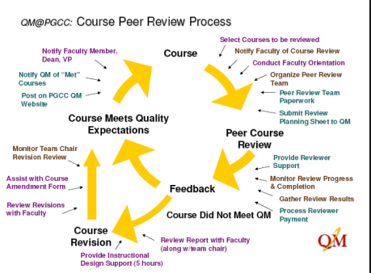

Slide 4
QM Standard 1.1
Required instructions make clear how to get started and where to find various course components.

Slide 5
Peer Reviewer Recommendations
Reviewer recommendations: It might be nice to spell out that students click the modules link on the left to access modules. Since this is an introductory class, there may be some students who have never used Canvas and might be unfamiliar with how to navigate.
The instructor should consider sharing how she prefers to be addressed by students who may come from different cultures and duplicate information she provides in the course syllabus that gives her email address, phone number, and office location.

Slide 6

Before QM
First-Day Home Page
First day of class
Required texts:
The correct textbooks for this class include the following:
The Norton Field Guide to Writing with Readings, 3rd edition. by Richard Bullock and Maureen Daly Goggin. ISBN 978-0-393-91957-8
2) The Bedford Handbook, 9th edition, ISBN: 978-1-4576-0802-5
Textbooks are available at the Santa Fe bookstore on the Northwest Campus.
Copies of textbooks are available at the Santa Fe College Library, but they cannot be checked out of the library.
The syllabus had contained two sets of books, but this semester we're using the ones listed here.
Please let me know if you have questions about the class!
Photo by CollegeDegrees360 Flickr

Slide 7
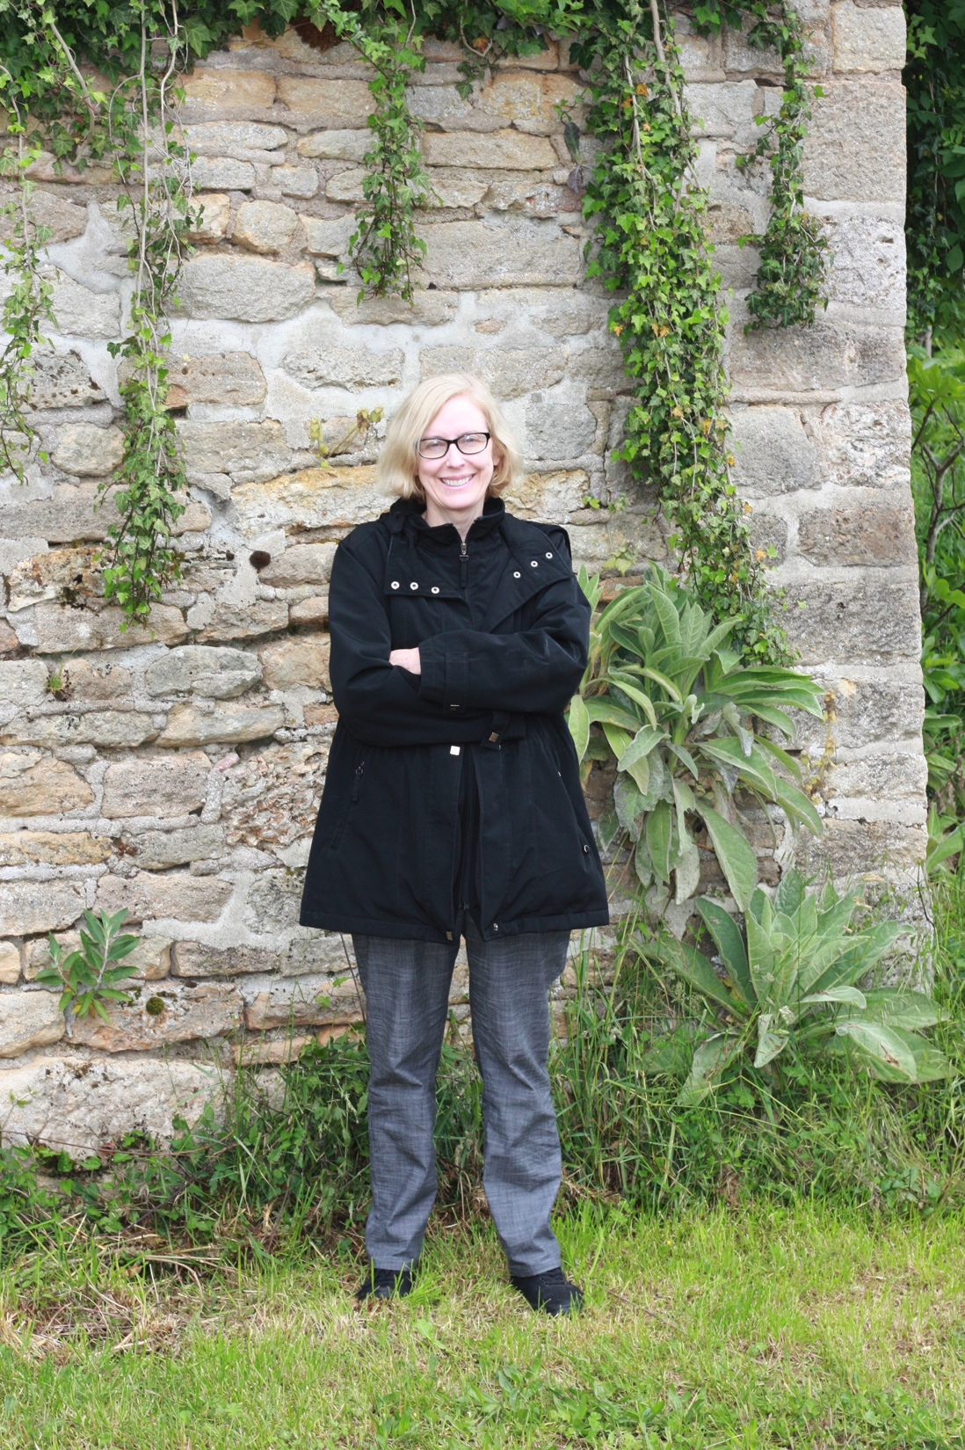
After QM
First-Day Home Page
Welcome to ENC1101!
Start by clicking on modules on the left and then opening the Week 1 module.
I look forward to working with you!
Professor Suzanne Carlton
Please let me know when you have questions!
The best way to contact me is by class mail or on our Class Connection discussion.
See the syllabus for additional contact information and office hours.

Slide 8
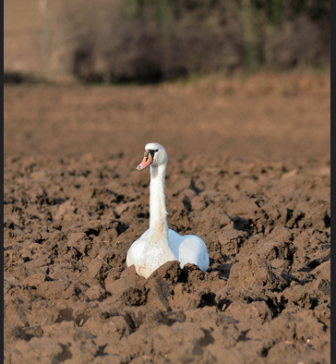
Before QM
Course Introduction
Before I started the QM Review, students were simply directed
from the home page to open the Week 1 Module
to locate class work.
“Confused Swan” Photo by Jeff_Fahey flicker

Slide 9
Peer Reviewer Recommendations
Reviewer recommendations: The page (beginning notes) lets learners know what they are to do for Week 1 but also has information about the course and other information that is in the syllabus. It may be helpful to break this up and have an “about the course” giving general information about the course as well as the syllabus. Links to those pages/navigation tool would be helpful.

Slide 10
After QM
Course Introduction
Beginning Notes Week 1
https://courses.sfcollege.edu/courses/317096/pages/beginning-notes-week-1?module_item_id=6174735 https://courses.sfcollege.edu/courses/317096/pages/beginning-notes-week-1?module_item_id=6174735

Slide 11
After QM
Beginning Notes Week 1
Welcome to ENC1101. I look forward to working with you this semester!
Everything you need for this first week of class can be found in the week 1 module. This week includes reading the class syllabus, introducing yourself to classmates, working on thesis development, and writing essay 1.
Week 1 module objectives
By the end of this week students should be able to recognize a vague thesis and to write a thesis that is specific and focused.

Slide 12
After QM
Beginning Notes Week 1, Continued
Questions?
If you have any questions about the class or an assignment, please ask them. I am happy to help.
Post to Class Connection, a discussion for students to ask for help or clarification. If you have any questions about class or an assignment, you may post them here. Teacher and students may respond.
Post to Let's Discuss Writing, a discussion for students to post questions specifically focused on writing. Teacher and students may respond.
Send an email: questions may be sent through class mail, the inbox link at the top right of our class site. Class mail also connects to my Santa Fe College email.
Call my office phone: 352.381.3652.
Questions about Canvas?
If you have questions about Canvas, you can start by clicking on Canvas 101 for students located on the left.

Slide 13
QM Standard 2.4
The relationship between learning objectives or competencies and course activities is clearly stated.

Slide 14

Peer Reviewer Recommendations
The module objectives listed in each week’s beginning notes and on the course worksheet are measurable and consistent with the course-level objectives as stated in this standard.
Lewis Global PR Photo

Slide 15
ENC 1101 Minimum Course Outcomes
Students will be competent in reading instructions and essays.
Students will be able to write essays substantially free of major errors of standard written English.
Students will be able to use supporting details in an essay.
Students will be competent in structuring essays.
Students will be competent in formatting their essays according to MLA conventions.
Students will be able to incorporate information from two or more distinct sources into an essay.
Students will learn that the process of writing requires working with drafts in order to achieve an effective final product.

Slide 16
Before and After QM
Module Objectives
Before
Week 3
Remember that your Essay 2 rough draft is due to the Week 3B discussion for writing workshop peer review
MLA paper format is required for essay assignments. MLA materials are provided in the Bedford Handbook and class handouts.
After
By the end of Week 3 students should be able to write peer reviews regarding essay structure, supporting details, MLA documentation, MLA paper format, and sentence-level errors.
They should be able to reflect on their own writing and their goals for revision.
They should be able to write shorter and longer assignments using correct MLA documentation and correct MLA paper format.

Slide 17
Students and Teacher Benefit
Focus on class work instead of experiencing stress from navigation
Engage in activities that clearly align with course objectives
Use technology necessary to the class and to learning
Have accessibility as needed
Know about college resources
Participate in assessments that align with course objectives
Sees course from a learner’s point of view
Connects with students
Creates a clearer learning environment
Makes sure course objectives align with class work and materials
Receives positive feedback
Has a class recognized as QM certified

Slide 18
Suggestions Regarding QM Peer Review
Complete the course “Applying the QM Rubric” (APPQMR)
Complete a QM Self-Review Worksheet before submitting course
Be willing to listen to reviews
Be willing to make necessary changes
View the peer review process as helpful

Slide 19
Links to Classes: Before and After Peer Review
https://courses.sfcollege.edu/courses/332404
(Before QM Peer Review)
https://courses.sfcollege.edu/courses/317096
(After QM Peer Review)

Slide 20
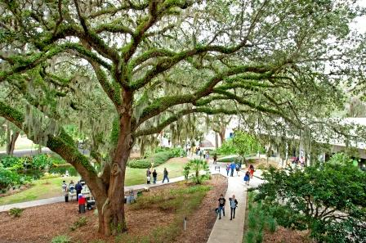
Thank You!
SSan
Santa
Fe
College
Gainesville,
Florida

