Slide 1


Casting a Research Net: A Voyage through QM, Interaction, and Performance in Online Courses
Ramiro de la Rosa, Instructional Designer
Rita Vela, Instructional Designer

Slide 2


About the Presenters
Dr. Ram de la Rosa
  Asst. Director OL
  PhD Leadership
  MEd Instructional Technology
  15 years in field
Rita Vela
  Instructional Designer II
  MEd Instructional Technology
  13 years in field

Slide 3
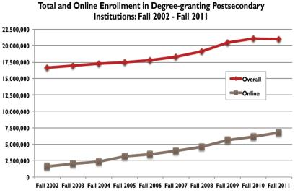
Adoption of Online Learning
Overall higher education enrollment dropped in 2012 for the first time in years
Ten-year trend indicates that online enrollment increased at rates exceeding those of higher education as a whole
(Allen & Seaman, 2012)
Notes:
RITA
Changing Course: Ten Years of Tracking Online Education in the United States is the tenth annual
report on the state of online learning among higher education institutions in the United States.
The study is aimed at answering some of the fundamental questions about the nature and extent
of online education. Based on responses from over 2,800 colleges and universities,
higher education in the United States.

Slide 4
Study Goals
To document the impact of changes that occurred in online courses as a result of their redevelopment to adhere to Quality Matters standards.
To determine whether students would view the course quality standards with the same outcome as the Quality Matters reviewers.

Slide 5
The Process
Course selection
Courses reviewed with QM Rubric
Students taking the original course were surveyed.
Data collected using a survey tool
Courses re-developed
Courses re-reviewed by same reviewer
Students taking the redeveloped course were surveyed

Slide 6
Selection of Courses
Courses were initially developed in 2005 by professors who had experience developing and teaching online courses.
Both courses were reviewed by the same master QM reviewer before and after.
Both courses did not meet the minimum quality standards.
Course review only included the content developed by the content expert and not any additional content that section instructors

Slide 7
About the data
Survey collected data on demographics
Although we collected data on student activity within the course, the activity was not tied to the individual student responses. So, the data applied to all students, not just those that responded to the survey
We wanted to compare student & reviewer perceptions on the quality standards in the rubric.
We compared students opinions on the course quality standards before and after redevelopment and by course

Slide 8
Purpose of the Study
The purpose of the study is to identify the relationships between student’s perception of his/her Level of Interaction and Engagement with the instructor as measured by the Quality Matters General Standard 5 and student’s post-secondary Academic Performance in an online course as measured by Expected Grade, Overall Online Interaction, Sense of Community, Quality of Online Discussions, Technology, and the Leader-Member Exchange Score (LMX-7).
Notes:
RITA

Slide 9
Definitions
Notes:
RAM

Slide 10

Quality Matters General Standard 5
GS 5.1: The learning activities promoted the achievement of the stated learning objectives.
GS 5.2: Learning activities provided opportunities for interaction that support active learning.
GS 5.3 The instructor’s plan for classroom response time and feedback on assignments was clearly stated.
GS 5.4: The requirements for student interaction were clearly articulated.
        Measured using a 5-point Likert scale:
            5 = “Strongly Agree”
            4 = “Agree”
            3 = “Neutral”
            2 = “Disagree”
            1 = “Strongly Disagree”
General Standard 5: Forms of interaction incorporated in the course motivate students and promote learning.

Slide 11
Leader Member Exchange
Leader-Member Exchange (LMX-7)
  Measured student’s perception of the Level of Interaction (LMX) with the instructor
  LMX-7 is a seven-item instrument, which measures three dimensions of leader-member relationships: respect, trust, obligation
  The LMX-7 uses a 5-point Likert scale, which scores between 7 points (very low) to 35 points (very high)
(Graen & Uhi-Bien, 1995; Northouse, 2007)

Slide 12

Expected Grade
Students were asked:
  What is your expected grade in this online course?
    Measured as
      A = 4
      B = 3
      C = 2
      D = 1
      F = 0
(Drouin, 2008)

Slide 13

Overall Online Interaction
Students were asked:
  How was the overall online interaction in this course?
  What was the overall sense of community in this online course?
  What was the overall quality of online discussions in this course?
  Measured in a continuous scale
(Drouin, 2008)

Slide 14
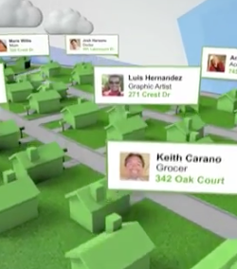
Sense of Community
      Students were asked:
        What was the overall sense of community in this online course?
        Measured using a 5-point Likert scale:
            5 = “Very High”
            4 = “High”
            3 = “Moderate”
            2 = “Minimal”
            1 = “None”

Slide 15

Quality of Online Discussion
      Students were asked:
        What was the overall quality of the online discussions in this course?
        Measured using a 5-point Likert scale:
      5 = “Excellent”
      4 = “Above Average”
      3 = “Average”
      2 = “Below Average”
      1 = “Extremely Poor”

Slide 16

Technology
Blog
      Students were asked:
        Did the instructor foster interaction by incorporating such tools as blogs, wiki’s, journals, discussion board, etc.?
        Measured using a 5-point Likert scale:
      5 = “7 or more”
      4 = “5-6 tools”
      3 = “3-4 tools”
      2 = “1-2 tools”
      1 = “0 tools”
Wiki
Discussion Board

Slide 17
Demographics
Demographic survey created by the study investigator to collect participant demographics
  Age – measured in years
  Gender – measured as either male or female
  Ethnicity – measured using the U.S. Census guidelines
  Number of Online Courses Enrolled this Semester – measured as a continuous variable
  Number of Online Courses Taken in the Past– measured as a continuous variable
Notes:
When considering for…

Slide 18
Research Questions

Slide 19
Research Question 1
  H01: Is there a relationship between student’s perceived Level of Interaction and Engagement (QM Standard 5) with the instructor and Expected Grade in the online course when considering students’ age, gender, ethnicity, number of online courses enrolled this semester, and number of online courses taken in the past

Slide 20
Research Question 2
H02: Is there a relationship between student’s perceived Level of Interaction and Engagement (QM Standard 5) with the instructor and Overall Online Interaction in the online course when considering students’ age, gender, ethnicity, number of online courses enrolled this semester, and number of online courses taken in the past

Slide 21
Research Question 3
H03: Is there a relationship between student’s perceived Level of Interaction and Engagement (QM Standard 5) with the instructor and Sense of Community in the online course when considering students’ age, gender, ethnicity, number of online courses enrolled this semester, and number of online courses taken in the past

Slide 22
Research Question 4
H04: Is there a relationship between student’s perceived Level of Interaction and Engagement (QM Standard 5) with the instructor and Quality of Online Discussion in the online course when considering students’ age, gender, ethnicity, number of online courses enrolled this semester, and number of online courses taken in the past

Slide 23
Research Question 5
H05: Is there a relationship between student’s perceived Level of Interaction and Engagement (QM Standard 5) with the instructor and Technology in the online course when considering students’ age, gender, ethnicity, number of online courses enrolled this semester, and number of online courses taken in the past

Slide 24
Research Question 6
H06: Is there a relationship between student’s perceived Level of Interaction and Engagement (QM Standard 5) with the instructor and the Level of Interaction (LMX-7) in the online course when considering students’ age, gender, ethnicity, number of online courses enrolled this semester, and number of online courses taken in the past

Slide 25
Research Variables

Slide 26
Independent Variables
One Likert-scale 5-point variable for Quality Matters General Standard 5
  General Standard 5: Forms of interaction incorporated in the course motivate students and promote learning.

Slide 27
Dependent Variables
Continuous variables
  Expected Grade
  Perceived Overall Online Interaction
  Perceived Sense of Community
  Perceived Quality of Online Discussion
  Technology
  LMX (Leader-Member Exchange)

Slide 28
Demographic Variables
Two dichotomous
  Gender and Ethnicity
Three continuous
  Age
  Number Of Online Courses Enrolled In Current Semester
  Number Of Online Courses Taken In The Past

Slide 29
Methodology

Slide 30
Sampling Plan
Participants enrolled in online courses at a south Texas university were recruited to participate in the study
82 survey responses from students in online courses where Quality Matters was implemented
57 survey responses from students in online courses where Quality Matters was not implemented.
Surveys were provided within participants’ online course. Participants login to their course, click on the link provided, read consent form and decided whether to exit or continue on to the survey
Data were collected electronically
Participation was strictly voluntary and did not affect the student’s grade in any manner
Online students completed
  Consent form
  Demographic survey
  Leader-Member Exchange (LMX-7)
  Online Course Questionnaire

Slide 31
Ethical Considerations
Anonymity of participation
Strictly Voluntary
Grade not dependent on whether the students take or do not take the survey
Can withdraw at anytime without penalty
Informed consent
IRB approval

Slide 32
Descriptive Statistics Of Students

Slide 33
Demographics

Slide 34
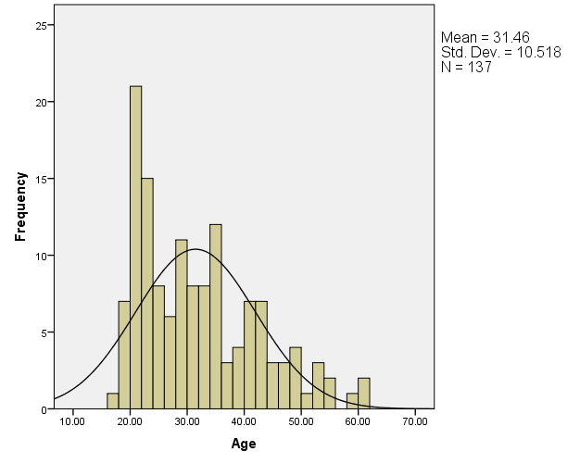
Students’ Age
N = 137
Mean = 31.46
Std. Dev. = 10.518
Min = 17
Max = 61

Slide 35
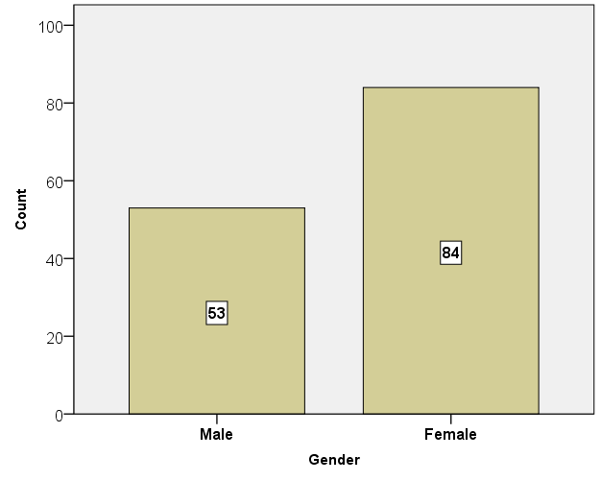
Students’ Gender
N = 137
Male = 53
Female = 84
Notes:
National Study 70% F, 30% male

Slide 36
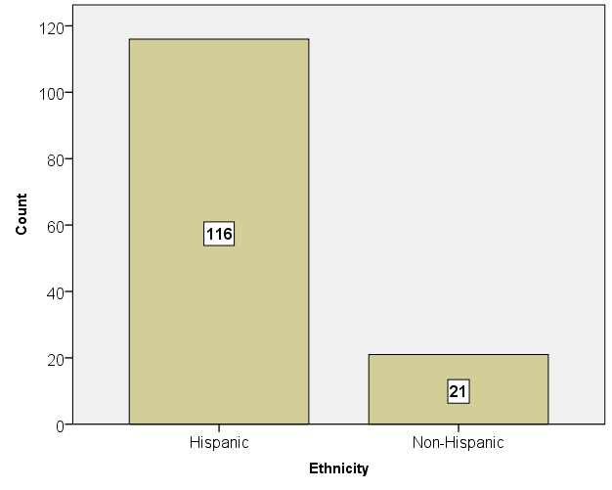
Students’ Ethnicity
N = 137
116 students were Hispanic
21 students were non-Hispanic
Notes:
National 62%white, 19 Black,

Slide 37
Control Variables

Slide 38
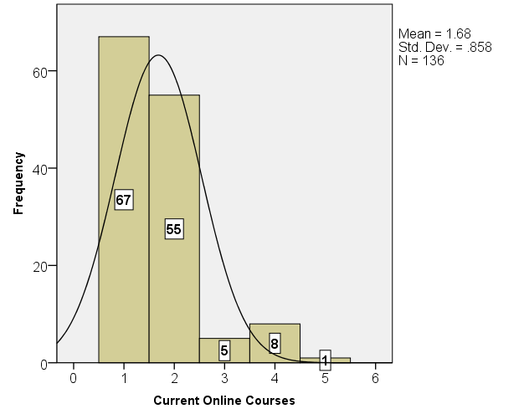
Online Courses Enrolled in Current Semester
N = 136
Min = 1
Max = 5
Mean = 1.68
Std. Dev. = .858
Scale: Continuous

Slide 39
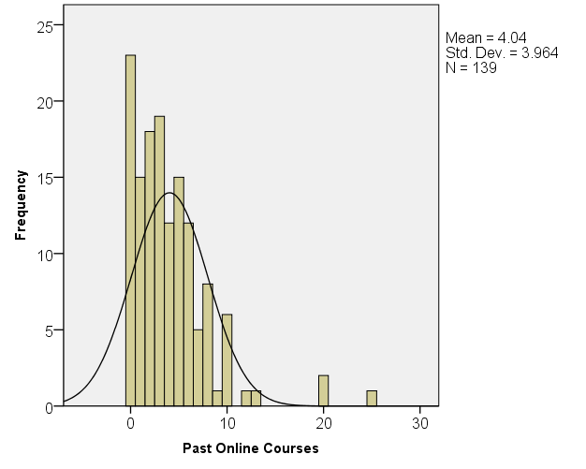
Number of Online Courses taken in the Past
N = 139
Mean = 4.04
Std. Dev. = 3.964
Min = 0
Max = 25
Scale: Continuous

Slide 40
Independent Variables

Slide 41
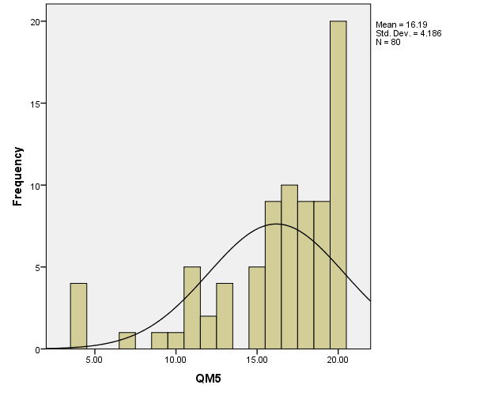
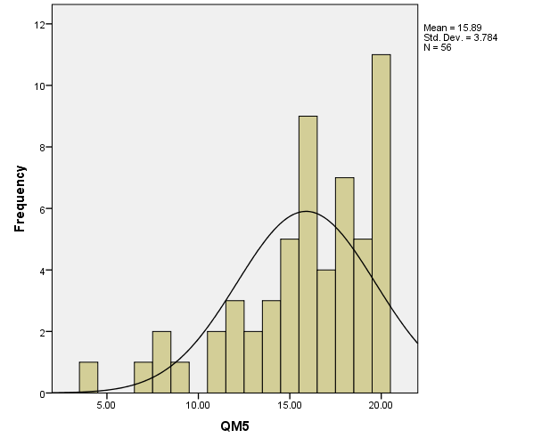
Quality Matters General Standard 5
QM Courses
Non-QM Courses

Slide 42
Dependent Variables

Slide 43
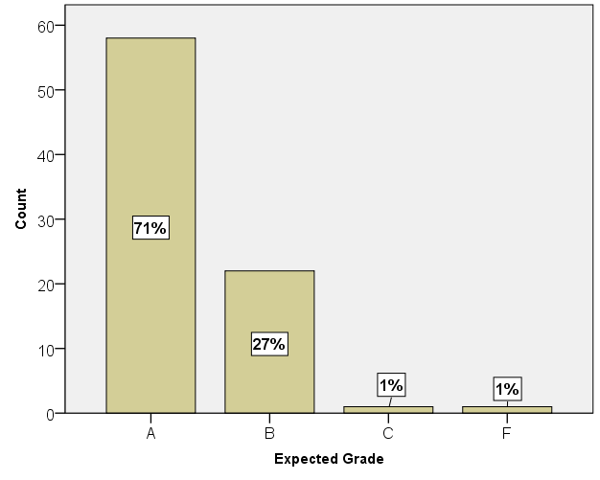
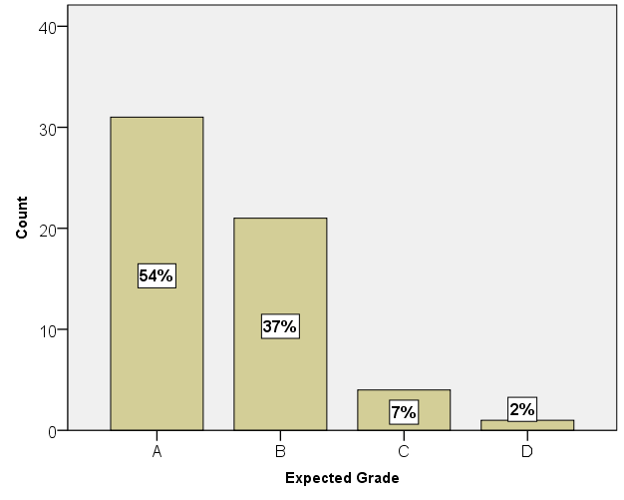
Students’ Expected Grade for the Online Course
QM Courses
Non-QM Courses

Slide 44
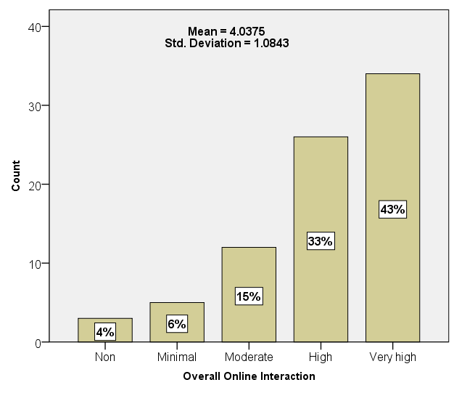
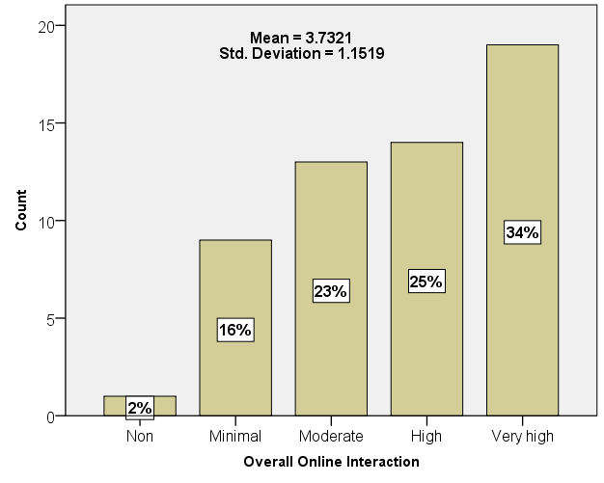
Students’ Perceived Overall Online Interaction
QM Courses
Non-QM Courses

Slide 45
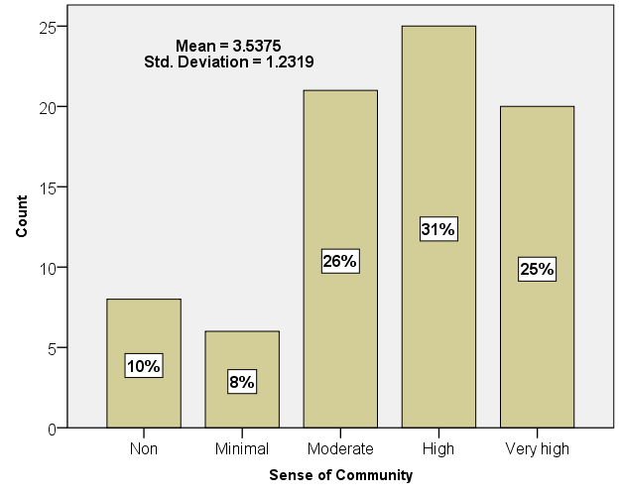
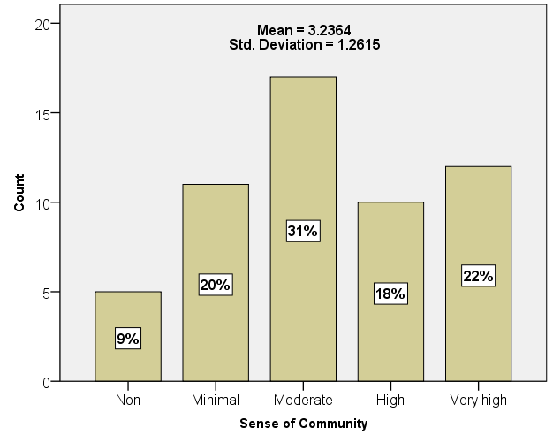
Students’ Perceived Sense of Community
QM Courses
Non-QM Courses

Slide 46
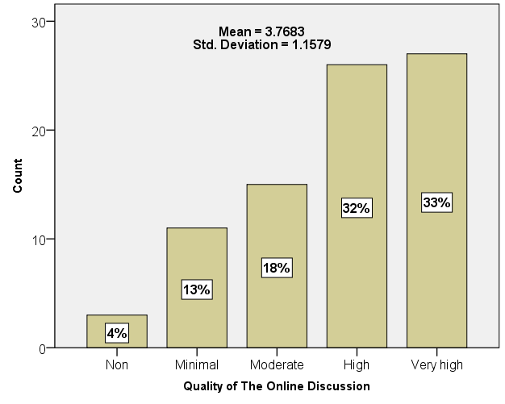
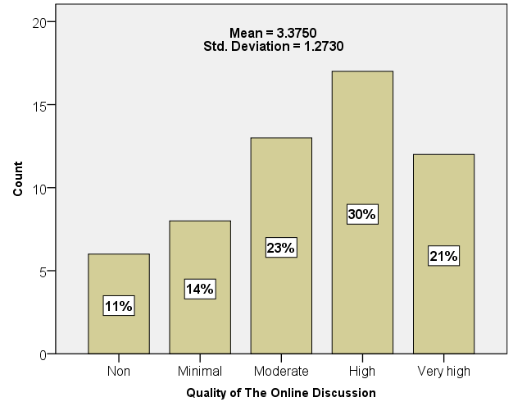
Students’ Perceived Quality of Online Discussions
QM Courses
Non-QM Courses

Slide 47
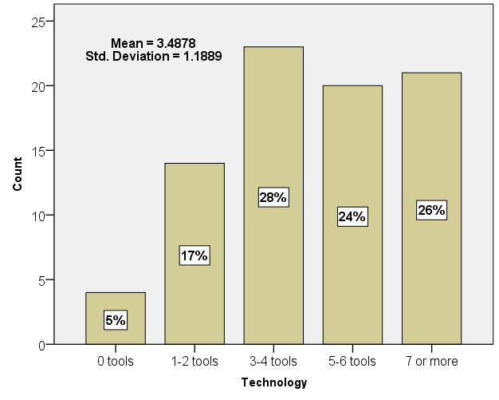
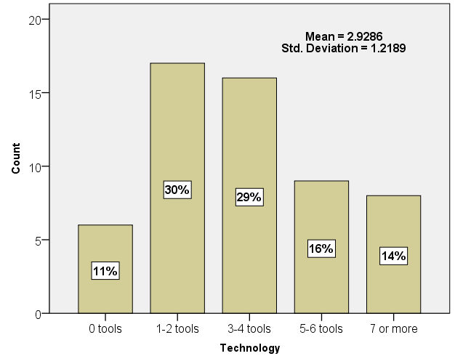
Technology Tools Used in Course
QM Courses
Non-QM Courses

Slide 48
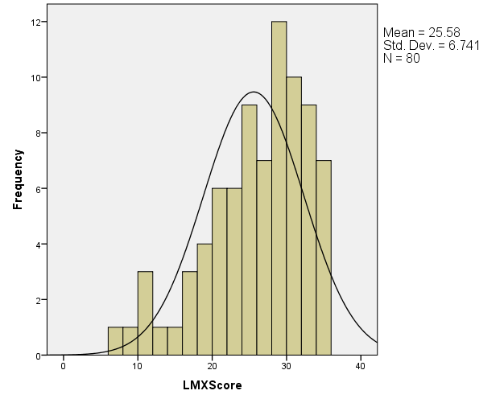
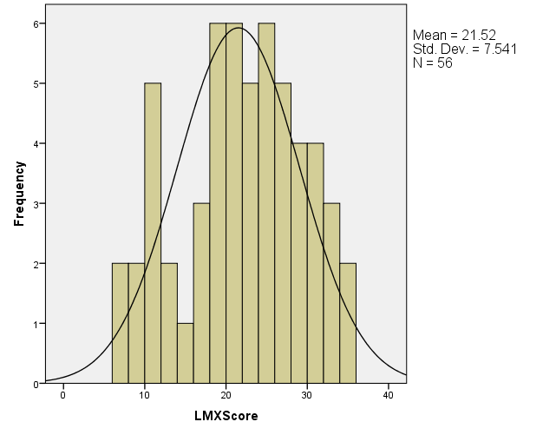
Students’ Perceived Level of Interaction (LMX-7)
QM Courses
Non-QM Courses

Slide 49
Multiple Regression Analysis

Slide 50
Multiple Regression Blocks
Block 1 - Stepwise
  Age
  Gender
  Ethnicity
Block 2 – Stepwise
  Number of Online Courses this Semester
  Number of Online Courses taken in the Past
Block 3 - Enter
  QM General Standard 5

Slide 51
Results of Multiple Regression for Null Hypothesis 1

Slide 52
Null Hypothesis (Ho1)
  There is no relationship between student’s perceived Level of Interaction and Engagement (QM GS 5) with the instructor and Expected Grade in the online course when considering students’ age, gender, ethnicity, number of online courses enrolled this semester, and number of online courses taken in the past

Slide 53
Do any of these variables predict
Expected Grade?
QM Courses
Non-QM Courses
Block 1 - Stepwise
  Age
  Gender
  Ethnicity
Block 2 - Stepwise
  Number of Online Courses this Semester
  Number of Online Courses taken in the Past
Block 3 – Enter
  QM General Standard 5
Block 1 - Stepwise
  Age
  Gender
  Ethnicity
Block 2 - Stepwise
  Number of Online Courses this Semester
  Number of Online Courses taken in the Past
Block 3 – Enter
  QM General Standard 5
Accept Null H_{O}1
Accept Null H_{O}1
Notes:
Null Hypothesis (Ho1)

Slide 54
Results of Multiple Regression for Null Hypothesis 2

Slide 55
Null Hypothesis (Ho2)
There is no relationship between student’s perceived Level of Interaction and Engagement with the instructor and Overall Online Interaction in the online course when considering students’ age, gender, ethnicity, number of online courses enrolled this semester, and number of online courses taken in the past

Slide 56
Do any of these variables predict
Overall Online Interaction?
QM Courses
Non-QM Courses
Block 1 - Stepwise
  Age
  Gender
  Ethnicity
Block 2 - Stepwise
  Number of Online Courses this Semester
  Number of Online Courses taken in the Past
  (ΔR² = .068, β = -0.240)
Block 3 – Enter
  QM General Standard 5 (ΔR² = .277, β = 0.576)
Block 1 - Stepwise
  Age
  Gender
  Ethnicity
Block 2 - Stepwise
  Number of Online Courses this Semester
  Number of Online Courses taken in the Past
Block 3 – Enter
  QM General Standard 5 (ΔR² = .275, β = 0.531)
Reject Null H_{O}2
Reject Null H_{O}2
Notes:
Null Hypothesis (Ho2)

Slide 57
Results of Multiple Regression for Null Hypothesis 3

Slide 58
Null Hypothesis (Ho3)
There is no relationship between student’s perceived Level of Interaction and Engagement (QM Standard 5) with the instructor and Perceived Sense of Community in the online course when considering students’ age, gender, ethnicity, number of online courses enrolled this semester, and number of online courses taken in the past
Notes:
H03: Is there a relationship between student’s perceived Level of Interaction and Engagement (QM Standard 5) with the instructor and Sense of Community in the online course when considering students’ age, gender, ethnicity, number of online courses enrolled this semester, and number of online courses taken in the past

Slide 59
Do any of these variables predict
Sense of Community?
QM Courses
Non-QM Courses
Block 1 - Stepwise
  Age
  Gender
  Ethnicity
Block 2 - Stepwise
  Number of Online Courses this Semester
  (ΔR2 = 0.117, β = 0.259)
  Number of Online Courses taken in the Past
  (ΔR² = 0.117, β = -0.261)
Block 3 – Enter
  QM General Standard 5 (ΔR² = 0.188, β = 0.474)
Block 1 - Stepwise
  Age
  Gender
  Ethnicity
Block 2 - Stepwise
  Number of Online Courses this Semester
  Number of Online Courses taken in the Past
  (ΔR² = 0.08, β = 0.301 )
Block 3 – Enter
  QM General Standard 5 (ΔR² = 0.238, β = 0.494)
Reject Null H_{O}3
Reject Null H_{O}3
Notes:
Null Hypothesis (Ho3)

Slide 60
Results of Multiple Regression for Null Hypothesis 4

Slide 61
Null Hypothesis (Ho4)
There is no relationship between student’s perceived Level of Interaction and Engagement (QM GS 5) with the instructor and Perceived Quality of Online Discussions in the online course when considering students’ age, gender, ethnicity, number of online courses enrolled this semester, and number of online courses taken in the past
Notes:
H04: Is there a relationship between student’s perceived Level of Interaction and Engagement (QM Standard 5) with the instructor and Quality of Online Discussion in the online course when considering students’ age, gender, ethnicity, number of online courses enrolled this semester, and number of online courses taken in the past

Slide 62
Do any of these variables predict
Quality of Online Discussions?
QM Courses
Non-QM Courses
Block 1 - Stepwise
  Age
  Gender
  Ethnicity
Block 2 - Stepwise
  Number of Online Courses this Semester
  Number of Online Courses taken in the Past
Block 3 – Enter
  QM General Standard 5 (ΔR² = 0.198, β = 0.486)
Block 1 - Stepwise
  Age
  Gender
  Ethnicity
Block 2 - Stepwise
  Number of Online Courses this Semester
  Number of Online Courses taken in the Past
Block 3 – Enter
  QM General Standard 5 (ΔR² = 0.253 , β = 0.509)
Reject Null H_{O}4
Reject Null H_{O}4
Notes:
Null Hypothesis (Ho4)

Slide 63
Results of Multiple Regression for Null Hypothesis 5

Slide 64
Null Hypothesis (Ho5)
There is no relationship between student’s perceived Level of Interaction and Engagement (QM Standard 5) with the instructor and the Technology used in the online course when considering students’ age, gender, ethnicity, number of online courses enrolled this semester, and number of online courses taken in the past

Slide 65
Do any of these variables predict
Technology?
QM Courses
Non-QM Courses
Block 1 - Stepwise
  Age
  Gender
  Ethnicity
Block 2 - Stepwise
  Number of Online Courses this Semester
  Number of Online Courses taken in the Past
  (ΔR² = .061, β = -0.235)
Block 3 – Enter
  QM General Standard 5 (ΔR² = 0.068, β = 0.284)
Block 1 - Stepwise
  Age
  Gender
  Ethnicity
Block 2 - Stepwise
  Number of Online Courses this Semester
  Number of Online Courses taken in the Past
Block 3 – Enter
  QM General Standard 5 (ΔR² = 0.151, β = 0.394)
Reject Null H_{O}5
Reject Null H_{O}5
Notes:
Null Hypothesis (Ho3)

Slide 66
Results of Multiple Regression for Null Hypothesis 6

Slide 67
Null Hypothesis (Ho6)
There is no relationship between student’s perceived Level of Interaction and Engagement (QM Standard 5) with the instructor and the Level of Interaction (LMX-7) used in the online course when considering students’ age, gender, ethnicity, number of online courses enrolled this semester, and number of online courses taken in the past

Slide 68
Do any of these variables predict
Level of Interaction (LMX-7)?
QM Courses
Non-QM Courses
Block 1 - Stepwise
  Age
  Gender
  Ethnicity
Block 2 - Stepwise
  Number of Online Courses this Semester
  Number of Online Courses taken in the Past
  (ΔR² = 0.077, β = -0.237)
Block 3 – Enter
  QM General Standard 5 (ΔR² = 0.307, β = 0.605)
Block 1 - Stepwise
  Age
  Gender
  (ΔR² = 0.086, β = -0.269)
  Ethnicity
Block 2 - Stepwise
  Number of Online Courses this Semester
  Number of Online Courses taken in the Past
Block 3 – Enter
  QM General Standard 5 (ΔR² = 0.300, β = 0.555)
Reject Null H_{O}5
Reject Null H_{O}5
Notes:
Null Hypothesis (Ho3)

Slide 69
Results Summary for QM Courses
Independent Variables | Dependent Variables
 | Exp. Grade | Overall OL Interaction | Sense of Community | Quality of OL Posts | Technology | LMX-7
Age
Gender
Ethnicity
Number of Courses taken in the past |  | ΔR² = .068 β = -0.240 r_{p} = -0.242 | ΔR² = .117 β = -0.261 r_{p} = -0.216 |  | ΔR² = .061 β = -0.235 r_{p} = -0.133 | ΔR² = .077 β = -0.237 r_{p} = -0.127
Number of Courses this Semester |  |  | ΔR² = .117 β = 0.259 r_{p} = 0.216
QM General Standard 5 |  | ΔR² = .277 β = 0.576 r_{p} = 0.586 | ΔR² = .188 β = 0.474 r_{p} = 0.492 | ΔR² = .198 β = 0.486 r_{p} = 0.486 | ΔR² =.068 β = 0.284 r_{p} = 0.361 | ΔR² =.307 β = 0.605 r_{p} = 0.609

Slide 70
Results Summary for non-QM Courses
Independent Variables | Dependent Variables
 | Exp. Grade | Overall OL Interaction | Sense of Community | Quality of OL Posts | Technology | LMX-7
Age
Gender |  |  |  |  |  | ΔR² = .086 β = -0.269 r_{p} = -0.242
Ethnicity
Number of Courses taken in the past |  |  | ΔR² = .08 β = 0.301 r_{p} = 0.239
Number of Courses this Semester
QM General Standard 5 |  | ΔR² = .275 β = .531 r_{p} = .562 | ΔR² = .238 β = .494 r_{p} = .517 | ΔR² = .253 β = .509 r_{p} = .522 | ΔR² =.151 β = .394 r_{p} = .391 | ΔR² =.300 β = .555 r_{p} = .557

Slide 71
Closing Thoughts and Recommendations

Slide 72
Limitations of the Study
Predominantly a large Hispanic student sample
Restrictions on generalizability to populations outside a south Texas region

Slide 73
Recommendations for Further Study
Further explore LMX to measure Academic Performance in online courses
Explore why Hispanics reported lower online engagement than non-Hispanic
  Compare reported engagement to actual engagement
  Explore possibility that Hispanics, compare to non-Hispanic, are conservative in the reported engagement
  Perform qualitative research
  Incorporate a research-based student assessment tool – compare two groups
Notes:
1. Further explore LMX to measure Academic Performance in online courses
(LMX showed to be a better tool for measuring AP in an online environment when compared to the Big 5)
2. Explore why Hispanics reported lower online engagement than non-Hispanic
(EVEN when the N for Hispanics was much higher)
(significant finding)
Compare reported engagement to actual engagement
(Software available to gather actual engagement)
Hispanics conservative in the reported engagement compare to non-Hispanic
(Hispanics as a culture may be more conservative)
Perform qualitative research
(Gain knowledge of other factors that could be hindering online engagement)
(Examine perceptions of online learning, engagement)
Incorporate a research-based student assessment tool – compare two groups
(explore if Hispanics are at a disadvantaged in computer skills, reading and writing skills, digital communication skills)
(evaluate online engagement based on students with comparable scores, to evaluate whether or not Ethnicity is a significant factor and not skill)

Slide 74
Take Away
Implications for online faculty
  Implement strategies to address Hispanic students’ needs in online environments
  Foster relationships with students that enable risk taking and critical thinking
  Use transformational leadership language in a consistent manner
Notes:
Implications for online faculty
Implement strategies to address Hispanic students’ needs in online environments
(Seek out faculty training, research to help develop strategies. Strategies to help students be more engaging online)
(Conduct end-of-course survey to hear out students’ concerns with online learning)
Foster relationships with students that enable risk taking and critical thinking
(Explore if one or two face-to-face classes would improve online engagement)
Use transformational leadership language in a consistent manner
(Critical in an online environment since faculty and student may never meet face to face.

