Slide 1
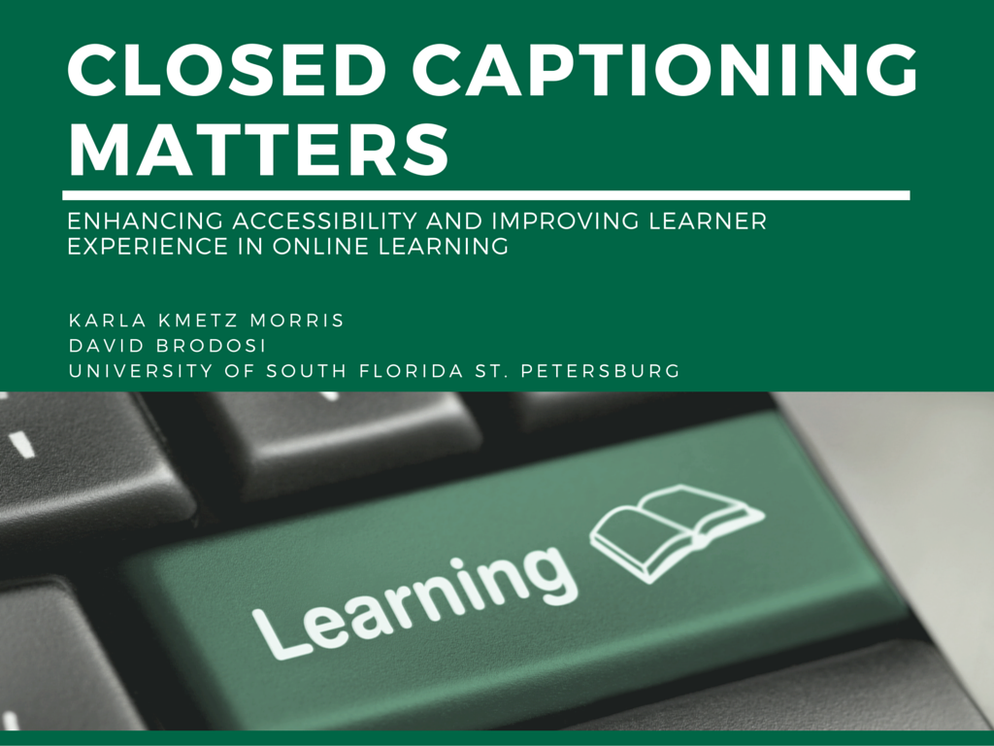

Slide 2
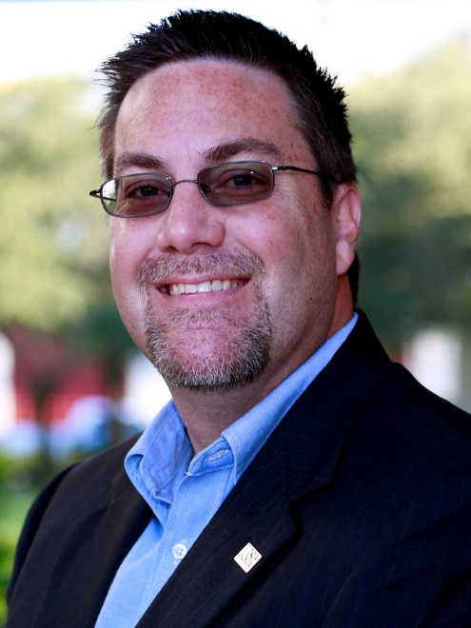
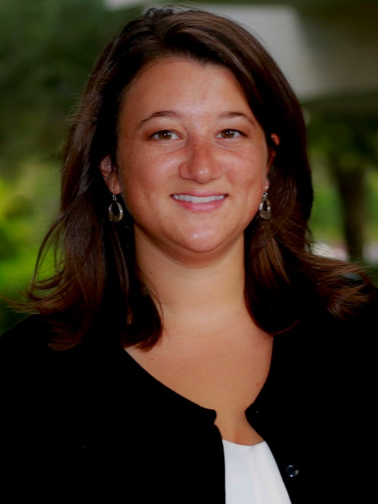

About Us
Karla Kmetz Morris
Manager of Instructional Design Services
David Brodosi
Director of Operations
Online Learning & Instructional Technology Services

Slide 3
What We Are Here to Share
USFSP conducted a study to determine if closed captioning had any impact on students without a reported disability.

Slide 4
Goals for Today
We hope you leave with new ideas regarding:
  Rationale for closed captioning online courses
  Processes to caption online courses at your institution
  Practices for closed captioning online courses
There will be time for Q & A

Slide 5
Quick Poll
Who's in the audience?
Faculty
Designers
Managers, directors, dean, or higher

Slide 6
Support Services for Students with a Disability
Ad hoc process
  Per student request
Found three levels of service
  C-Print Transcripts for meaning
  Full transcriptions
  Transcription with time code
USFSP was only doing C-print!
Were students really getting the same level of service?
When was the lawsuit going to drop?

Slide 7
Our Solution
How to get around administration?
  Find ways to benefit all students?
  Show that it’s cost effective.
  Try to be the leader for Florida Colleges and Universities.
That’s when the idea for the project was born.

Slide 8
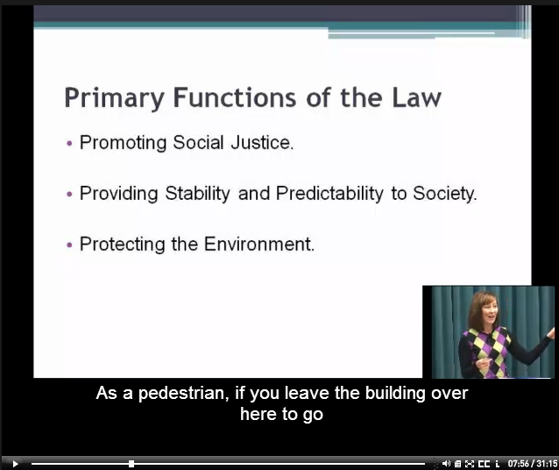
The Project
Caption two online courses previously offered without captions
  Intro to Psych
  Business Law I
Compare achievement and student evaluations
Seek student and faculty feedback through survey and discussion

Slide 9
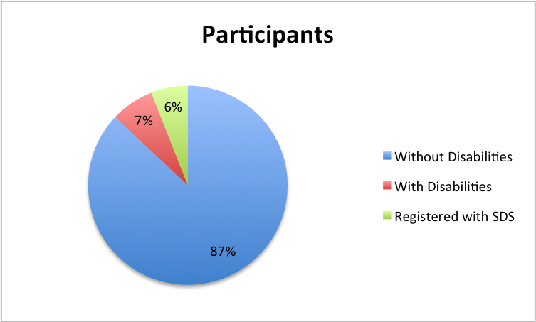
The Participants
Total of 241 students:

Slide 10
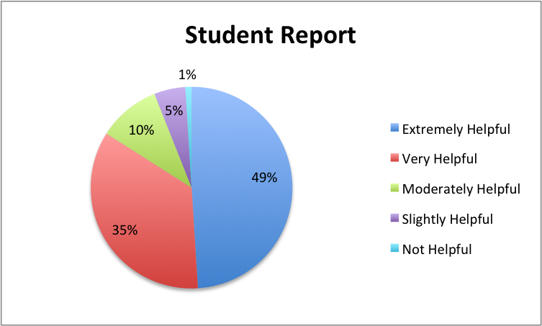
The Findings
Reported Benefits
Students
Clarification
Comprehension
Spelling
Note-taking
Faculty
Improvements in evaluations

Slide 11
Cost Analysis
Explored:
  External vendor
  In-house captionist
  Speech-to-text software
Considerations:
  Annual cost
  Time investment
  Accuracy

Slide 12
Results @ USFSP
Online Learning at USFSP:
  All online courses can receive closed captioning for course media.
  All online courses developed through our office must be closed captioned.
    Official procedure within Instructional Design Operating Procedure
    Combination of external vendor or staff (if script provided)
Proposed USF System Procedure:
  Caption/Transcribe media in all F2F and Online courses

Slide 13
Questions?

Slide 14
Contact Us
We’d love to hear from you!
David Brodosi
brodosi@mail.usf.edu
Karla Kmetz Morris
kmetz1@mail.usf.edu

