Slide 1

Closing the Loop:
Applying the QM Rubric to Online Course Survey Redesign
Quality Matters
Mid-Atlantic Regional Conference
March 24, 2015
Joan Mikalson, Associate Provost of Student & Faculty Services
Wendy Trevor, Executive Director, CETLA
Mohua Bose, Executive Director, Institutional Effectiveness
Meghan Morris Deyoe, Director, Outcomes Assessment

Slide 2

Excelsior College
Online courses
Aggregated model, exams, prior learning credit
1140 instructional faculty
Adult learners
  Historically underrepresented in higher education
  76% students in full-time employment
  30% active military;10% veterans
  Average age 38 years

Slide 3

End of Course Evaluations
Experience item content mapping to QM standards?

Slide 4
Background and Opportunity
Trigger: faculty concerns about double negatives
Student Course Evaluation
Tool revised every five years
Last revision 2010
Centralized process
Notes:
Vacroux report

Slide 5
Background and Opportunity
Ongoing Discourse - Student Course Surveys & Faculty
Topical: Chronicle of Higher Education
    UC Berkeley professors (Sep 2014)
      “Statistical misuse” and problems/confusion between “consumer satisfaction and product value”
    Max Lewontin: “For Adjuncts, a Lot is Riding on Course Evaluations” (October 2014)
      Flaws in the instrument
Notes:
Vacroux report
The two Berkeley professors identified two questions related to instructor effectiveness and course value as particularly exemplar of things that learners are “not equipped” to “cast judgments” upon.

Slide 6
Survey Revision Feedback Loop
Office of Strategy & Institutional Effectiveness
Faculty Steering Committee
Schools
Instructional Designers
Faculty Steering Committee
Notes:
Just to show how the feedback got back to FSC. We can add other input as well as FPDs really are the schools.
From MB: Please see my comment on the slide regarding COELAS.

Slide 7
Feedback
Faculty
  Concrete statements
    Learner ability to evaluate/ position to judge
    Good teaching vs. Experience with the course
      Introduction to the course
      Activities and interactions with others
      Access to support services
      Knowledge of how to use/purpose of instructional materials
      Knowledge of how they will be assessed
Notes:
This began to correlate to QM standards.

Slide 8
QM Standards
Course Technology
6
Overview and Introduction
1
Quality Matters
Standards
Course Activities & Learner Support
5
Assessment and Measurement
3
Notes:
We began to see the alignment between feedback from faculty about the survey design and a few of the QM standards.
When we looked at the existing survey items and the alignment with the 10 QM standards there were seven areas of alignment that were identified across the standards, specifically in Assessment and Measurement (QM 3.2, 3.3, and 3.5), Course activities and learner interaction (QM 5.1, 5.2, and 5.3), and Course Technology (QM 6.2). There were the seven areas.
The QM area on Instructional Material is an area where initially there was no alignment with our current survey, and we felt it will be beneficial to have an alignment there, and therefore an item was added to this area on instructional material.

Slide 9
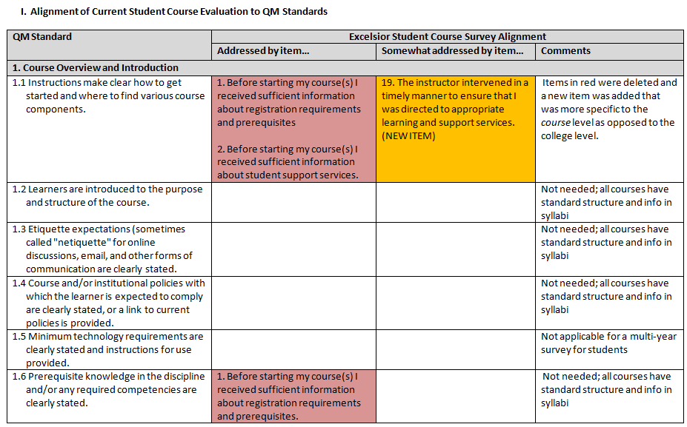
Notes:
This is the detailed mapping process that was undertaken. In the initial process, the QM standards that directly aligned included: 1.1, 1.6, 3.2, 5.1, 5.2, 7.4. The revised survey is directly aligned with QM standards: 1.1, 3.2, 4.1, 4.2, 5.1, 5.2 (Note that the item aligned with 1.6 was deleted since this was considered part of the standard structure and is not necessary to ask on a multi-year survey for students.)
In addition, items #1 and #2 (in alignment with 1.1) were eliminated since they pertained to a college-wide level more so than a specific course level. A more course-specific item was added and is somewhat aligned with QM 1.1
I added Patrick’s new item since it somewhat addressed the QM standard. Just a note I kept your color scheme—orange are items that somewhat align and yellow are for items that align. New items don’t have a different color, but it is noted that they are new. Deleted items are in red.

Slide 10
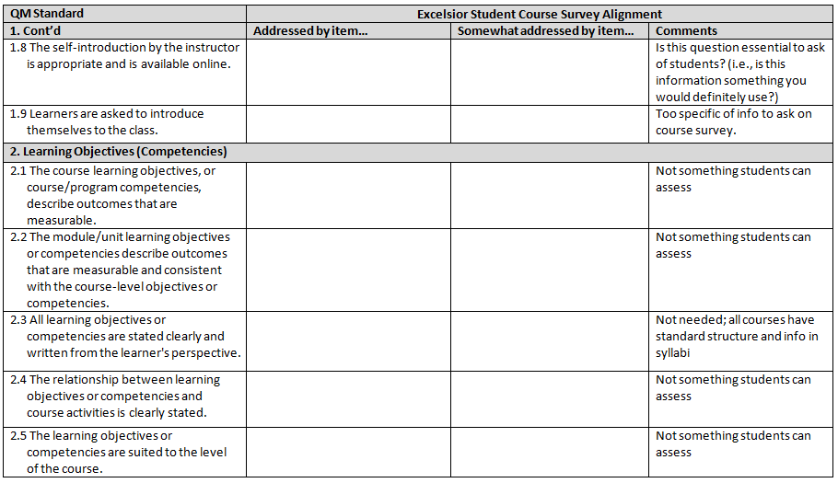
Notes:
The QM standards 2.1-2.5 were more related to instructional design and assessment and are not items students can assess

Slide 11
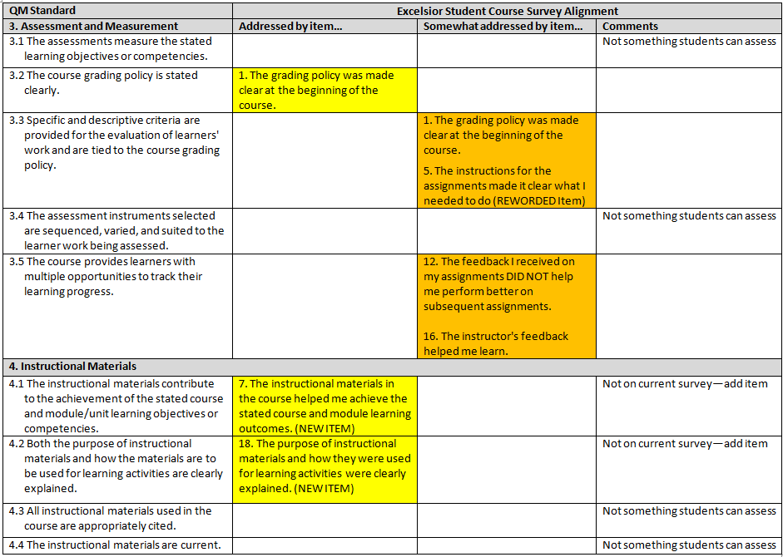
Notes:
Note that 4.2 was an area which was not addressed on our survey so we added a new item on this aspect in the revised survey.
An item also was added to address 4.1

Slide 12
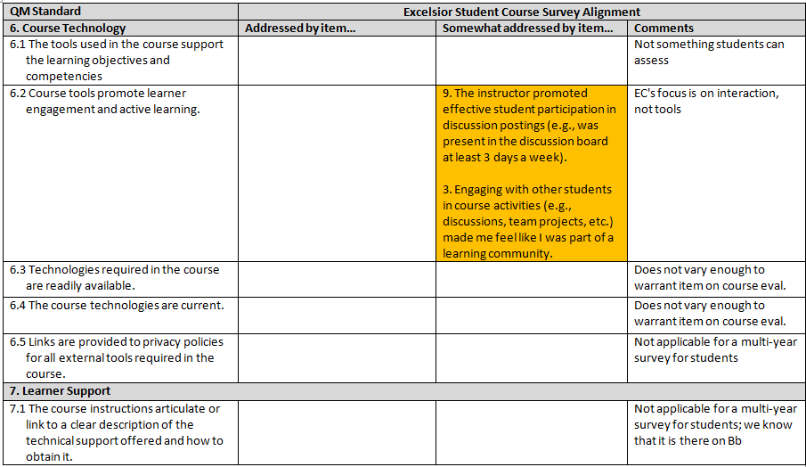

Slide 13
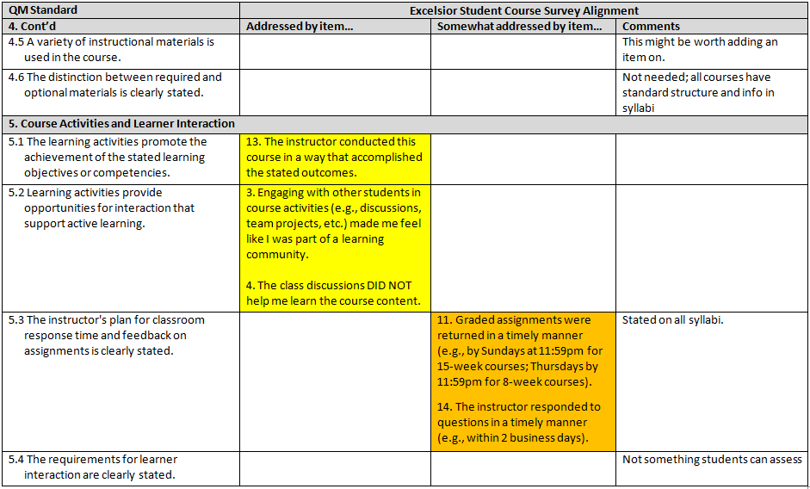

Slide 14
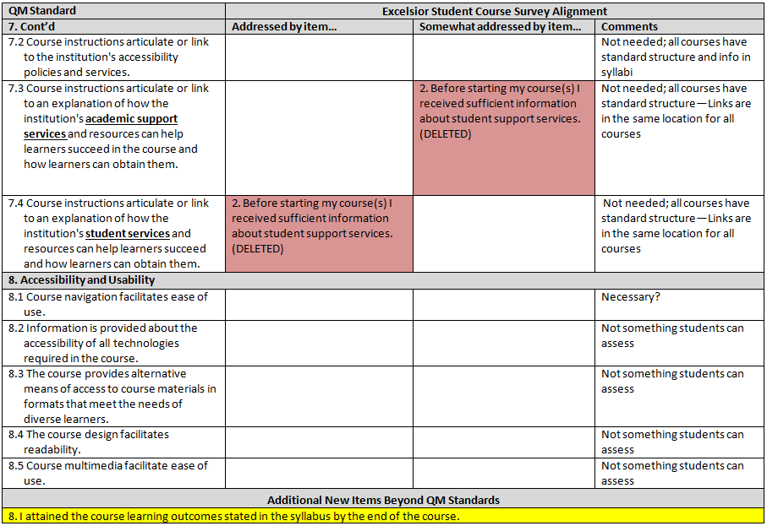
Notes:
Survey item #2 was deleted (that was directly aligned with QM 7.4, somewhat aligned with QM 7.3) since the links for students are in a standard location for all courses and are not needed on a multi-year survey for students.
From MB: We also deleted the item which previously aligned with 7.4.
Overall, even if not in a slide, it will be beneficial to sum it up of where we saw alignment (I mentioned in my comment under slide 7), and where we did not make any effort to incorporate into the survey because:
Centralized course
Not something students could assess—more based on instructional design

Slide 15
Summary of QM Alignment
Seven primary areas of alignment in 3 areas:
  Assessment and Measurement: QM 3.2, 3.3, and 3.5
  Course Activities and Learner Interaction: QM 5.1, 5.2, and 5.3
  Course Technology: QM 6.2
Additions: Instructional Materials: 4.2 not previously addressed. New item on revised survey
Notes:
From MB:
If one looks at the mapping document, one will be able to see that in the comments section, where we place all courses have standard structure it means that due to the unique centralized course design and the assurance that we are following the standards made us not want to place items on the survey regarding that aspect.

Slide 16
Unaddressed Standards
Areas where learners are not best placed to make a judgment of quality, e.g. Standard 2 (2.1, 2.2)
2.3
  Rationale: Unique centralized course development that incorporates QM standards in the design of the course
    Templates with module and course objectives in each module.
  Future opportunity: 2.4
    Now they are in each module not tied to activity (assignment)
Notes:
2.1 Measurability of course and module outcomes and consistency of module outcomes with course-level objectives
2.3 Clarity in writing of objectives from a learner standpoint. And stated prominently—we have them in modules and in syllabus.
2.4 Relationship between learning objectives or competencies and course objectives is clearly stated—integration throughout the course link between the activities and the learning objectives.

Slide 17
Benefits
Immediate feedback on learner’s experience
Learner-centered awareness of design
Learner engagement with idea of quality improvement; reinforces institutional commitment
Faculty “buy in” to end of course survey as students “judge what they can”
Improved online course quality
Notes:
More benefits?

Slide 18
Closing the Loop
Course Development
Course Delivery
Student Course Survey
Faculty Feedback
QM Course Reviews
QM Committee
Template Revisions
Course revisions

Slide 19

Questions

Slide 20
Thank you
      jmikalson@excelsior.edu
      wtrevor@excelsior.edu
      mbose@excelsior.edu
      mmdeyoe@excelsior.edu

