Slide 1

Coffee and Course Design
Professional Development Model
New Mexico State University

Slide 2
Your Presenters
Sandra Johnson, Consultant
Instructional Innovation and Quality
Quality Matters Coordinator
Online Course Improvement Program
Susie Bussmann, Director
Instructional Innovation and Quality
Distance Education
Online Course Improvement Program

Slide 3

Agenda
Overview of the Online Course Improvement Program (OCIP)
Discuss Coffee and Course Design PD Model
Share examples of Coffee and Course Design Workshops
Share feedback from participants
Questions and answers

Slide 4
Online Course Improvement Program (OCIP)
Focused on instructional design principles for developing quality blended/online courses.
Quality Matters is the foundation for program.
Uses mentoring for just-in-time assistance to participants.
Provides professional development
Coffee and Course Design (CDC) one component of OCIP.
Focuses on friendly atmosphere that encourages connections and collaboration with peers.

Slide 5

Why CCD?
Short and sweet
Informal
Hands on
Targeted one thing
Tangible and immediate result
Supported
Collaborative

Slide 6
Coffee and Course Design Workshops
Meets in the morning for one hour ~ once per month.
Coffee, donuts, granola bars, etc. is provided.
One topic is shared.
30 minutes spent on demonstration or “how to.”
30 minutes spent on hands-on application.
Presenters stay after workshop for support if needed.

Slide 7
Set-Up for Workshop
Use of wiki to prepare and share workshop agenda.
Includes step-by-step directions.
Provides examples and helpful tips.
Provides additional resources.
Wiki is an open resource for anytime/anywhere access.
Any faculty or staff from university community can attend.

Slide 8
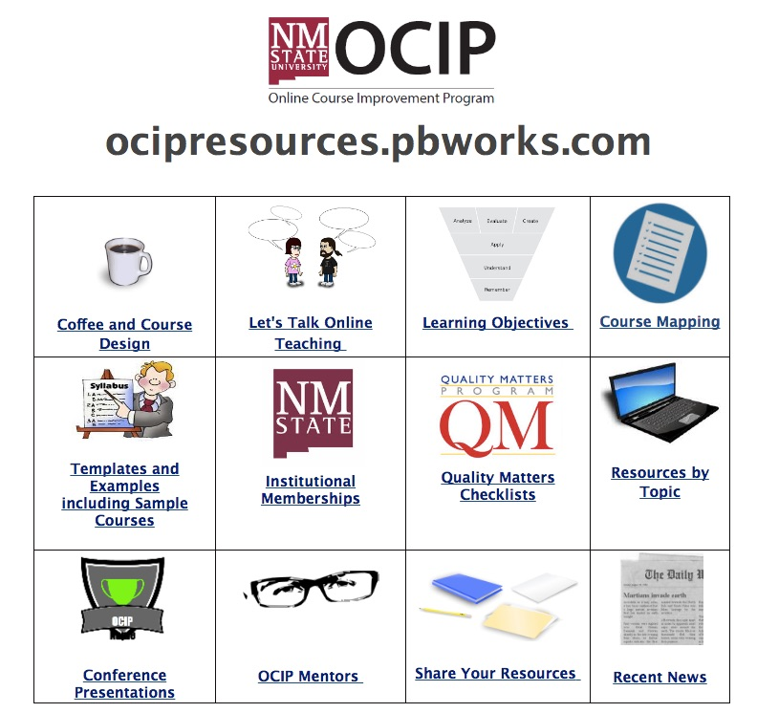
CDC Examples
OCIP Resources Wiki
ocipresources.pbworks.com
Sharing/Demonstration
Banners for Your Online Course

Slide 9

Other Important Information
Promotion is key!
NMSU system-wide listserv, Hotline newsletter,
program emails, Canvas PD course
Preparation necessary
Incentive - PD hour
Affordable - $10 - $15/session
Lab setting preferable

Slide 10

Future Plans
Hybrid format - face-2-face & online
Add additional topics
Incorporate more videos
Use faculty presenters

Slide 11

Any Questions?
Thank you for attending!

