Slide 1

Building Community with Informal Peer Review Cohorts

Slide 2
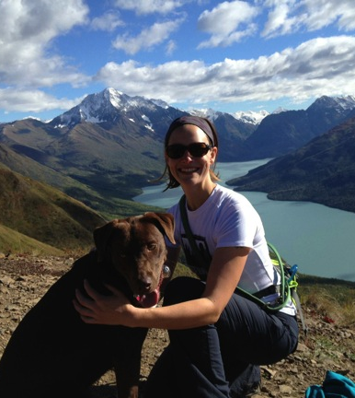
Melissa White
Instructional Designer
Adjunct Faculty
QM Coordinator
QM Certificates:
  Face to Face Facilitator
  Online Facilitator Certification
  Peer Reviewer Course
  Course Review Manager
  Continuing and Professional Education Accelerated Reviewer
Dog Lover

Slide 3
Friday Happy Hour
What is your name?
Where are you visiting from?
What is your favorite standard and why?

Slide 4
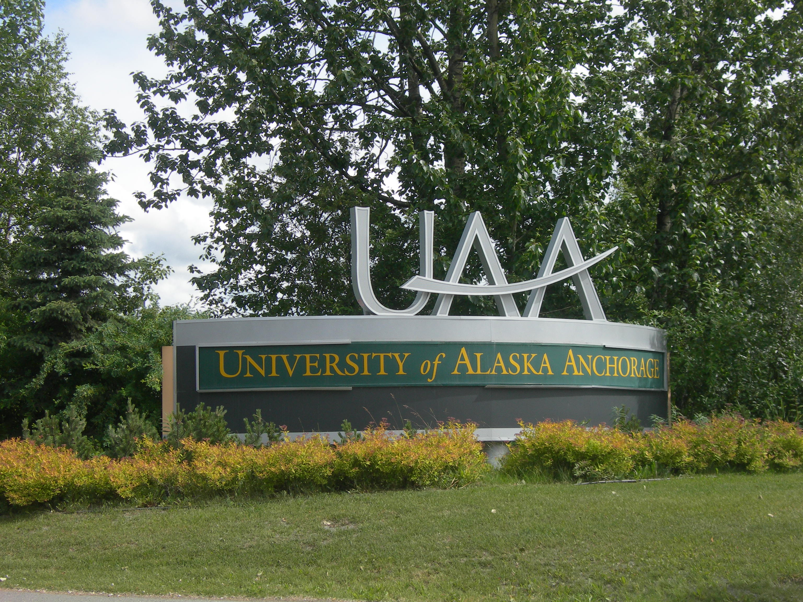
Implementation 2014-15

Slide 5


Slide 6
Implementation Year
Statewide subscription to Quality Matters
Lead team - Academic Innovations & eLearning
Outreach at the department level
Focus on professional development
  APPQMR
  PRC
Create a sense of community
Build upon success of Kodiak College and Kenai Peninsula College
Peer reviews!

Slide 7

Peer Review Challenges
No current department/program/university policies for addressing issues of workload (gasp!)
The course review worksheet is a barrier – more paperwork
Faculty soft spots

Slide 8
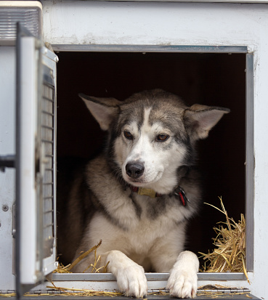
Cohort
Everything is Awesome…When You’re Part of a Team!
Build upon success of our iTeach and Tech Fellow Cohorts
Informal peer reviews.
Practice for inexperienced peer reviewers.

Slide 9
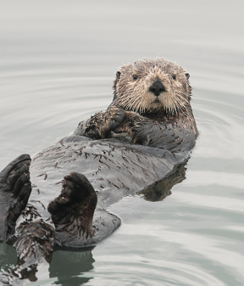
Course Instructors
5 Faculty Members
English, Psychology, & Education
First Group out of UAA

Slide 10
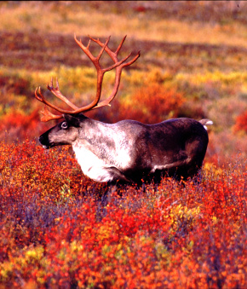
Peer Reviewers
Partner “Seasoned” Master Reviewer with
Recently certified peer reviewer

Slide 11
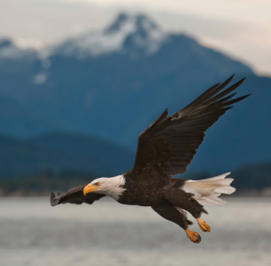
Initial Meeting
Overview of the Peer Review Process
How the Cohort will work

Slide 12
Timeline
January 30 – Submit Course Workshops
February 6 – Approval of Course Workshops
Feb 6 – February 27 – Informal Peer Reviews
March
  Meet in cohort groups
  Course Revisions
  Potential review changes
March 31 – Finalized Informal Peer Review
April TBA – meeting of cohort
April – Publication of QM blog post, application for formal peer review (optional)

Slide 13
Modified Timeline
1 review complete!
3 in progress
1 faculty member opted out
1 peer reviewer opted out
Reviews will be complete by April 24.

Slide 14
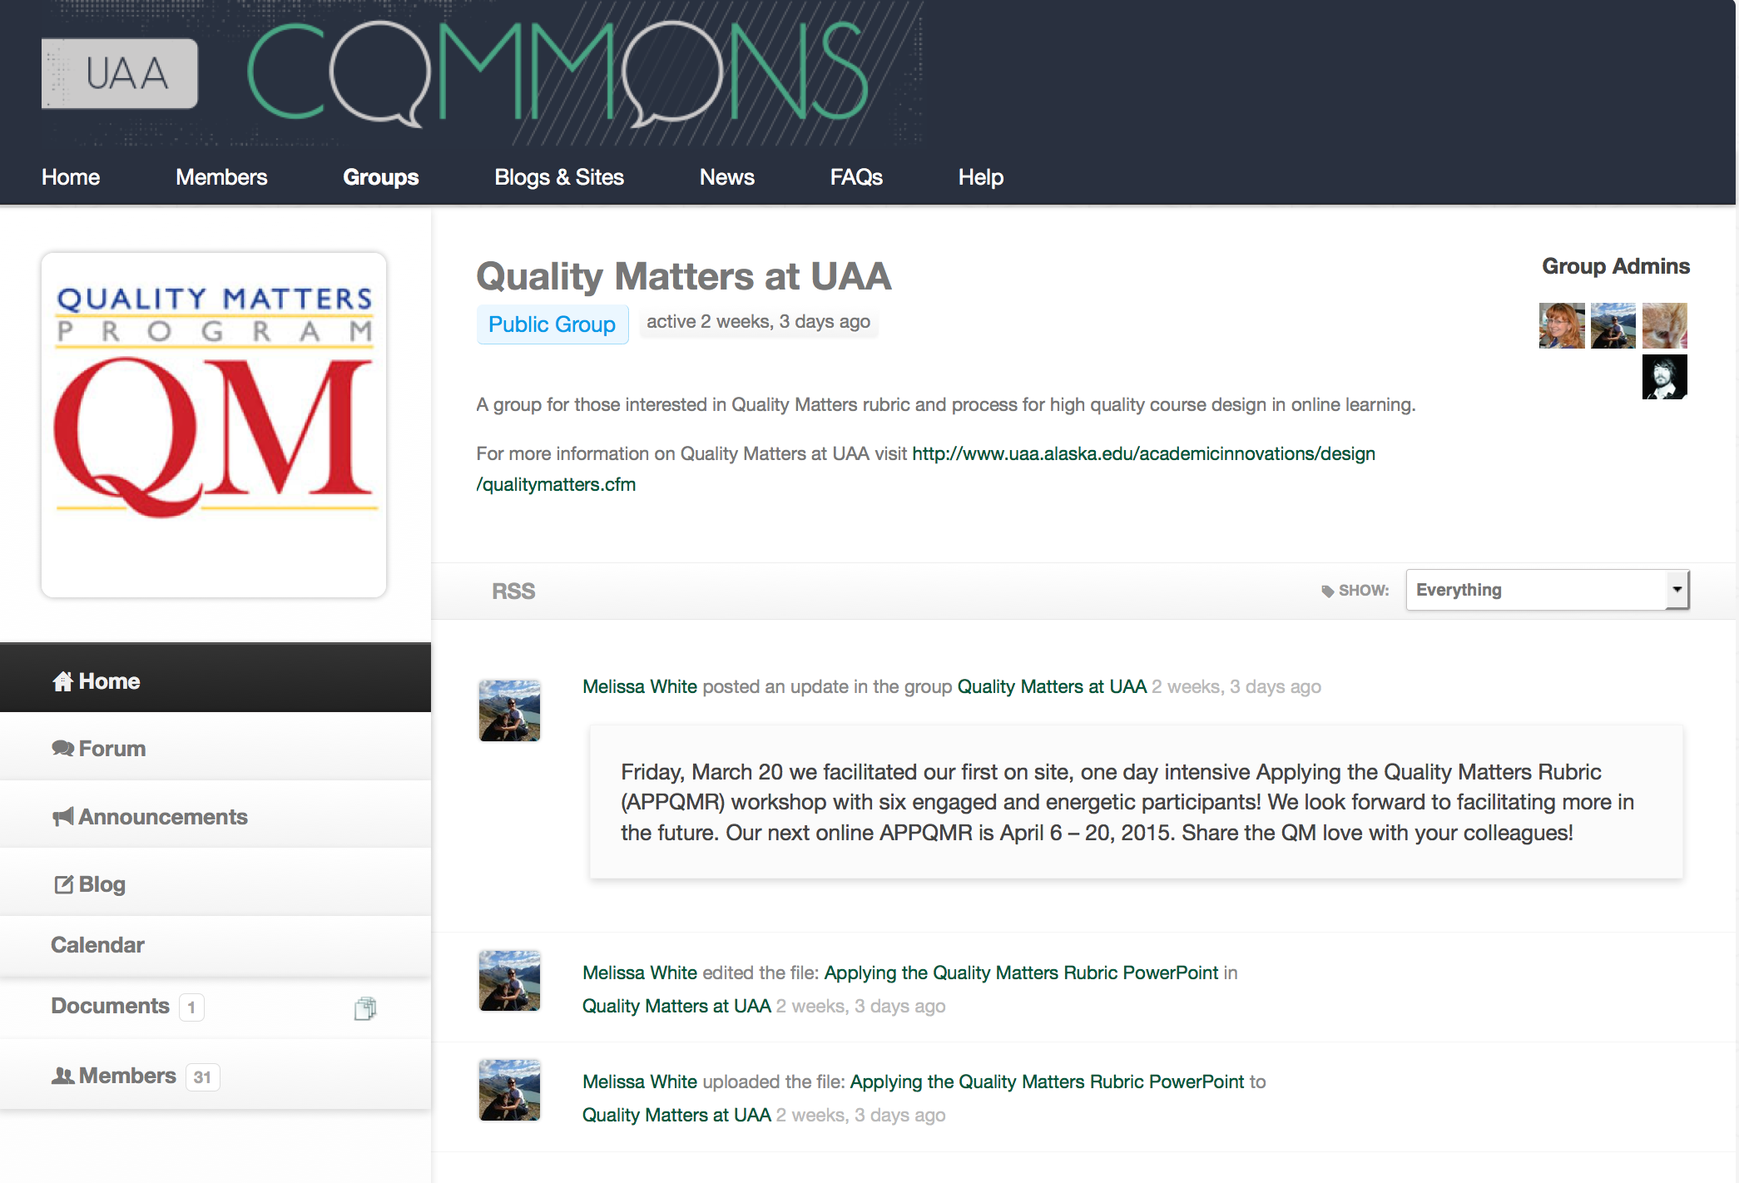


Slide 15
Successes & Challenges
4 of 5 will complete cohort
1 applying for formal peer review
Will have a larger cohort in the fall 2015
Workload is on the table
Prioritization – the good, the bad, and the ugly

Slide 16

Thank You!
Let’s connect ☺
mbwhite3@uaa.alaska.edu
Twitter: melissabee49 @banker_melissa

