Slide 1

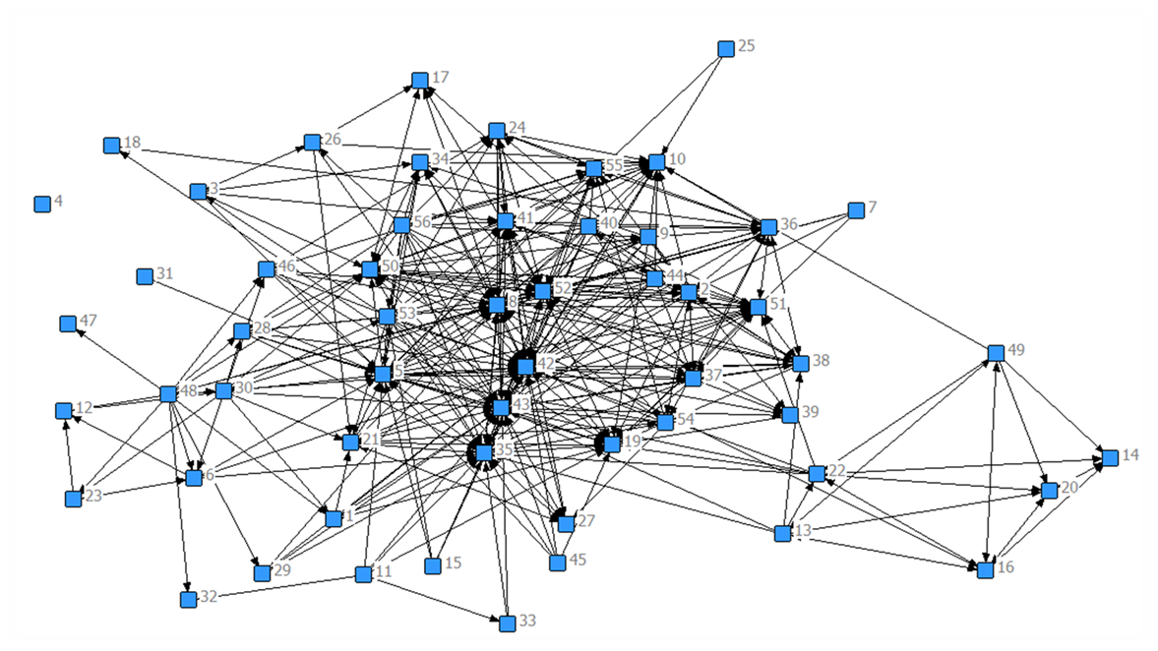
A Community of Quality:
Using Social Network Analysis to Study University-Wide Implementation of QM
Slides available at facdev.niu.edu/QM15_SNA

Slide 2
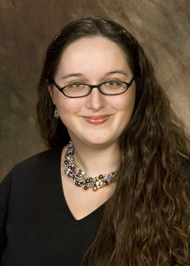
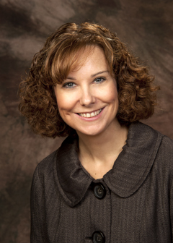
Presenters
John Cowan
Sr. Research Associate
Outreach
jcowan@niu.edu
Aline Click
Director
eLearning Services
aclick@niu.edu
Stephanie Richter
Assistant Director
Faculty Development
srichter@niu.edu
Tracy Miller
Online Teaching Coordinator
Faculty Development
tracy.miller@niu.edu

Slide 3
Session Objective
Define social network analysis and describe its use in studying community formation
Describe a SNA protocol used to identify key brokers and increase connection within a community

Slide 4
Activity
Write your name on a post-it note
Choose size based on your experience with QM
  Small: 0-2 years
  Medium: 3-5 years
  Large: 6+ years
Choose color based on your institution
  Blue: 4-year, higher ed
  Yellow: 2-year, higher ed
  Green: K-12
  Pink: Corporate

Slide 5
Activity
Post your name on the poster
Public
Private

Slide 6
Activity
Add your connections
During our presentation, pass the markers around to add lines to connect yourself with anyone you know and consider a colleague

Slide 7
Our Community:
Faculty and Staff Working with Online Teaching Quality Standards at NIU

Slide 8
Notes:
Welcome Screen: Show this slide on the screen prior to the session to help your participants identify that they’re in the right place and in the right session. Add your institution and date in a text box to make the information more specific.
Last updated 01/23/15

Slide 9
QM at NIU
Adopted September, 2014
Review is optional but encouraged (and required for courses or programs to be promoted)
Standards are automatically incorporated in courses developed by eLearning Services

Slide 10
Community of Inquiry
Adopted CoI framework to address siloing and increase sense of ownership for faculty
Sample Activities:
  Campfires in Cyberspace
  Informal presentations & discussion within departments
  Online Course Design Academy
Problem: How to evaluate community formation?
Notes:
Is this a good network or a bad network?
Is this a strong network or a weak network?

Slide 11
Social Network Analysis

Slide 12
What is Social Network Analysis?
A systematic method for capturing relationships in a group
Allows visual representation of quantitative data using lines (connections) and dots (nodes)

Slide 13
SNA as Research Methodology
A mixed methods approach (an ethnographic sandwich)
Started in the 1930’s (Moreno, 1934)
1970s – present - Advancements with technology and fusion between matrix algebra and graph theory and the social sciences allows network measurements (White, Boorman & Breiger, 1976)

Slide 14
An Ethnographic Sandwich
Initial Contact
Social Network Analysis
Review/Member Checking
(Halgin & DeJordy, 2008)

Slide 15
Common SNA Statistical Measures
Centrality | How central an actor is in a network
Betweeness | The degree to which an actor is located between others on pathways in a network
Density | The ratio of connections in a network to the total number of possible connections
Cliques | Smaller complete subgroups that exist within a larger network
Distance | The distance from one actor to another in a network
Geodesic Distance | The number of relations in the shortest possible walk from one actor to another actor
Homophily | The tendency of members of a network to cluster with other members who share similar characteristics
(Hanneman & Riddle, 2005)

Slide 16
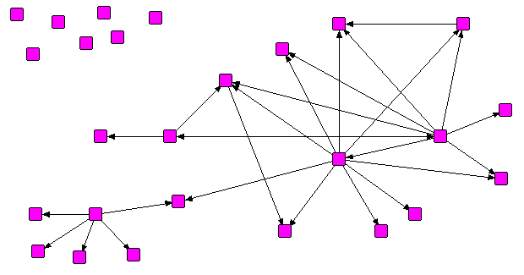
A Sample Network
Notes:
Is this a good network or a bad network?
Is this a strong network or a weak network?

Slide 17
Scenario:
Should a Small Company Expand?
An Overview of Social Network Analysis

Slide 18
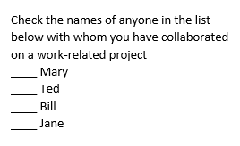
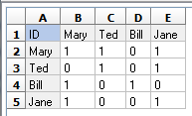
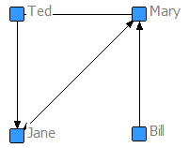
Step 1: Connections
Survey group members to determine connections
Survey data entered into a matrix
(0 = no connection, 1 = connection)
Software renders data as visual diagram
Software images from UCINET (Analytic Technologies)

Slide 19
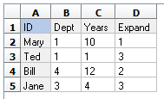
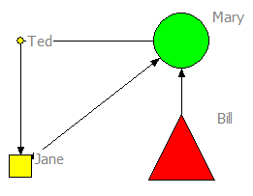
Step 2: Attributes
Characteristics of individuals are also are gathered in survey
What is your department? (1) Sales (2) Service (3) Accounting (4) Product Development
How many years in your current position?
Do you believe the company should expand operations? (1) Yes (2) No (3) Undecided
Attribute data entered into a matrix
Software renders matrix data as visual diagram
Department = Shape
= Product Development
= Accounting
= Sales
Years in Position = Size
Larger Shape = Longer Time
Expand = Color
Yes
No
Undecided
Notes:
Based upon the network, what decision might be predicted?
How might advocates for or against change influence the decision?

Slide 20
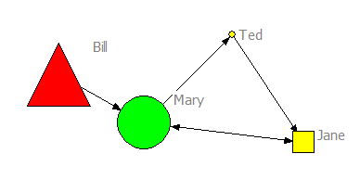
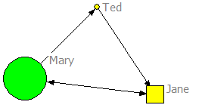
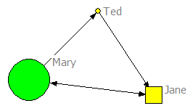
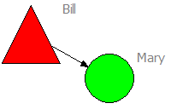
Step 3: Ego Networks
An individual’s network (sub-network) within a larger network (1-step)
Whole Network
Mary
Ted
Jane
Bill
Department = Shape
= Product Development
= Accounting
= Sales
Years in Position = Size
Larger Shape = Longer Time
Expand = Color
Yes
No
Undecided
Notes:
What is likely to be the outcome?
What might advocates for or against change do to influence the decision?

Slide 21
Quality Matters at NIU:
Social Network Analysis

Slide 22
Network Overview
Initial network data gathered at 2014/2015 APPQMR Sessions
Initial network data included three elements:
  Who have you worked with to develop online content prior to APPQMR?
  Who have you worked with on Quality Matters prior to APPQMR?
  Who would you seek advice from?
56 total participants (nodes)

Slide 23
Quantitative Statistics – Whole Network
Centrality Measures |  | Current Measure
Density | Number of lines in a graph, expressed as a proportion of the maximum possible number of lines. | 0.136
Degree | Number of links per person. | 7.464
Distance | Number of connections in the shortest possible walk from one actor to another. | 1.965
Components | Portions of the network that are disconnected from each other. | 25
Fragmentation | Percentage of the network that is disconnected (areas where network connections are absent). | 0.558
Cliques | Number of subgroups wherein all members are connected to each other. | 23

Slide 24
The Initial NIU QM Network

Slide 25
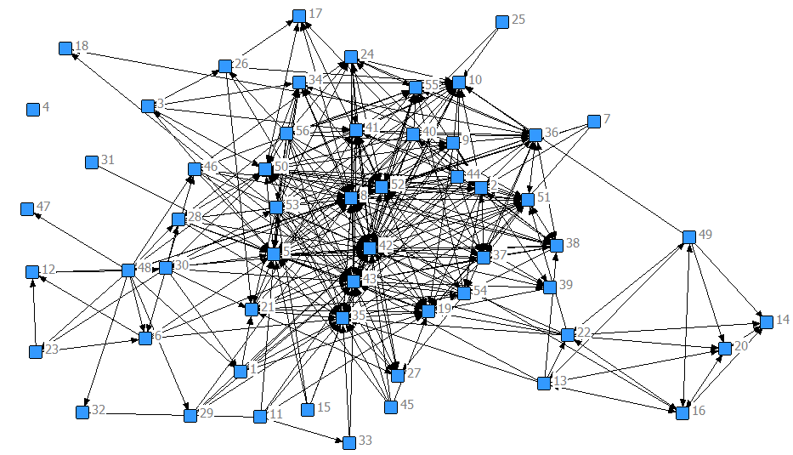
The Initial NIU QM Network:
Three Component Composite Image
Numbers = Participant ID

Slide 26
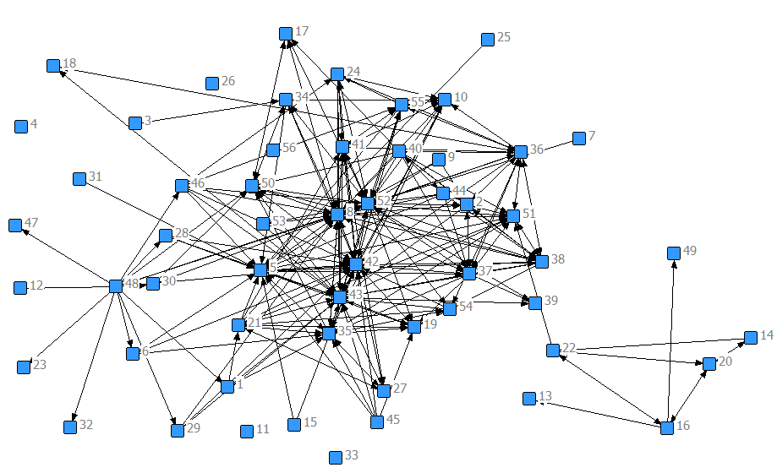
Who have you worked with to develop online content prior to APPQMR?
Numbers = Participant ID

Slide 27
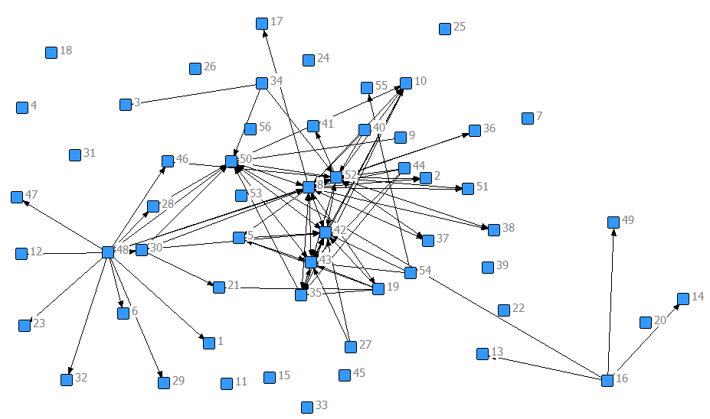
Who have you worked with on Quality Matters prior to APPQMR?
Numbers = Participant ID

Slide 28
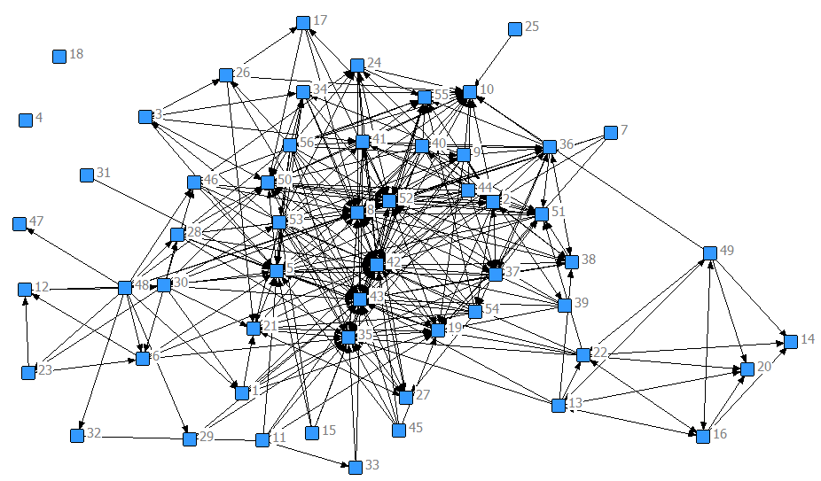
Who would you seek advice from?
Numbers = Participant ID

Slide 29
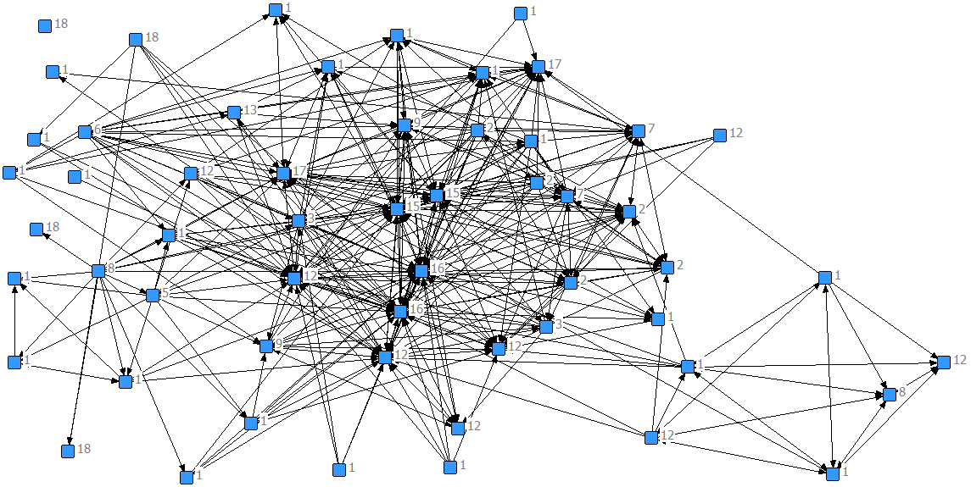
Composite Network: Members’ Roles
Numbers = Role
1 = Professor | 4 = Graphic Artist | 7 = Web Developer | 10 = Analyst | 13 = Dean | 16 = QM FacDev Advisor
2 = Instructional Designer | 5 = Coordinator | 8 = Chair | 11 = NA | 14 = Other | 17 = QM Outreach Advisor
3 = Researcher | 6 = Director | 9 = Support Staff | 12 = Instructor | 15 = QM eLearning Advisor | 18 = Non-Respondent

Slide 30
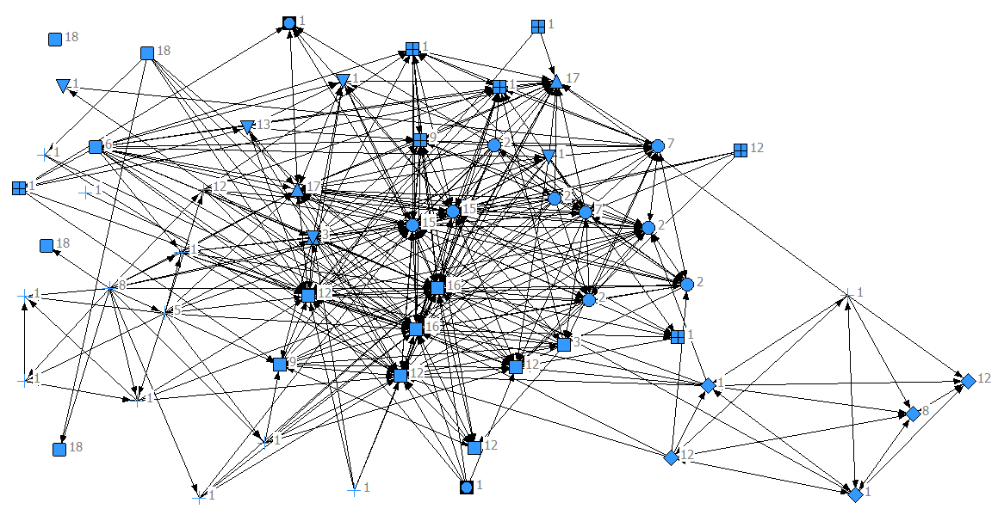



Composite Network: Members’ Location
Numbers = Role
Shape = Locations
eLearning | College of Education | College of Business | Other
Faculty Development | College of Liberal Arts and Sciences | College of Health and Human Sciences
Outreach | College of Visual and Performing Arts | Office of Assessment

Slide 31
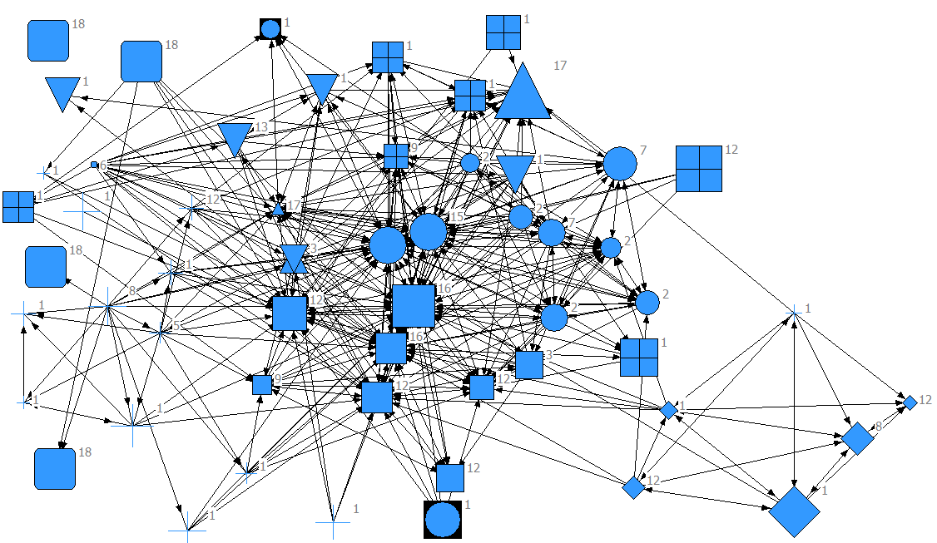
Composite Network: Members’ Power
Numbers = Role
Shape = Locations
Size = Power
Power = A combination of rank, tech skill self-rating and experience (online teaching and developing content)
The larger the shape, the greater the power rating

Slide 32
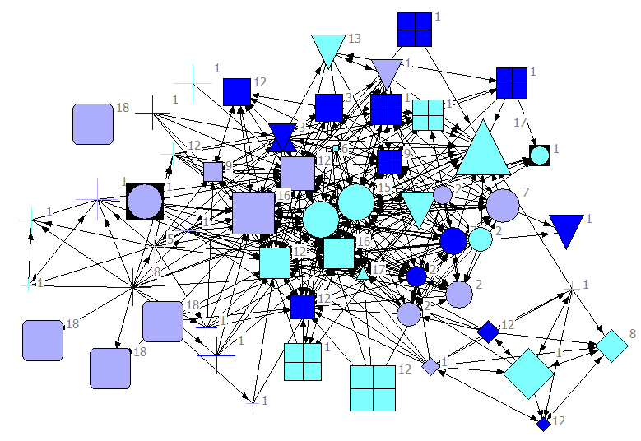
Interest in QM Reviewer Training
Numbers = Role
Shape = Locations
Size = Power
Color = Interest
Interested and Able
Need More Information
Not Interested or Not Able

Slide 33
Next Steps

Slide 34
Next Steps
Continue gathering initial data for new entrants to the network
Identify actions to take based on individual nodes in the network
Provide opportunities for networking and community growth
Conduct a follow-up survey to get new data after 6-12 months

Slide 35
Desired Results
Centrality Measures | Current Measure | Future Analysis Positive Indicator
Density | 0.136
Degree | 7.464
Distance | 1.965
Components | 25
Fragmentation | 0.558
Cliques | 23

Slide 36
References and Resources
Analytic Technologies (2015). Social Network Analysis Software – Cultural Domain Analysis Software. Retrieved from: http://www.analytictech.com/.
DeJordy, R. and Halgin, D. (2008). Introduction to ego network analysis. Retrieved from: http://www.analytictech.com/e‐net/PDWHandout.pdf.
Hanneman, Robert A. and Mark Riddle. 2005. Introduction to social network methods. Riverside, CA: University of California, Riverside. Retrieved http://faculty.ucr.edu/~hanneman/.
Moreno, J.L. (1934). Who Shall Survive? Washington, DC: Nervous and Mental Disease Publishing Company.
White, H. C., Boorman, S. C., & Breiger, R. L. (1976). Social structures from multiple networks, I: Blockmodels of roles and positions. American Journal of Sociology, 81, 730-780.

Slide 37
Questions?
John Cowan
Sr. Research Associate
Outreach
jcowan@niu.edu
Aline Click
Director
eLearning Services
aclick@niu.edu
Stephanie Richter
Assistant Director
Faculty Development
srichter@niu.edu
Tracy Miller
Online Teaching Coordinator
Faculty Development
tracy.miller@niu.edu
Slides available at facdev.niu.edu/QM15_SNA

