Slide 1
Applying QM to a Face-to-Face Course
Blending, Flipping, Extending: QM Beyond the Online
Stacey S Cofield, PhD
Associate Professor, Department of Biostatistics

Slide 2
The Course Today
QM standards can be effectively applied to an in person, traditional, lecture-based course to achieve a more dynamic and purposeful class room.
This session will look at how course competencies can be supported using QM standards, including:
  The syllabus
  Independent and group activities
  Lectures
  Assessments: homework, exams, and projects
slide 2 of 35

Slide 3
Objectives Today
Apply QM standards to a face-to-face class (f2f)
Categorize learning activities to a module-level, course-level, or competency (degree) level objective
Design a three-level outline for a f2f session incorporating think → do → explain activities
slide 3 of 35

Slide 4
How will we meet the Objectives?
Who am I?
Review the QM Rubrics
What Can Go Online?
Applying the Rubrics
Building Active Learning from the Beginning
A Dynamic Classroom
slide 4 of 35

Slide 5
Who Am I?
Associate Professor
  Research Methods & Clinical Trials
  Graduate Program Committee
  Online Courses Committee
Clinical Research Areas:
  Multiple Sclerosis
  Rheumatoid Arthritis
Statistical Research Areas:
  Longitudinal Modeling
  Missing Data Approaches
  Patient Reported Outcomes
Graduate & Undergraduate
Online Teaching:
  BST 611 & 612: Applied Introductory Biostatistics (no math requirement)
  2008-2012: f2f with recorded lectures posted online
  2013-2016: stand alone online content
Multiple Blended Courses
slide 5 of 35

Slide 6
QM Rubrics
QM
For each slide the QM rubric will appear in the upper right corner
Course Overview and Introduction
Learning Objectives: 2.1 & 2.2 Learning Objectives
Assessment and Measurement: 3.1 Assessments
Resources and Materials: 4.1 Instructional Materials
Learner Engagement: 5.1 Course Activities
Course Technology: 6.1 Course Tools
Learner Support
Accessibility
Key Elements
6.1
2.1 & 2.2
4.1
5.1
3.1
slide 6 of 35

Slide 7
Your Course Overview and Introduction
QM 1
Following QM for Rubric 1 frees up time in class
A lot of the first f2f lecture can now live online:
  Set up a syllabus quiz
  Online introduction discussion forum
  Clarity in course expectations
slide 7 of 35

Slide 8
Communication is key
QM 1
Policies, due dates, & grades should be clear up front → Post online
If it impacts student performance, post or email AND say in f2f
slide 8 of 35

Slide 9
Getting Started on QM 2
QM 2
It will be impossible for students to understand the goals of the course if you don’t understand them start to finish
Get a big picture idea of what you want out of the course & the f2f interactions
What major topics will be covered? What learning materials will be presented? What technologies and media will be needed → QM 6?
slide 9 of 35

Slide 10
2.1 & 2.1 Learning Objectives
QM 2
These are often lost on students & can be broad
End the course with a review
  The end of the course would be the slideshow of the trip
End by asking them what they did gain
Start the course with an overview
  Think of this as having your reservations for a trip
Start by asking students what they hope to gain from the course
slide 10 of 35

Slide 11
2.1 & 2.1 Learning Objectives
QM 2
Degree or Course Objectives may be mandated
They may not be written as student-centered or active objectives
What you can do is look at each objective and then align your course goals with each objective
  It will help if you can also align the lecture objectives
slide 11 of 35

Slide 12
Learning Objective Alignment
QM 2
Degree Objective: Broad Concept
Course Objective: Specific Understanding
Module Objective: Practicing Application
slide 12 of 35
Notes:
Activity:
Align three statements: Use JMP software to perform a t-test -> Understand when to apply a t-test ->
Align three activities: Worksheet -> Paper -> Comprehensive Exam

Slide 13
Learning Objective Alignment – Activity #1
QM 2
PUH 350 – Beating the Odds: Statistical Modeling & Disease Prediction
Activity 1 – You each have 3 objectives: 1 degree, 1 course, 1 module
  See if you can align them in the two diagrams on your handout activity #1
Degree Objective: Broad Concept
Course Objective: Specific Understanding
Module Objective: Practicing Application
slide 13 of 35
Notes:
Activity:
Align three statements: Use JMP software to perform a t-test -> Understand when to apply a t-test ->
Align three activities: Worksheet -> Paper -> Comprehensive Exam

Slide 14
Vote your choice
Go to: pollev.com/uabSSC
Or text: uabSSC to 22333 then text your vote
slide 14 of 35

Slide 15
Objectives to Align on Handout # 1
Vote:
Degree → Course → Module
#1: a → b → c
#2: b → a → c
#3: c → a → b
Critique published research manuscripts
Understand historical milestones in public health and how they influence current practice
Complete the 11-point paper checklist for the assigned research paper
slide 15 of 35

Slide 16
Learning Objective Alignment – Activity #1
QM 2
Degree Objective: Broad Concept b
Understand historical milestones in public health and how they influence current practice
Course Objective: Specific Understanding a
Critique published research manuscripts
Module Objective: Practicing Application c
Complete the 11-point paper checklist for the assigned research paper
slide 16 of 35
Notes:
Activity:
Align three statements: Use JMP software to perform a t-test -> Understand when to apply a t-test ->
Align three activities: Worksheet -> Paper -> Comprehensive Exa

Slide 17
Assessments
QM 3
Once the degree objectives are aligned with course and module objectives, it is time to think about the course assessments
Each assessment should be supported by the practicing application for the module objective
Start simple and build to more complex assessments
slide 17 of 35

Slide 18
Assessments
QM 3
Simple assessments may include multiple choice, true-false, fill-in-the-blank, and matching type activities OR
They can be self-assessments, learning checks, “grade-free” activities for practice → can be online
Use rubrics!
  We are forced to do so online because you can’t defend your grading decisions to every single student very easily
  But if you have them for f2f you can use class time for more active learning or tutorials following assessments
slide 18 of 35

Slide 19
What Type of Assessments?
QM 3
90% of what we teach to others
80% of what we experience with others
70% of what we discuss with others
50% of what we hear & see
30% of what we see
20% of what we hear
10% of what we read
From William Glasser
slide 19 of 35
Notes:
activity: put activities in order: read materials -> watch video - > provide print example / tutorial -> provide web tutorial -> discussion board on activity -> homework / exam -> show class how to get correct answer

Slide 20
What Type of Assessments?
QM 3
Make thinking visible
~Vygotsky
Think → Plan → Write → Summarize
Think → Plan → Do
  Start with an online activity
  Move the concept to f2f small group work
  Escalate to a large group discussion
  Address similar problem in a homework or exam
slide 20 of 35
Notes:
Also called a “Snowball Activity” start it online and move it to classroom

Slide 21
Assessments – Activity # 2
QM 3
Work in Pairs
Each pair has a set of 6 post-it notes each with a different assessment for critiquing published research
Put the post-its in the correct order on the boards starting with the first assessment on board #1
slide 21 of 35
Notes:
activity: put activities in order: read materials -> watch video - > provide print example / tutorial -> provide web tutorial -> discussion board on activity -> homework / exam -> show class how to get correct answer

Slide 22
6 Assessments – Activity #2
QM 3
Summarize the whole online discussion (homework, graded)
Watch a video & complete learning checks (graded for completion)
Write a paragraph taking pro & con position on one discussion point (graded)
Critique a classmate paragraph using rubric (graded for completion)
Post & reply to 3 classmates on the discussion board (graded)
Read published manuscript and complete the discussion check list (graded for completion)
slide 22 of 35
Notes:
activity: put activities in order: read materials -> watch video - > provide print example / tutorial -> provide web tutorial -> discussion board on activity -> homework / exam -> show class how to get correct answer

Slide 23
Assessments – Activity #2
QM 3
1. Watch a video & complete learning checks
(graded for completion)
2. Read published manuscript and complete the discussion check list
(graded for completion)
3. Post & reply to 3 classmates on the discussion board (graded)
4. Write a paragraph taking pro & con position on one discussion point (graded)
5. Critique a classmate paragraph using rubric
(graded for completion)
6. Summarize the entire discussion
(paper or exam)
slide 23 of 35
Notes:
activity: put activities in order: read materials -> watch video - > provide print example / tutorial -> provide web tutorial -> discussion board on activity -> homework / exam -> show class how to get correct answer

Slide 24
Instructional Materials
QM 4
A variety of materials allows different learners to achieve highest learning level
Compiling the materials should go hand-in-hand with the types of assessments that are included
  You wouldn’t want students to only read speeches for a course on giving speeches
  Having students watch videos would be more effective
slide 24 of 35
Notes:
4.1 Instructional Materials
Use class time for enhanced interactive learning. Remember we recall more of what we do and what we teach than what we read

Slide 25
Instructional Materials
QM 4
In online courses, materials are often presented in a variety of ways to support the learning objectives:
  A video to watch
  Supporting or foundational materials to read
  Learning checks within the online materials (→ QM 3)
  Graded activities escalate (→ QM 3):
    grade-free activity → homework → exam
slide 25 of 35
Notes:
4.1 Instructional Materials

Slide 26
Instructional Materials
QM 4
Escalate the active learning in materials:
  Read about how to outline a speech (learning checks)
  Watch a speech, create outline from the video (pass/fail)
  Create own outline (graded)
  Record one section of speech for review by class member or teacher (pass/fail)
  Give full speech (graded)
slide 26 of 35
Notes:
4.1 Instructional Materials
1&2 are Think
3 is Plan
4 and 5 are Do

Slide 27
Instructional Materials
QM 4
The same things can be used effectively in f2f classes:
  Post readings or videos before class time
  Have small activities online prior to class
  Reserve class time for active learning
The online system allows for reinforcement of materials with review videos
Do not need to spend valuable f2f time in review
slide 27 of 35
Notes:
4.1 Instructional Materials

Slide 28
Learner Engagement
QM 5
Each activity should promote some kind of learning interaction:
  Student to content: reading / watching
  Student to instructor: lecture / discussion
  Student to student: group work / discussion / peer review
slide 28 of 35
Notes:
5.1 Course Activities:
Learning activities promote interaction:
Student to Content
Student to Instructor
Student to Student

Slide 29
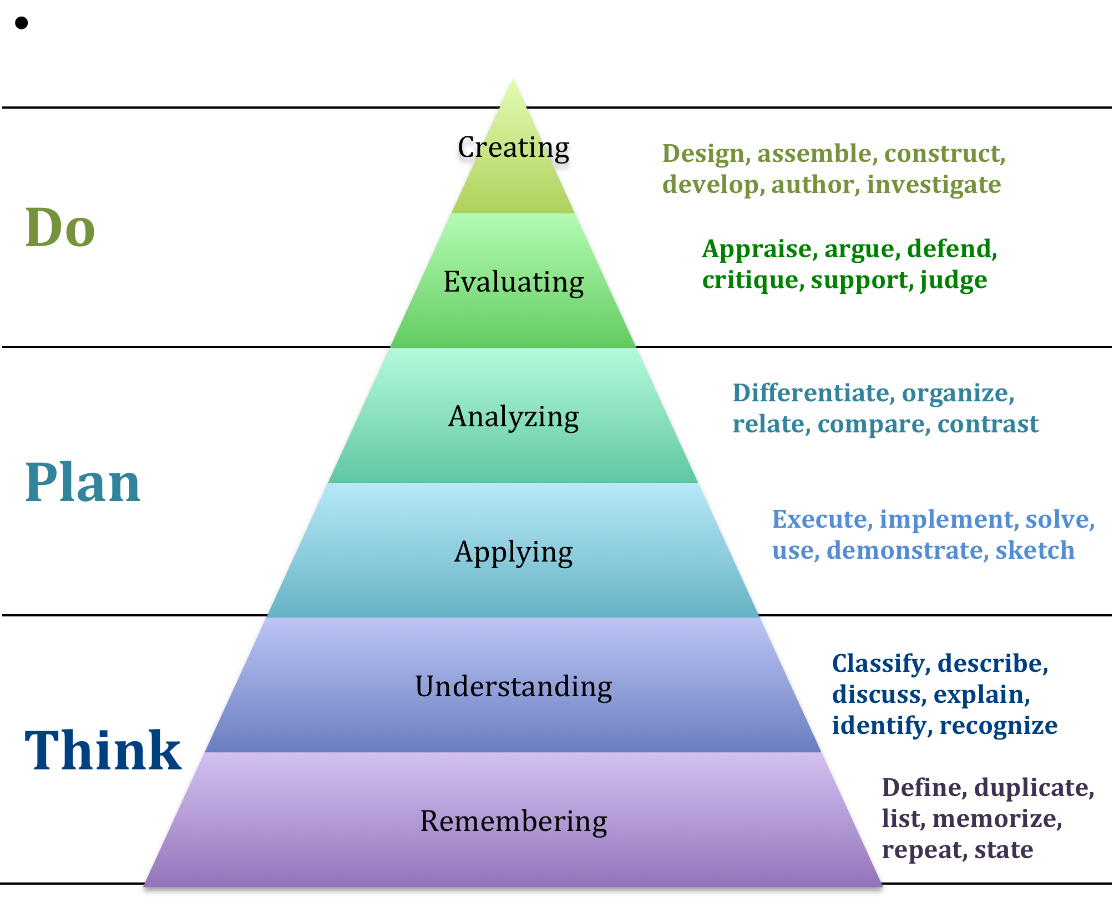
slide 29 of 35

Slide 30
Outline for Course – Activity #3
QM 5
Using Handout #3, craft an outline of a
Think → Plan → Do for a single course module
There are examples on the handout but you may also use your own course example
slide 30 of 35

Slide 31
QM 5
Outline for Course – Activity #3
Let’s share some examples…
slide 31 of 35

Slide 32
Technology for the Assist
QM 6
A small amount of online time can reduce in person office hours
Publish a digest of weekly Q&A emails or sessions
Set up problem solving forums where students can peer-to-peer mentor with supervision – everyone can see or read everything
Augment f2f time with videos or tutorials online, can open up the classroom time for discussion
slide 32 of 35

Slide 33
Learner Support & Accessibility
QM 7
& 8
Again this is where QM can be used in the online delivery system to support your f2f goals
Access to tutorials or other websites
Direct links to school supports
Even if you plan on largely lecture based, recording them and/or transcripting them is QM 4, 7 & 8!
slide 33 of 35

Slide 34
Revisit Objectives for Today
Objective for Today | How was objective addressed? | Activity Type
Apply QM standards to a face-to-face class | Review of Rubrics | Lecture
 | What Can Go Online? | Lecture
 | Applying QM Rubrics | Activity #1
Categorize learning activities to a module-level, course-level, or competency (degree) level objective | Overview of Assessment Types | Lecture
 | Alignment of Assessments | Activity #2
Design a three-level outline for a f2f session incorporating think, do, and explain activities | Types of Instructional Materials | Lecture
 | Types of Learner Engagement | Lecture
 | Outline Think → Plan → Do | Activity #3
slide 34 of 35

Slide 35
Thank You!
SCofield@uab.edu

