Slide 1
A Quality Assurance Taxonomy for Online Education:
A New Criticality Measure
Quality Matters 7th Annual Conference 2015
Monday 2ND November, 2015
1:30 – 2:20 pm
Genevieve Boucaud, PhD
boucaudg@usc.edu.tt

Slide 2
Objectives of the Presentation
Describe a new quality taxonomy for online education
Explain how the categorization system of the taxonomy works
State how the taxonomy can be used in specific contexts

Slide 3
Problem and Significance
The shortage of specific quality assurance (QA) measures that focus on the distinct needs of parochial system.
Growth in Online Learning
Accountability Issues
Accreditation
Identify QA Measures
Identify Key QA Dimensions
Build a Quality Taxonomy

Slide 4
Problem and Significance
Philosophical
Philosophy of Education
Theoretical
Internal Characterization of Quality
Practical
Facilitate Development of QA Measures
(Quality Taxonomy)
Collaboration
Knowledge Capital; Stakeholder Buy-in

Slide 5

Literature Design

Slide 6
Questions
What measure can we use to assess quality in AOHE programs?
What is the nature of QA measures that currently exist in online higher education?
What are key QA dimensions for AOHE?
What meaningful taxonomy, for quality
can be derived from the key QA
dimensions for AOHE?

Slide 7
Methodology
Research Design: Delphi Survey
Rationale
Scarcity; Small Sample;
Methodological Fit; Collaboration
Sample
Source Stakeholders
Upper Level Administrators
Program Directors
Faculty
Students

Slide 8
Findings
Twelve (12) Dimensions
Institutional Commitment, Support, and Leadership;
Instructional Design and Delivery;
Faculty Support, Training, and Qualifications;
Student Support;
Infrastructure;
Stakeholder Perceptions;

Slide 9
Findings
Twelve (12) Dimensions
Institutional Mission;
Curriculum Design and Review;
Course Design and Development;
Program Design;
Administration; and
The Integration of Faith and
Learning (IFL)

Slide 10
Findings
Eight (8) Themes
QA dimensions are shared by traditional and online education.
Align with Institutional Mission
Curriculum Design and Review
Course Design and Development
Program Design
Administration
The Integration of Faith and Learning (IFL)
Online dimensions differ from face-to-face dimensions in terms of their intentionality and criticality.

Slide 11
Findings
Eight (8) Themes
There are five dimensions that are most notably critical to online education.
Institutional Commitment, Support, and Leadership
Instructional Design and Delivery
Faculty Support, Training, and Qualifications
Student Support
Infrastructure
The increased criticality of the five dimensions is the result of the
time-space distance introduced
by online learning.

Slide 12
Findings
Eight (8) Themes
A systems approach is vital to online quality.
The extent to which quality measures are applied will determine core competency.
It is essential to balance stakeholder needs in determining extent.
The integration of faith and learning dimension pervades all the other dimensions.

Slide 13
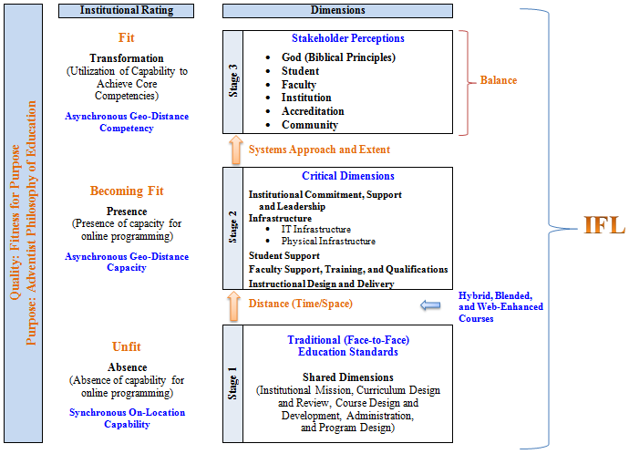

Slide 14
Conclusions
QA Must be Aligned to Philosophy
No Need for New Dimensionality
Collaboration is Vital
Increased Intentionality and a Systems Approach are Necessary

Slide 15
Recommendations
Stakeholders
Identify a regulatory body to oversee QA
Develop QA documents based on taxonomy
Set base criteria before beginning new programs
Engage in inter-HEI collaboration
Join online education communities outside system

Slide 16
Summary and Discussion
Describe a new quality taxonomy for online education
Explain how the categorization system of the taxonomy works
State how the taxonomy can be implemented in specific contexts

Slide 17
Thank You

