Slide 1
The Crooked Alignment
Ensuring Learning Objectives and Assessments Align

Slide 2

Who We Are
Sharon Gibson-Mainka
Lead Information Technology Consultant
QMC, QM Master Reviewer,
APPQMR Facilitator, QM IYOC Facilitator

Slide 3

Who We Are
Jernaley Martin
Senior Information Technology Consultant
QMC, QM Master Reviewer,
APPQMR Facilitator, QM IYOC Facilitator

Slide 4
Session Objectives
Describe common challenges in ensuring alignment.
Recall actions for addressing common alignment challenges.
Identify ways for aligning objectives and assessments.

Slide 5
What’s My Take-away?
Network with your peers.
Share your experiences and expertise.
Gather new ideas for the workplace.

Slide 6
Our Stats…
As of 10/05/16, only 9 of 13 reviews “Met” Std. 3.1 initially:
“The assessments measure
the stated learning objectives or competencies.”
Notes:
From Rubric Standards Report through MyQM…
3.1 - 3.1 The assessments measure the stated learning objectives or competencies.
9 Met
4 Met Amend
0 Not Met
100% Percentage Overall Met
69% Percentage Met
31% Percentage Met Amend
0% Percentage Not Met
Not including all internal, informal QM Reviews through our institution.

Slide 7
What Reviewers Said…
“I had a hard time aligning the objectives with the assessments in the module.”

Slide 8
What Reviewers Said…
“While many assessments aligned with the Course Objectives, I couldn’t accurately define the alignment between the assessments and Module Objectives.”

Slide 9
What Reviewers Said…
“The module objective uses two action verbs, but it appears students are being assessed on only one of the verbs.”

Slide 10
What Reviewers Said…
“The module objective is written for higher level of learning, but the only form of assessment is a multiple-choice test.”

Slide 11
Case Study #1

Slide 12
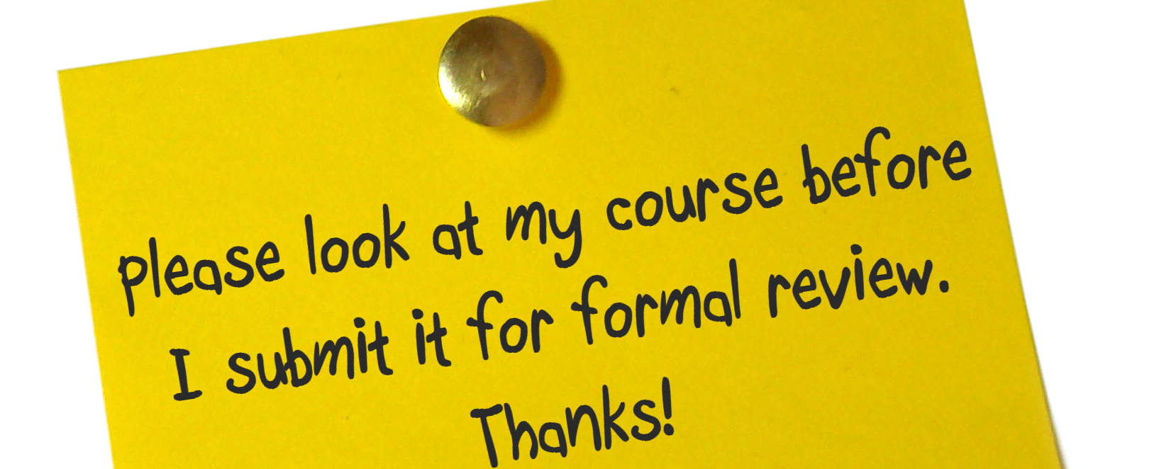
An Internal Review
No Choice Except Multiple-Choice
Notes:
Image Source:
Peterls B
POST-IT sticky note
Flickr, Creative Commons
https://www.flickr.com/photos/flatcat/3555774083/in/photolist-6qdgKH-71EKNS-7PHzgx-8o6cAK-dLBazz-6tPTRZ-8o9noW-9CbwkU-9GvR5e-6saHLh-8bXirB-aHDBzc-acDwnv-axhrKt-6EEik-6oHGms-9ahugv-uyLzW-65Nj2D-GV3fDE-GV3gJL-2TYXYA-7EuMTs-87wUso-8LvPZi-bti9Zm-7qD2tS-61PRZU-91Vpww-79eCZz-6kLYtP-fx2JtD-jL6q8A-6aWb2q-3eoR1q-9BBNiU-4rYGhX-npC3vo-7UwCVE-jL51jV-bJJ3Nz-8yeVtF-9j9fGZ-4xwEK2-4hsNqu-6oDwQV-9D3npi-4EXMtU-g9sWs-9ya8G6

Slide 13
Group Activity #1
1. Break-out into small groups.
2. Review the handout.
3. Recommend changes.
4. Discuss with your group.
Notes:
Break-out into pairs or small groups.
Review the handout provided.
Recommend changes for improvements.
Discuss your insights with your group.
Would you determine that this example (refer to the handout) “Met” Standard 3.1? What factors did you consider in making your decision? What recommendation, if any, would you provide your colleague?

Slide 14
Group Suggestions / Tips
Notes:
**Presenter will use drawing tools to write suggestions/tips shared by group.

Slide 15
Potential Push-Back
Need automated grading for large enrollment courses.
Lack of time/resources.
Unclear definition of “assessment.”
Objectives are only measured in end-of-course project.
Notes:
At our institution,

Slide 16
Case Study #2

Slide 17
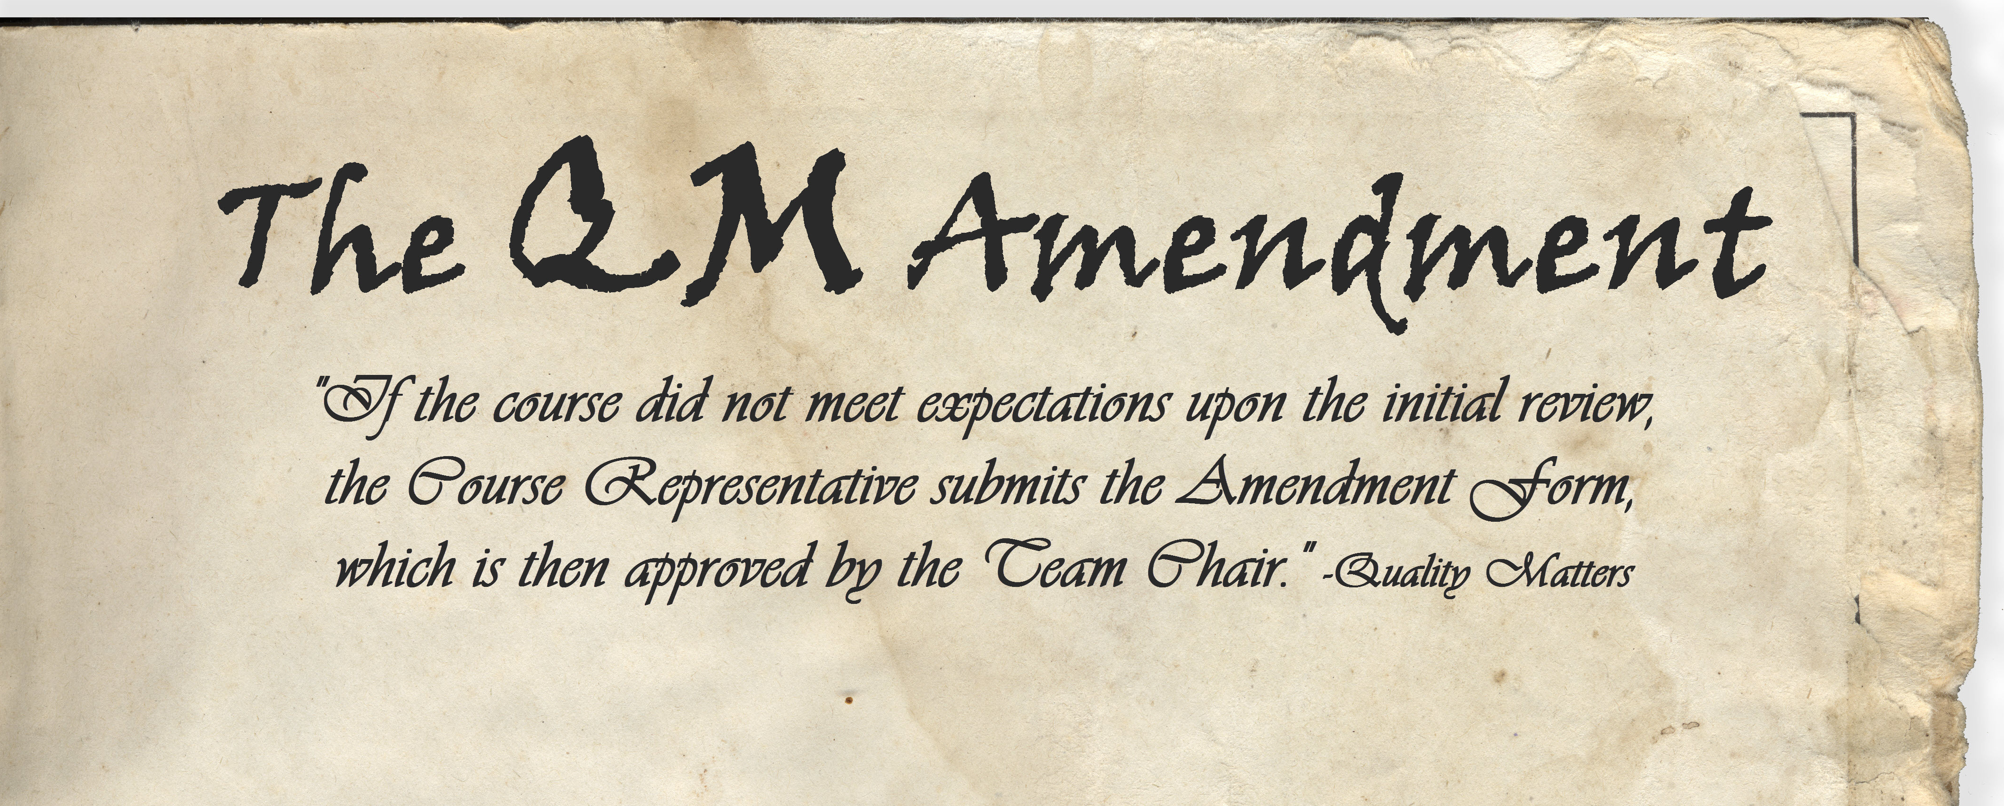
The Amendment Phase
All Module Objectives Assess Final Exam
Notes:
Image Source:
Thomas Hebert
Paper, circa ‘31
Flickr Image, Creative Commons
https://www.flickr.com/photos/thomashebert/2367382540/in/photolist-4Bcsmm-7d6pUb-4mdQmS-edX4Zn-FR5qkp-7yvFiZ-yUJdu-h6T5GF-JmPEwR-61Cr5P-qhzKbY-dLNywz-dYRtKZ-4NkoSf-787fdx-j553FR-aVZQ8t-7XsG6R-9745Z-omPtfd-b4RWAv-7tLKDN-7tLJCj-7tLHCd-7tLMn1-7tLGJw-6Fmfrj-aVZQ64-6RED4j-edQ2yU-ob4KsY-edXbAk-4N8eb8-7tGNMD-edQb7s-5nbmmr-qJWwee-brGzga-8DpFNc-ofjoU-ofjeE-6RGSof-fMocv-fMocu-J6WoVY-8mhBRG-98tmdx-8jmR7H-4mdQmQ-UdrJ

Slide 18
Group Activity #2
1. Break-out into small groups.
2. Review the handout.
3. Recommend changes.
4. Discuss with your group.
Notes:
Break-out into pairs or small groups.
Review the handout provided.
Recommend changes for improvements.
Discuss your insights with your group.

Slide 19
Group Suggestions / Tips
Notes:
**Presenter will use drawing tools to write suggestions/tips shared by group.

Slide 20

Questions?
Insights?
!
?
?
!
?
!
!

Slide 21
Resources: Multiple-Choice and Bloom’s
Duncan, Walter. (August 29, 2016). The TEACH BIG Blog. Multiple-Choice Questions Based on Bloom’s Taxonomy. Retrieved from https://get.quickkeyapp.com/multiple-choice-blooms-taxonomy/
Duncan, Walter. (October 11, 2016). The TEACH BIG Blog. Multiple-Choice Questions Based on Bloom’s Taxonomy Part 2. Retrieved from https://get.quickkeyapp.com/multiple-choice-blooms-taxonomy-part-2/
Pappas, Christopher. (January 22, 2014). eLearning Industry. How To Write Multiple-Choice Questions Based On The Revised Bloom’s Taxonomy. Retrieved from https://elearningindustry.com/how-to-write-multiple-choice-questions-based-on-revised-bloom-s-taxonomy
Johnston, Tracy. (April 20, 2015). Palomar College Test Writing Strategies. Multiple Choice and Bloom’s Taxonomy. Retrieved from https://www2.palomar.edu/pages/testwritingstrategies/2015/04/20/multiple-choice-and-blooms-taxonomy/
Notes:
Resources for writing strong multiple-choice based on Bloom’s.

