Slide 1

Please form groups of 3 people that that have the same color index card
(it is best if you do not know the folks in your group, for after all,
NATIONAL CONFERENCE=NETWORKING)
http://melvillegroup.com/challenges/sales-marketing-operations-alignment
Introduce yourself and working as a group, write a THREE WORD PHRASE that describes ALIGNMENT in an instructional course

Slide 2
What’s In It For You?
Dot-Voting
Page 2
Notes:
Before I begin the presentation we are going to do a “dot-vote” . You all have colored dot stickers. Please take one of those stickers and put it next to the learning objective listed on the bottom of page 2 of your handout that most interests you in this presentation. Take a moment and write in your own words, a learning objective that represents what you would wish to take away from this session. Now that you have identified what interests you most, make sure to jot notes about that topic.

Slide 3


jsprangers@hennepintech.edu
Notes:
My name is Jane Sprangers. I am a veterinarian and a biology instructor at Hennepin Technical College in Minnesota. I have been involved with QM since 2008, have had four of my own courses QM certified with a 5th “in the works” and am currently a QM Master Reviewer and co-Coordinator for my institution.

Slide 4

Design to Align . . .
"When Venus met Jupiter" by Tom Blackwell is licensed under CC BY-NC 2.0
Notes:
If you are looking for “Design to Align . . . “you are in the right place! If you are looking for a different session, this isn’t it!

Slide 5

http://www.kuder.com/2013/01/raise-your-hand-adopt-a-classroom
Notes:
Before we begin, a show of hands please
K12 faculty
Higher ed faculty
IDs
Admin?
New to QM???

Slide 6

http://www.onehungryhippo.co.uk/lets-strip-everything-back-to-the-beginning
Notes:
So the subtitle of this presentation is “ . . .let’s start at the beginning” –

Slide 7

“That’s a very good place to start . . .”
http://moviemicah.blogspot.com/2014/02/the-sound-of-music-1965.html
Notes:
SO, why “at the beginning”, as Julie Andrews tells us, that’s a very good place to start, and NO , I am not going to sing it for you!

Slide 8

What is alignment?
http://www.clipartpanda.com/clipart_images/free-download-clip-art-52704530
Notes:
When we are talking about alignment IN A COURSE, what exactly does that mean??? For your introductory activity today, you and your partners came up with a 3 word phrase that described alignment. Let’s share what some of those were . . . . .

Slide 9
ALIGNMENT means making sure that:
what we teach,
how we teach,
and what we assess are congruent.
Notes:
So if we put it all together . . .

Slide 10
WHAT = Objectives
HOW = Activities
ASSESS = Assessments

Slide 11

Notes:
Quality Matters has done extensive research on alignment, which again, is the direct correlation between course/lesson objectives and the activities and materials/resources that support success in demonstrating accomplishment of those objectives through the assessments.

Slide 12
5
out of
8
Notes:
IN fact, so central is the concept of alignment to QM, standards that address alignment are found in 5 of the 8 general standards of the 5th edition of the QM rubric!. The alignment standards are 2.1, 2.2, 3.1, 4.1, 5.1, and 6.1. They are the highlighted standards on the last page of your handout.

Slide 13
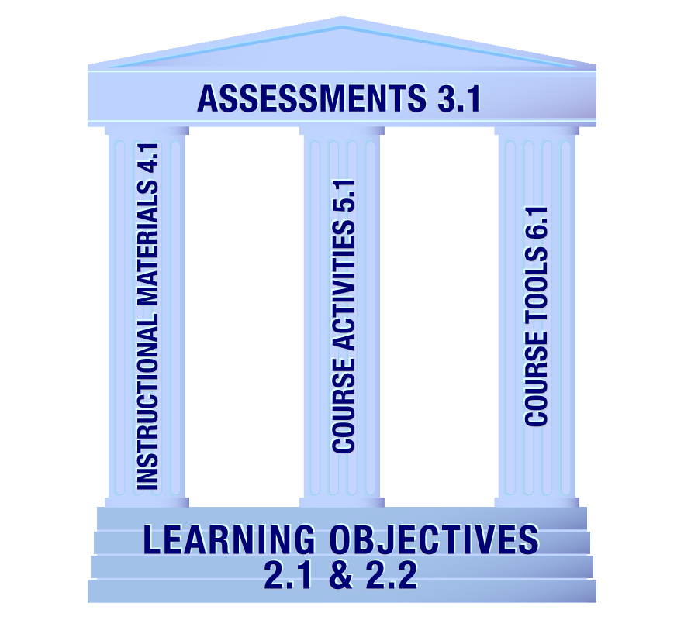
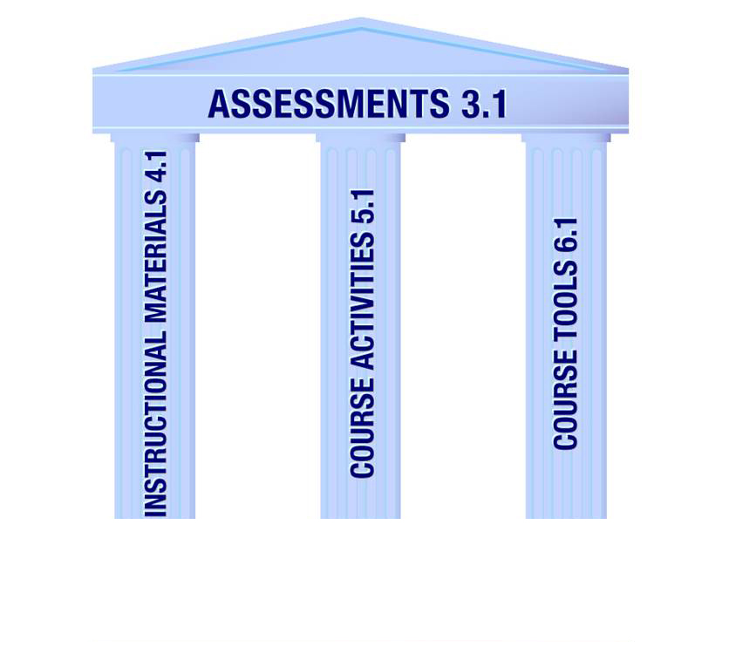
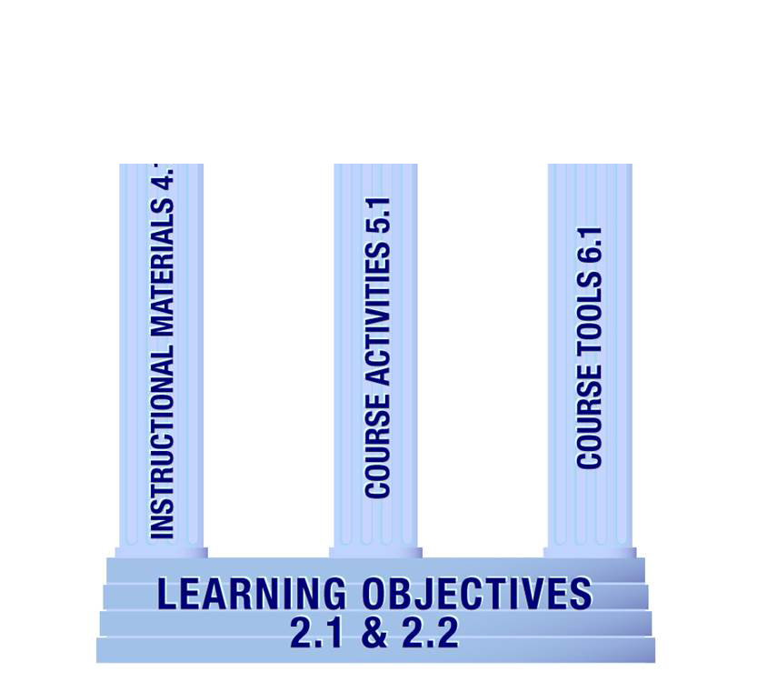
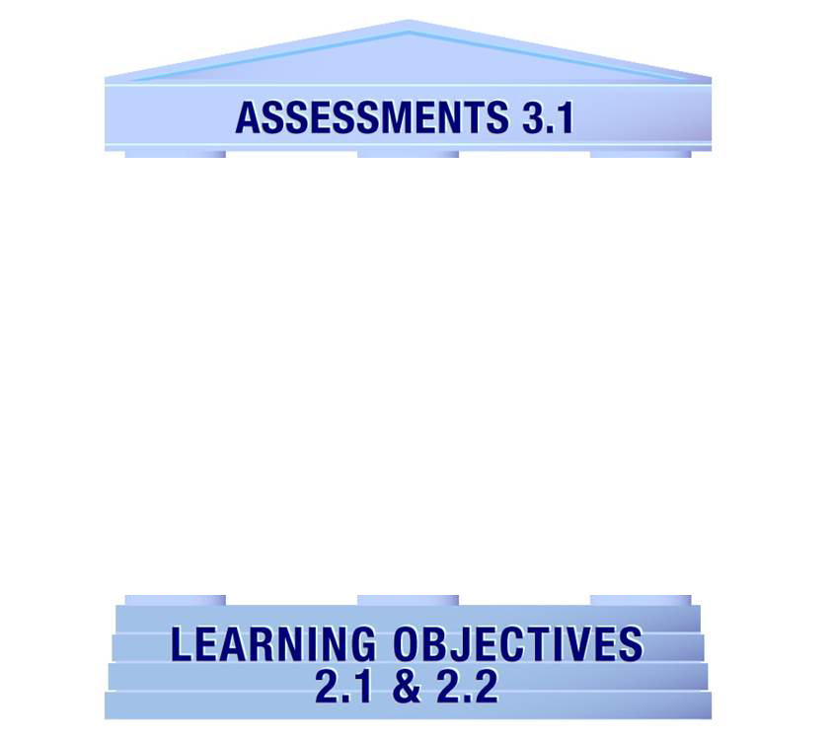
Submitted by James Fowlkes and Brenda Boyd
Notes:
QM uses this graphic to demonstrate the importance of alignment. The learning objectives (or competencies) establish the foundation of the course, while instructional materials, course activities, and course tools work together to support the achievement of the objectives as demonstrated by the assessments. If any one of these elements is missing, the structure is not complete. Would you want to live in a house without a foundation, or without a wall or without a roof?????

Slide 14
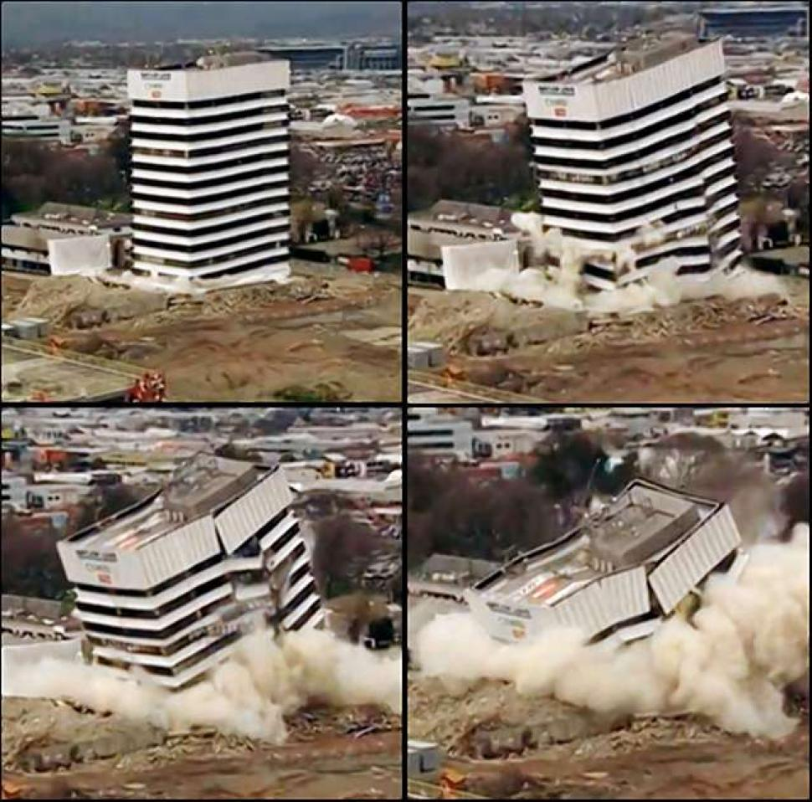
http://www.nydailynews.com/news/world/new-zealand-first-ever-controlled-building-implosion-brings-earthquake-damaged-structure-article-1.1129496
Notes:
An incomplete structure does have a tendency to implode or to FALL DOWN! So, too can our courses fall flat for our learners if we do not pay attention to alignment.

Slide 15

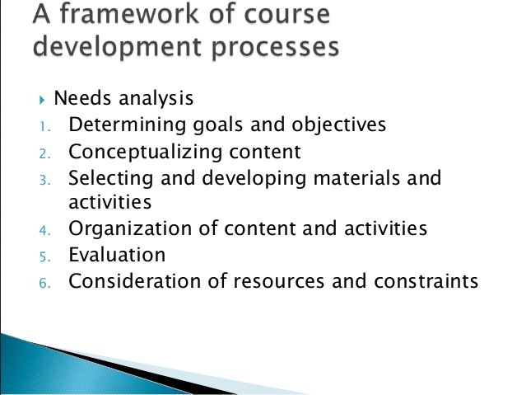
Notes:
Today, we are just going to investigate five of the specific review standards that involve components of alignment. I’ve already mentioned them, but here’s a recap – the course-level learning objectives, the module level learning objectives, the assessments and the learning materials and activities. It’s important to realize that the “finished product” of a course is likely structured with learning objectives first, followed by content materials and activities, with assessment as the final step to see if our learners “got it”? That is a pretty standard approach to course DELIVERY. It is also a pretty standard approach for course development as can be seen on this slide I obtained from a slideshare deck. However, it may not be the best practice for such design.

Slide 16
Course Design
Objectives
Assessments
Notes:
IN fact, I would propose that we think about these parts of our courses a little bit differently. I would propose that we think about HOW WE ARE GOING TO ASSESS our learners BEFORE we develop our learning activities! And I would propose that BEFORE WE GET STARTED, we MAKE ABSOLUTELY SURE OUR LEARNING OBJECTIVES ACTUALLY DESCRIBE THE OUTCOMES WE WANT OUR LEARNERS TO ACHIEVE! How are our learners going to be DIFFERENT after they take our courses? What will they be able to do AFTER that they could NOT DO BEFORE?

Slide 17

http://www.animationfactory.com/en/search/close-up.html?&oid=4997930&s=51&sc=51&st=308&q=keys&spage=3&hoid=3163c8677fde0d89d1bfef313c9556ef
Notes:
Our learning objectives ARE THE KEYS to our course. Let’s get those right before we move on in our course design, OR as we start to ponder what assessments we might wish to use, let’s tweak the objectives to make sure we are assessing what we told our learners WE WOULD ASSESS because . . .

Slide 18

http://www.animationfactory.com/en/search/close-up.html?&oid=12105434&s=1&sc=1&st=5&category_id=EI&q=puzzle&spage=1&hoid=64340fce941a25675553e154762720e2
Notes:
If the objectives and the assessments don’t fit together, we are in trouble from the get-go!

Slide 19
MODULE
MODULE
COURSE
MODULE
MODULE
Notes:
Let’s start with the objectives. Generally, when we design a course, there are two different “levels” of objectives. There are those objectives that give information to our learners about what they will be able to do after they complete the entire COURSE and those objectives that give information to the learner on what they will be able to DO on a weekly, module or unit basis. Module-level objectives are meant to be smaller, more discrete pieces of the course level objectives. COURSE objectives – Umbrella!!!!!!
Usually, there are multiple module-level objectives to support a course level objective. Think of your module-level objectives as a detailed listing or a subset of a course level objective.

Slide 20

http://www.mrwallpaper.com/blooming-tree-wallpaper
Notes:
There is a plethora of tools available to assist us in our endeavors to write exemplary learning objectives – Taxonomies are one way to go about it. Bloom’s taxonomy is a commonly used resource. First developed in the 1950s, the taxonomy was revised in the 1990s.
It is a set of three hierarchical models used to classify educational learning objectives into levels of complexity and mastery. It provides a way to organize thinking skills into six levels, from the most basic to the more complex. The three lists cover the learning objectives in cognitive, affective and sensory (psychomotor) domains. The cognitive domain list has been the primary focus of most traditional intellectual endeavors and is frequently used to structure curriculum learning objectives, assessments and activities.
So, Blooms taxonomy is arranged in “levels” of learning from basic knowledge, or remembering, through understanding, applying, analyzing, evaluating and creating . . .
Objectives will include 4 distinct components: Audience, Behavior, Condition and Degree.
Objectives must be both observable and measurable to be effective.
Use of words like understand and learn in writing objectives are generally not acceptable as they are difficult to measure.
Written objectives are a vital part of instructional design because they provide the roadmap for designing and delivering curriculum.
Throughout the design and development of curriculum, a comparison of the content to be delivered should be made to the objectives identified for the program. This process, called performance agreement, ensures that the final product meets the overall goal of instruction identified in the first level objectives.
Characteristics of objectives
Observable and measurable
Unambiguous
Results oriented / clearly written / specific
Measurable by both quantitative and qualitative criteria
Communicate a successful learning in behavioral terms
Written in terms of performance
Samples
Given a standard sentence, the English 101 student should be able to identify the noun and verb without error.
Given an assortment of EMS equipment to pick from, the paramedic should be able to identify all of the equipment necessary to perform rapid sequence intubation without error.
There is a sample of Bloom’s verb wheel in your handout that you might wish to use as a reference as you embark on the journey to AMAZING OBJECTIVES. And I do have some references for writing learning objectives listed on your handout. It is interesting to note that as I was compiling the information for this presentation, as I investigated
learning objectives, an enormous number of references cited the QM rubric and its standards to be used as guidelines. Hmmm . . .

Slide 21
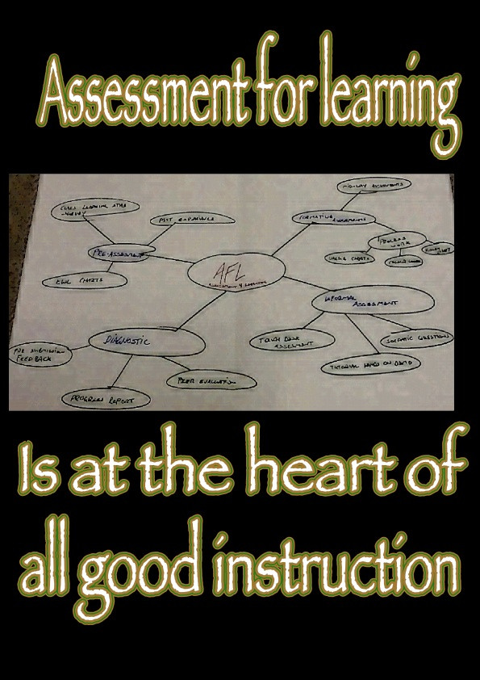
CC image courtesy of Ken Whytock on Flickr
Notes:
Again, I propose, that as we create our objectives, we think about how we are going to assess BEFORE we set those objectives in stone! So LET’S GO AHEAD AND THINK ABOUT our assessments next . . . And notice this sign reads “Assessment FOR learning”, not assessment OF learning. Hmmmm .. . interesting

Slide 22
How would you assess???????
Recall
Explain
Notes:
SO you’ve written your objectives and now you thinking about assessing your learners. Take a peek at this example. How am I going to determine if my learners are able to DO what I told them (in the objective) that they needed to DO?. What type of assessment might you use for an objective that starts with . . . Page 4 in your handout gives you space to write your thoughts!
Recall – MC, fill in
Explain – we are moving up a step in the cognitive domain here – essay questions, paper, discussion
Would you use a MC question to have your learner EXPLAIN???? Would you have your learners write a research paper if the objective stated they needed to recall a definition? Now those examples are a bit extreme, but they do bring up an interesting point. If the assessment and objective do not align – HOW DO MY LEARNERS MAKE SENSE OF THE COURSE?

Slide 23
How would you assess?????
Classify
Interpret
Notes:
Let’s try another one????
Classify – concept map, written exam questions, homework assignment, matching question
Interpret –
Is this giving you food for thought?????? It is not my intent to turn you all into certified instructional designers, BUT by your very profession as an instructor – most of you ARE designing courses! And realistically, here is where the K12 fokks have such an advantage over many of the higher ed folks – because you guys were ACTUALLY trained in how to do this . . . While most of the rest of us are making it up as we go!1
SO yes, YOU do have to figure out how to write exemplary, astounding, dazzling, amazing, impressive objectives!!! You DO have to figure out what the best ACTION VERB choice is for your objectives. For some of you – that means having a visit with an instructional designer. For some of you that means you need to be proactive and teach yourself how to do this. The most detailed, comprehensive learning objectives are framed using the
“ABCD” model: audience, behavior, conditions,
and degree. IN the higher ed realm, the behavior is the most essential element of the learning objective. IN other words, what is the learner going to be able to DO if (s)he accomplishes the objective?

Slide 24
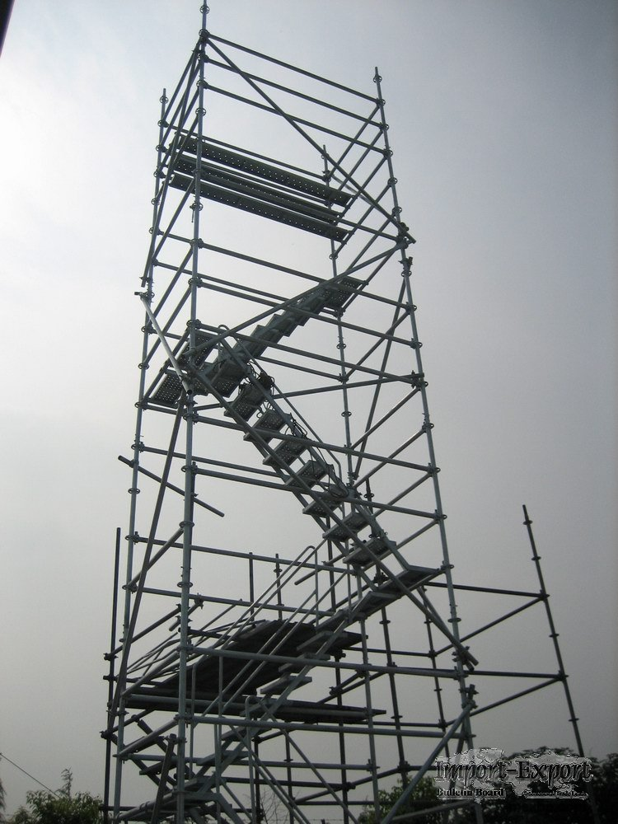
http://www.imexbb.com/scaffold-11458053.htm
Notes:
And that brings us to an interesting idea An instructional concept we often hear about, which is scaffolding. This is instructors scaffolding learning experiences for the students. Taking learners on a gradual journey from the lower level thinking skills to the higher level skills. This is commonly seen in the differences between module level and course level objectives – module level objectives and their accompanying assessments “build up” to the course level objective.

Slide 25
How would YOU get from . . .
There? Interpret Case Studies (CO)
Here?
NO Prior knowledge
Notes:
When we “Scaffold”, we desire to move learners progressively toward higher level thinking skills, stronger understanding and, ultimately, greater independence in the learning process. The design of the module learning objectives and their assessments are critical to developing this high level critical thinking skill in my learners, BUT I NEED TO PLAN IT OUT AND PREPARE FOR IT FIRST WITH MY COURSE DESIGN.

Slide 26

CC image courtesy of Bernard Spragg on Flickr
Notes:
SO, you are likely sitting there and thinking – this woman is crazy and is TALKING IN CIRCLES AND YES YES YES I AM talking in circles – I am going around and around between my objectives and assessments and doing so almost ad nauseum as I am designing my course!

Slide 27

CC image courtesy of GW Public Health on Flickr
Notes:
AND I am doing it FOR THAE BENEFIT OF MY LEARNERS! Because I wan’t to set ALL of them up to be successful, lifelong learners.

Slide 28

CC Image courtesy of Alan Cleaver on Flickr
Notes:
SO, I will take the time it takes on the FRONT end of the course! Because ultimately, that will take less time! If my learners see my course hanging together and it makes sense to them, I AM HOME FREE! And driving that course, facilitating that course WILL BE A DREAM COME TRUE! So, in the words of a wise man who accomplishes phenomenal things with horses! “take the time it takes so it takes less time”.

Slide 29

https://creativemoo.com/category/my-life-in-advertising
Notes:
So, it’s time for a bit of self-reflection. We’ll take a moment as you consider your own learning objectives, whether they be course-level objectives or module-level objectives. Ponder this . . . Do you HAVE learning objectives? Is there something you might wish to DO with your current objectives after listening the last 20 minutes or so? Do you need to tweak them at all? Choose different verbs? Double check your assessments for alignment. Take a minute and write down a few thoughts on your handout page . . .

Slide 30

Sharing is caring
Notes:
We all know sharing is caring, so let’s share a few of the ideas we came up with. If you hear something new, or something you might wish to consider for yourself, jot it down!

Slide 31

https://saveourskylineohio.com/2015/06/26/is-bigwind-as-sneaky-as-sylvester-the-cat
Notes:
And I will admit that I have been being a little bit sneaky with you all up to this point. I mentioned briefly at the beginning of this presentation that we were going to investigate 5 SRSs of the 5th edition of the QM rubric, BUT I NEVER TOLD YOU EXACLTY WHAT THEY WERE. We, as a group, just considered and investigated standards 2.1, 2.2. and 3.1 in the QM rubric. And we did it in a relatively short span of time!

Slide 32
Standard 2.1
The course learning objectives,
or course/program competencies,
describe outcomes that are
measurable
Notes:
So, what are the standards. Well, here is standard 2.1 Jane read it - - - what will learners be able to DO! These are broad and overarching objectives . . .

Slide 33
The module/unit learning objectives
or competencies describe outcomes
that are measurable and consistent
with the course-level objectives
or competencies
Standard 2.2

Slide 34
Standard 3.1
The assessments measure the
stated learning objectives
or competencies
Notes:
So this is YOUR ROAD MAP for designing the rest of your course.

Slide 35
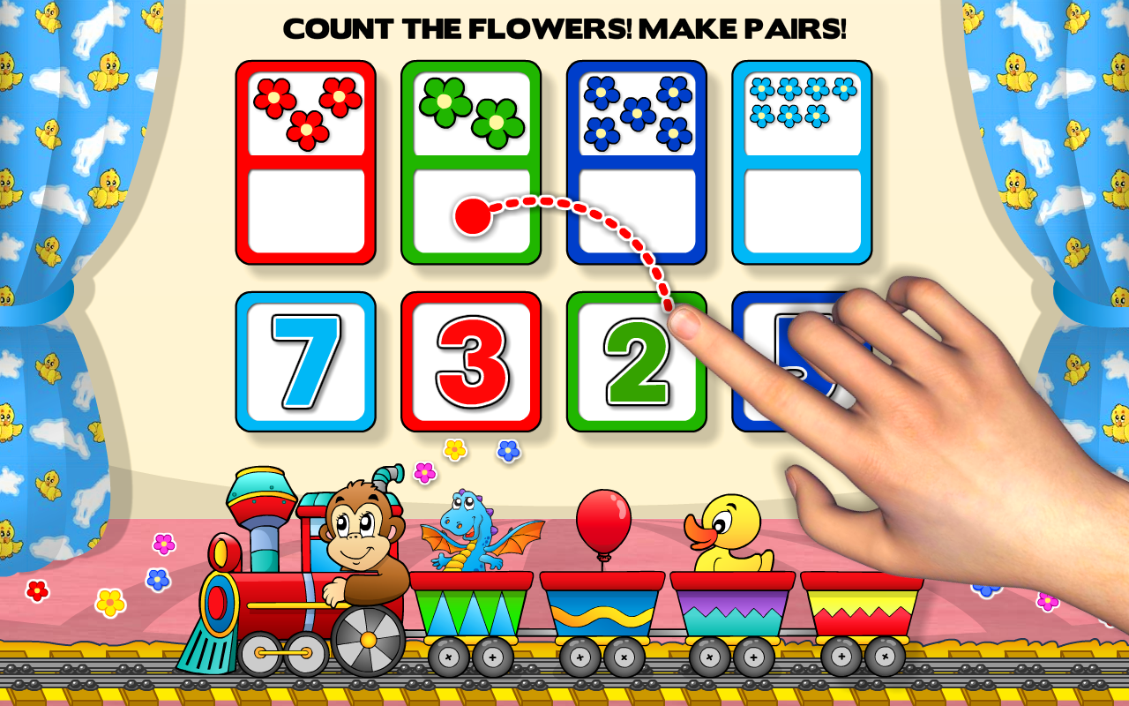
http://fungames-forkids.com/preschool-all-in-one-basic-skills-adventure-with-toy-train-vol-1-learning-fun-educational-kids-games-letters-numbers-colors-shapes-patterns-123s-counting-and-abcs-reading-for-toddlers-k
Notes:
Now it’s time to move onto the instructional materials and learning activities. If we have written our objectives well so that they are measureable and is we have designed our assessments to measure those objectives, then it is not overly complicated to choose materials and activities that support the objectives and the assessment! We just have to think about is a bit. Does a lecture help accomplish the goals, a lab activity, practice performing research using databases, practice composing paragraphs, reading articles or a textbook, viewing videos or animations, . . . Whatever the activities may be, we can now slide them into the appropriate places in our course and we might even discover activities that DO NOT MAKE SENSE for the course as well . . .

Slide 36
The instructional materials
contribute to the achievement
of the stated course and
module/unit learning objectives
or competencies
Standard 4.1
Notes:
And these are standards 4.1 in the QM rubric and

Slide 37
The learning activities
promote the achievement of the
stated learning objectives or
competencies
Standard 5.1
Notes:
. . . And standard 5.1

Slide 38

http://facultyecommons.com/learning-analytics-aligning-course-and-module-objectives
Notes:
And now here is where the rubber meets the road. Do You Know Alignment when you see it! It’s all well and good to talk about this stuff, but how about putting it into practice. Can you determine if parts of a course are out of whack or misaligned?????? Because that it what your teams are going to do right now! Notice, at the beginning of this whole shebang, I asked you to sit in groups of three. That is the number of people that sit on a QM review team. So, as you go through this activity, we are going to make decisions as a team, however, just as on a review team, majority rules! We are not looking for total agreement here. If two of you think an objective doesn’t belong THROW IT OUT. If tow of you feel that an instructional material does not fit in with the objectives THROW IT OUT!

Slide 39

Courtesy of www.clipartbest.com
Notes:
Give credit where credit is due – Some od these materials were developed by Robin O’Callahan, an ID at Winona State Univ in MN and Darcy Turner, and ID at St. Paul College in MN

Slide 40
Notes:
You all have a colored sheet of paper in your handout. If you sat with people that had the same color index card, you should all have the same colored paper.The people in your group should all have the same colored paper! So let’s take a peek at that paper now! At the top, you see the course title and description.
Next is a description of what will be covered in the module. Then, on the back there is a series of boxes. COs, MOs Learning activities and assessments

Slide 41
COURSE
COURSE
MODULE
MODULE
MODULE
Notes:
For this activity the MODULE objectives are SET IN STONE! These ARE the objectives for the module. Your task is to ALIGN the module objectives with the appropriate course objectives by drawing arrows. AND DO NOT BE SURPRISED if some of the course objectives DO NOT BELONG! So that is your first step . ..

Slide 42
Determine which Course Level Learning Objectives align with the Module Level Learning Objectives and which ones don’t
Determine which Instructional Materials align with which Module Level Learning Objectives and which ones don’t
Determine which Assessments align with which Module Level Learning Objectives and which ones don’t.
Notes:
Then, you are going to do the same with the instructional materials and the assessments. So take a few minutes and work together to figure out which of these go together and which ones DON’T! AGAIN, THE MODULE OBJECTIVES ARE CORRECT, SO DON’T MESS WITH THOSE!

Slide 43
Sharing is caring
Notes:
So how did it go??????? Did the COs and MOs align? Did the learning activities support the MOs? Were all the MOs assessed?

Slide 44
Resources | Course Level Objectives | Module Level Objectives | Assessments | Materials and Activities
Listed here
Notes:
So I often get questions like, HOW DO YOU DO IT Well, This is my template to check for alignment in my courses. It is just a simple table! And it is included in your handout. I used this with my A&P and my Nutrition courses. Before I begin to write each of my modules, I take the time to complete this table. I compile all the resources I might have on a given module, whether they be from publishing houses, are web-based, are from colleagues or if I have used them in the past and just fill in the columns, beginning with the course level objectives I will be including in the module. I will tell you that it took me a bit of time to get into this mode of thinking so . . .

Slide 45
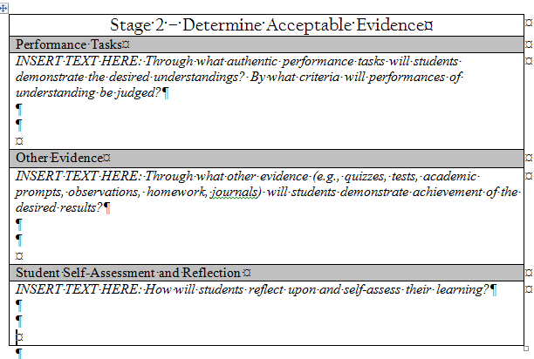
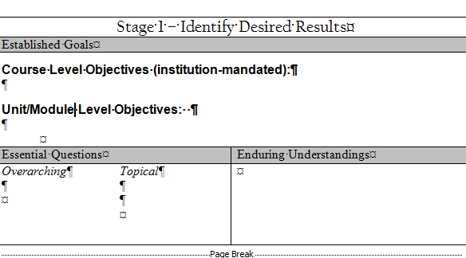
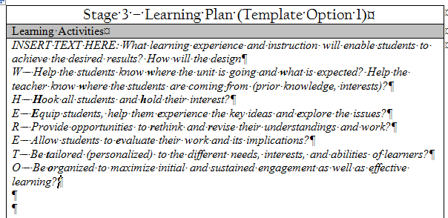
Notes:
. . . For the first couple courses I designed and developed, I used this grid. It is from the book “Understanding by Design” by Wiggins and McTighe and consists of three stages. Stage 1 is to identify the desired results, the objectives, stage 2 encompasses determining acceptable evidence, which is the assessments, and stage 3 details the learning plan, the materials and activities. The reference for this textbook is listed in your handout!
Notice in both of these models, the assessment piece comes BEFORE the learning activities are planned out. Interesting!! . By the way, just in case you were wondering about this the QM rubric is designed in the same way – learning objectives, GS 2, then assessments, GS3, then learning materials and activities, GS4 and GS5.

Slide 46

CC image courtesy of Ben Smith on Flickr
Notes:
And then an essential piece to this puzzle is how do I clearly communicate this alignment information to my learners? How do they know there is a plan in place for their achievement of the goals I set before them? We all have that expert blind spot, where we think our courses are so well-designed, that there would never be anything that we would have to do to improve it! We know where everything is, we know what goes with what as far as assessments and objectives, so we think it must be obvious to our learners as well. So, how do we ENSURE that it is obvious?

Slide 47
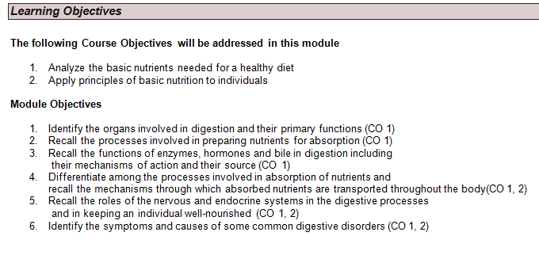
Notes:
Now there are a gazillion ways to accomplish communicating alignment to your learners. So this is what it looks like in my course. This is the method I have chosen . . .. For now. I am always looking for new and improved ways to accomplish this type of communication! First I show them the course objectives that will be addressed in the module, then the module level objectives AND THEIR LINK to the course objectives. Now look at these course objectives Analyze, apply – these are higher order thinking skills, and I am beginning my scaffold to those skills by asking learners to identify, recall, differentiate. . . Knowing, we’ll GET TO THE ACTUAL ANALYSIS a bit later in the course . . .

Slide 48
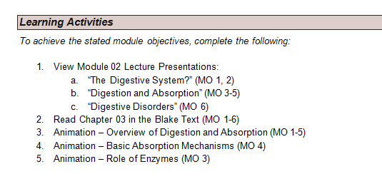

Slide 49
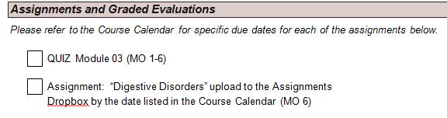
Notes:
And I show them the links that exist between the assessments and the learning objectives. Again this is only ONE way to accomplish this communication to my learners. There are many others . . . Which brings us to . . .

Slide 50

http://www.randomacts.org/blog/lights-camera-action-share-smile
Notes:
Lights, camera action! Now is the time to think a moment and come up with your own personal action plan! Something you are going to do THIS WEEKEND to address alignment in your course! And yes, I MEAN ACT! What are you GOING TO DO! Right! NOW! THIS! WEEK!??????? PAGE 5 on your handout – let’s get going!

Slide 51
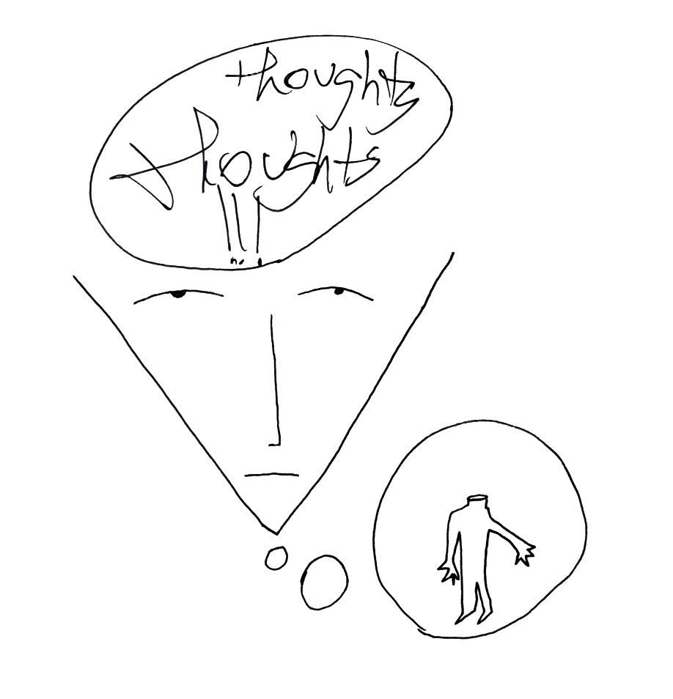
CC Image courtesy of Dan Allison on Flickr
Notes:
And now – any final thoughts, questions, concerns, comments . . .??

Slide 52

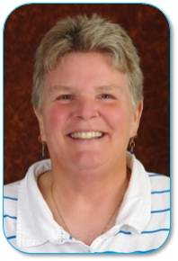
`
CC Image courtesy of Jaybird on Flickr
Notes:
Thank you all for coming – I hope you find some of this information useful as you continue on your own QM journey!

