Slide 1
Digital Storytelling: Using Narrative Based Technologies in Online & Blended Courses
Bethany Germany: Adler School

Slide 2
The Plan
Digital Storytelling
  Background
  What is Digital Storytelling
  Teachers and Students Objectives
  Incorporating Digital Storytelling in a Course
  Q & A

Slide 3
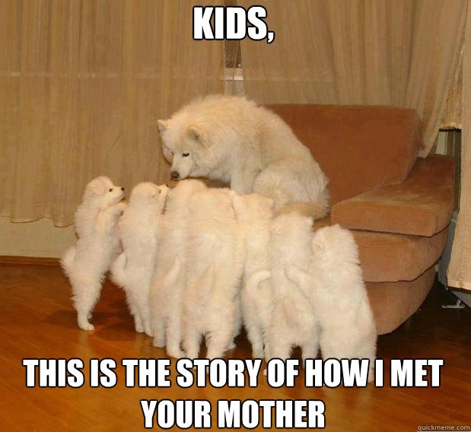
Storytelling
“The art of narrating various experiences or events whether they be personal, cultural, historical, religious, familiar, fictional, or even autobiographical.” (Conquergood)
Oral, written, audio, video
music

Slide 4
Digital Storytelling
“Incorporating various media forms alongside traditional storytelling practices to create and deliver a narrative about a cultural norm, historical event, the self, experience and so on. This format relies on the intersection of media and tools to tell a story.” (University of Houston,2012)
Digital stories are short (2-5 minute) videos created from diverse media and is typically narrated by the storyteller. (Vivienne & Burgess, 2012)

Slide 5
Storytelling & Education
Where does storytelling factor into education?
Ancient practice
Tied to our social, culture, and political spheres
Learn through stories
Transformed into an online forum

Slide 6
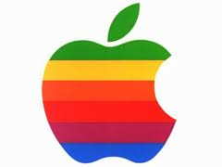

Teacher & Educational Objectives
Appeal to different learning styles
Interdisciplinary learning
Create Immediacy
Connect to course/weekly objectives
(http://digitalstorytelling.coe.uh.edu/educational_goals.html)

Slide 7
Student & Learning Objectives
Increase comprehension
Develop and practice communication skills
Peer to peer engagement
(http://digitalstorytelling.coe.uh.edu/educational_goals.html)

Slide 8
Digital Storytelling Resources
Online tools to help you create a digital story
  Thinglink
  Voicethread
  Glogster
  Xtranormal
  Storybird
  iMovie
Online Resources
  Center for Digital Storytelling
  University of Houston
  Spartan Guides
Your school’s ID team can help!

Slide 9
Digital Storytelling & Introductions
Meet one another
  Instructor introduction
  Student introduction
  Course “teaser trailer”

Slide 10
Digital Storytelling & Course Work
Concepts
  Preview or “hook” story to introduce a concept
  Alter lesson with a digital story
  Use stories already on the internet
    YouTube, UH, Center for Digital Storytelling, Library Database, tools mentioned
Projects
  Student create own digital stories about a topic or themselves in groups or individually
Http://digitalstorytelling.coe.uh.edu/educational_goals.html
http://www.storycenter.org/ethical-practice/

Slide 11
Digital Storytelling is Here to Stay
Information can benefit those you want to test waters & those already doing it with new tools & ideas
“The universe is not made of atoms. It’s made of tiny stories.” (Hitrecord, 2012).
Q & A

Slide 12
Citations
McArthur, J. (2009). Composing podcasts: Engaging digital natives in the communication classroom. Communication Teacher, 23(1). 15-18. doi: 10.1080/17404620802592957.
Center for digital storytelling. ( 2013, March 21). Home. Retrieved from http://www.storycenter.org/
Makers. (2013, March 21). Documentary. Retrieved from http://www.makers.com/documentary/
Spartan guides. (2013, March 21). Research tools. Retrieved from http://sdst.libguides.com/researchtools
University of Houston. (2013, March 21). Educational uses of digital storytelling. Retrieved from http://digitalstorytelling.coe.uh.edu/
Vivienne, S. & Burgess, J. (2012). The digital storyteller’s stage: Queer everyday activist negotiating privacy and publicness. Journal of Broadcast & Electronic Media, 56(3). 362-377. doi: 10.1080/08838151.2012.705194.

