Slide 1




The Ohio State University
College of Education and Human Ecology
The benefits of a liberated syllabus
Kelvin Trefz M. Ed.
Educational Technologist
EdTech
Educational Technologist
Notes:
The Ohio State University name is recognized and respected worldwide. Our reputation is a valuable asset.
To support the forging of a more cohesive One University, the president challenged the Office of University Communications to launch a new branding initiative.
The university’s brand guidelines provide a roadmap for telling our inspiring stories in one consistent voice.
Because we all play a role in strengthening our brand, our college worked with University Communications to create a sub-brand aligned with the university’s brand.
Here are the benefits to you of using the new sub-brand:
Your work is quickly identified with Ohio State’s respected reputation, but with a distinctive presentation that uniquely represents our college.
Using our new brand guidelines serves as a tool for consistency, to mark our communications as distinctly our own.

Slide 2


Permissions
Materials discussed and shared in this presentation are copyrighted by Quality Matters or The Ohio State University (OSU). All rights are reserved.
QM11 was adapted with permission from Quality Matters for use by The Ohio State University. The faculty and staff of OSU developed, modified, and aligned the College of Education and Human Ecology’s Curriculum Committee’s 11 parts of a syllabus and hold the rights to this work.
Notes:
Colors.
All publications should be predominantly scarlet and gray.
However, secondary colors may be used as well.
The university has designated 12 secondary colors to create the university’s secondary color palette.
For EHE, University Communications recommends 9 of those colors.
They suggest that departments, centers, and named centers within our college develop their own unique combinations of secondary colors
and apply them consistently throughout their communications to establish their own unique look within the Ehe family look.
You will see in a minute when we show the templates how secondary colors might be used.

Slide 3
Overview
The syllabus is the foundation of the course. How do you take the
syllabus and liberate it to perform by meeting the standards? We designed a unique review process based on the
11 parts of a syllabus and the Quality Matters standards. We will discuss the benefits to the faculty and students.
Learning Objectives
  1: The participants will list the 11 parts of a syllabus.
  2: The participants will identify the parts of each standard that applies to the syllabus.
  3: The participants will list at least one benefit of the review process for the designer and faculty
Notes:
Here are the design elements of the college’s new brand guidelines.
Whether you are creating publications for print or for many electronic use, such as publications shared as PDFs or e-mails, these guidelines help you decide what design elements to include.
Note, however, that we have created templates with these design elements for your use.
By using the templates, you can personalize your piece with your content and photos and not worry about proper use of design elements.
We’ll come back to the templates shortly.
For now, here are the elements you will see in these templates—not necessarily all together.
Rows of small circles of different sizes and, possibly, different colors
Larger circles in different formats
For instance, a circle shadow shape to highlight areas of importance or text
A circle as a shape to hold a photo
Circles with solid or dotted rules
Overlapping circles with fill or with dotted lines
You will also see rounded corner bars or boxes.

Slide 4
Why am I here?
What is the QM at The Ohio State University?
What is the QM11 process?
How does the QM11 review work?
What are the benefits of the QM11 review?
Notes:
As I said, we created templates so you wouldn’t need to think about all these design details, except to know what they are and that we want to preserve them in the templates.
The templates are in Microsoft Word so the majority of your faculty, staff and students can use them easily.
We have a template for a flyer, a fact sheet (which has more content than a flyer), a variety of brochures or report covers, and a four-page newsletter template.
So let’s have a look at them.

Slide 5

Quality Matters at The Ohio State
University
The Ohio State University is a subscriber to Quality Matters (QM), a peer-review process designed to ensure quality design and continuous improvement of online and hybrid courses. https://odee.osu.edu/odee-grants/quality-matters-grants
Quality Matters (QM) is an inter-institutional organization that sets baseline research-supported standards to ensure quality design for online and hybrid courses. The QM Rubric is supported on national standards and best practices, research literature, and instructional design principles. http://odee.osu.edu/quality-matters
Quality Matters is a strategic metric and indicator to:
Ensure Ohio State develops a consistent, high quality online education presence that meets or exceeds the current accepted academic rigor and standards.
From the Strategic Planning at The Ohio State University https://odee.osu.edu/sites/default/files/odee-strategicplan.pdf
Notes:
Colors.
All publications should be predominantly scarlet and gray.
However, secondary colors may be used as well.
The university has designated 12 secondary colors to create the university’s secondary color palette.
For EHE, University Communications recommends 9 of those colors.
They suggest that departments, centers, and named centers within our college develop their own unique combinations of secondary colors
and apply them consistently throughout their communications to establish their own unique look within the Ehe family look.
You will see in a minute when we show the templates how secondary colors might be used.

Slide 6
What is the QM11 process?
QM11 combines the College Curriculum Committee’s 11 parts of the syllabus with the eight Quality Matters (QM) standards applied only to the course syllabus.
While QM looks at the whole online course the syllabus is a major portion of that course. We developed a modified form of the QM standards and 11 parts
Notes:
Here are the design elements of the college’s new brand guidelines.
Whether you are creating publications for print or for many electronic use, such as publications shared as PDFs or e-mails, these guidelines help you decide what design elements to include.
Note, however, that we have created templates with these design elements for your use.
By using the templates, you can personalize your piece with your content and photos and not worry about proper use of design elements.
We’ll come back to the templates shortly.
For now, here are the elements you will see in these templates—not necessarily all together.
Rows of small circles of different sizes and, possibly, different colors
Larger circles in different formats
For instance, a circle shadow shape to highlight areas of importance or text
A circle as a shape to hold a photo
Circles with solid or dotted rules
Overlapping circles with fill or with dotted lines
You will also see rounded corner bars or boxes.

Slide 7
What is the QM11 process?
The intent of this effort was to create a simple process that will point persons to the items or areas of the syllabus that may need improvement.
Once this information is known then the instructor, designer or other parties can make changes as needed to improve the syllabus and thus the course. This can be an iterative process and can be done quickly by the reviewers. It normally takes less the 30 minute to review a syllabus.
Notes:
Here are the design elements of the college’s new brand guidelines.
Whether you are creating publications for print or for many electronic use, such as publications shared as PDFs or e-mails, these guidelines help you decide what design elements to include.
Note, however, that we have created templates with these design elements for your use.
By using the templates, you can personalize your piece with your content and photos and not worry about proper use of design elements.
We’ll come back to the templates shortly.
For now, here are the elements you will see in these templates—not necessarily all together.
Rows of small circles of different sizes and, possibly, different colors
Larger circles in different formats
For instance, a circle shadow shape to highlight areas of importance or text
A circle as a shape to hold a photo
Circles with solid or dotted rules
Overlapping circles with fill or with dotted lines
You will also see rounded corner bars or boxes.

Slide 8
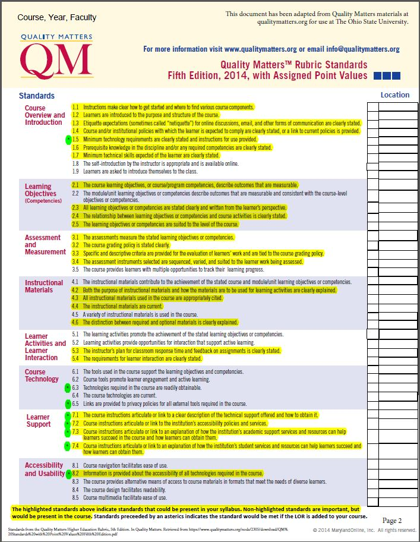
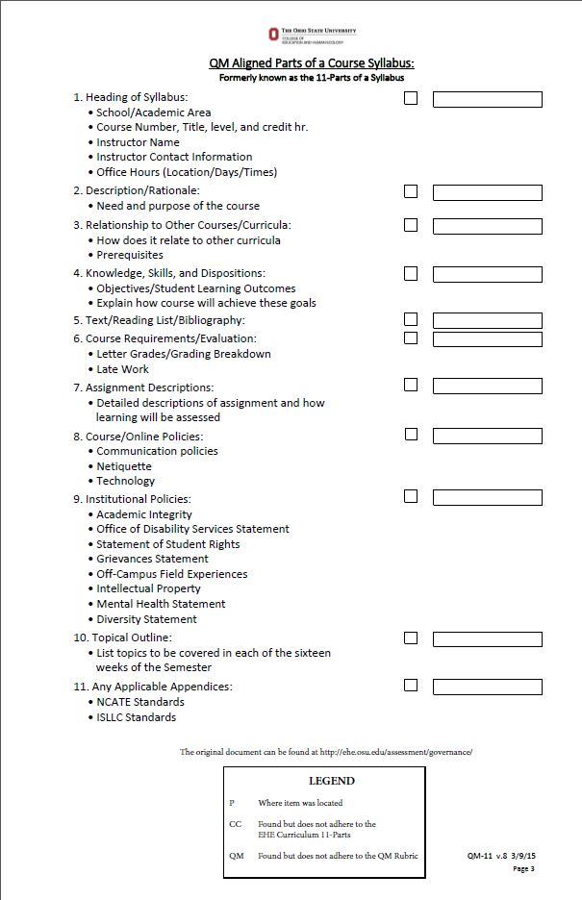

Slide 9
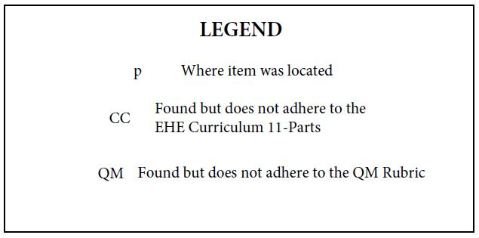


How does the QM11 review work?
Notes:
Here are the design elements of the college’s new brand guidelines.
Whether you are creating publications for print or for many electronic use, such as publications shared as PDFs or e-mails, these guidelines help you decide what design elements to include.
Note, however, that we have created templates with these design elements for your use.
By using the templates, you can personalize your piece with your content and photos and not worry about proper use of design elements.
We’ll come back to the templates shortly.
For now, here are the elements you will see in these templates—not necessarily all together.
Rows of small circles of different sizes and, possibly, different colors
Larger circles in different formats
For instance, a circle shadow shape to highlight areas of importance or text
A circle as a shape to hold a photo
Circles with solid or dotted rules
Overlapping circles with fill or with dotted lines
You will also see rounded corner bars or boxes.

Slide 10
What are the benefits of the QM11 review?
Curriculum Committee
Reduced workload due to the required QM11 review before submission
Original 11 parts was transformed using QM – meets national/OSU standards
New/Redesigned courses must meet standards
Helps provide instructor buy in to the process
QM11 checklist can be used with all course
Notes:
Here are the design elements of the college’s new brand guidelines.
Whether you are creating publications for print or for many electronic use, such as publications shared as PDFs or e-mails, these guidelines help you decide what design elements to include.
Note, however, that we have created templates with these design elements for your use.
By using the templates, you can personalize your piece with your content and photos and not worry about proper use of design elements.
We’ll come back to the templates shortly.
For now, here are the elements you will see in these templates—not necessarily all together.
Rows of small circles of different sizes and, possibly, different colors
Larger circles in different formats
For instance, a circle shadow shape to highlight areas of importance or text
A circle as a shape to hold a photo
Circles with solid or dotted rules
Overlapping circles with fill or with dotted lines
You will also see rounded corner bars or boxes.

Slide 11
What are the benefits of the QM11 review?
Department Chair
Strong support from Curriculum Committed (CC) for standards
Can submit syllabi to EdTech for review
Reviewed syllabi can be used with the instructor or design team to modify the course
Reviewed and accepted (CC) syllabi/courses are on the path to QM certification
The licensure process may be easier with QM11 reviewed courses
QM certification would elevate courses and programs for online degrees or professional development
Notes:
Here are the design elements of the college’s new brand guidelines.
Whether you are creating publications for print or for many electronic use, such as publications shared as PDFs or e-mails, these guidelines help you decide what design elements to include.
Note, however, that we have created templates with these design elements for your use.
By using the templates, you can personalize your piece with your content and photos and not worry about proper use of design elements.
We’ll come back to the templates shortly.
For now, here are the elements you will see in these templates—not necessarily all together.
Rows of small circles of different sizes and, possibly, different colors
Larger circles in different formats
For instance, a circle shadow shape to highlight areas of importance or text
A circle as a shape to hold a photo
Circles with solid or dotted rules
Overlapping circles with fill or with dotted lines
You will also see rounded corner bars or boxes.

Slide 12
What are the benefits of the QM11 review?
Faculty/Instructor
Has a simple checklist to ensure they have all parts needed
Boilerplate materials are available from EdTech
QM provides annotations and examples for each review standard
Quicker turnaround time with the Curriculum Committee
First step to toward QM certification
Has first look at the alignment of learning objectives, materials/content and assessments
Communications and Expectations: Student-Student, Student-Instructor are clearly outlined
Notes:
Here are the design elements of the college’s new brand guidelines.
Whether you are creating publications for print or for many electronic use, such as publications shared as PDFs or e-mails, these guidelines help you decide what design elements to include.
Note, however, that we have created templates with these design elements for your use.
By using the templates, you can personalize your piece with your content and photos and not worry about proper use of design elements.
We’ll come back to the templates shortly.
For now, here are the elements you will see in these templates—not necessarily all together.
Rows of small circles of different sizes and, possibly, different colors
Larger circles in different formats
For instance, a circle shadow shape to highlight areas of importance or text
A circle as a shape to hold a photo
Circles with solid or dotted rules
Overlapping circles with fill or with dotted lines
You will also see rounded corner bars or boxes.

Slide 13
What are the benefits of the QM11 review?
Designers
Easy process for instructors and Chairs to submit syllabi
All online courses must have the QM11 review
Increases the number of courses and instructor utilizing EdTech services
Easy process to review syllabi (< 30 minutes)
Readymade list of possible improvements
QM provides annotations and examples for each review standard
Boilerplate materials are available from EdTech
Notes:
Here are the design elements of the college’s new brand guidelines.
Whether you are creating publications for print or for many electronic use, such as publications shared as PDFs or e-mails, these guidelines help you decide what design elements to include.
Note, however, that we have created templates with these design elements for your use.
By using the templates, you can personalize your piece with your content and photos and not worry about proper use of design elements.
We’ll come back to the templates shortly.
For now, here are the elements you will see in these templates—not necessarily all together.
Rows of small circles of different sizes and, possibly, different colors
Larger circles in different formats
For instance, a circle shadow shape to highlight areas of importance or text
A circle as a shape to hold a photo
Circles with solid or dotted rules
Overlapping circles with fill or with dotted lines
You will also see rounded corner bars or boxes.

Slide 14
What are the benefits of the QM11 review?
Students
Well-designed syllabus means fewer ambiguities
Content/Materials and tests are in sync
Expectations and timings are known
Grading process is clearly stated
Communications and expectations are clearly stated
Notes:
Here are the design elements of the college’s new brand guidelines.
Whether you are creating publications for print or for many electronic use, such as publications shared as PDFs or e-mails, these guidelines help you decide what design elements to include.
Note, however, that we have created templates with these design elements for your use.
By using the templates, you can personalize your piece with your content and photos and not worry about proper use of design elements.
We’ll come back to the templates shortly.
For now, here are the elements you will see in these templates—not necessarily all together.
Rows of small circles of different sizes and, possibly, different colors
Larger circles in different formats
For instance, a circle shadow shape to highlight areas of importance or text
A circle as a shape to hold a photo
Circles with solid or dotted rules
Overlapping circles with fill or with dotted lines
You will also see rounded corner bars or boxes.

Slide 15
QM standards contained in the syllabus
Course Overview and Introduction
1.1 Instructions make clear how to get started and where to find various
course components.
1.2 Learners are introduced to the purpose and structure of the course.
1.3 Etiquette expectations (sometimes called “netiquette”) for online
discussions, email, and other forms of communication are clearly stated.
1.4 Course and/or institutional policies with which the learner is expected to
comply are clearly stated, or a link to current policies is provided.
1.5 Minimum technology requirements are clearly stated and instructions for
use provided.
1.6 Prerequisite knowledge in the discipline and/or any required
competencies are clearly stated.
1.7 Minimum technical skills expected of the learner are clearly stated.
1.8 The self-introduction by the instructor is appropriate and is available
online.
1.9 Learners are asked to introduce themselves to the class.
Notes:
Here are the design elements of the college’s new brand guidelines.
Whether you are creating publications for print or for many electronic use, such as publications shared as PDFs or e-mails, these guidelines help you decide what design elements to include.
Note, however, that we have created templates with these design elements for your use.
By using the templates, you can personalize your piece with your content and photos and not worry about proper use of design elements.
We’ll come back to the templates shortly.
For now, here are the elements you will see in these templates—not necessarily all together.
Rows of small circles of different sizes and, possibly, different colors
Larger circles in different formats
For instance, a circle shadow shape to highlight areas of importance or text
A circle as a shape to hold a photo
Circles with solid or dotted rules
Overlapping circles with fill or with dotted lines
You will also see rounded corner bars or boxes.

Slide 16
QM standards contained in the syllabus
Learning Objectives (Competencies)
2.1 The course learning objectives, or course/program competencies,
describe outcomes that are measurable.
2.2 The module/unit learning objectives or competencies describe outcomes
that are measurable and consistent with the course-level objectives or
competencies.
2.3 All learning objectives or competencies are stated clearly and written
from the learner’s perspective.
2.4 The relationship between learning objectives or competencies and
course activities is clearly stated.
2.5 The learning objectives or competencies are suited to the level of the
course.
Notes:
Here are the design elements of the college’s new brand guidelines.
Whether you are creating publications for print or for many electronic use, such as publications shared as PDFs or e-mails, these guidelines help you decide what design elements to include.
Note, however, that we have created templates with these design elements for your use.
By using the templates, you can personalize your piece with your content and photos and not worry about proper use of design elements.
We’ll come back to the templates shortly.
For now, here are the elements you will see in these templates—not necessarily all together.
Rows of small circles of different sizes and, possibly, different colors
Larger circles in different formats
For instance, a circle shadow shape to highlight areas of importance or text
A circle as a shape to hold a photo
Circles with solid or dotted rules
Overlapping circles with fill or with dotted lines
You will also see rounded corner bars or boxes.

Slide 17
QM standards contained in the syllabus
Assessment and Measurement
3.1 The assessments measure the stated learning objectives or competencies.
3.2 The course grading policy is stated clearly.
3.3 Specific and descriptive criteria are provided for the evaluation of learners’ work
and are tied to the course grading policy.
3.4 The assessment instruments selected are sequenced, varied, and suited to the
learner work being assessed.
3.5 The course provides learners with multiple opportunities to track their learning
progress.
Notes:
Here are the design elements of the college’s new brand guidelines.
Whether you are creating publications for print or for many electronic use, such as publications shared as PDFs or e-mails, these guidelines help you decide what design elements to include.
Note, however, that we have created templates with these design elements for your use.
By using the templates, you can personalize your piece with your content and photos and not worry about proper use of design elements.
We’ll come back to the templates shortly.
For now, here are the elements you will see in these templates—not necessarily all together.
Rows of small circles of different sizes and, possibly, different colors
Larger circles in different formats
For instance, a circle shadow shape to highlight areas of importance or text
A circle as a shape to hold a photo
Circles with solid or dotted rules
Overlapping circles with fill or with dotted lines
You will also see rounded corner bars or boxes.

Slide 18
QM standards contained in the syllabus
Instructional Materials
4.1 The instructional materials contribute to the achievement of the stated
course and module/unit learning objectives or competencies.
4.2 Both the purpose of instructional materials and how the materials are to
be used for learning activities are clearly explained.
4.3 All instructional materials used in the course are appropriately cited.
4.4 The instructional materials are current.
4.5 A variety of instructional materials is used in the course.
4.6 The distinction between required and optional materials is clearly
explained.
Notes:
Here are the design elements of the college’s new brand guidelines.
Whether you are creating publications for print or for many electronic use, such as publications shared as PDFs or e-mails, these guidelines help you decide what design elements to include.
Note, however, that we have created templates with these design elements for your use.
By using the templates, you can personalize your piece with your content and photos and not worry about proper use of design elements.
We’ll come back to the templates shortly.
For now, here are the elements you will see in these templates—not necessarily all together.
Rows of small circles of different sizes and, possibly, different colors
Larger circles in different formats
For instance, a circle shadow shape to highlight areas of importance or text
A circle as a shape to hold a photo
Circles with solid or dotted rules
Overlapping circles with fill or with dotted lines
You will also see rounded corner bars or boxes.

Slide 19
QM standards contained in the syllabus
Learner Activities and Learner Interaction
5.1 The learning activities promote the achievement of the stated learning objectives
or competencies.
5.2 Learning activities provide opportunities for interaction that support active
learning.
5.3 The instructor’s plan for classroom response time and feedback on assignments
is clearly stated.
5.4 The requirements for learner interaction are clearly stated.
Notes:
Here are the design elements of the college’s new brand guidelines.
Whether you are creating publications for print or for many electronic use, such as publications shared as PDFs or e-mails, these guidelines help you decide what design elements to include.
Note, however, that we have created templates with these design elements for your use.
By using the templates, you can personalize your piece with your content and photos and not worry about proper use of design elements.
We’ll come back to the templates shortly.
For now, here are the elements you will see in these templates—not necessarily all together.
Rows of small circles of different sizes and, possibly, different colors
Larger circles in different formats
For instance, a circle shadow shape to highlight areas of importance or text
A circle as a shape to hold a photo
Circles with solid or dotted rules
Overlapping circles with fill or with dotted lines
You will also see rounded corner bars or boxes.

Slide 20
QM standards contained in the syllabus
Course Technology
6.1 The tools used in the course support the learning objectives and competencies.
6.2 Course tools promote learner engagement and active learning.
*6.3 Technologies required in the course are readily obtainable.
6.4 The course technologies are current.
*6.5 Links are provided to privacy policies for all external tools required in the
course.
Notes:
Here are the design elements of the college’s new brand guidelines.
Whether you are creating publications for print or for many electronic use, such as publications shared as PDFs or e-mails, these guidelines help you decide what design elements to include.
Note, however, that we have created templates with these design elements for your use.
By using the templates, you can personalize your piece with your content and photos and not worry about proper use of design elements.
We’ll come back to the templates shortly.
For now, here are the elements you will see in these templates—not necessarily all together.
Rows of small circles of different sizes and, possibly, different colors
Larger circles in different formats
For instance, a circle shadow shape to highlight areas of importance or text
A circle as a shape to hold a photo
Circles with solid or dotted rules
Overlapping circles with fill or with dotted lines
You will also see rounded corner bars or boxes.

Slide 21
QM standards contained in the syllabus
Learner Support
*7.1 The course instructions articulate or link to a clear description of the technical
support offered and how to obtain it.
*7.2 Course instructions articulate or link to the institution’s accessibility policies and
services.
*7.3 Course instructions articulate or link to an explanation of how the institution’s
academic support services and resources can help learners succeed in the
course and how learners can obtain them.
*7.4 Course instructions articulate or link to an explanation of how the institution’s
student services and resources can help learners succeed and how learners can
obtain them.
Notes:
Here are the design elements of the college’s new brand guidelines.
Whether you are creating publications for print or for many electronic use, such as publications shared as PDFs or e-mails, these guidelines help you decide what design elements to include.
Note, however, that we have created templates with these design elements for your use.
By using the templates, you can personalize your piece with your content and photos and not worry about proper use of design elements.
We’ll come back to the templates shortly.
For now, here are the elements you will see in these templates—not necessarily all together.
Rows of small circles of different sizes and, possibly, different colors
Larger circles in different formats
For instance, a circle shadow shape to highlight areas of importance or text
A circle as a shape to hold a photo
Circles with solid or dotted rules
Overlapping circles with fill or with dotted lines
You will also see rounded corner bars or boxes.

Slide 22
QM standards contained in the syllabus
Accessibility and Usability
8.1 Course navigation facilitates ease of use.
*8.2 Information is provided about the accessibility of all technologies required in
the course.
8.3 The course provides alternative means of access to course materials in formats
that meet the needs of diverse learners.
8.4 The course design facilitates readability.
8.5 Course multimedia facilitates ease of use.
Notes:
Here are the design elements of the college’s new brand guidelines.
Whether you are creating publications for print or for many electronic use, such as publications shared as PDFs or e-mails, these guidelines help you decide what design elements to include.
Note, however, that we have created templates with these design elements for your use.
By using the templates, you can personalize your piece with your content and photos and not worry about proper use of design elements.
We’ll come back to the templates shortly.
For now, here are the elements you will see in these templates—not necessarily all together.
Rows of small circles of different sizes and, possibly, different colors
Larger circles in different formats
For instance, a circle shadow shape to highlight areas of importance or text
A circle as a shape to hold a photo
Circles with solid or dotted rules
Overlapping circles with fill or with dotted lines
You will also see rounded corner bars or boxes.

Slide 23
QM Aligned Parts of a Course Syllabus
1. Heading of Syllabus
1.1. School/Academic Area:
1.2. Course Number, Title, level, and credit hr.
1.3. Instructor Name:
1.4. Instructor Contact Information:
1.5. Office Hours (Location/Days/Times):
2. Description/Rationale:
2.1. Need and purpose of the course
Notes:
Here are the design elements of the college’s new brand guidelines.
Whether you are creating publications for print or for many electronic use, such as publications shared as PDFs or e-mails, these guidelines help you decide what design elements to include.
Note, however, that we have created templates with these design elements for your use.
By using the templates, you can personalize your piece with your content and photos and not worry about proper use of design elements.
We’ll come back to the templates shortly.
For now, here are the elements you will see in these templates—not necessarily all together.
Rows of small circles of different sizes and, possibly, different colors
Larger circles in different formats
For instance, a circle shadow shape to highlight areas of importance or text
A circle as a shape to hold a photo
Circles with solid or dotted rules
Overlapping circles with fill or with dotted lines
You will also see rounded corner bars or boxes.

Slide 24
QM Aligned Parts of a Course Syllabus
3. Relationship to Other Courses/Curricula:
3.1 How does it relate to other curricula
3.2 Prerequisites
4. Knowledge, Skills, and Dispositions
4.1. Objectives/Student Learning Outcomes
4.2. Explain how course will achieve these goals
Notes:
Here are the design elements of the college’s new brand guidelines.
Whether you are creating publications for print or for many electronic use, such as publications shared as PDFs or e-mails, these guidelines help you decide what design elements to include.
Note, however, that we have created templates with these design elements for your use.
By using the templates, you can personalize your piece with your content and photos and not worry about proper use of design elements.
We’ll come back to the templates shortly.
For now, here are the elements you will see in these templates—not necessarily all together.
Rows of small circles of different sizes and, possibly, different colors
Larger circles in different formats
For instance, a circle shadow shape to highlight areas of importance or text
A circle as a shape to hold a photo
Circles with solid or dotted rules
Overlapping circles with fill or with dotted lines
You will also see rounded corner bars or boxes.

Slide 25
QM Aligned Parts of a Course Syllabus
5. Text/Reading List/Bibliography
6. Course Requirements/Evaluation:
6.1. Letter Grades/Grading Breakdown
6.2. Late Work
Notes:
Here are the design elements of the college’s new brand guidelines.
Whether you are creating publications for print or for many electronic use, such as publications shared as PDFs or e-mails, these guidelines help you decide what design elements to include.
Note, however, that we have created templates with these design elements for your use.
By using the templates, you can personalize your piece with your content and photos and not worry about proper use of design elements.
We’ll come back to the templates shortly.
For now, here are the elements you will see in these templates—not necessarily all together.
Rows of small circles of different sizes and, possibly, different colors
Larger circles in different formats
For instance, a circle shadow shape to highlight areas of importance or text
A circle as a shape to hold a photo
Circles with solid or dotted rules
Overlapping circles with fill or with dotted lines
You will also see rounded corner bars or boxes.

Slide 26
QM Aligned Parts of a Course Syllabus
7. Assignment Descriptions:
7.1. Detailed descriptions of assignment and how learning will be
assessed
8. Knowledge, Skills, and Dispositions
8.1. Communication polices
8.2. Netiquette
8.3. Technology
Notes:
Here are the design elements of the college’s new brand guidelines.
Whether you are creating publications for print or for many electronic use, such as publications shared as PDFs or e-mails, these guidelines help you decide what design elements to include.
Note, however, that we have created templates with these design elements for your use.
By using the templates, you can personalize your piece with your content and photos and not worry about proper use of design elements.
We’ll come back to the templates shortly.
For now, here are the elements you will see in these templates—not necessarily all together.
Rows of small circles of different sizes and, possibly, different colors
Larger circles in different formats
For instance, a circle shadow shape to highlight areas of importance or text
A circle as a shape to hold a photo
Circles with solid or dotted rules
Overlapping circles with fill or with dotted lines
You will also see rounded corner bars or boxes.

Slide 27
QM Aligned Parts of a Course Syllabus
9. Institutional Policies
9.1. Academic Integrity
9.2. Office of Disability Services Statement
9.3. Statement of Student Rights
9.4. Grievances Statement
9.5. Off-Campus Field Experiences
9.6. Intellectual Property
9.7. Mental Health Statement
9.8. Diversity Statement
Notes:
Here are the design elements of the college’s new brand guidelines.
Whether you are creating publications for print or for many electronic use, such as publications shared as PDFs or e-mails, these guidelines help you decide what design elements to include.
Note, however, that we have created templates with these design elements for your use.
By using the templates, you can personalize your piece with your content and photos and not worry about proper use of design elements.
We’ll come back to the templates shortly.
For now, here are the elements you will see in these templates—not necessarily all together.
Rows of small circles of different sizes and, possibly, different colors
Larger circles in different formats
For instance, a circle shadow shape to highlight areas of importance or text
A circle as a shape to hold a photo
Circles with solid or dotted rules
Overlapping circles with fill or with dotted lines
You will also see rounded corner bars or boxes.

Slide 28
QM Aligned Parts of a Course Syllabus
10. Topical Outline
10.1. List topics to be covered in each of the sixteen weeks of the
Semester
11. Any Applicable Appendices
11.1. NCATE Standards
11.2. ISLLC Standards
Notes:
Here are the design elements of the college’s new brand guidelines.
Whether you are creating publications for print or for many electronic use, such as publications shared as PDFs or e-mails, these guidelines help you decide what design elements to include.
Note, however, that we have created templates with these design elements for your use.
By using the templates, you can personalize your piece with your content and photos and not worry about proper use of design elements.
We’ll come back to the templates shortly.
For now, here are the elements you will see in these templates—not necessarily all together.
Rows of small circles of different sizes and, possibly, different colors
Larger circles in different formats
For instance, a circle shadow shape to highlight areas of importance or text
A circle as a shape to hold a photo
Circles with solid or dotted rules
Overlapping circles with fill or with dotted lines
You will also see rounded corner bars or boxes.

Slide 29
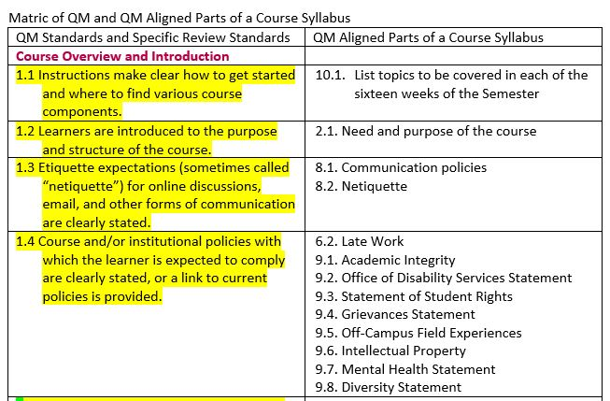

Slide 30

Kelvin Trefz M.Ed.
Educational Technologist
EHE EdTech College of Education and Human Ecology
245 Ramseyer Hall, 29 W. Woodruff Avenue, Columbus, OH 43210
614-688-1243 Office
trefz.1@osu.edu ehe.osu.edu/edtech/

