Slide 1

Emerging Technologies Engage Students
Emerging Technologies Engage Students
An Active Learning Experiment
An Active Learning Experiment

Slide 2
Purpose of the Experiment
Investigate students’ perceptions of using emerging technologies in 2 online Management Information System (MIS) courses.
Investigate QM standards 5 and 6 related to emerging and engaging educational technologies
Partnership between Faculty Center for Teaching with Technology and instructor – value of educational technologies.

Slide 3
MIS 128 & MIS 426
Business Computing Systems and Management Information Systems
Learning Outcomes:
  MIS 128: Acquire beginning skills with industry-standard application software to solve business-related problems, present information from data, perform functional calculations, and select appropriate software for various business tasks.
  MIS 426: Describe the extensive business reporting capabilities enabled by enterprise systems, the Internet, and business intelligence software.
Fully online 5-week course offered Summer 2, 2013
Enrollment: 28 total
QM Reviewed Course

Slide 4
QM Standards
Standard 5: Learner Interaction and Engagement
  5.2: Learning activities that provide opportunities for interaction and support active learning
Standard 6: Course Technology
  6.2: Course tools and media support student engagement and guide the student to become an active learner
  6.4: Students can readily access the technologies required in the course
  6.5 The course technologies are current

Slide 5
Literature
“Advancements in both digital technologies and learning theories are transforming the way we teach and learn...” --Blessinger and Wankel (2012, p. 3),
Deep learning “entails active and devoted engagement with rigorous, high-quality learning activities that is also enjoyable and interesting for the learner.”
--Biggs (2003)
“The idea that student learning is strongly and positively associated with student engagement in the classroom is strongly supported in educational literatures.”
--Molinari and Huonker, 2010

Slide 6
Literature
To develop a model of student satisfaction in an online classroom environment, we posited two key attributes for effective online learning: positive perceptions of technology and interest in course engagement.
--Drennan, 2005
“Accreditation bodies like AACSB are recognizing that ‘students have an obligation to actively participate in their educational experiences.’ Further, AACSB asserts that “without the intentional engagement of students little if any learning will take place.”
--Molinari and Huonker, 2010

Slide 7
Method
Pre- and post-course Likert scale surveys to ascertain the student’s previous experience with online courses and their new experiences with a QM-reviewed course
Thirteen-question, pre-course survey
Fifteen-question, post-course survey
Thirty questions, demographics and normative environment

Slide 8
Pre-Course Survey Results
Pre-Course survey – 28/28
  89% of the respondents had taken an online course before the survey-semester
  89% of the respondents expected to ‘learn’ in an online setting
  67% of the respondents did not expect an online course to be boring

Slide 9
Learning Technologies – QM 5.2/6.2
Course Scavenger Hunt
Audio Prezi of the Syllabus
Windows Movie Maker course introduction
Facebook Groups for discussions
Desktop Videos for application assignments
Integration of SoftChalk modules to provide interactive content
Videos included from the NBC Learn video archives
Classlive sessions (aka Bb Collaborate)

Slide 10
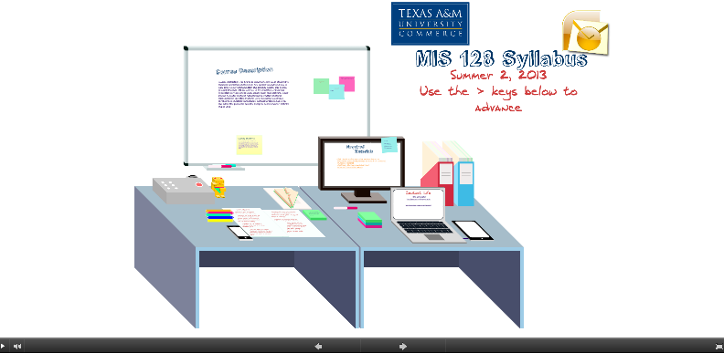
Prezi Syllabus

Slide 11


Slide 12
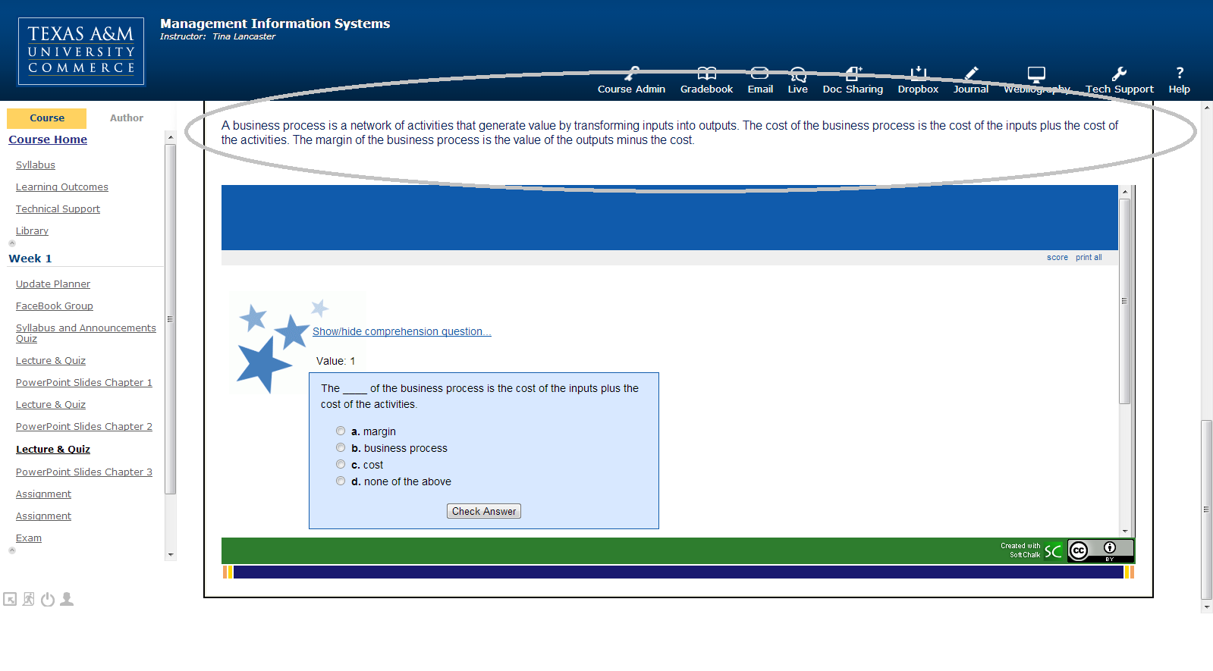
SoftChalk

Slide 13
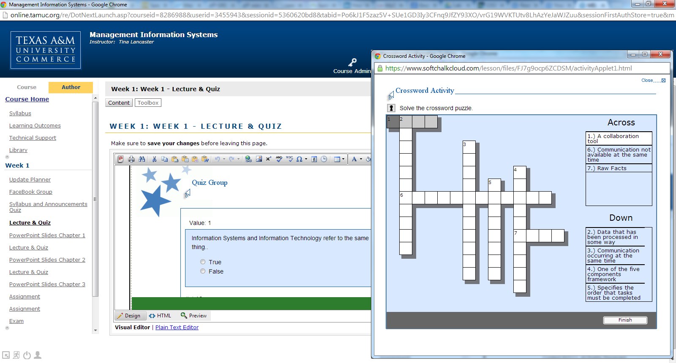

Slide 14
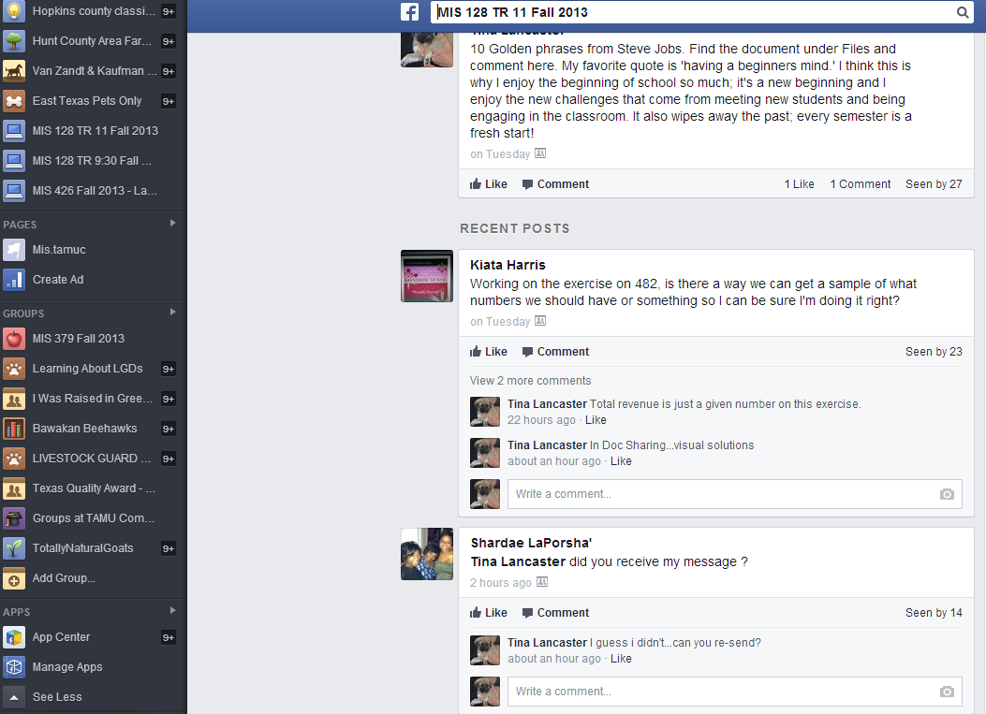
Facebook Group
Discussion Post
Questions/Answers

Slide 15
Post-Course Survey Results
71% of the respondents thought the Internet was used effectively to teach these courses
56% said they would still choose to take this course in the online format
79% said they would take another course online after having this one
Post-Course Survey – 14/28

Slide 16
Instructor Course Perceptions
Experienced higher level of engagement with the students
Increased participation during Class Live than previous semesters
Students questions answered on Facebook reduced the number of individual emails.
Far more group activity than in a traditional discussion board.

Slide 17
Next Steps
Repeat experiment in blended MIS courses Fall 2013, Spring 2014, and Summer 2014 using same experiment conditions.

