Slide 1

Course Development
Summer Institute
Online Course Improvement Program
Quality Matters Regional Conference
San Antonio, TX
November, 2015

Slide 2

How many of your institutions offer summer professional development?

Slide 3
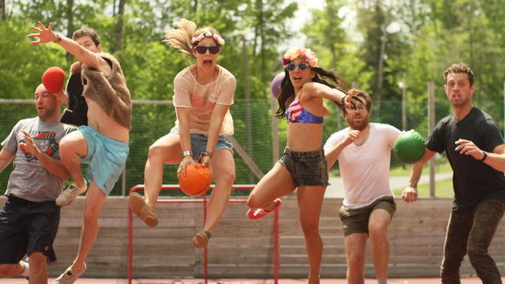
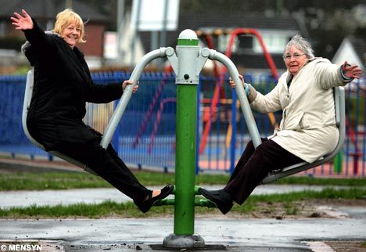

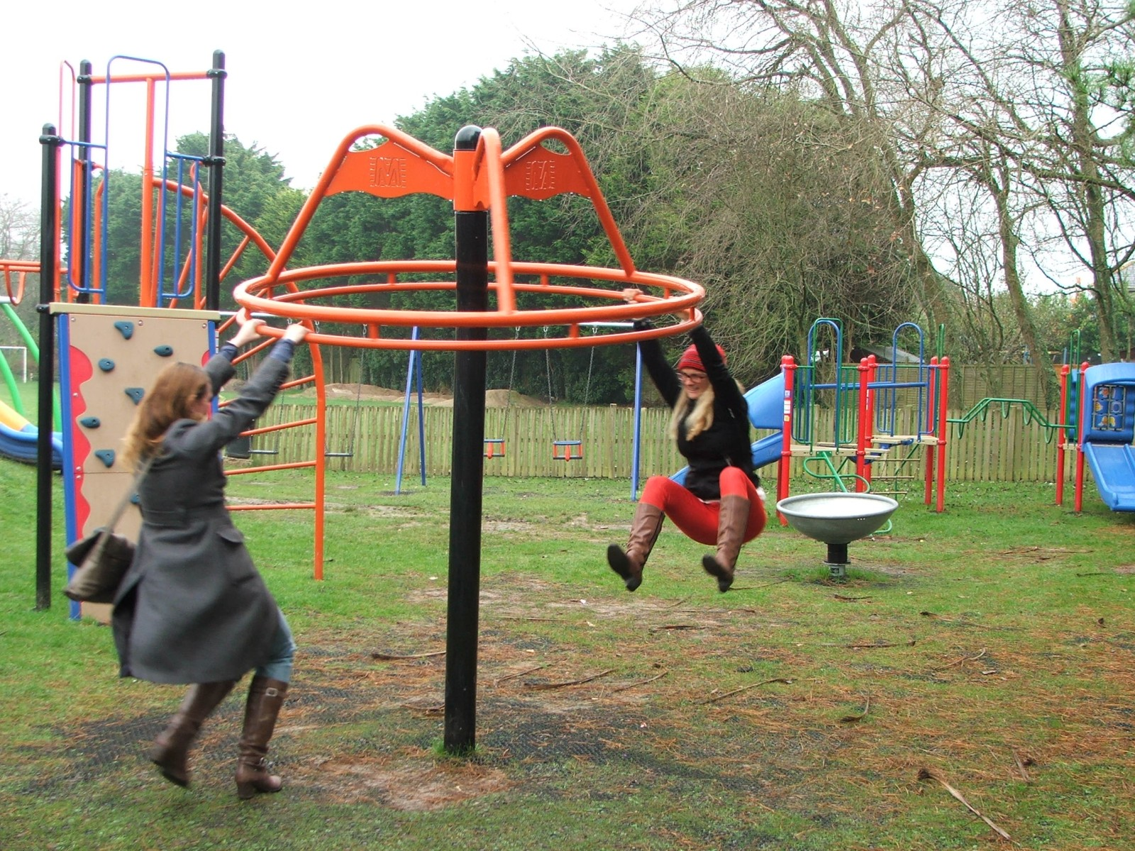
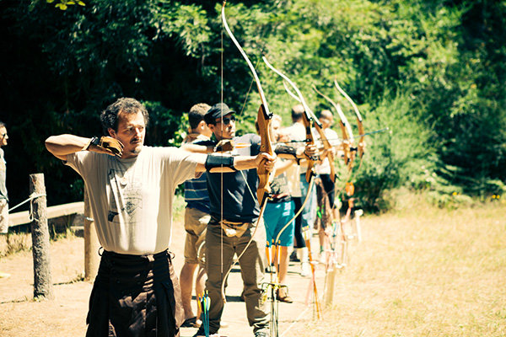
https://media.timeout.com/images/102431249/617/347/image.jpg
http://crookedhouse.typepad.com/crookedhouse/images/2008/05/23/old_women_on_roundabout.jpg
https://alchemyimprovcomedy.files.wordpress.com/2012/06/summer-camp.gif?w=705
http://assets3.thrillist.com/v1/image/1264196/size/tl-horizontal_main/9-adult-summer-camps-where-you-can-shoot-guns-play-guitar-and-learn-how-to-kidnap-somebody
http://bit.ly/1Pu1k9I

Slide 4

Why a Faculty Summer Camp?
Need
Time
Focus
Goal oriented
Efficient
Individualized attention
https://pixabay.com/en/logs-timber-lumber-wood-logging-690100/

Slide 5

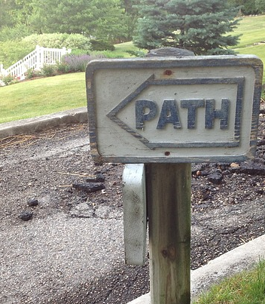
Background Information
1998 - 2009 Previous offerings from ITAL
2010 - One-Year-Plus Fellowship and
2013 - New2Online Program
2013 - iPad Technology Summer Camp
www.imagechef.com
Ah-ha! A need to revise the format of previous summer camps.
Greater ALIGNMENT:
Quality in online course design and production.
2014 - 2 Course Development Summer Camps
2015 - Course Design Summer Institute
https://pixabay.com/en/sign-path-post-road-607442/
Notes:
Changed name from camp to institute - fancier name, but we’ll call them all camps in this presentation. ITAL=Institute for Technology Assisted Learning

Slide 6

Summer Institute Offered by...
Online Course Improvement Program
Team of (almost) Five
Director
3.5 FTE Instructional Consultants
All Quality Matters Peer/Master Reviewers
Academic Technology
Team of 3.5 FTE
Canvas and technology support
http://www.jobfindersites.com/wp-content/uploads/2015/09/summer-staff.jpg

Slide 7

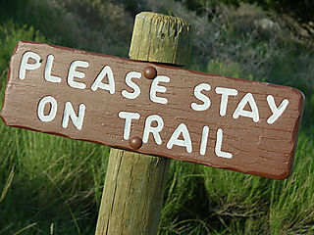
Role of Quality Matters
Foundation for designing summer institute
Guide for course development
Used as self-review for self-identifying areas of development or revision
Informal course review (meets/needs revisions) as measurement of completion
http://freshsqueezedliving.typepad.com/.a/6a00e54f13bdb2883400e55386dfb88834-320pi

Slide 8

OCIP Summer Camp - Mapping the Way
Developed course design workshops and presentations
Checklists for QM standards
Course map templates and samples
Access to QM certified sample courses
Developed resources on ocipresources.pbworks.com
Mentor assigned to each participant for one-on-one guidance
https://pixabay.com/en/treasure-map-treasure-hunt-153425/

Slide 9

OCIP Summer Institute- Agenda
Flipped Model:
Course maps
Recorded webinars
Completion of self review
On-site expectations
Attend workshops, presentations, and open labs
Mentor support onsite or online
https://pixabay.com/en/swiss-army-knife-pocket-knife-blade-154314/
Notes:
homework for participants

Slide 10

Let’s go take a LOOK!
http://www.fieldtripper.com/fieldtripday/img/flag.png
Summer Camp Agenda
Notes:
Agenda, Workshops and Presentations built around Quality Matters Standards, All handouts and checklists are linked here

Slide 11
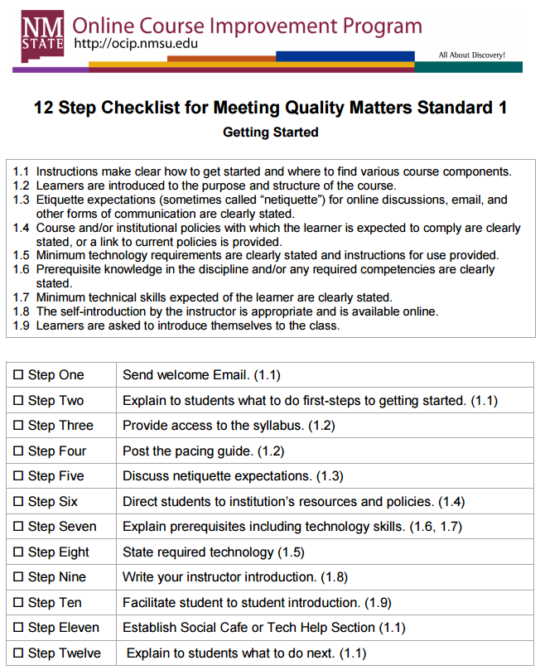
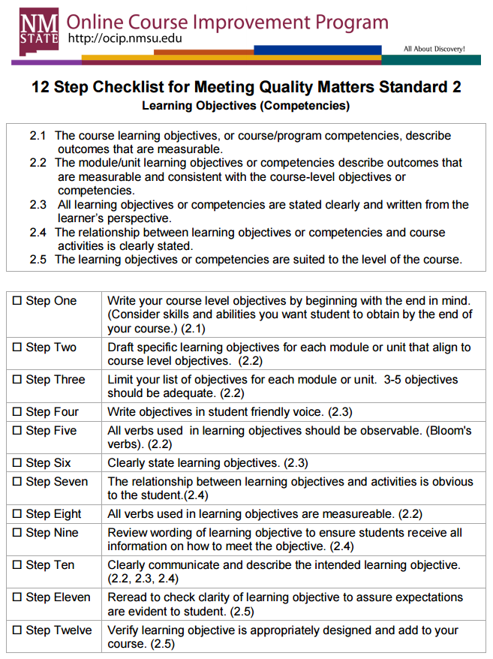
OCIP QM Checklists

Slide 12
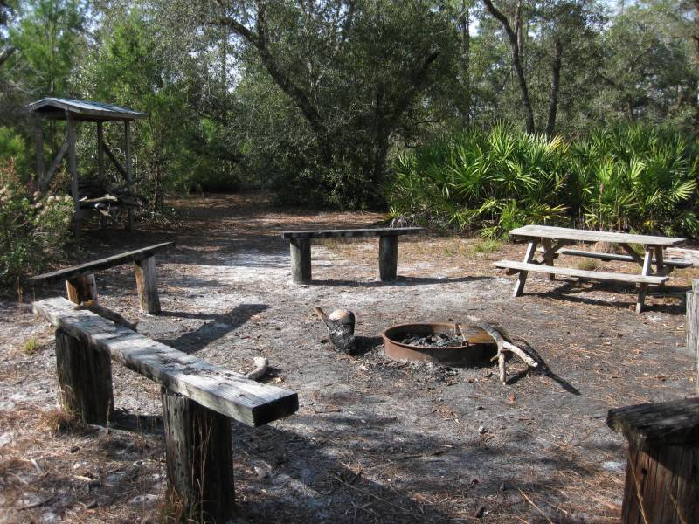
Recruitment
2014
Open application process and rubric to score applications
So many applicants that we added a second summer session
Applicants on wait list from first session
2015
Special request from Dean of College of Business for moving current MBA courses to fully online
Available seats were filled without an open application process
Filled remaining seats with College of Education and College of Arts and Sciences
Notes:
2014: higher needs rank higher;

Slide 13
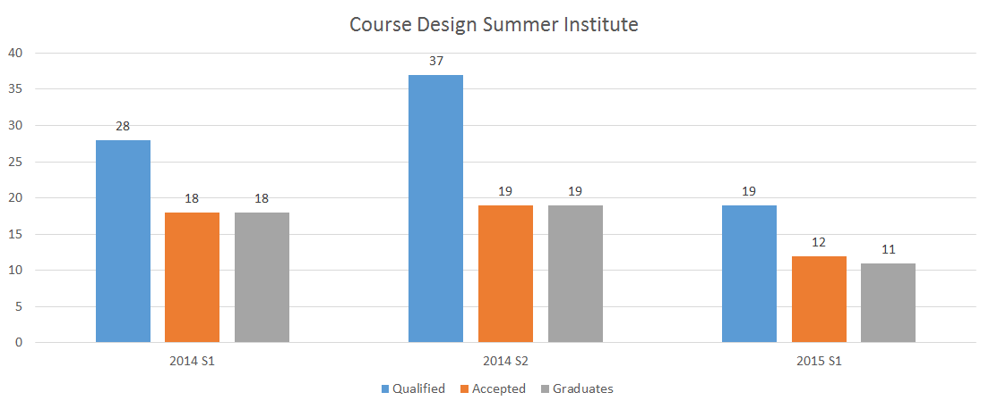
2014 - 2015 Summer Institute

Slide 14
Changes in 2015 from 2014 Lessons Learned
No required attendance
Completion of Quality Matters self-review
Course must meet expectations of an informal review
Upon completion, stipend of $1500 plus fringes
Letter to department head explaining accomplishments and completions
Recognition at annual IIQ Awards Celebration
Total Course Summer Institute Budget
Approximately 15K with 14K in stipends

Slide 15

Keeping the Fire Going
Continued partnership
Formal course reviews
Additional courses in departments getting informally/formally reviewed
Other departments wanting Camp
https://pixabay.com/en/fire-camp-bonfire-wood-heat-30231/

Slide 16
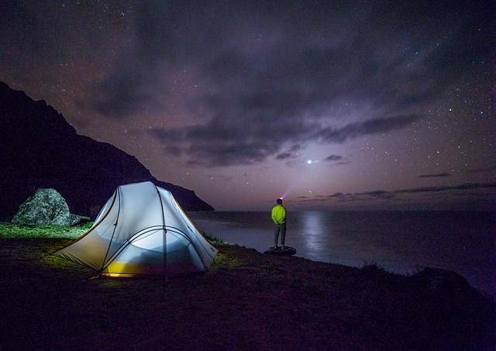
Questions?
https://pixabay.com/en/night-stars-galaxy-wonder-camp-839807/
See what’s out there-- visit the
OCIP Open Source Wiki

Slide 17

Feel free to contact us!
Michelle Lebsock
(575) 646-7436
Miley Grandjean
(575) 646-5492
email: ocip@nmsu.edu
website: ocip.nmsu.edu
Resource Wiki: ocipresources.nmsu.edu
Tweet us: @nmsuocip #NMSUOCIP

