Slide 1
Expect more to attain more:
Reaching for 100% faculty certifications
Quality Assurance in Online Learning
November 1, 2016
Notes:
Susan

Slide 2
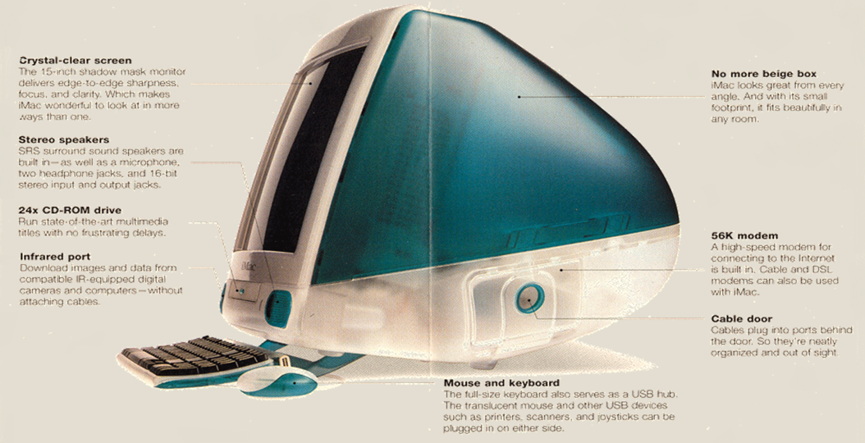
1999
Notes:
Susan

Slide 3

2016
Notes:
Susan

Slide 4
2016
1st in online courses
1st in number of students enrolled
Notes:
Susan

Slide 5
In Your Case………
Where is your institution on the online continuum?
What steps are needed to continue your momentum?
Take aways from St. Petersburg College experience.
Notes:
Susan

Slide 6
Online Review: Timeline
May 2009 Blackboard purchased ANGEL
March 2012 Blackboard no longer updating ANGEL
July 2013 Faculty dinners:
“Student success and engagement online”
August 2013 President extended conversation to “Review of
Online” and invited faculty to lead the process
Notes:
Anne

Slide 7
Online Review Focus
Course quality
Faculty roles and responsibilities
Faculty professional development
Systems for continuous improvement
Notes:
Anne

Slide 8
Online Review: Timeline
Sept-Nov 2013 Six committees meeting weekly
            Team 1: Big Picture
            Team 2: Online Course Development and Review
            Team 3: Faculty Roles and Support
            Team 4: Student Readiness to Learn Online
            Team 5: Academic and Student Support Services
            Team 6: Organizational Structure
November 2013 Presentation to Board of Trustees
January 2014 Online Steering Committee Formed
Notes:
Anne

Slide 9
Online Revitalization: Steering Committee
Mission
To enhance student success and retention by creating resources which prepare students for learning in the online modality, and by committing faculty, staff and administrators to high standards of quality in the content and delivery of courses and services.
  Adoption of Quality Matters
  Faculty certification
  Course template
  Standard course development
  Student support services
Notes:
Anne

Slide 10
Online Revitalization: Timeline
February 2014 Job posting for Associate Vice President
February 2014 Faculty certification process developed
February 2014 LMS transition started
February 2014 Adoption of Quality Matters
March 2014 Reorganization to Online Learning & Services
July 2014 New AVP, Online Learning & Services
Notes:
Anne

Slide 11
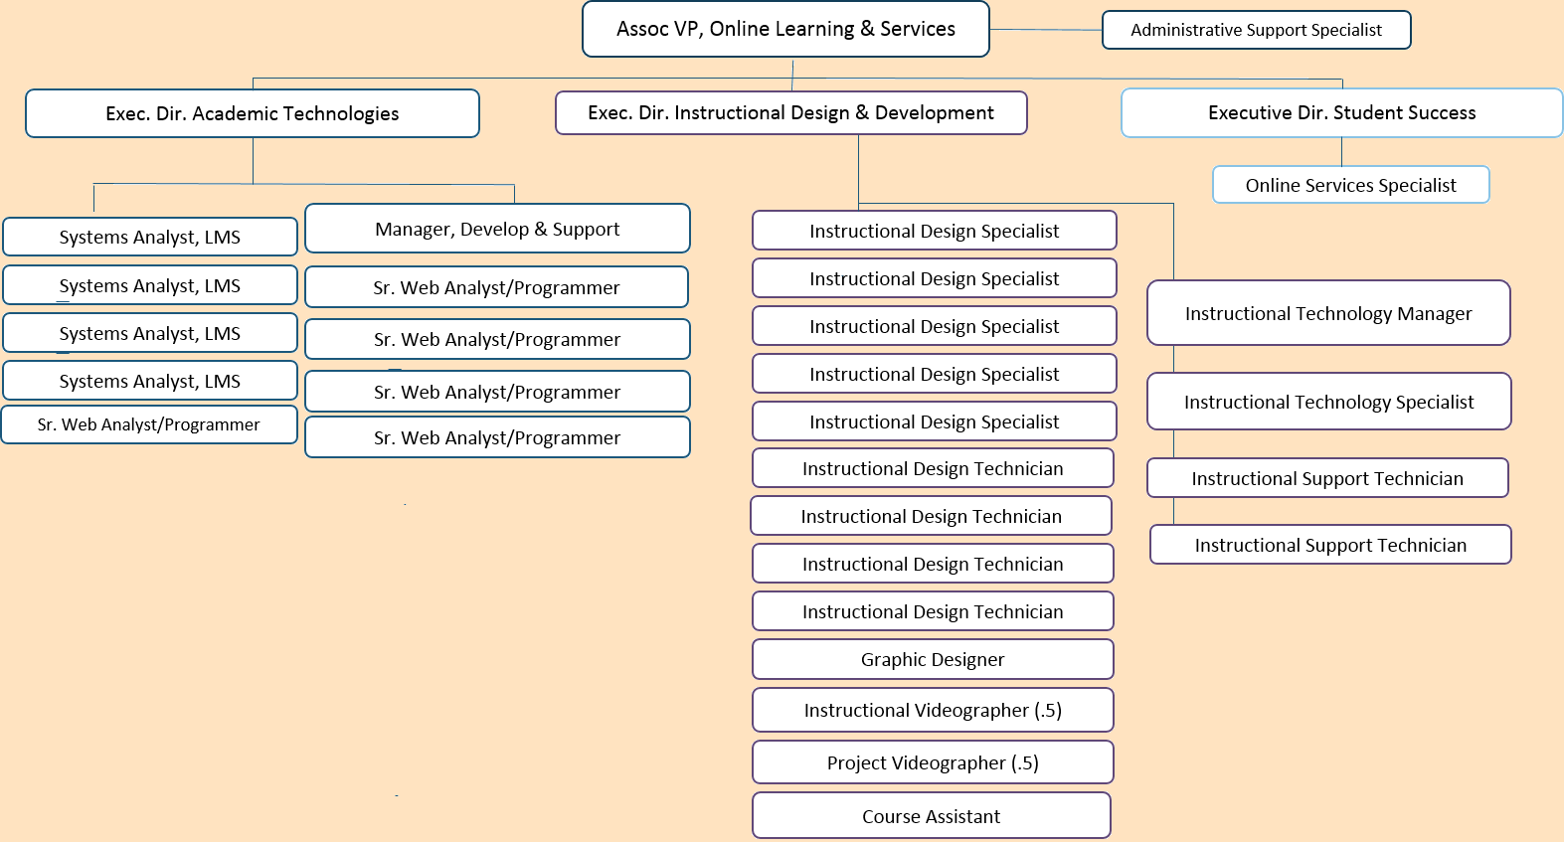
Online Learning & Services
Notes:
Susan

Slide 12
Online Revitalization
Student and faculty readiness
Online courses
Student services accessible online
Notes:
Susan

Slide 13
Faculty Certification
 | All Faculty | Online/Blended Teaching Certification | Online Developer Certification | Online Reviewer Certification
LMS competency
Teaching for Online/Blended
Developing for Online/Blended
QM Rubric
QM Peer Reviewer
Notes:
Susan

Slide 14
Faculty Certification
 | All Faculty | Online/Blended Teaching Certification | Online Developer Certification | Online Reviewer Certification
LMS competency | 1,787
Teaching for Online/Blended |  | 843
Developing for Online/Blended |  |  | 147
QM Rubric |  |  | 244
QM Peer Reviewer |  |  |  | 63
Notes:
Susan

Slide 15
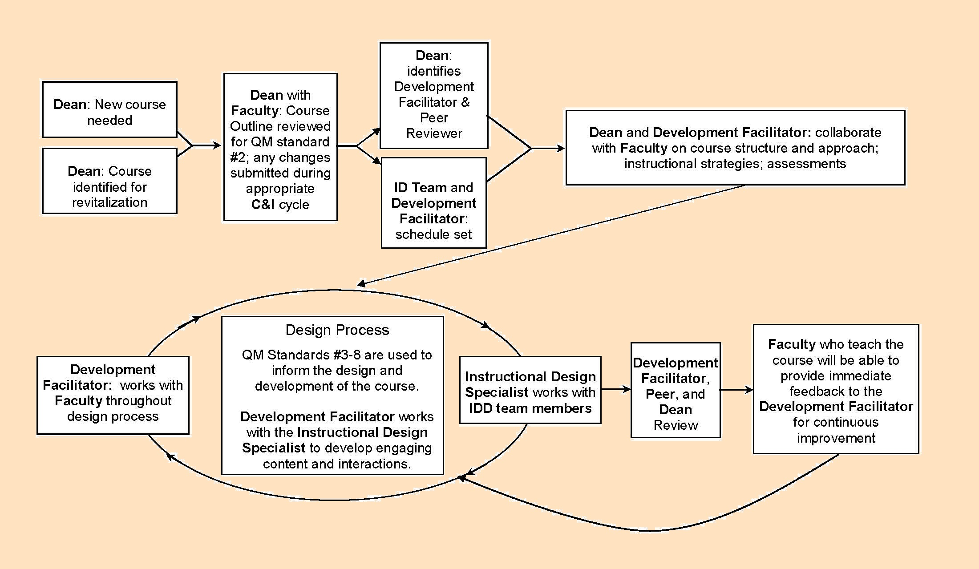
Standard Course Development
Notes:
Susan

Slide 16
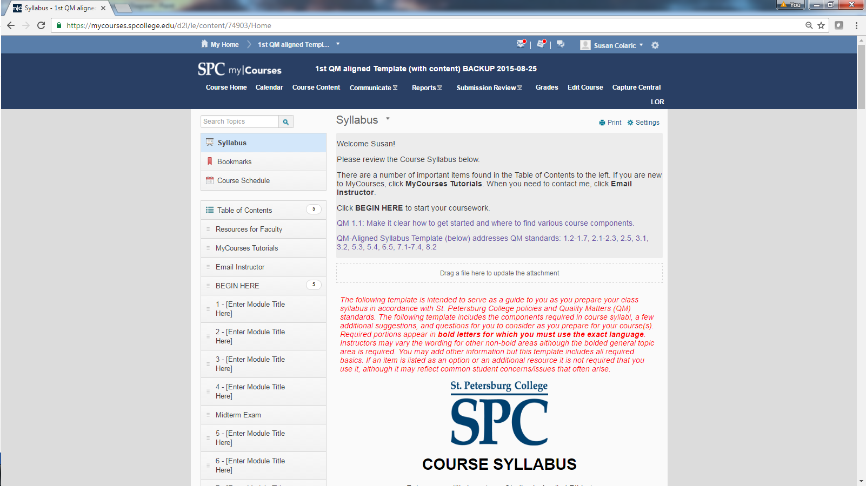
Common Course Template
Notes:
Susan

Slide 17
Communication
Steering Committee
Department meetings
Faculty Governance Organization
Online Revitalization Open Forums
Weekly FAQs
https://ols.spcollege.edu/
Notes:
Susan

Slide 18
Evidence of culture shift
Common language
100% compliance
Use of Standard Course
Positive feedback
Collaborative development
Ongoing improvement
Notes:
Anne

Slide 19
QUESTIONS?
Susan Colaric
Anne Cooper
St. Petersburg College

