Slide 1
The Value of Visuals:
A Broader View of Standard 8
eLearning Design and Services
INDIANA UNIVERSITY

Slide 2
General Standard 4
Instructional materials are sufficiently comprehensive to achieve stated course objectives and learning outcomes.
… for all students.
© DLG Images
Notes:
DLG Images. Traditonal Umbrella. Digital image. Flickr. Yahoo!, 12 Mar. 2015. Web. 27 Oct. 2016. <https://www.flickr.com/photos/131260238@N08/16606777908/in/photolist-riu5v3-e1nVws-5if3H2-h1dEHx-h1cF4X-rA4s1n-a21Few-dLTAMY-jsPBmd-4rpKYV-gQehjJ-7nHuP7-dLTAyL-97nKqd-HDeGij-8nVNTY-C2rUt-riBtHH-53aLZN-iydcKA-47Fq6f-fcWWK-hMPEQ9-GK1MHR-9ua3Jh-jVpiMi-efgRUU-4GGbnt-mAQa6E-5BGxoW-jVofax-CDXJc-qpSRQB-88LMVr-cvFyvU-j6HXgv-8KH3WD-77xLtd-88BF7F-2XxrHa-37ZtnD-7ZuP8e-8ca33s-9hvwPA-8fV8RF-egw9D9-2oKuRD-569yzm-FGx8Q1-BRFsm1>.

Slide 3
Highlights of Specific Review Standards 4.1, 4.2, 4.5
Materials contribute to achievement
Purpose of material is clear
There is a variety of materials
… for all students.
© DLG Images
Notes:
DLG Images. Traditonal Umbrella. Digital image. Flickr. Yahoo!, 12 Mar. 2015. Web. 27 Oct. 2016. <https://www.flickr.com/photos/131260238@N08/16606777908/in/photolist-riu5v3-e1nVws-5if3H2-h1dEHx-h1cF4X-rA4s1n-a21Few-dLTAMY-jsPBmd-4rpKYV-gQehjJ-7nHuP7-dLTAyL-97nKqd-HDeGij-8nVNTY-C2rUt-riBtHH-53aLZN-iydcKA-47Fq6f-fcWWK-hMPEQ9-GK1MHR-9ua3Jh-jVpiMi-efgRUU-4GGbnt-mAQa6E-5BGxoW-jVofax-CDXJc-qpSRQB-88LMVr-cvFyvU-j6HXgv-8KH3WD-77xLtd-88BF7F-2XxrHa-37ZtnD-7ZuP8e-8ca33s-9hvwPA-8fV8RF-egw9D9-2oKuRD-569yzm-FGx8Q1-BRFsm1>.

Slide 4

Instructional Materials
Contribute to learning with variety and clear purpose
4.1
4.2
4.5
© DLG Images
Notes:
DLG Images. Traditonal Umbrella. Digital image. Flickr. Yahoo!, 12 Mar. 2015. Web. 27 Oct. 2016. <https://www.flickr.com/photos/131260238@N08/16606777908/in/photolist-riu5v3-e1nVws-5if3H2-h1dEHx-h1cF4X-rA4s1n-a21Few-dLTAMY-jsPBmd-4rpKYV-gQehjJ-7nHuP7-dLTAyL-97nKqd-HDeGij-8nVNTY-C2rUt-riBtHH-53aLZN-iydcKA-47Fq6f-fcWWK-hMPEQ9-GK1MHR-9ua3Jh-jVpiMi-efgRUU-4GGbnt-mAQa6E-5BGxoW-jVofax-CDXJc-qpSRQB-88LMVr-cvFyvU-j6HXgv-8KH3WD-77xLtd-88BF7F-2XxrHa-37ZtnD-7ZuP8e-8ca33s-9hvwPA-8fV8RF-egw9D9-2oKuRD-569yzm-FGx8Q1-BRFsm1>.

Slide 5
General Standard 8
The course design reflects a commitment to accessibility and usability for all learners.
© DLG Images
Notes:
DLG Images. Traditonal Umbrella. Digital image. Flickr. Yahoo!, 12 Mar. 2015. Web. 27 Oct. 2016. <https://www.flickr.com/photos/131260238@N08/16606777908/in/photolist-riu5v3-e1nVws-5if3H2-h1dEHx-h1cF4X-rA4s1n-a21Few-dLTAMY-jsPBmd-4rpKYV-gQehjJ-7nHuP7-dLTAyL-97nKqd-HDeGij-8nVNTY-C2rUt-riBtHH-53aLZN-iydcKA-47Fq6f-fcWWK-hMPEQ9-GK1MHR-9ua3Jh-jVpiMi-efgRUU-4GGbnt-mAQa6E-5BGxoW-jVofax-CDXJc-qpSRQB-88LMVr-cvFyvU-j6HXgv-8KH3WD-77xLtd-88BF7F-2XxrHa-37ZtnD-7ZuP8e-8ca33s-9hvwPA-8fV8RF-egw9D9-2oKuRD-569yzm-FGx8Q1-BRFsm1>.

Slide 6
Highlights of Specific Review Standards 8.1, 8.3, 8.4, 8.5
Facilitates ease of use
Provides alternate formats
Protects readability
… for all students.
© DLG Images
Notes:
DLG Images. Traditonal Umbrella. Digital image. Flickr. Yahoo!, 12 Mar. 2015. Web. 27 Oct. 2016. <https://www.flickr.com/photos/131260238@N08/16606777908/in/photolist-riu5v3-e1nVws-5if3H2-h1dEHx-h1cF4X-rA4s1n-a21Few-dLTAMY-jsPBmd-4rpKYV-gQehjJ-7nHuP7-dLTAyL-97nKqd-HDeGij-8nVNTY-C2rUt-riBtHH-53aLZN-iydcKA-47Fq6f-fcWWK-hMPEQ9-GK1MHR-9ua3Jh-jVpiMi-efgRUU-4GGbnt-mAQa6E-5BGxoW-jVofax-CDXJc-qpSRQB-88LMVr-cvFyvU-j6HXgv-8KH3WD-77xLtd-88BF7F-2XxrHa-37ZtnD-7ZuP8e-8ca33s-9hvwPA-8fV8RF-egw9D9-2oKuRD-569yzm-FGx8Q1-BRFsm1>.

Slide 7
Instructional Materials
8.1
Contribute to learning with variety and clear purpose
Are readable, easy to use, and varied in format
4.1
8.3
4.2
8.4
4.5
8.5
© DLG Images
Notes:
DLG Images. Traditonal Umbrella. Digital image. Flickr. Yahoo!, 12 Mar. 2015. Web. 27 Oct. 2016. <https://www.flickr.com/photos/131260238@N08/16606777908/in/photolist-riu5v3-e1nVws-5if3H2-h1dEHx-h1cF4X-rA4s1n-a21Few-dLTAMY-jsPBmd-4rpKYV-gQehjJ-7nHuP7-dLTAyL-97nKqd-HDeGij-8nVNTY-C2rUt-riBtHH-53aLZN-iydcKA-47Fq6f-fcWWK-hMPEQ9-GK1MHR-9ua3Jh-jVpiMi-efgRUU-4GGbnt-mAQa6E-5BGxoW-jVofax-CDXJc-qpSRQB-88LMVr-cvFyvU-j6HXgv-8KH3WD-77xLtd-88BF7F-2XxrHa-37ZtnD-7ZuP8e-8ca33s-9hvwPA-8fV8RF-egw9D9-2oKuRD-569yzm-FGx8Q1-BRFsm1>.

Slide 8
Design Elements
…are instructional materials.
© DLG Images
Notes:
DLG Images. Traditonal Umbrella. Digital image. Flickr. Yahoo!, 12 Mar. 2015. Web. 27 Oct. 2016. <https://www.flickr.com/photos/131260238@N08/16606777908/in/photolist-riu5v3-e1nVws-5if3H2-h1dEHx-h1cF4X-rA4s1n-a21Few-dLTAMY-jsPBmd-4rpKYV-gQehjJ-7nHuP7-dLTAyL-97nKqd-HDeGij-8nVNTY-C2rUt-riBtHH-53aLZN-iydcKA-47Fq6f-fcWWK-hMPEQ9-GK1MHR-9ua3Jh-jVpiMi-efgRUU-4GGbnt-mAQa6E-5BGxoW-jVofax-CDXJc-qpSRQB-88LMVr-cvFyvU-j6HXgv-8KH3WD-77xLtd-88BF7F-2XxrHa-37ZtnD-7ZuP8e-8ca33s-9hvwPA-8fV8RF-egw9D9-2oKuRD-569yzm-FGx8Q1-BRFsm1>.

Slide 9
Design Elements
Scale
Color
Typography
Tone (Tone)
© DLG Images
Notes:
DLG Images. Traditonal Umbrella. Digital image. Flickr. Yahoo!, 12 Mar. 2015. Web. 27 Oct. 2016. <https://www.flickr.com/photos/131260238@N08/16606777908/in/photolist-riu5v3-e1nVws-5if3H2-h1dEHx-h1cF4X-rA4s1n-a21Few-dLTAMY-jsPBmd-4rpKYV-gQehjJ-7nHuP7-dLTAyL-97nKqd-HDeGij-8nVNTY-C2rUt-riBtHH-53aLZN-iydcKA-47Fq6f-fcWWK-hMPEQ9-GK1MHR-9ua3Jh-jVpiMi-efgRUU-4GGbnt-mAQa6E-5BGxoW-jVofax-CDXJc-qpSRQB-88LMVr-cvFyvU-j6HXgv-8KH3WD-77xLtd-88BF7F-2XxrHa-37ZtnD-7ZuP8e-8ca33s-9hvwPA-8fV8RF-egw9D9-2oKuRD-569yzm-FGx8Q1-BRFsm1>.

Slide 10

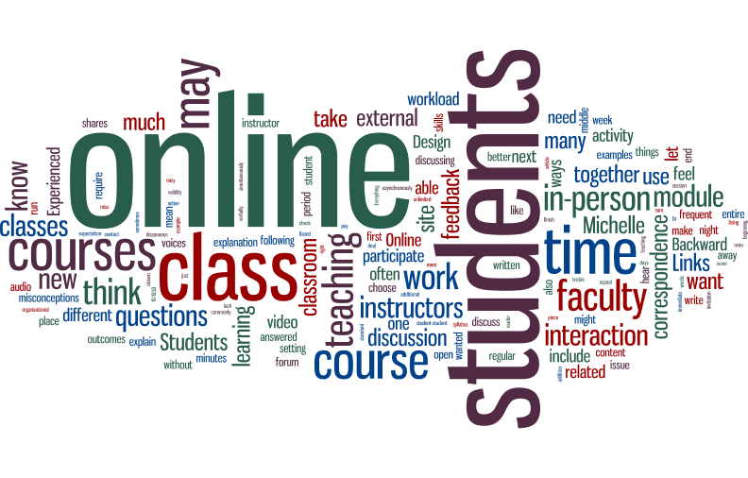
Design Elements: Scale
Notes:
Are you emphasizing what you want to emphasize?
Word cloud with all words in document weighted by frequency vs word cloud with common words removed to focus on “important” words.

Slide 11
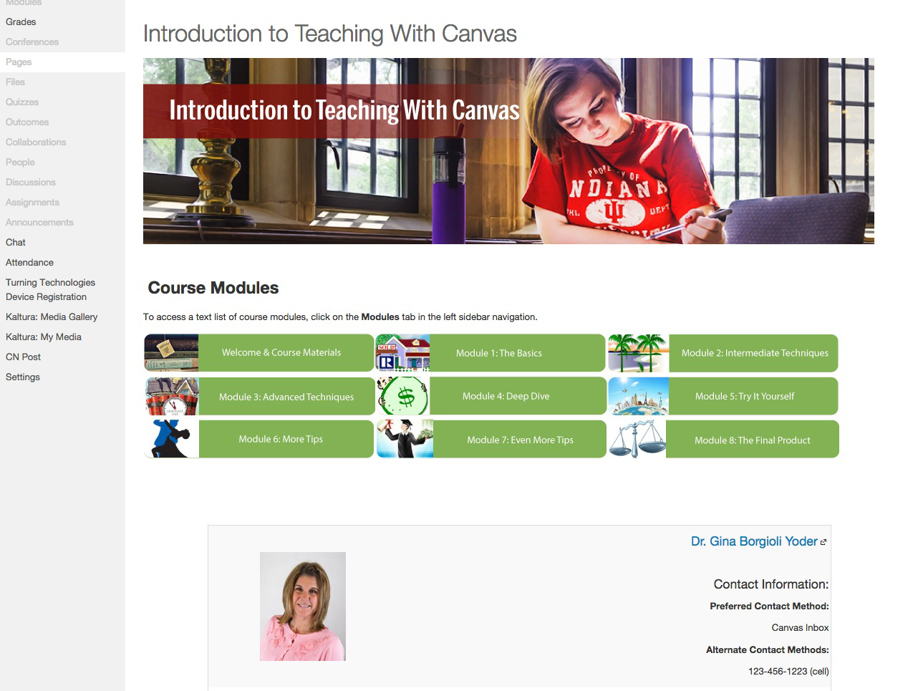
Design Elements: Scale
Notes:
Note the large header image overshadowing the page content. The actual modules and instructor contact information and de-emphasized by their relatively small size.

Slide 12
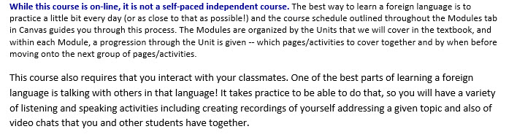
Design Elements: Typography
single-spaced 10 point Calibri
1.15 spaced 11 point Calibri
Single spaced 11 point Harrington
This is an asynchronous, web-based course delivered through Canvas, which allows us to expand
the social interface for the online class. Emphasis is on creating a virtual learning community for
this course with the goal of building a continuous thread of conversation that expands weekly as
new topics are introduced and students contribute new ideas and responses to questions posed.
Grades depend on the quality of online discussion and participation by all students.

Slide 13
Design Elements: Color
Is this good use of color?

Slide 14
Design Elements: Color
Is this better use of color?

Slide 15
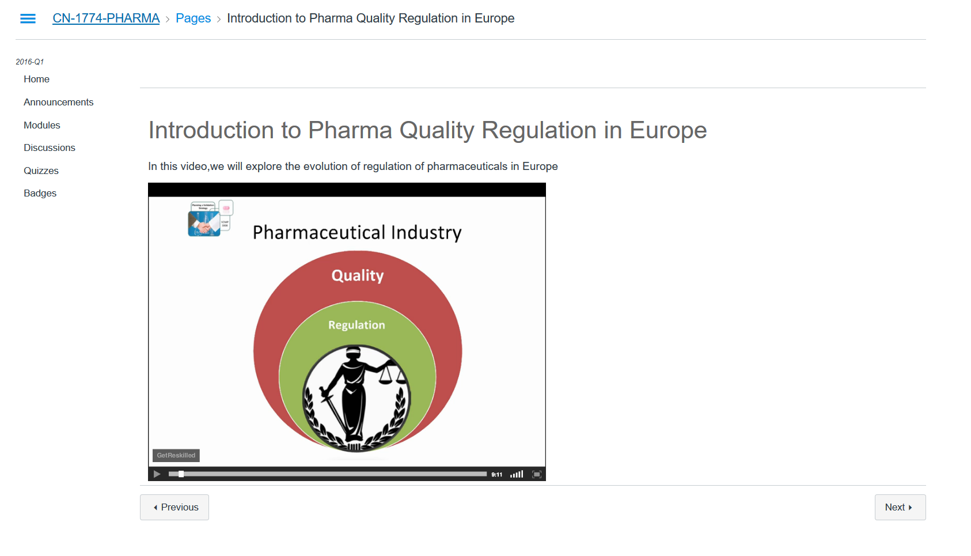
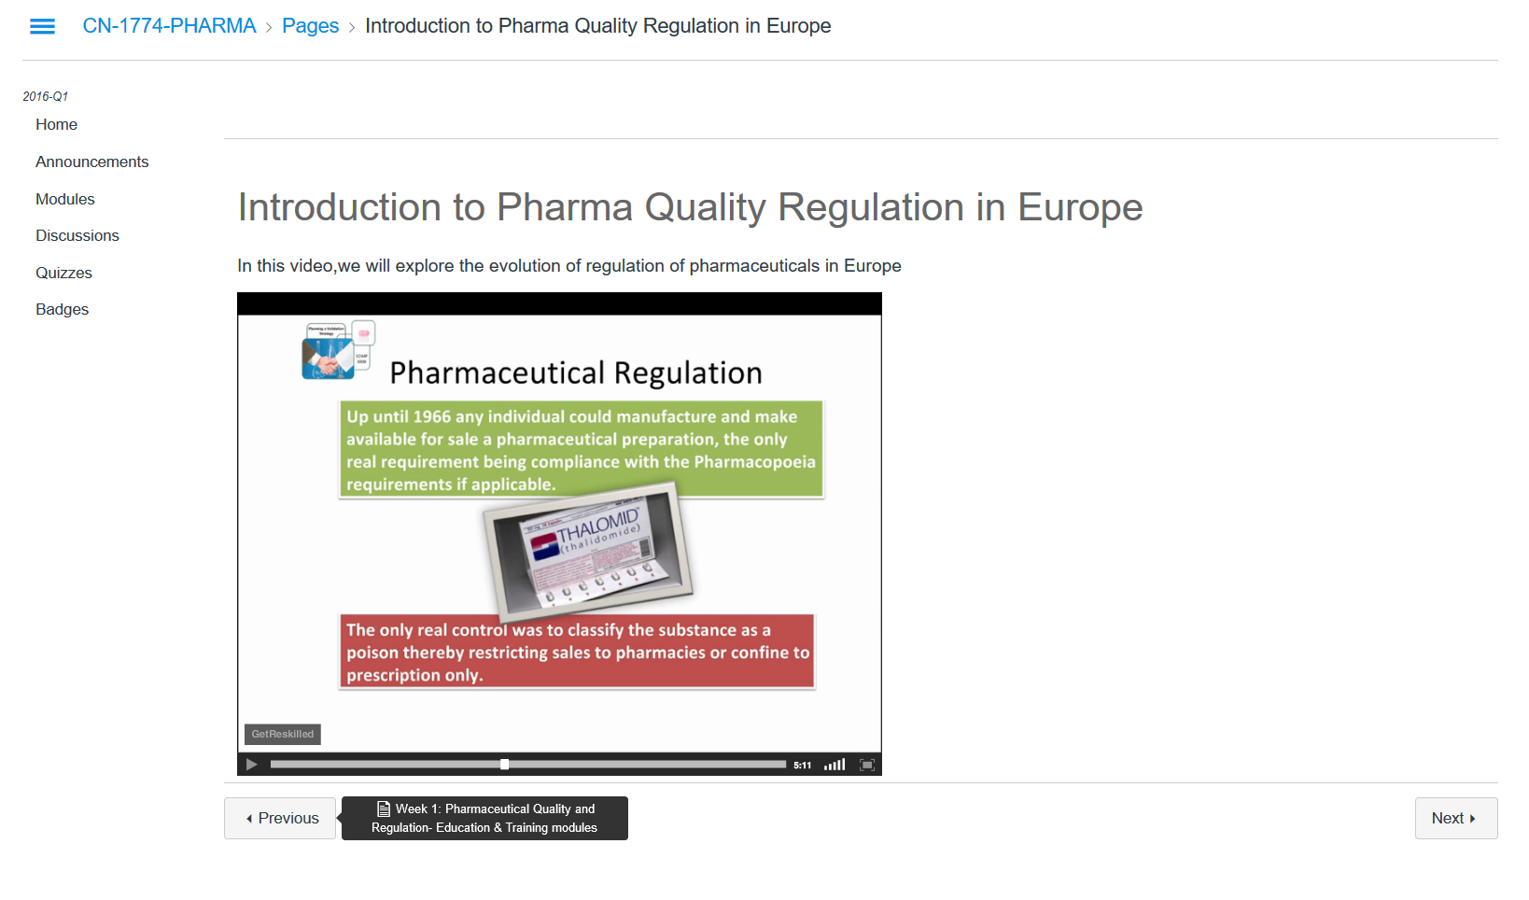
Design Elements: Color
Notes:
https://learn.canvas.net/courses/630
Color
Meaning of red and green in image

Slide 16
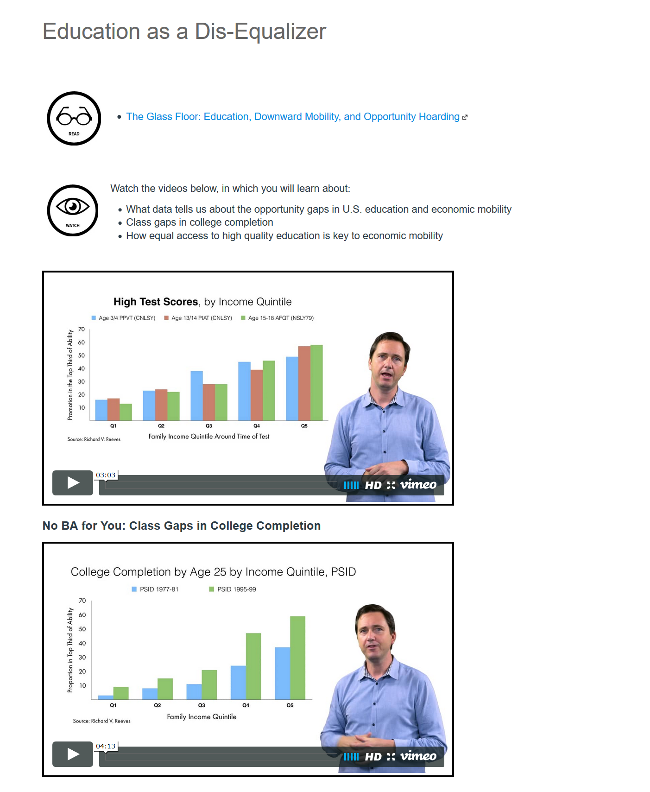
Design Elements: Color
Notes:
https://learn.canvas.net/courses/1333
Better example
Color = differentiates content
Scale represents content
Scale represents importance of content chunks
Icons appropriate relative scale

Slide 17
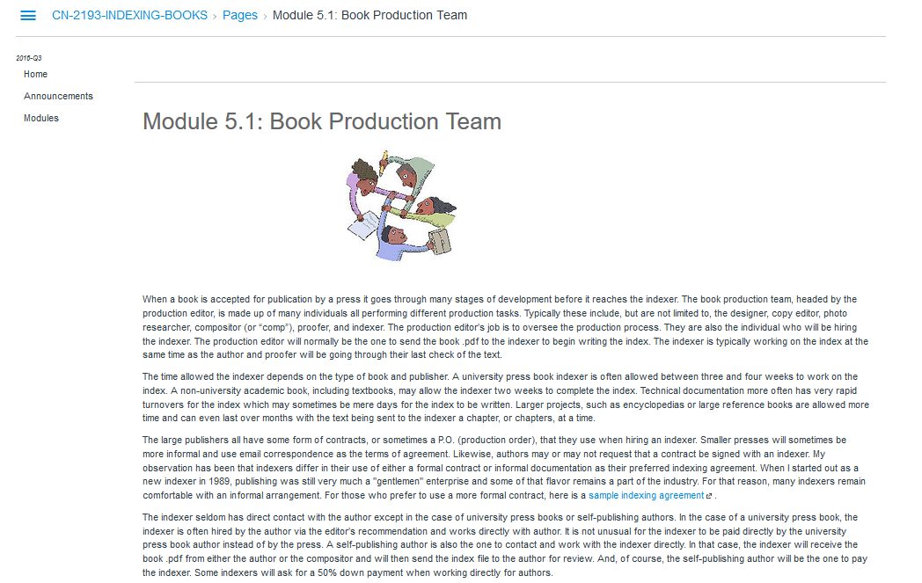
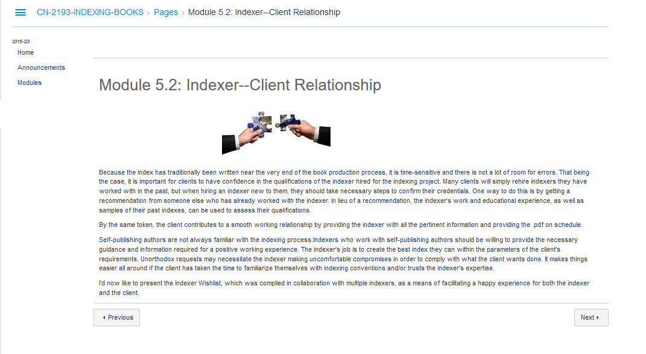
Design Elements: Tone

Slide 18

Design Elements: Color
Notes:
https://learn.canvas.net/courses/630
Tone – Open shirt, no undershirt does not fit with professional content.
HOWEVER, this is an Irish professor. Now that you know that, does it make you feel differently about tone?

Slide 19
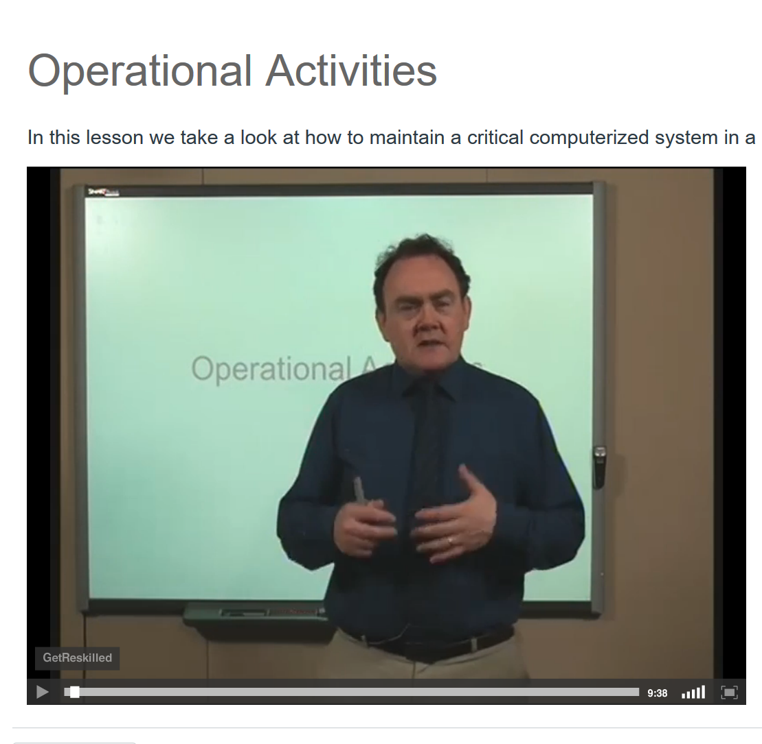
Design Elements: Color
Notes:
Inconsistent tone – A switch! He put on a tie.

Slide 20
Activity
Assess handouts for strengths and weaknesses related to scale, typography, color, and/or tone
On the sticky note, circle the design elements of note and add comments related to strengths and weaknesses
Share your thoughts
Use this handout as a takeaway to review these design considerations in the future

Slide 21
eLearning Design & Services
Anna Lynch: ahlynch@iu.edu
Renée Petrina: rpetrina@iu.edu @Skill2Teach

