Slide 1


Slide 2

Photo by pgcap - Creative Commons Attribution-NonCommercial-ShareAlike License https://www.flickr.com/photos/53892129@N02
Created with Haiku Deck

Slide 3
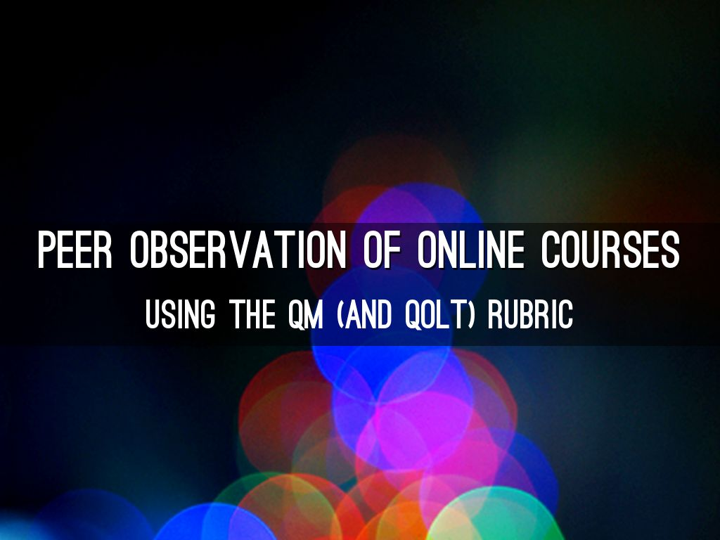
Photo by Shermeee - Creative Commons Attribution License https://www.flickr.com/photos/56502208@N00
Created with Haiku Deck

Slide 4

Photo by pni - Creative Commons Attribution-NonCommercial-ShareAlike License https://www.flickr.com/photos/16391511@N00
Created with Haiku Deck

Slide 5
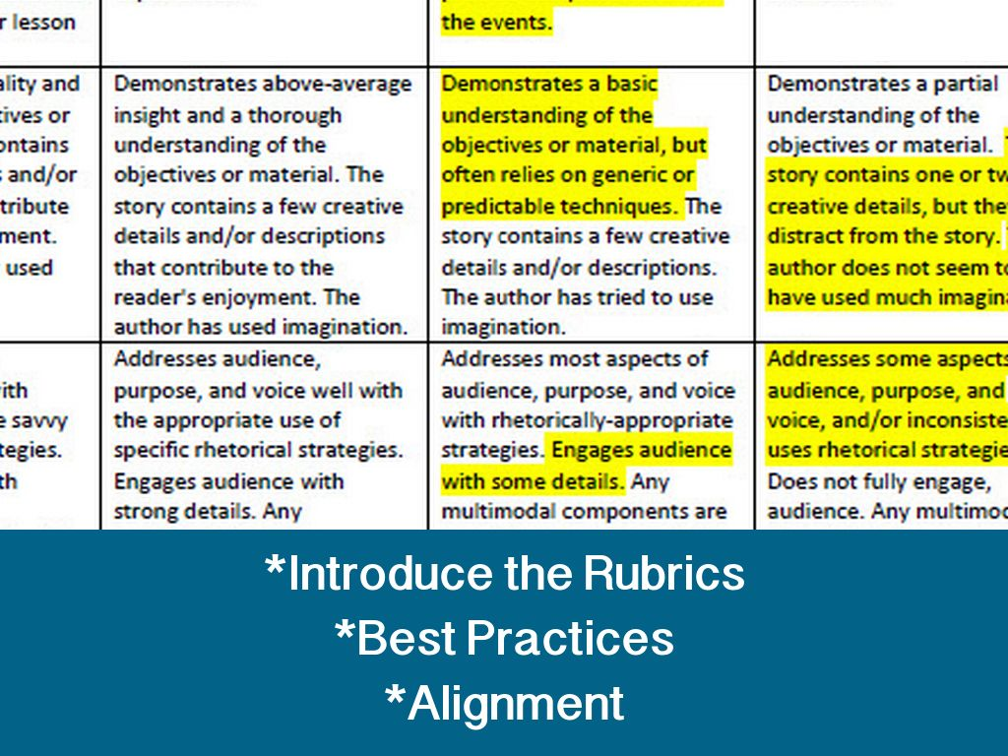
Photo by tengrrl - Creative Commons Attribution-ShareAlike License https://www.flickr.com/photos/83528664@N00
Created with Haiku Deck

Slide 6

Photo by Florian SEROUSSI - Creative Commons Attribution-NonCommercial-ShareAlike License https://www.flickr.com/photos/22144986@N00
Created with Haiku Deck

Slide 7
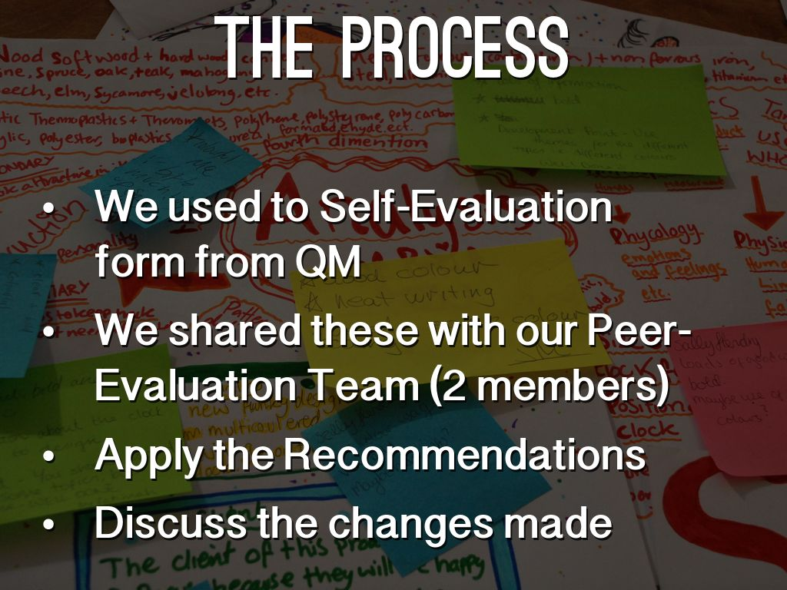
Photo by Jordanhill School D&T Dept - Creative Commons Attribution License https://www.flickr.com/photos/42042252@N02
Created with Haiku Deck

Slide 8
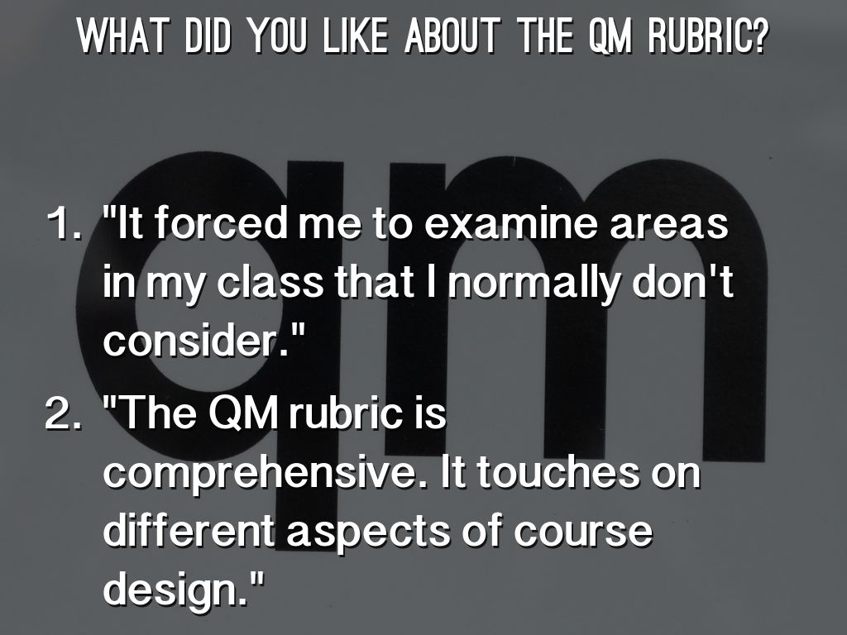
Photo by mag3737 - Creative Commons Attribution-NonCommercial-ShareAlike License https://www.flickr.com/photos/50318388@N00
Created with Haiku Deck

Slide 9

Photo by mattcornock - Creative Commons Attribution-NonCommercial License https://www.flickr.com/photos/41672704@N06
Created with Haiku Deck

Slide 10
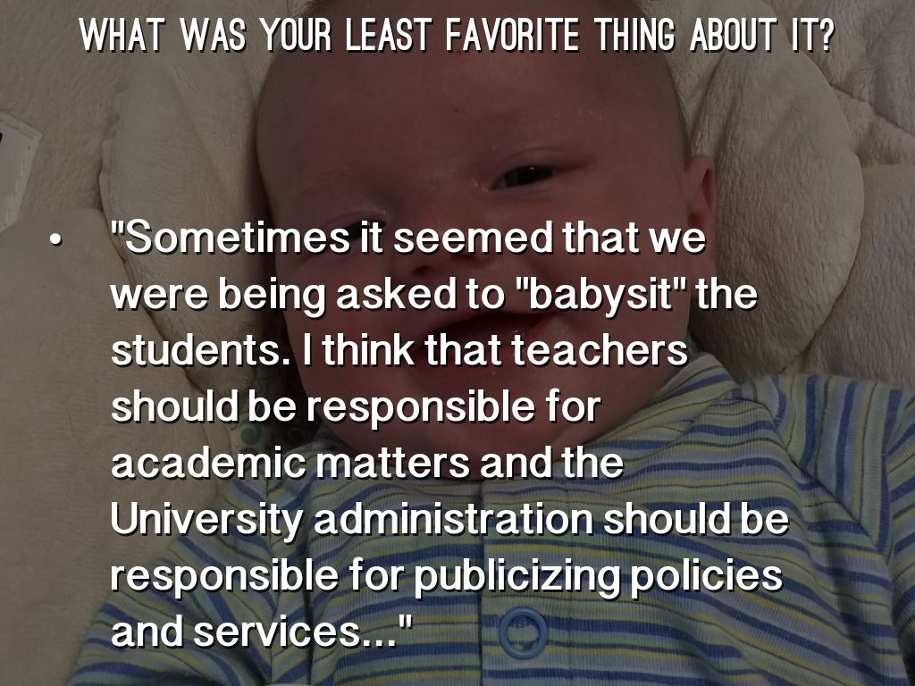

Slide 11
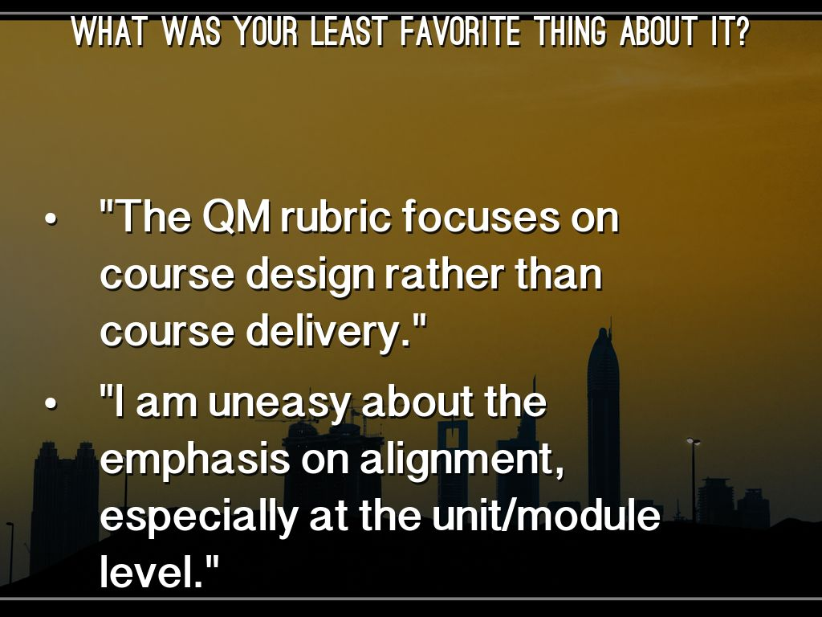
Photo by fatboyke (Luc) - Creative Commons Attribution-NonCommercial-ShareAlike License https://www.flickr.com/photos/8264376@N03
Created with Haiku Deck

Slide 12
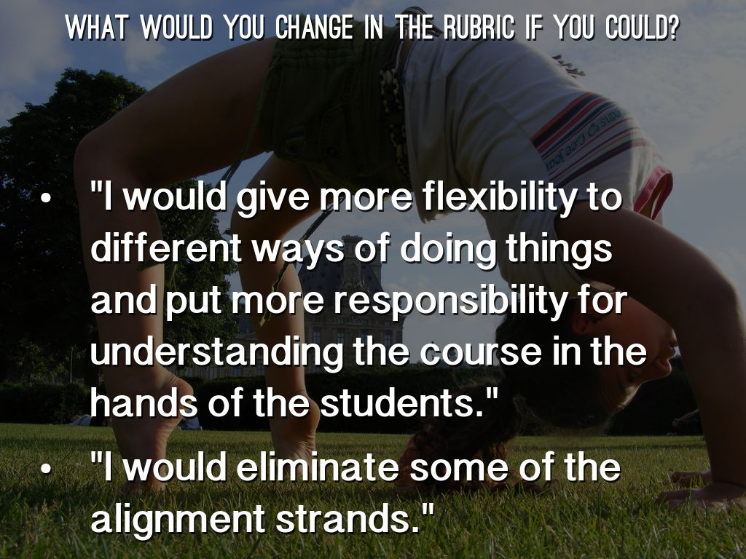
Photo by SordaCadencia - Creative Commons Attribution-NonCommercial License https://www.flickr.com/photos/11350170@N06
Created with Haiku Deck

Slide 13

Photo by juhansonin - Creative Commons Attribution License https://www.flickr.com/photos/38869431@N00
Created with Haiku Deck

Slide 14
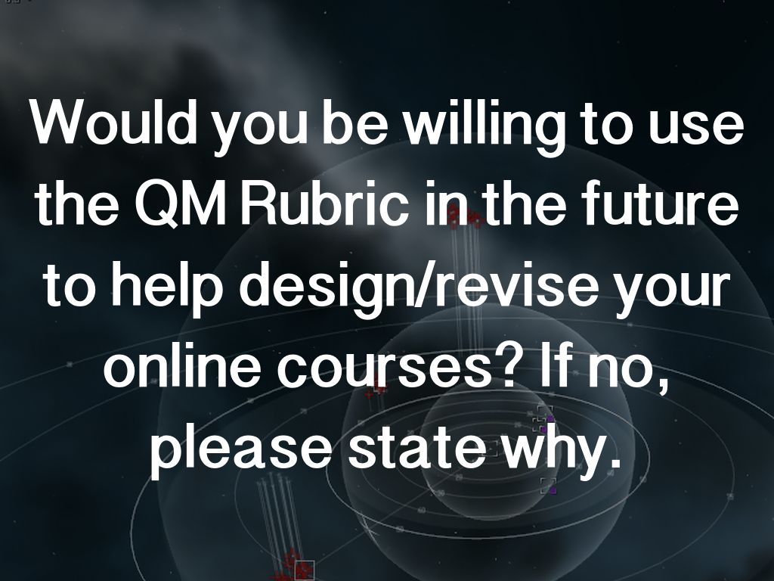
Photo by CrazyKinux - Creative Commons Attribution-NonCommercial-ShareAlike License https://www.flickr.com/photos/42976004@N00
Created with Haiku Deck

Slide 15
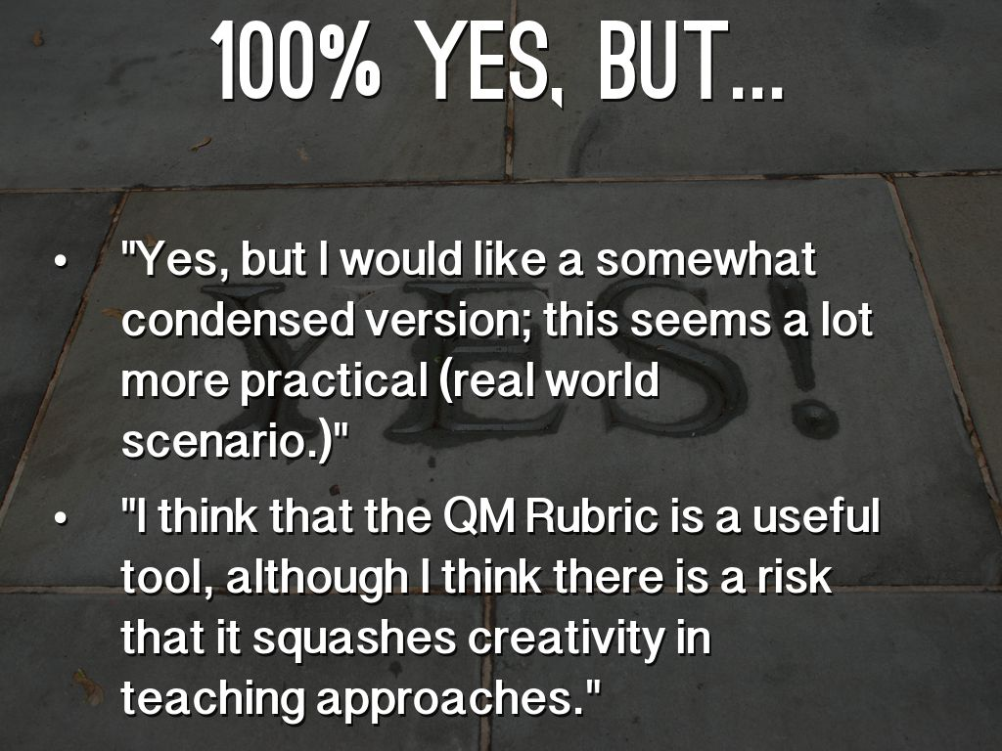
Photo by Joe Shlabotnik - Creative Commons Attribution-NonCommercial-ShareAlike License https://www.flickr.com/photos/40646519@N00
Created with Haiku Deck

Slide 16
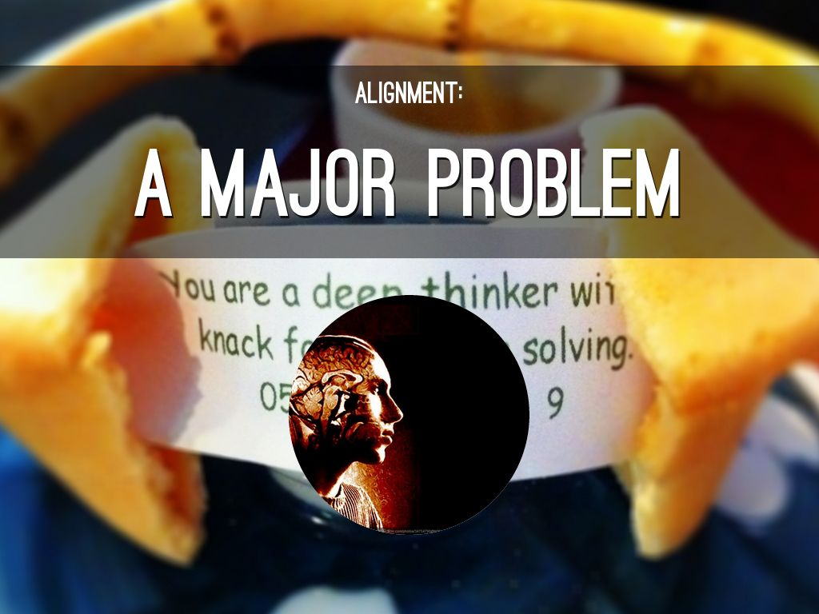
Photo by Tomasz Stasiuk - Creative Commons Attribution-ShareAlike License https://www.flickr.com/photos/36116655@N00
Created with Haiku Deck

Slide 17

Photo by albertogp123 - Creative Commons Attribution License https://www.flickr.com/photos/57280691@N02
Created with Haiku Deck

Slide 18

Photo by c_ambler - Creative Commons Attribution License https://www.flickr.com/photos/13600186@N06
Created with Haiku Deck

