Slide 1
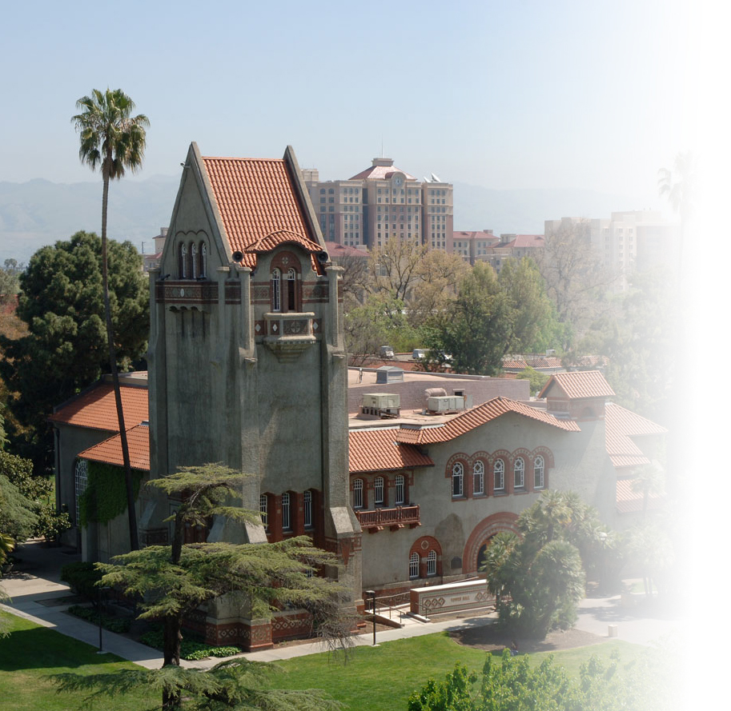
Feeding Many Birds with One Piece of Bread: Process and Impact of Providing Accessible Multimedia Course Materials
Stacey Knapp, Keith Sanders, Amy Strage, and Elizabeth Tu
San José State University
April 10, 2015
QM Works in the Great Pacific Northwest 2015 Conference

Slide 2
Agenda
Our story
About our title
The context: our campus & our collaborators
Assessing the needs
  Questions about video usage
  Questions about captioning needs
Our captioning services
  Infrastructure
  Workflow process
Wrap-up: Take-away’s
Q & A

Slide 3
GreenTalk Speaker Series
Success Story at SJSU
All Engineering students are required to take the 100W course and attend the Green Talk guest speaker series
GreenTalk lectures feature practicing engineers, scientists, and technical experts who deliver up-to-date briefings on how they deal with environmental issues
The live lecture series is held in the Engineering Auditorium; students enrolled in evening sections have to view recorded versions of the talks on DVD

Slide 4
Is This a Success Story for All?
In Fall 2014 a student registered with Accessible Education Center (AEC) enrolled in ENGR 100W and his instructor contacted me saying she needed closed captioned (cc) Green Talk videos for the student

Slide 5
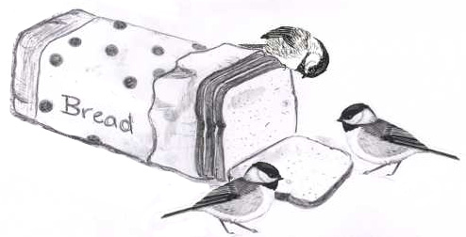
Feeding Many Birds with One Piece of Bread
What if we created a YouTube channel for the Green Talk series and added Closed Captioning …
?

Slide 6
The Evolution of the GreenTalk Series
The GreenTalk Series – one-hour noon talks every Wednesday for 10 weeks with 400+ engineering students since 2010
Since 2010
Fall 2014
Spring 2015
  DVD only
  YouTube
  Online playback with streaming media by 6 pm Same Day
  Quality cc in one week
  YouTube + Camtasia
  Online playback with streaming media by 6 pm Same Day
  Quality cc in 48 hours

Slide 7
Feeding the Flock?!
I distributed a name-optional survey electronically to two sections of Engineering 100W (Day and evening sections-both had access to YouTube)
A total of 33 (out of 48) students responded to the survey (69%)
The results were surprising…

Slide 8
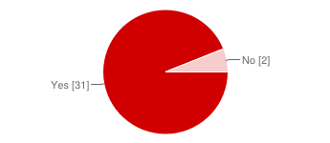
Is Video Option Important?
Do you think having the option to view the YouTube video, in addition to the live speaker, is important?
  Yes vs. No = 94% vs. 6%

Slide 9
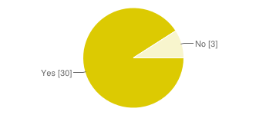
Is Closed Captioning Important?
Do you think having Closed Captioning on the video is important?
  Yes = 91%
  No = 9%

Slide 10
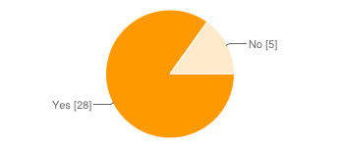
Viewing Preference: Closed Captioned vs. No Caption
If you were asked to watch the YouTube video, would you choose to view the closed captions?
  Yes= 85%
  No = 15%

Slide 11
Why Students Find Closed Captions Helpful
Part I
Student comments:
Speaker clarity (13)
  Sometimes when the speaker doesn't speak closely to the microphone...
  …if the person did not speak clearly or too quickly
  I may have not caught a certain word or sentence and while writing…
  Sometimes the microphone can have a technical issue…
  …some speakers can have an accent
  Sometimes the speaker is unclear …was either hard to understand or talked quietly.
  …easier to understand the speaker if for some reason you can't hear the audio itself
  Sometimes the speaker will deliver some technical terms…
  The captions work great for me to help me better understand the speaker.
Better learning of the term and notes, ability to rewind and view the text (13)
  Captions allow the viewer to a better understanding of the presentation

Slide 12
Why Students Find Closed Captions Helpful
Part II
Student comments: (continued)
Better learning of the term and notes (13)
  …its easier to pause the video and see what the speaker is saying
  …videos should be available for the student to review the material specially if student are required to write detailed memorandums.
  …having something to refer to and verify what I thought I heard.
  Some people understand better when they read words rather than listen to others.
  It's easier to keep track of what’s being said…and verify what was being said by replaying the video. Instead I can look at the closed captions.
  It help for quotations and it show the correct spelling of names and other terms
  The CC ensures that I will get the right information in my notes…
Better comprehension in a noisy environment (11)
  Sometime there are noises in the background so being able to read through it is important.
  In the event that the microphone isn't working too well or the speaker says a word in a way I don't recognize,
  …sometimes the audio of the video is not very clear
  Closed captioning would be useful because there is always the possibility of inaudibility when viewing
Hard of hearing problem (3)
English is not my main language (1)

Slide 13
Why Students Prefer
Live-Speaker Presentation
Student comments:
Interaction with the speaker (5)
  …more engaging to watch it in person since you can ask questions. …get to discuss with the speaker the ideas that they presented. …for the purpose of meeting them for a career opportunity or to ask questions. …ask questions about the talk.
Prefer live speaker, but video option important (4)
  Just a preference (1)Watching the live speaker made it mandatory to listen (1) scheduling conflicts (2)
Won’t fall asleep (1)

Slide 14
The Aviary: The Campus Context
Students:
  Total enrollment: ~ 31,000
  Registered w/ Accessible Education Center: ~ 1100 (4%)
Faculty:
  Full-time & part-time: ~ 1600
Accessible Technology Initiative Instructional
Materials (ATI IM) committee partners:
  Academic Technology
  Accessible Education Center
  Center for Faculty Development and
  Representatives from faculty, College Deans, Library,
  and the Bookstore

Slide 15
Assessing Faculty & Student Needs
  ATI IM administered two faculty surveys:
    #1 (December 2012) – To document video usage
    #2 (October 2013) – To better understand captioning needs

Slide 16
Portions of Videos Captioned
55% or more of In-Class videos are NOT CAPTIONED
62% or more of videos Outside of Class are NOT CAPTIONED
 | Not Captioned | < 25% | ~ 50% | > 75% | All | Don’t Know | Other
In-Class | 72 (55%) | 29 (22%) | 2 (2%) | 7 (5%) | 7(5%) | 7 (5%) | 8(6%)
Outside of Class | 82 (62%) | 10 (8%) | 2 (2%) | 2 (2%) | 4 (3%) | 12 (9%) | 20 (15%)

Slide 17
Source Video Format
This question is important to learn what kind of videos we will receive.
45% electronic files in Spring 2014 vs. ~ 75% electronic files received in Fall 2014
30% DVD in Spring 2014 vs. ~23% DVD in Fall 2014
Source Video Format | Percentage (Spring 2014) | Actual Percentage (Fall 2014)
Electronic file (e.g., m4v, Flash, QuickTime, Window Media, Real Player) | 45% | 74.7%
DVD | 30% | 22.8%
Other | 14% | 1.3%
VHS tape | 11% | 0
Blu-Ray | 1% | 0
Notes:
A 6 X 2 table describes the source video format in total number and percentage distribution. The source format options are:
Electronic files (e.g., m4v, Flash, QT, WM, Real media): 45%
DVD: 30%
Other: 14% (No videos 6; YouTube 5; Camtasia 2; video from online sources 2; Internet; Links on Internet/web; Collaborate, telelpresence; AT video, WebEx recordings, Captivate)
VHS tape: 11%
Blue Ray: 1 %

Slide 18
Copyright Ownership of Videos
This question is important to determine whether we can add captions to the videos.
44%: DO NOT have copyright for their videos
23% and more: have copyright or for some
12% and more: not sure, captioned DVD, from Library, etc.
Copyright Ownership | Percentage
No – for any of it | 44%
Yes – for everything I need captioned | 23%
Yes for some, no for others | 13%
Not sure | 12%
Other | 9%
Notes:
Copyright is an important issue. It determines how or whether we can add captions to their videos……
A 6 X 2 table describes the copyright ownership of the videos faculty need captioned.
44%: No copyright for any of it
23%: Yes for everything I need captioned
13%: Yes for some, no for others
12%: Not sure
9%: Other (NA 4; DVDs are already captioned; do not use video; shared; use videos from MLK library and linked to my website)

Slide 19
Play-back Methods
This question is important to determine the kind of deliverables we need to produce.
37% will be played back from a computer
30% will be streamed and played back online
26% and more are played back via DVD, campus video, etc.
Play-back Methods | Percentage
Electronic file played from a computer | 37%
Streamed online | 30%
DVD | 26%
Other | 8%
Blu-Ray | 0%
Notes:
A 6 X 2 table describes the play-back methods faculty plan to use in terms of total number and percentage distribution. The play-back methods include:
37%: Electronic files played from a computer
30%:streamed online
26%: DVD
8%: other formats (NA 5; assume DVD is the best; Campus videos; DVD at IRC. They play it for us; do not use video; VHS tape)
0%: Blu Ray

Slide 20
Introducing Captioning Services
2012 ~ 2013: Needs Assessment
Spring 2014: Pilot Testing
Fall 2014: Official Roll-out
Needs Assessment 2012 - 2013
Pilot program
Spring 2014
Official
Roll-out
Fall 2014

Slide 21
Captioning Services Infrastructure
Hardware and Software:
  Windows and Macs, Dragon Naturally Speaking, MovieCaptioner, AutoSync, YouTube, DVD Studio Pro, etc.
Online Info Hub:
  FAQs, request form via Google form, media dropbox, media library repository, etc.
Resources:
  2 staff working part-time; 4 part-time student assistants
Documentation:
  Job/workflow & software used, master database log sheet, etc.

Slide 22
Transcription Workflow
YouTube
MANUAL
TRANSCRIPTION
Dragon
VOICE RECOGNITION
TRANSCRIPTION
MULTIPLE VOICES OR
LOW QUALITY
ONE VOICE AND/OR
HIGH QUALITY
1ST
CORRECTION
2ND
CORRECTION
FACULTY
REVIEW &
APPROVAL
VIDEO
FILE
Transcription Workflow
CLOSED TRANSCRIPT
CAPTIONED VIDEO ONLY
COPYRIGHT NO COPYRIGHT

Slide 23
Wrap-up: Take-Away #1
Feeding many more students with your universal accessible teaching content

Slide 24
Wrap-up: Take-Away #2
Plan for appropriate online distribution – make sure all of the birds can find the bread…
Create/Monitor an unlisted You Tube channel
Create Google faculty group for distribution
Allow media services and accessibility staff to post to faculty group (streamlines distribution)
Report faculty/student feedback
Notes:
The easy part….

Slide 25
Wrap-up: Take-Away # 3
Team approach:
Include instructional designers, video producers, librarians, and IT specialists as early as possible in planning your course materials
Quality Matters!
Faculty
Learners
Media Producers
Instructional Designers

Slide 26
Thank you!!
Questions?

Slide 27
Points of Contact
Stacey Knapp, Faculty
Stacey.knapp@sjsu.edu
Phone: 831-234-8430
Keith Sanders, Media Producer
keith.sanders@sjsu.edu
Phone: 408.924.2866
Amy Strage, Assistant Vice President for Faculty Development
Director, Center for Faculty Development
  Amy.Strage@sjsu.edu
  Phone: 408.924.3715
Elizabeth Tu, Instructional Designer & Instructor
  Elizabeth.Tu@sjsu.edu
  Phone: 408.924.3093

Slide 28
Back-up Slides

Slide 29
What Do Students Say about Viewing Live Speaker vs. Videos with Closed Captions
Stacey Knapp and Elizabeth Tu
San José State University
December, 2014

Slide 30
Agenda
The Background
Who are the students?
Is video option important?
Viewing preference: closed captioned vs. no captions
Is closed captioning important?
Why students find closed captions helpful
Why students prefer
live-speaker presentation

Slide 31
The Background
During the Fall 2014 semester, SJSU’s Academic Technology unit (AT) and its Center for Faculty Development (CFD) began offering captioning or transcribing services at no cost to support faculty use of video/audio course materials in their teaching.
A total of 21:53 hours of videos were transcribed by three student assistants to support nine courses, as well as a small number of non-teaching campus events.
This presentation will focus on one of the nine courses, Engineering 100W, and the impact of adding closed captions to the GreenTalk series of 10 sessions.
Each talk consisted of a 1-hour presentation by a live speaker, from 12noon to 1pm, on Wednesdays. These talks were recorded by the campus Media Service.
A closed captioned version of each presentation was made available to students by the following Wednesday at 6 pm.
In early December, near the end of the course, students were asked to share their experiences in viewing live speakers and videos with closed captions.

Slide 32
Who are the ENGR 100W Students?
Their major/departments include:
  mechanical engineering, aviation, computer engineering, material engineering, electronic engineer, software engineering, chemical and civil engineering, International & Extended Studies

Slide 33
Questions about Video Usage (Survey #1)
Course formats
  Face-to-face vs. Hybrid vs. Online
How are videos used in their teaching?
  In Class vs. Outside of Class
What type of video content do faculty use?
What are the reasons for NOT showing/assigning videos in teaching?
What proportion of the videos are captioned?
  55% (in-class) and 62% (outside of class)

Slide 34
Course Formats
Over 90% of faculty are teaching at least one class FACE-to-FACE
Over 35% are teaching at least one class in HYBRID format (both in person and online instruction)
Approximately 14% are teaching at least one class fully ONLINE

Slide 35
Video Usage
83% of respondents reported using videos during class time
57% reported assigning videos for viewing outside of class
So, from the point of view of accessible instructional materials, attending to videos is important.

Slide 36
Type of Video Content
77% = Complex scenes (many people, lots of action and conversation, etc.)
67% = “Talking heads” (one person talking, etc.)
63% = Dialogues (interviewer and interviewee, etc.)
59% = Clips with elaborate graphics (photographs, data, etc.)
31% = Clips with few if any words (projections of the night sky, etc.)

Slide 37
Reasons for Not Showing or Assigning Videos
42% = The hardware was too unreliable (e.g., broken, parts missing, etc.)
42% = Couldn’t find videos that were educationally worthy
25% = Didn’t want to assume students (outside of class) had the equipment/access
24% = Video clips were not captioned/transcribed
18% = Didn’t know how to use the hardware in the room

Slide 38
Reasons for Using
Non-captioned Videos
48% = “I didn’t know how to go about getting the materials captioned/transcribed.”
44% = “I assumed students would ask if they needed/wanted captioning/transcription.”
39% = “I decided to use the materials at the last minute so I didn’t have time to have them captioned/transcribed.”
36% = “I didn’t know what my responsibilities were.”
16% = “I was told there were no resources to provide the captioning/transcription.”

Slide 39
Campus Captioning Needs (Survey #2 )
  Our second survey asked:
    Minutes of captioning needed
    Source video format
    Copyright ownership
    Play-back preferences
    How videos will be shown/assigned?

Slide 40
Estimating Captioning Needs
Number of minutes of video needing captioning per faculty
Average = 223 minutes (~3.7 hours)
Range = 1 to 2000 minutes

Slide 41
How Videos Are Shown/Assigned
Faculty were asked to check all that apply about how videos will be shown/assigned in their teaching.
Instructional/Pedagogy Methods | Percentage
Play back from a computer in classroom | 28%
Upload to Canvas (Learning Management System) | 22%
Provide students with links and expect them to find and view the video on their own | 15%
Play back from DVD or Blu-Ray in classroom | 14%
Upload to a website | 11%
Other | 10%
Notes:
A 7 X 2 table describes the instructional/pedagogy methods faculty plan to use in terms of total number and percentage distribution. The instructional/pedagogy methods include:
28%: Play back from a computer in classroom
22%: Upload to Canvas
15%: Provide students with links and expect them to find and vide the video on their own
14%: Play back from DVD or Blue Ray in classroom
11%: Upload to a website
10%: other (NA 8; do not show video; YouTube 3; Link from MLK; Use it duing lecture; IRC shows it on TV in the classroom)

Slide 42
Recommendations to Raise Awareness
Top-down approach
  Campus Academic Affairs Leadership Team (Provost, Vice Provost, Deans, AVPs)
  Academic Senate
  Curriculum Review Committee
  University Council of Chairs and Directors
  Road shows at colleges or departments
Bottom-up approach
  Direct email to faculty
  Open house
  Accessible video workshops
  Announcements via websites
Other accessibility outreach plan
  Campus-wide study to measure the accessibility status of PDF documents used in teaching

