Slide 1
Flexible but not Flimsy: Addressing Standards Using a Personalized Faculty Pathway
Robin O’Callaghan
Mary Bohman
Winona State University

Slide 2
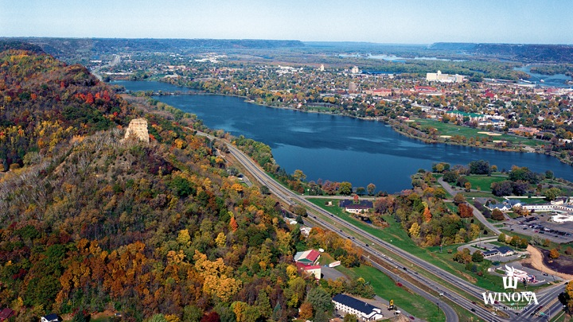
Winona State University

Slide 3
WeTeach Foundation
Module 1: Charting Your Course
Module 2: Quality Matters Overview
Module 3: Connecting with Online Student Services.
Module 4: Communicating and Collaborating with Your Students Online
Module 5: Learning Objectives and Course Design Modules
Module 6: Online Assessment and Feedback
Module 7: Instructional Materials
Format: Virtual meeting with online content

Slide 4
WeTeach Advanced
Module 0: Pre-Course Information
Module 1: Learning Objectives
Module 2: Alignment
Module 3: Assessments
Module 4: Instructional Materials
Module 5: Peek Inside a QM Course
Format: Weekly face-to-face meetings that progress into 1:1 custom meeting for online course design.

Slide 5
TLT InFocus:WeTeach
Video

Slide 6
Different Pathways to Quality
Quality Matters Recognition
Bi-Weekly or Weekly
1:1 Meetings
Foundation/Advanced
Summer Cohort

Slide 7
Advantages & Disadvantages
Advantages
Disadvantages
Flexibility for instructors
Faculty workload
Collaboration
“Self-select” the instructional materials
Evidence of completion
More time to manage for facilitators
Alignment of all program
“Self-select” could miss key components
Not streamlined for those who need structure

Slide 8
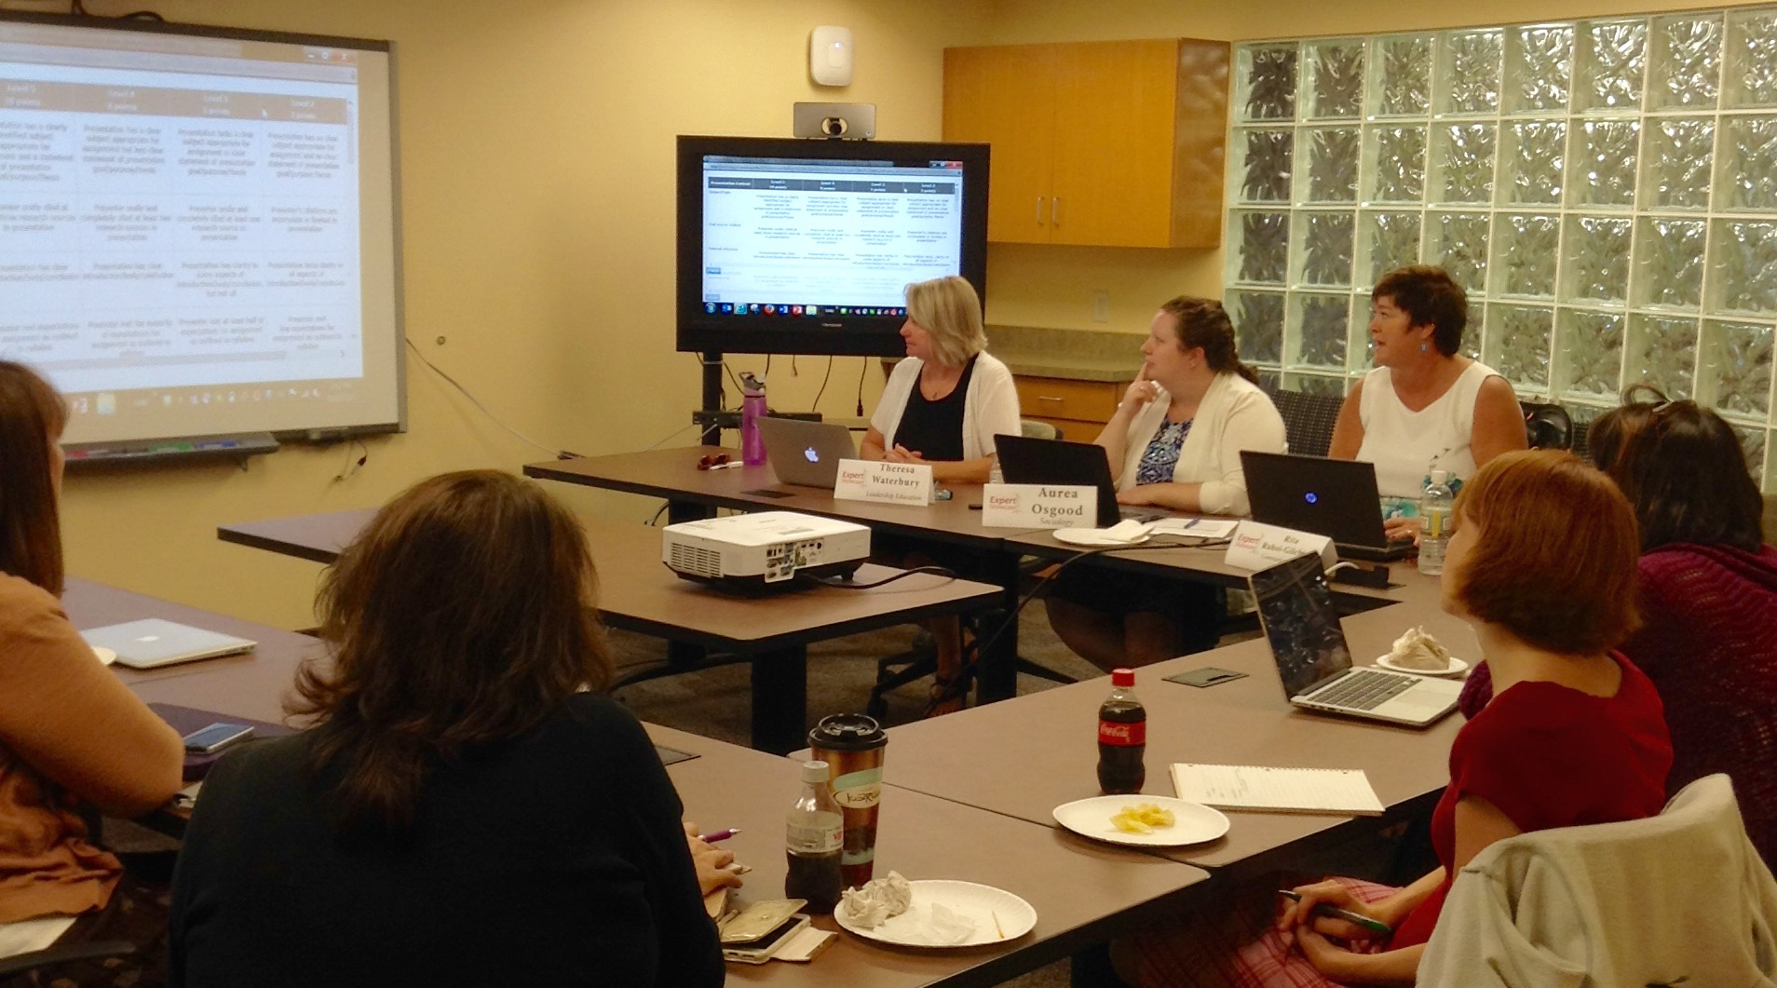
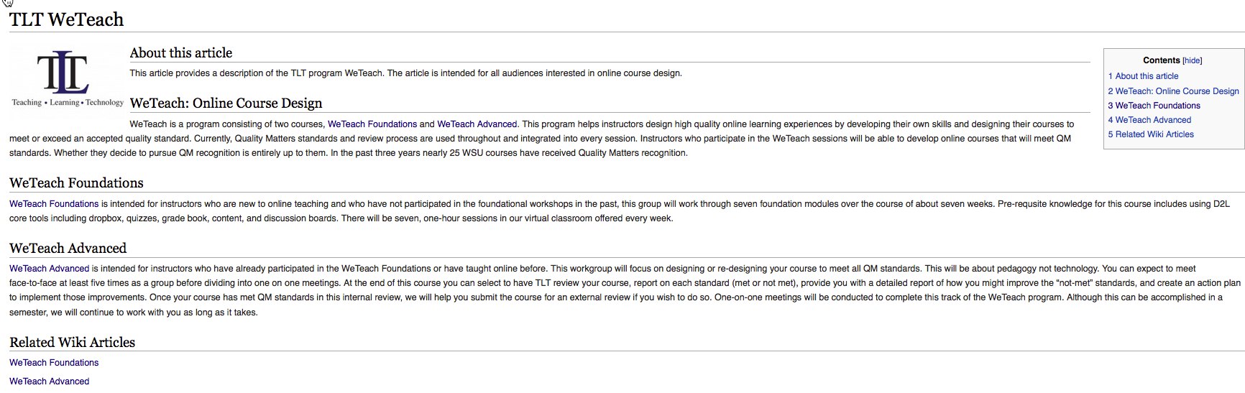
Tools to Communicate WeTeach Program
Targeted emails to faculty
Expert Showcase to gain faculty interest
Wiki- description of the courses with a promotional video

Slide 9
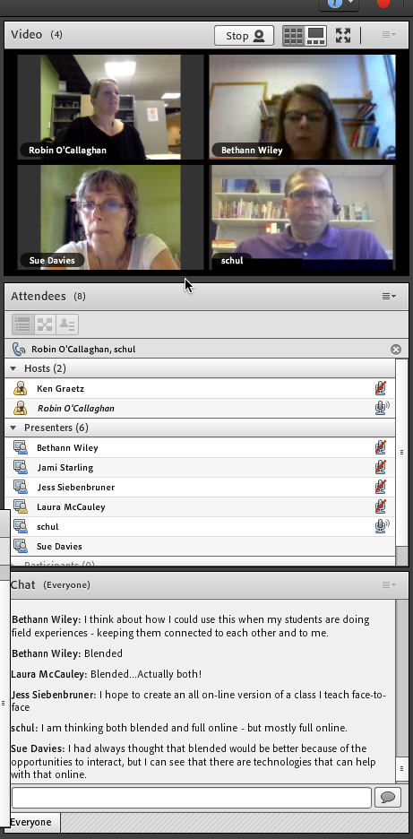
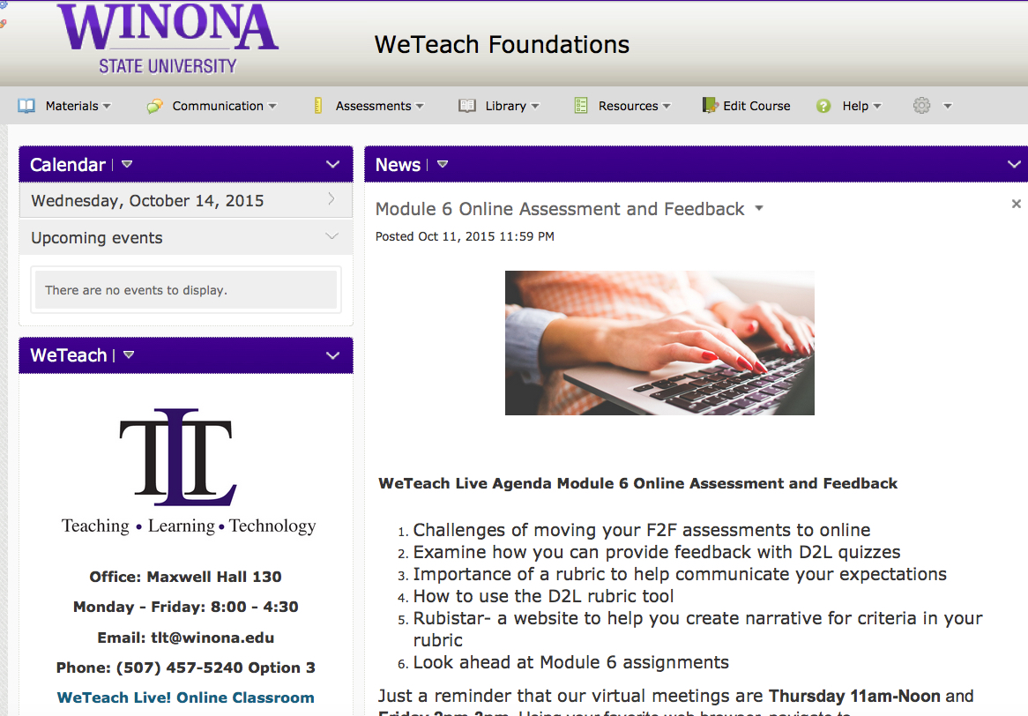
Tools to Build WeTeach Program
D2L – LMS
Doodle – Scheduling
Adobe Connect – WeTeach Foundation Virtual Meetings
ITV/Jabber – WeTeach Advanced

Slide 10

Project Management (Trello)
Flexible and easy to use
Access from a tablet or browser
Organized by board with lists and tasks
Tasks can be attached with:
  Check-lists
  Images
  Videos
  Documents
  Comments
  Links

