Slide 1

Flexible Trends in Education
Is the New QM Rubric Limber Enough?
QM Conference 2015
Presenters: Lee Scholder, J.D., M.S. & Andi Thompson, MBA, MEd

Slide 2

Changing Education Models
How can Quality Matters support the evolution of education?

Slide 3

Changing Education Models
Responding to needs of Lifelong Learners – need for flexibility, cost effectiveness, efficiency, relevance
  New and future competency-based flexible learning models.
    Stackable Credentials
    Modularization
    MOOC’s
    Personalized/Customized Pathways
    Self-Paced
    Prior Learning Assessment
    Credit for Prior Learning
    Changing Faculty Role
    Increased reliance on OER
3

Slide 4

Alignment to Industry Needs
Employer
Industry Alignment
University
Employers seek skilled workers
Position
Outcomes
Degree Program
Universities confer degrees
Desired Skills & Abilities
Competencies
Course
for completing a series of courses
with industry’ relevant & current skills
practical experience
Demonstrated Competence
Criteria
Activity
in which students learn
Performance History
Faculty Judgments
Grade
and are assessed
and a record of accomplishment
Graduate Preparedness
4
Notes:
Should the QM rubric hold us accountable for being explicit for how we align to industry needs.

Slide 5
Higher Education Conundrum
Employer
How do we connect the conferral of a degree with the ability to apply relevant, in-demand, employable skills?
University
Position
?
Degree Program
Employers seek skilled workers
Universities confer degrees
Desired Skills & Abilities
Course
for completing a series of courses
with industry’ relevant & current skills
practical experience
Demonstrated Competence
Activity
in which students learn
Performance History
Grade
and are assessed
and a record of accomplishment
5

Slide 6
Educational Models/Approaches
Competency-Based Education (CBE)
An educational approach focuses
on outcomes of learning & based
on a predetermined set of knowledge,
skills, and abilities that the student
is expected to accomplish.
Direct Assessment
An instructional program that, in lieu
of credit hours or clock hours as a measure of student learning, utilizes direct assessment of student learning, or recognizes the direct assessment of student learning by others.
CBE
Direct
Assessment

Slide 7


Quality Matters
Potential Quality Matters Roadblocks to Certification in New Models of Delivery
  Course Interactions (what interactions needed/with whom?)
  Assessment
  Instructional Materials (including ADA/implications for OER usage)

Slide 8
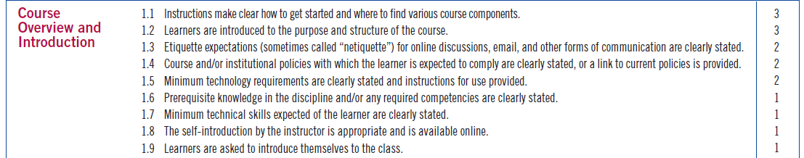
QM Higher Ed Rubric Standard 1

Slide 9
Course Interactions
Learner
Coach
Centralized Support Services
Faculty
Tutor
Another Learner
9

Slide 10
Learner Support Structure at Capella
Disaggregation of the faculty role ensures the academic and support needs of FlexPath learners are addressed and barriers to successfully achieving individual goals are minimized
1
FlexPath Faculty |  | Tutoring Faculty |  | Coaching Faculty
Focus on assessment and evaluation Emphasis on substantive feedback to learners Schedule that allows for 24 - 48 hour turnaround on assessments Less direct interaction with learners Close relationship with coaches and tutors |  | Content experts Assigned to each course Roles filled by Capella doctoral learners Proactive/visible resource within the courseroom and iGuide Close relationship with coaches and faculty |  | 1:1 coach to learners Focus on learner progress and holding them accountable Moving from a reactive customer-service focus (transactional) to a proactive coaching relationship Close relationship with faculty and tutors
2
3

Slide 11
Course Interactions
The Quality Matters™ Higher Education Rubric (5th Ed, 2014)
  1.8 The self-introduction by the instructor is appropriate and available online.
    The initial introduction creates a sense of connection between the instructor and the learners. It presents the instructor as professional as well as approachable, and includes the essentials, such as the instructor’s name, title, field of expertise, email address, phone number, and times when the instructor is typically online or may be reached by phone.
    Competency-Based Courses: The learner’s primary faculty or staff contact authors the self-introduction. The roles of instructor, facilitator, coach, mentor, assessor, or other staff who support the competency-based learner are clearly described. More than one self-introduction may be needed if learners are expected to contact different individuals for guidance on different aspects of the course.
  1.9 Learners are asked to introduce themselves to the class.
    Learner-to-learner interaction should be implemented wherever possible to foster learner engagement. In a few situations, such as when a class is very large, or the course is self-paced, learner introductions may not be feasible. Course Representatives are asked on the Course Worksheet if learner introductions are appropriate in the course. Reviewers refer to the Course Worksheet to determine if learner introductions are appropriate.

Slide 12
Course Interactions
The Quality Matters™ Higher Education Rubric (5th Ed, 2014)
1.8 The self-introduction by the instructor is appropriate and is available online.
  Competency-Based Courses: The learner’s primary faculty or staff contact authors the self-introduction. The roles of instructor, facilitator, coach, mentor, assessor, or other staff who support the competency-based learner are clearly described. More than one self-introduction may be needed if learners are expected to contact different individuals for guidance on different aspects of the course.
1.9 Learners are asked to introduce themselves to the class.
  In a few situations, such as when a class is very large, learner introductions may not be feasible. Instructors are asked to indicate in the Course Worksheet if there is a reason for not providing an opportunity for learner introductions.

Slide 13
Possible lessons to draw from CPE Rubric?
The Quality Matters™ Continuing and Professional Education Rubric (2nd Ed)
    intended for the design and review of online and blended courses—facilitated, mentored, or self-managed—that may have pass/fail, skills-based, or other completion or certification criteria but do not carry academic credit
    may be used to review and improve college-based, non-credit courses; massive open online courses (MOOCs); and professional training and personal development courses offered by various sponsors, including businesses, professional and vocational organizations and associations, government agencies, and special-interest societies
    either instructor led or self-paced; either way they must be structured and have completion criteria
    Based upon the The Quality Matters™ Higher Education Rubric (5th Ed, 2014) but with some key differences

Slide 14
Course Interactions – CPE Rubric Approach
.
  1.8 The self-introduction by the instructor/facilitator is appropriate and available online.
    If the instructor/facilitator’s role is minimal, the self-introduction may be abbreviated to professional qualifications and accessibility. If the course has no instructor/facilitator, information about whom the learner can contact with questions and how that individual may be contacted should be included.
    Competency-Based Courses: The learner’s primary faculty or staff contact authors the self-introduction. The roles of instructor, facilitator, coach, mentor, assessor, or other staff who support the competency-based learner are clearly described. More than one self-introduction may be needed if learners are expected to contact different individuals for guidance on different aspects of the course.
  1.9 Learners are asked to introduce themselves to fellow learners.
    Learner-to-learner interaction should be implemented wherever possible to foster learner engagement. In a few situations, such as when a class is very large, or the course is self-paced, learner introductions may not be feasible. Course Representatives are asked on the Course Worksheet if learner introductions are appropriate in the course. Reviewers refer to the Course Worksheet to determine if learner introductions are appropriate.
    If they are not, the Standard should be marked “Met.”

Slide 15
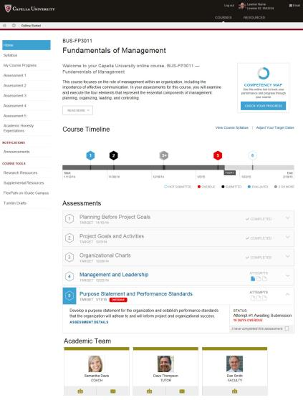
Capella Example

Slide 16
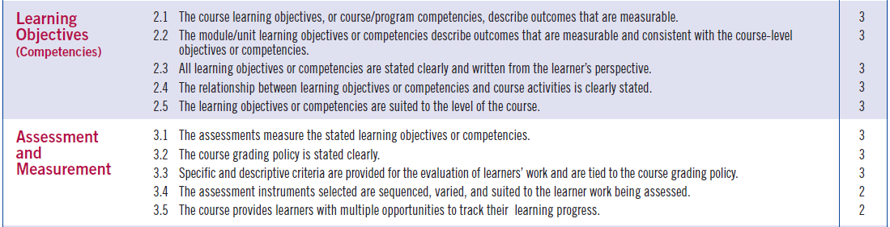
QM Higher Ed Rubric Standards 2 and 3
Example

Slide 17
Assessment Approaches
The Quality Matters™ Higher Education Rubric (5th Ed, 2014)
3.2 The course grading policy is stated clearly.
A clear, written statement fully explains how the course grades are calculated. The points, percentages, and weights for each component of the course grade are clearly stated. The relationship(s) between points, percentages, weights, and letter grades are explained. The instructor’s policy on late submissions is clearly stated.
Review the clarity of the explanation and presentation to the learner, not the simplicity or complexity of a given grading system itself. Even a relatively complex grading system can be made easy to understand.
Look for some or all of the following:
  1. A list of all activities, tests, etc., that will determine the final grade
  2. An explanation of the relationship between the final course letter grade and the learner’s accumulated points and/or percentages
  3. An explanation of the relationship between points and percentages, if both are used
  4. A clearly stated policy on point deductions for assignments submitted late
Competency-Based Courses: The grading pattern may be different from that used in traditionally graded courses, and grading policy is equally essential to describe in competency-based courses. Competency-based grades may rely exclusively on demonstration of mastery of the stated competencies, which may occur within the course or in a separate process external to the course. Grades may be in the form of a transcript listing competencies attained.

Slide 18
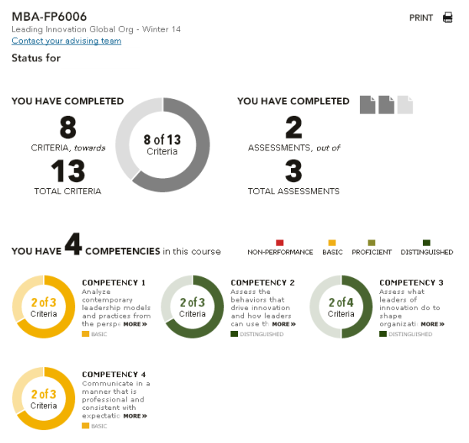
Competency-Based Grading/Visibility

Slide 19
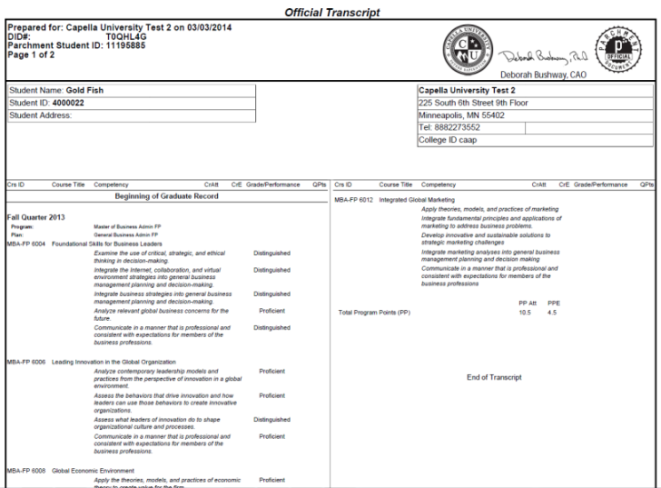
FlexPath Transcript
Official FlexPath transcripts are competency-based & display performance results for each competency in the program
Competencies are grouped by course but
performance results at the course level are
not reported on the transcript
19

Slide 20
Assessment Approaches
The Quality Matters™ Higher Education Rubric (5th Ed, 2014) (continued)
3.3 Specific and descriptive criteria are provided for the evaluation of learners’ work and are tied to the course grading policy.
Learners are provided with a clear and complete description of the criteria that will be used to evaluate their work and participation in the course. These criteria are stated upfront at the beginning of the course. The description or statement of criteria provides learners with clear guidance on the instructor’s expectations and on the required components of coursework and participation. The criteria give learners the information they need to understand how a grade on an assignment or activity will be calculated.
As a reviewer, confirm that the criteria used to evaluate learners’ performance aligns with the course objectives or competencies. Note, however, that you are not asked to look for and evaluate the instructor’s specific feedback to learners in Standard 3.3. Your focus is the design of the course, not the delivery of the course.
Examples of what to look for:
  1. Evidence that the instructor has stated the criteria for evaluation of all graded work. Criteria may be in the form of a detailed checklist, rubric, or other instrument for identifying the various levels of learner mastery.
  2. A description of the how learners’ participation in discussions will be graded, including the number of required postings per week; the criteria for evaluating the originality and quality of learners’ comments and their responsiveness to classmates’ comments; and the grade or credit learners can expect for varying levels of performance.
Competency-Based Courses: A description makes clear in specific terms the levels of mastery required to demonstrate the defined competencies.

Slide 21
Assessment Approaches
The Quality Matters™ Higher Education Rubric (5th Ed, 2014) (continued)
3.4 The assessment instruments selected are sequenced, varied, and suited to the learner work being assessed.
Multiple strategies, including “alternative” assessments (performance/authentic assessments)
Varied to include multiple ways of learning
Sequenced to promote learning process
Paced to give learners time to achieve mastery
For graduate courses may be one assessment but must have benchmarks for progress.
Competency-Based Courses: Assessment of competencies may not follow the pattern of assessment in traditional courses. As a reviewer, focus on whether the assessment instruments credibly establish that the learner has demonstrated the competency.
The CPE Rubric adds the following:
NOTE: The number and range of opportunities for learners to measure their learning progress should fit the length of the course. If the course is very short (e.g., a single module or lesson), the number of feedback opportunities would be fewer.

Slide 22
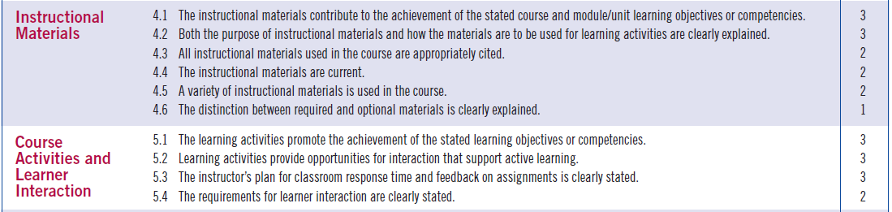
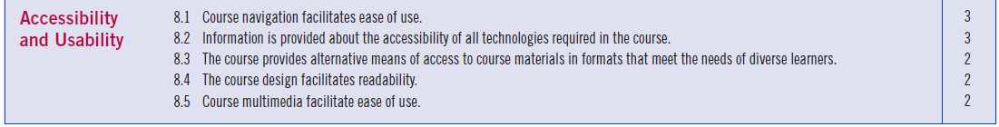
QM Higher Ed Rubric Standards 4,5,8
Example

Slide 23
Materials
The Quality Matters™ Higher Education Rubric (5th Ed, 2014)
General Standard 4 – Instructional Materials: Instructional materials enable learners to achieve stated learning objectives or competencies.
4.6 The distinction between required and optional materials is clearly explained.
  Clear explanations are provided to learners regarding which materials and resources are required and which are optional. Instructors are expected to clearly indicate which materials learners must acquire and use to complete course activities and assignments.
  Optional resources are identified as such. For example, extra videos or resources included for enrichment purposes and not required for course completion are labeled as “optional.” Designations about required and optional materials appear in the syllabus, class schedule, or instructions for learning activities and are available from the start of the course.
  Competency-Based Courses: In competency-based courses, all materials may be optional. The introduction specifies which materials and activities are required, supplemental, or optional.

Slide 24
Materials
The Quality Matters™ Higher Education Rubric (5th Ed, 2014)
General Standard 5 – Course Activities and Learner Interaction: Course activities facilitate and support learner interaction and engagement.
5.2 Learning activities provide opportunities for interaction that support active learning.
  Types of interaction include learner-instructor, learner-content, and learner-learner...
  Competency-Based Courses: In competency-based courses, the interaction with the instructor, facilitator, coach, mentor, or assessor may take different forms. Learner-learner interaction in discussion forums is encouraged but may be limited by the differential pace of individual learners; and other forms of learner-learner interaction may be impractical, as learners prepare in different ways for assessment of their competencies. Communication through program-level, learner-learner forums is a viable alternative to course-based forums.
The CPE Rubric adds the following:
…Examples of activities in non-facilitated courses that encourage active learning are
Self-check features at key points throughout the content
Automated exercises
Automated feedback on responses

Slide 25
Materials
The Quality Matters™ Higher Education Rubric (5th Ed, 2014)
General Standard 5 – Course Activities and Learner Interaction: Course activities facilitate and support learner interaction and engagement.
5.4 The requirements for learner interaction are clearly stated.
  Look for a clear, prominently placed statement of the instructor’s expectations for learner participation in required courses interactions (frequency, length, timeliness, etc.).
  Typically, in course information page or syllabus.
  Competency-Based Courses: (no particular provisions to address this differently).
The CPE Rubric adds the following:
Some courses may not require or even enable learner-learner interaction. If it is clear from the design of the course or through a statement in the course introduction or Course Worksheet that interaction is not a component of this course, this standards should be marked as “Met.”

Slide 26
Current Trend to Accommodate Different Paths for Individual Learners
Customization & Personalization Trend in Higher Ed
Time
Learning Activities
Assessments
Self-Paced/qtr
Learning Activities
Assessments
Self-Paced /multi-qtr
Choice/Personalized Learning Activities
Assessments
Self-Paced/multi-qtr
Choice/Personalized Activities
Assessment choice/personalization
Modularized content into smaller, more customizable combos

Slide 27
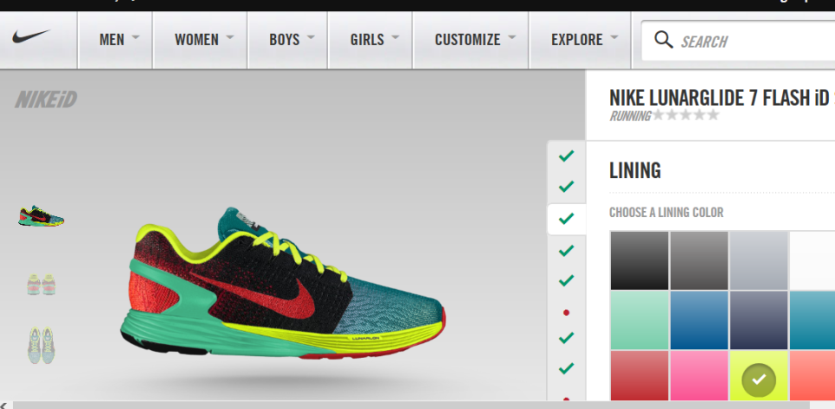

Slide 28
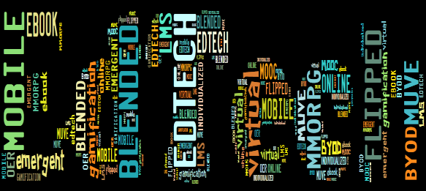
Q&A and Discussion
How do you see QM supporting your institution’s next steps?
Where does it need to evolve to accommodate where you’re going --- or has it come far enough?

Slide 29















Discussion
Thank You

