Slide 1

Here early?
Earn a badge!
GO HERE:
tinyurl.com/QMearlybird

Slide 2
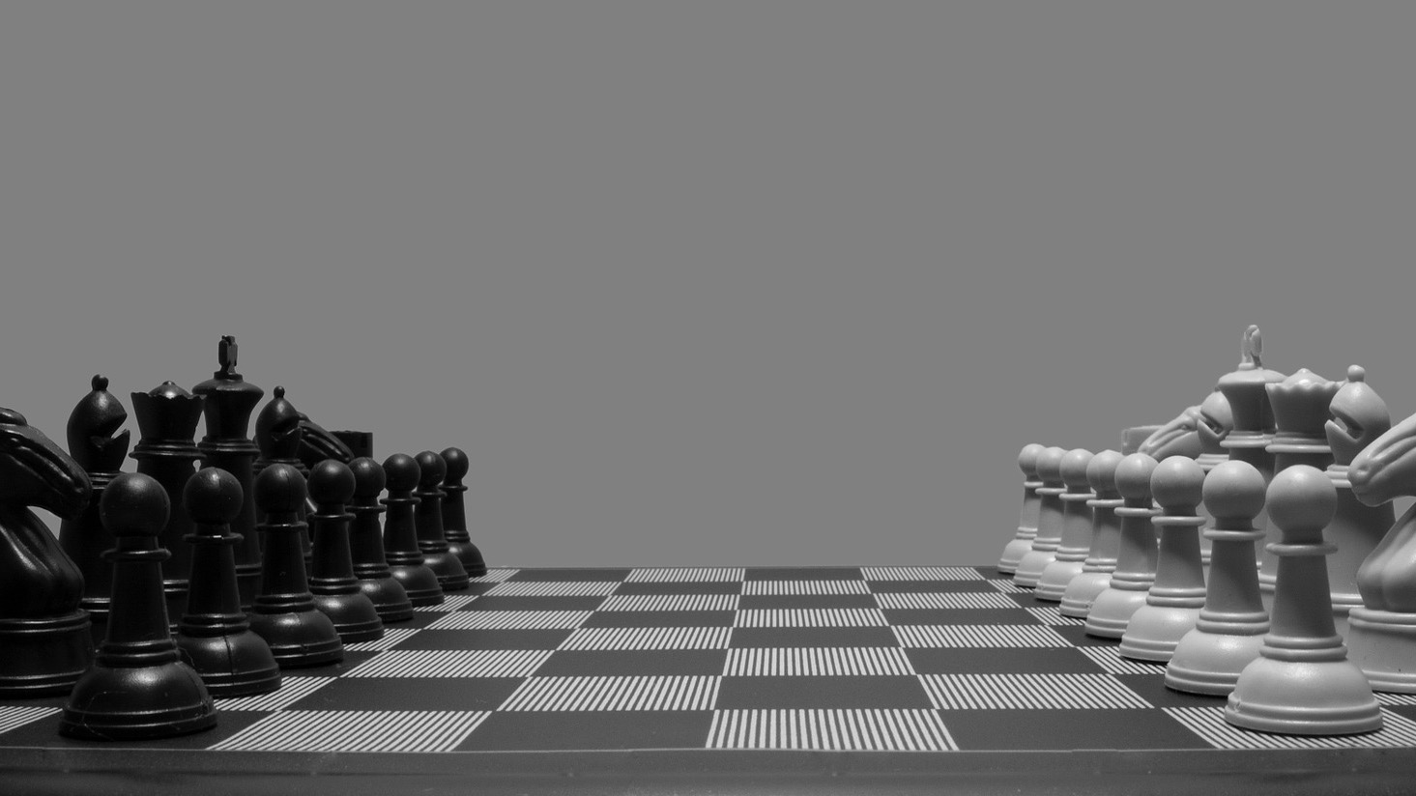
Game On!
Enhancing the Classroom with Gamification
Notes:
Introductions
Today, we will focus on:
Explaining how gamification can motivate learners to engage with learning materials.
Identifying strategies for increasing engagement in the classroom.
Assessing various applications for inclusion in courses.

Slide 3

Play Along!
Now’s your chance to earn some badges!
Notes:
Steve

Slide 4
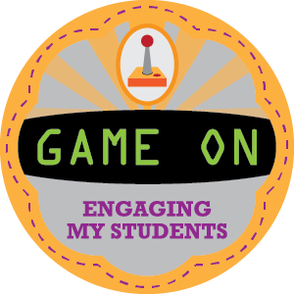

Earn some badges
Notes:
Steve
Ask us questions in order to earn the Great Question badge!

Slide 5

Gamification: A Broad Definition
A process of making systems, services and activities more enjoyable and motivating
Employs game design elements
Used in non-game contexts
To improve user engagement, productivity, flow, and learning
Notes:
Jill
Gamification is the application of game-design elements and game principles in non-game contexts in attempts to improve user engagement, organizational productivity, and learning.

Slide 6

The Challenges of Online Learning
Student engagement
Motivation
Sense of learning…alone
Seeing the big picture
Assessing one’s own learning
Notes:
Jill
Let’s take a look at some of the challenges of online learning and see if gamification can help to resolve some of these difficulties.

Slide 7

Student Engagement
Notes:
Steve
This is a familiar scene isn’t it? Students dozing off in a classroom. Or, in an online course, the student that never participates in the discussion forum, never asks questions… Essentially, they’re a ghost.

Slide 8
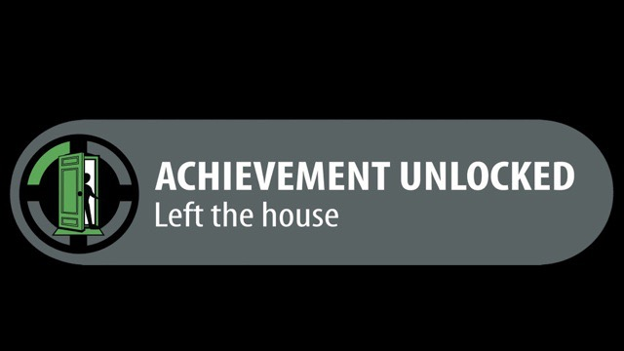
Motivation
Notes:
Jill
Congratulations, you left the house!
The nature of learning online lends itself to the necessity of being a self-motivated learner. Procrastination is already a huge hurdle to overcome with our students, and online doesn’t make it any easier. So, how do we motivate these students to check-in to class more often?

Slide 9

Learning Alone
Notes:
Steve
Good for the introverts, but not so good for the extroverts. How do we make students feel more included and connected to the other students in the course?

Slide 10

The Big Picture
Notes:
Jill
Where am I in this course?
Kenneth Blanchard tells a story in his best seller book “The One Minute Manager“ about how difficult it would be to bowl if you could not see the pins. You would send the ball down the ally and perhaps would hear the sound of some pins falling, but really would not have any idea of “how you did.” Hard to teach someone to bowl if I cover up the pins”.
Having a sense of what we’re aiming for is essential for any learning environment.

Slide 11

Am I Learning?
Notes:
Steve
Do students have an opportunity to assess whether or not they are really grasping the material?

Slide 12
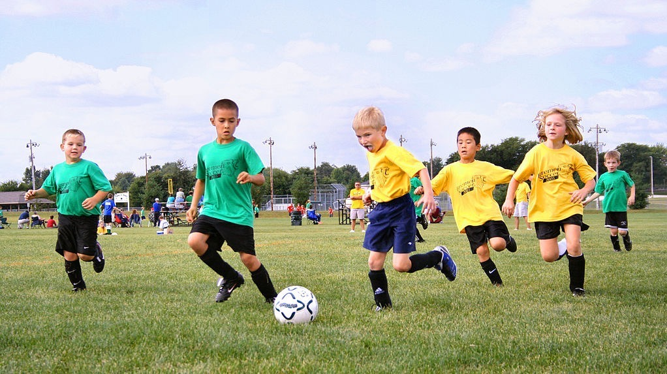
What do we know about games?
Strategy Matters
It’s okay to lose/fail
It’s second nature to us
Games are social
Games are competitive
They’re fun!
Notes:
Steve
Strategy Matters: Multiple ways to win, but finding the best way to complete the objective(s) is best. You can only learn this by playing multiple times.
If you lose, that’s okay. Try again! We don’t stop playing a game because we lose the first time. (well, maybe sometimes) ;)
We’ve been playing games since we were kids. It started with Peek-a-boo, moved up to Chutes and Ladders, then little league, etc…
We play games with each other. It’s meant to be a social experience.
Competition helps to raise the stakes. How do I stack up against my friends?
Games are fun. Often, we find that the best lessons we learn in school occur when we didn’t even realize we were learning.

Slide 13

The Science of Games
Human psychology
Consumer Behavior
(this is what the business world calls it)
Behavior Modification
  Loyalty
Visualization of Data
Metacognition
Notes:
Steve
There is a science to this.
We learned from Maslow back in the 1940’s that we are hard-wired as human beings with a certain set of needs. These needs move us from basic physical needs, like eating, sleeping, breathing, to more complex needs like self-esteem, achievement, problem solving and creativity.

Slide 14
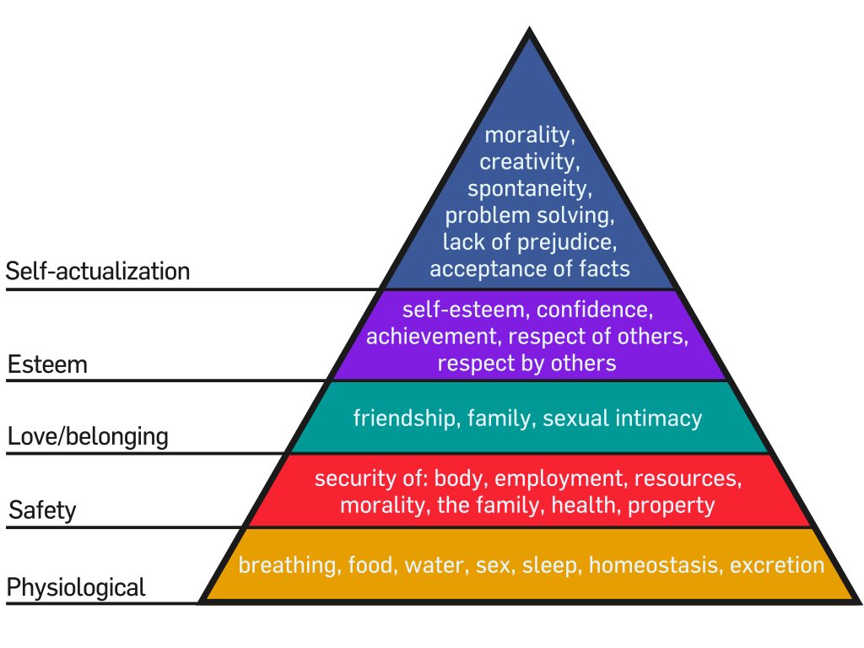
Notes:
Steve

Slide 15
The Science of Games
Human psychology
Consumer Behavior
(this is what the business world calls it)
Behavior Modification
  Loyalty
Visualization
Metacognition
Notes:
Jill
The business world uses these needs to their advantage. They use it to effect our behavior. They reward us for positive behavior (i.e. we purchase something) and eventually, come back to them to purchase even more.
Games are most fun when we can see what the goal is. The nature of games is that there is a desired outcome, and a series of steps or strategies have to be taken in order to assure a win. Think about it. When you play a board game, the board isn’t hidden from you. You can see all the properties to purchase in Monopoly, and plan how you will spend your resources to acquire the most desirable locations. Many digital games show you where you are in the progress of the game. You can see how far you’ve come, and how much farther you have to go.
Metacognition plays into these gaming. We have numerous opportunities to self-assess, either through previous wins, but more importantly through losses, so we know what to avoid next time. When we purchase a new game for a group to play, there is often one person reading the directions to the group (i.e. teaching the group) how to play the game.

Slide 16
That’s great…but
Notes:
Steve
Maybe you’re thinking… ok… I get what you’re saying.

Slide 17
I don’t buy it.
Notes:
Steve
I don’t buy it. I don’t subscribe to participating in these consumer behavior experiments

Slide 18

Frequent Flyer?
Notes:
Jill
American Airlines frequent flyer program “AA Advantage” is one of the oldest in the country. Is flying another airline even an option if you’ve got a ton of frequent flyer miles built up with someone else?

Slide 19
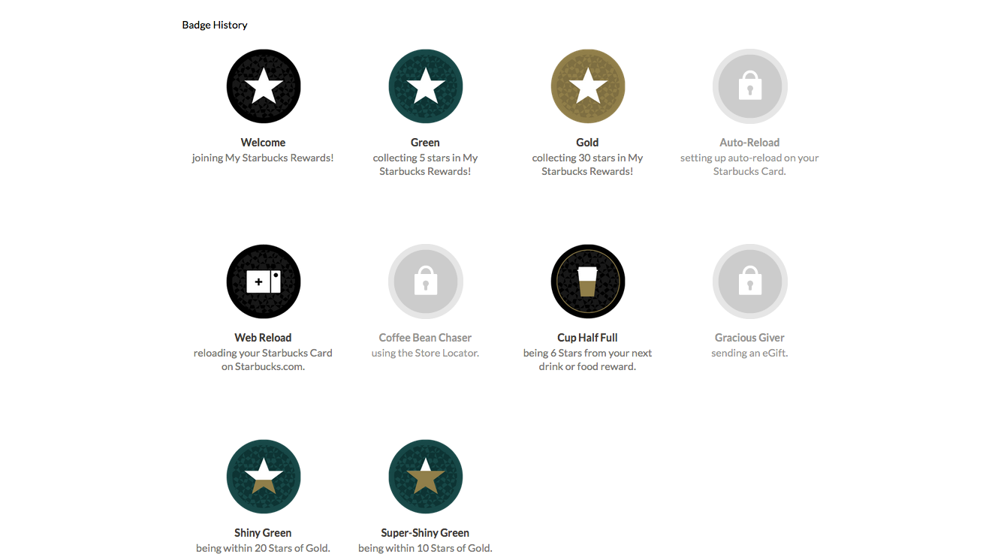
Starbucks?
Notes:
Steve
Have you ever registered a starbucks card? The REWARDS that you earn get you free coffee, and you can even earn badges for how many cups of coffee you drink. Every 12 cups gets you a free cup of coffee, any size you want.
Just for the record, The Most Expensive Starbucks Drink Ever is $86.55

Slide 20
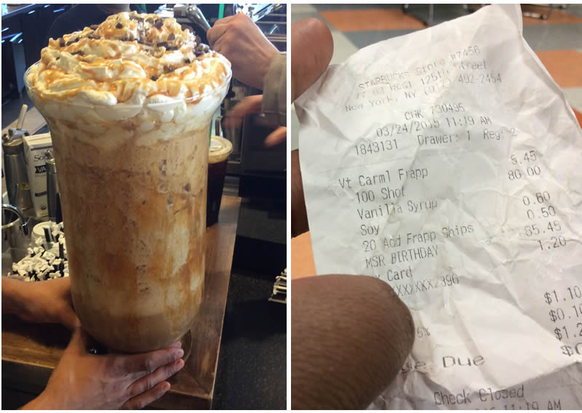
Notes:
Steve
Whoa…
100 shot, Caramel Frappuccino with soy, vanilla syrup, and Frapp chips for good measure.
All in all excluding sales tax, the drink clocked in at $86.55 and contained about 7,650 mg of caffeine!

Slide 21

Groceries?
Notes:
Jill
Do you use a frequent shopper card? Loyalty programs save you money, and provide coupons to you based on your shopping habits. Some stores allow you to trade in your points for things like gas.

Slide 22

Do you shop on Amazon?
Notes:
Steve
The more you shop on amazon, the more you qualify for special loyalty programs. You can be invited to Amazon Vine, where they will send you products to review and you get to keep the products. Every purchase is tracked, remembered, and selectively targeted to you.
What if education was

Slide 23
So What’s the Point?
Notes:
Steve

Slide 24

Everyday experiences are gamified.
Notes:
Steve

Slide 25
How can we connect what we do in education to what we love about games?
Notes:
Steve
So, that being the case, the queestion is…

Slide 26
Badging
Notes:
Steve
Demonstration of Badges we use

Slide 27
Where have we seen badges?
Notes:
Steve
Boy Scouts / Girl Scouts Merit Badges. Isn’t this essentially Competency Based Education?

Slide 28

Notes:
Jill
Scouts
How many of you have ever been a girl scout or boy scouts? Earning a badge is the ultimate in competency based education – either you can tie the knot or you can’t. Either you can swim in the deep and of the pool or you can’t. The badge itself represents a specified level of achievement for a specific skill.

Slide 29

Notes:
Jill
Our Military recognizes various accomplishments and their personnel wear a wide assortment of insignia, ribbons, medals, badges, tabs and patches. These can represent rank, campaign and service medals, personal accomplishments, combat badges, and designation of units.

Slide 30
How we use it.
Faculty Workshop
Different tiers of badges
We award badges physically on name tags
Award badges digitally for their portfolio
Allows a visual representation of knowledge they have accquired
Notes:
Steve

Slide 31
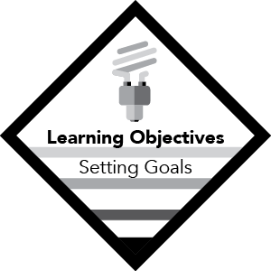
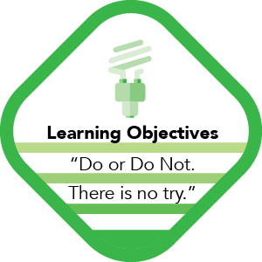
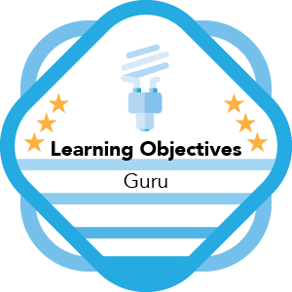
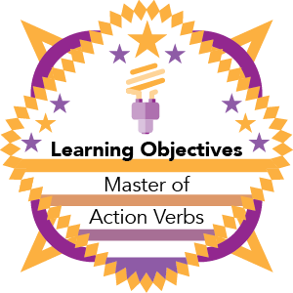
Level 1
Attendance
Level 2
Participation
Level 3
Application
Level 4
Teaching
Notes:
Steve
There are four tiers of badges that attendees can earn. It all starts with Attendance, then moves to actively participating in the demonstration. Next, attendees can apply what they’ve learned to their own course, and finally, if they demonstrate their ability to teach this topic to a colleague, they will earn a level 4 badge.

Slide 32
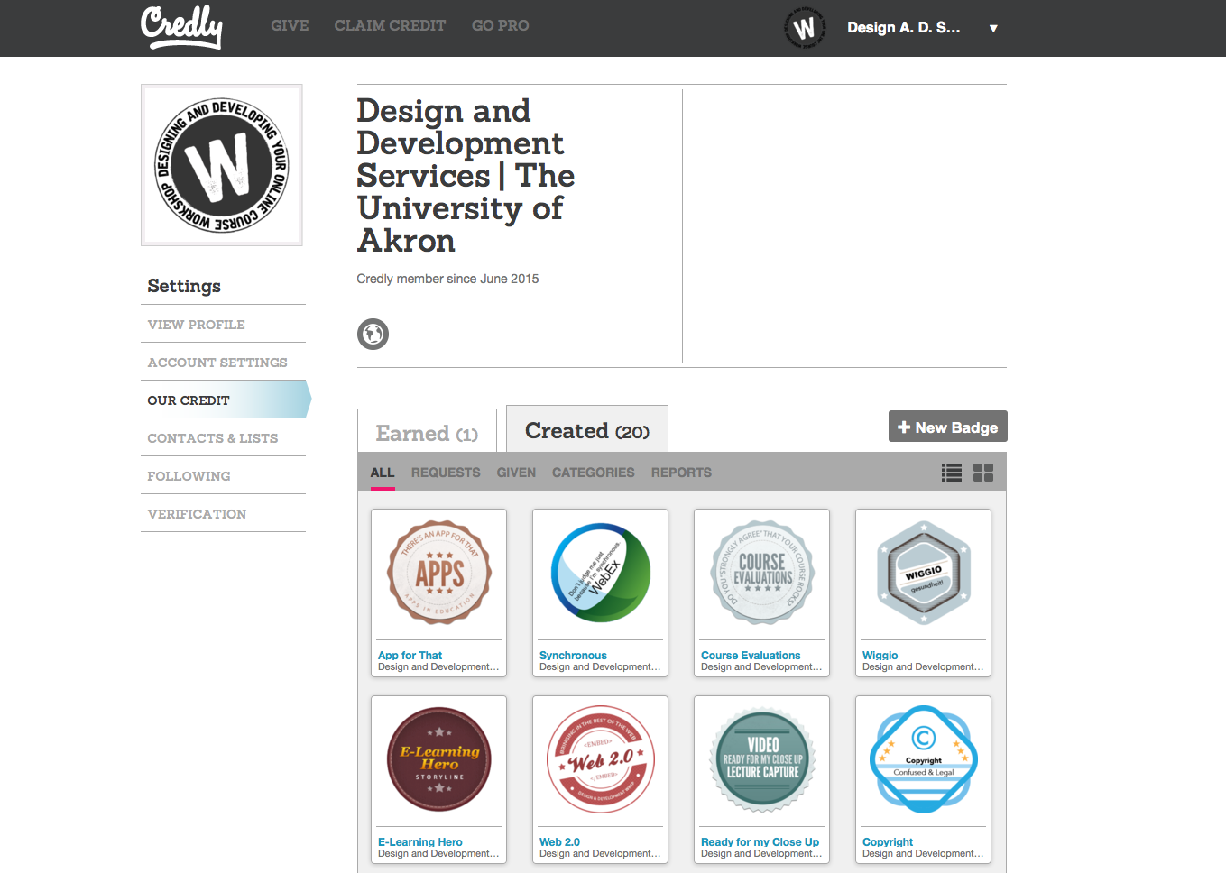



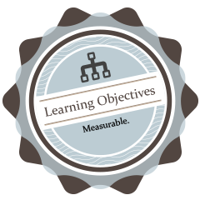






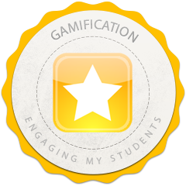



Notes:
Steve

Slide 33
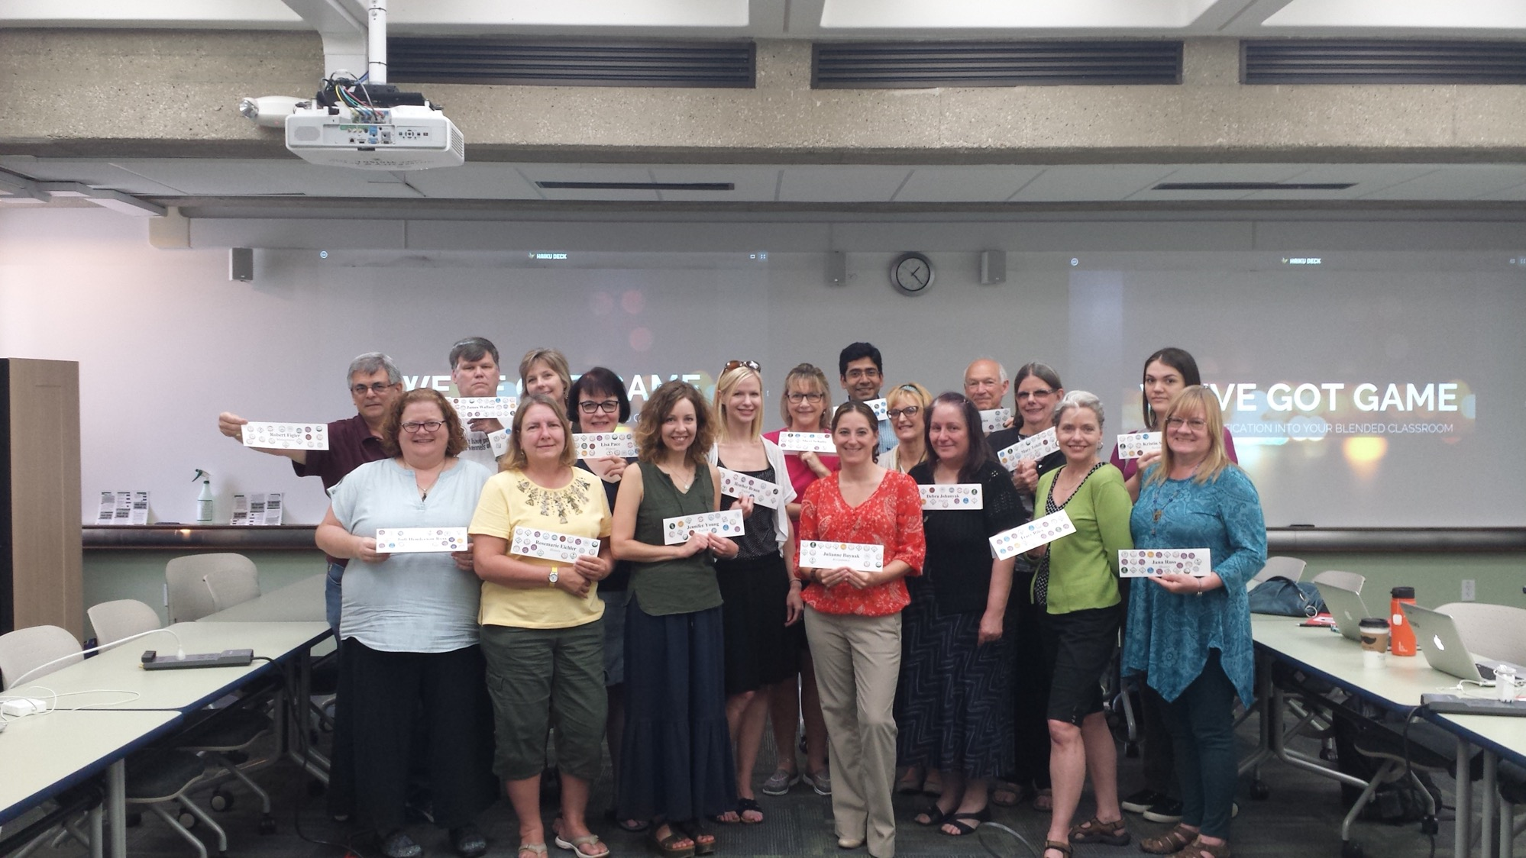
Notes:
Steve

Slide 34
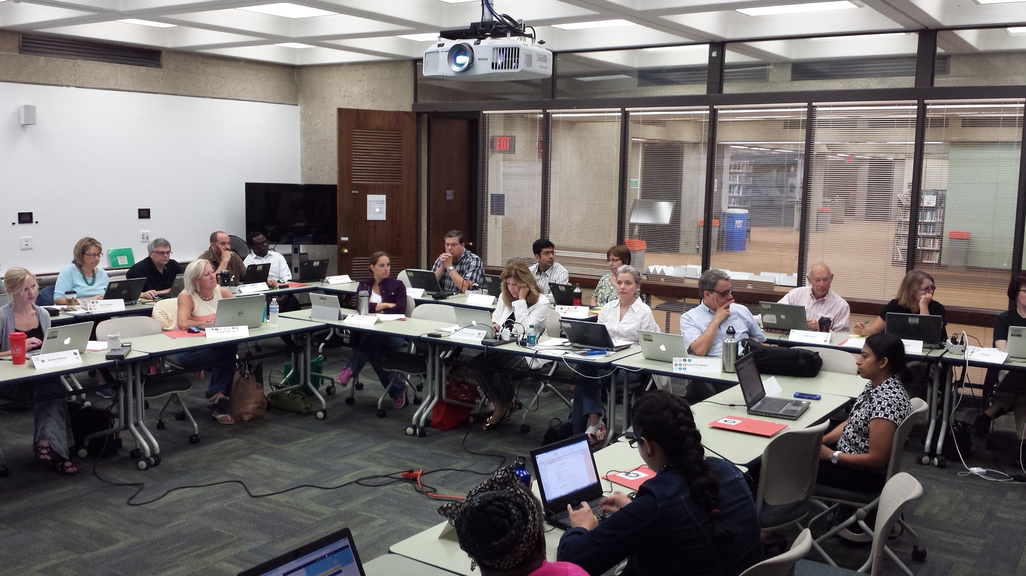
Notes:
Steve

Slide 35
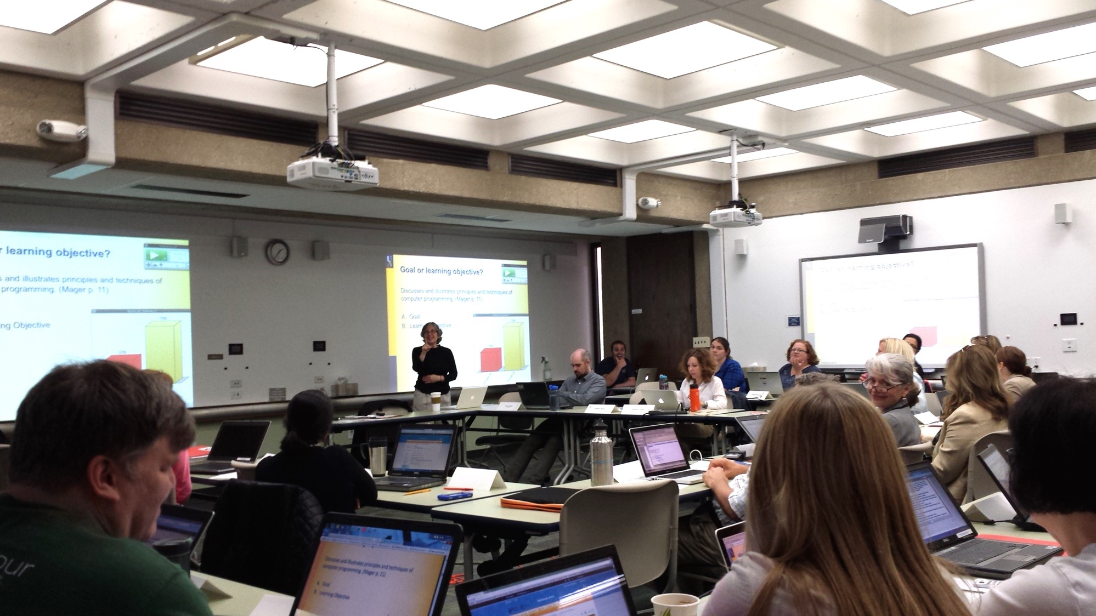
Notes:
Steve

Slide 36
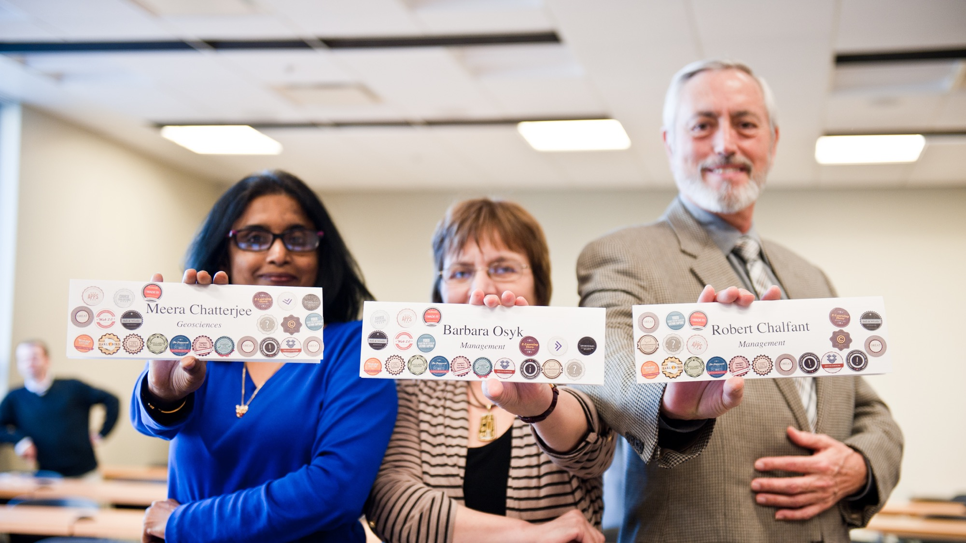
Notes:
Steve

Slide 37
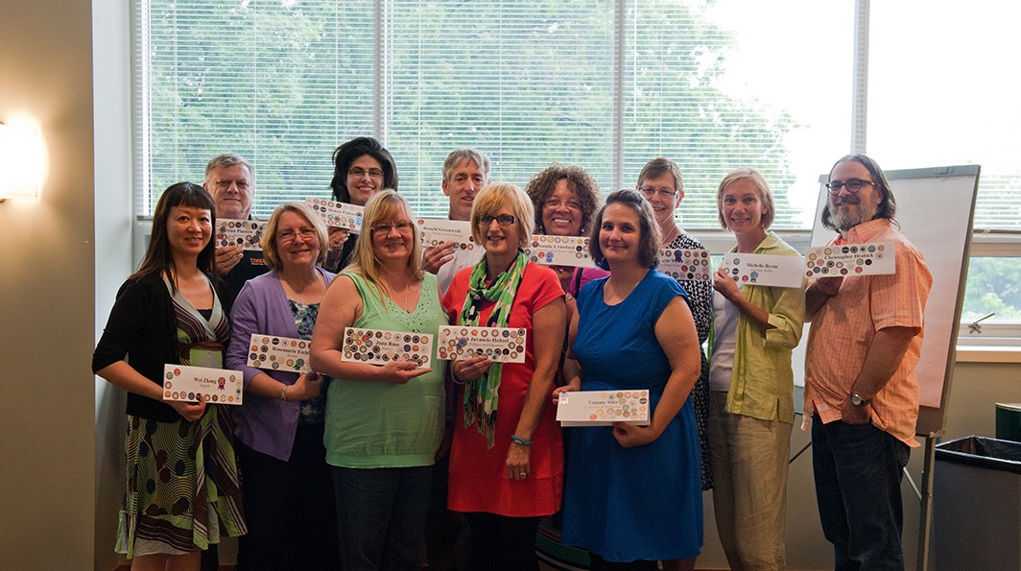
Notes:
Steve

Slide 38
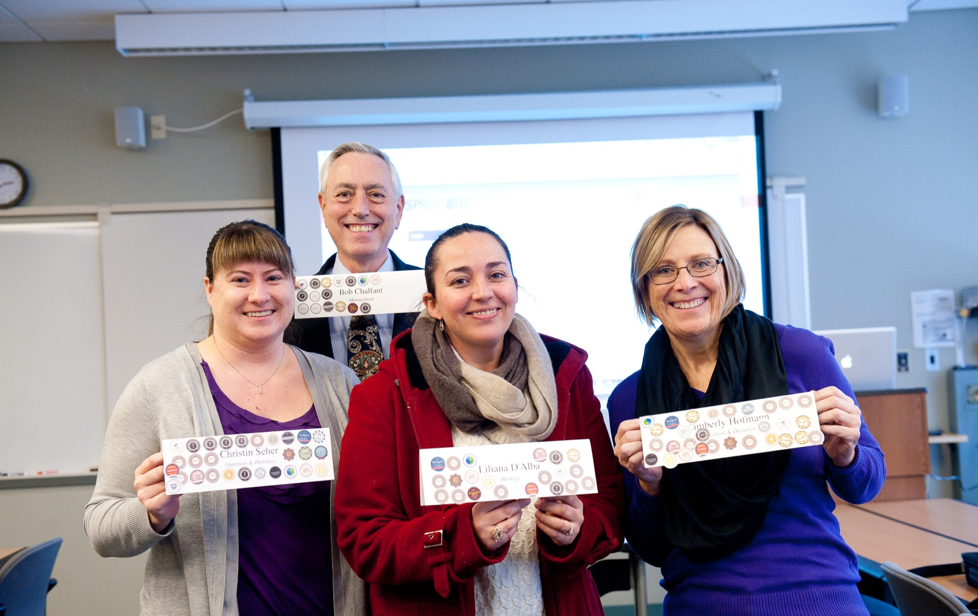
Notes:
Steve

Slide 39
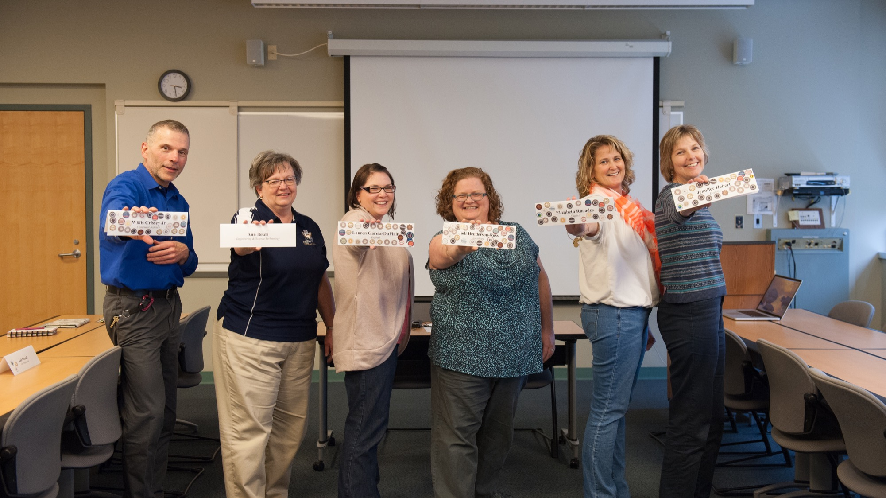
Notes:
Steve

Slide 40

Notes:
Steve

Slide 41
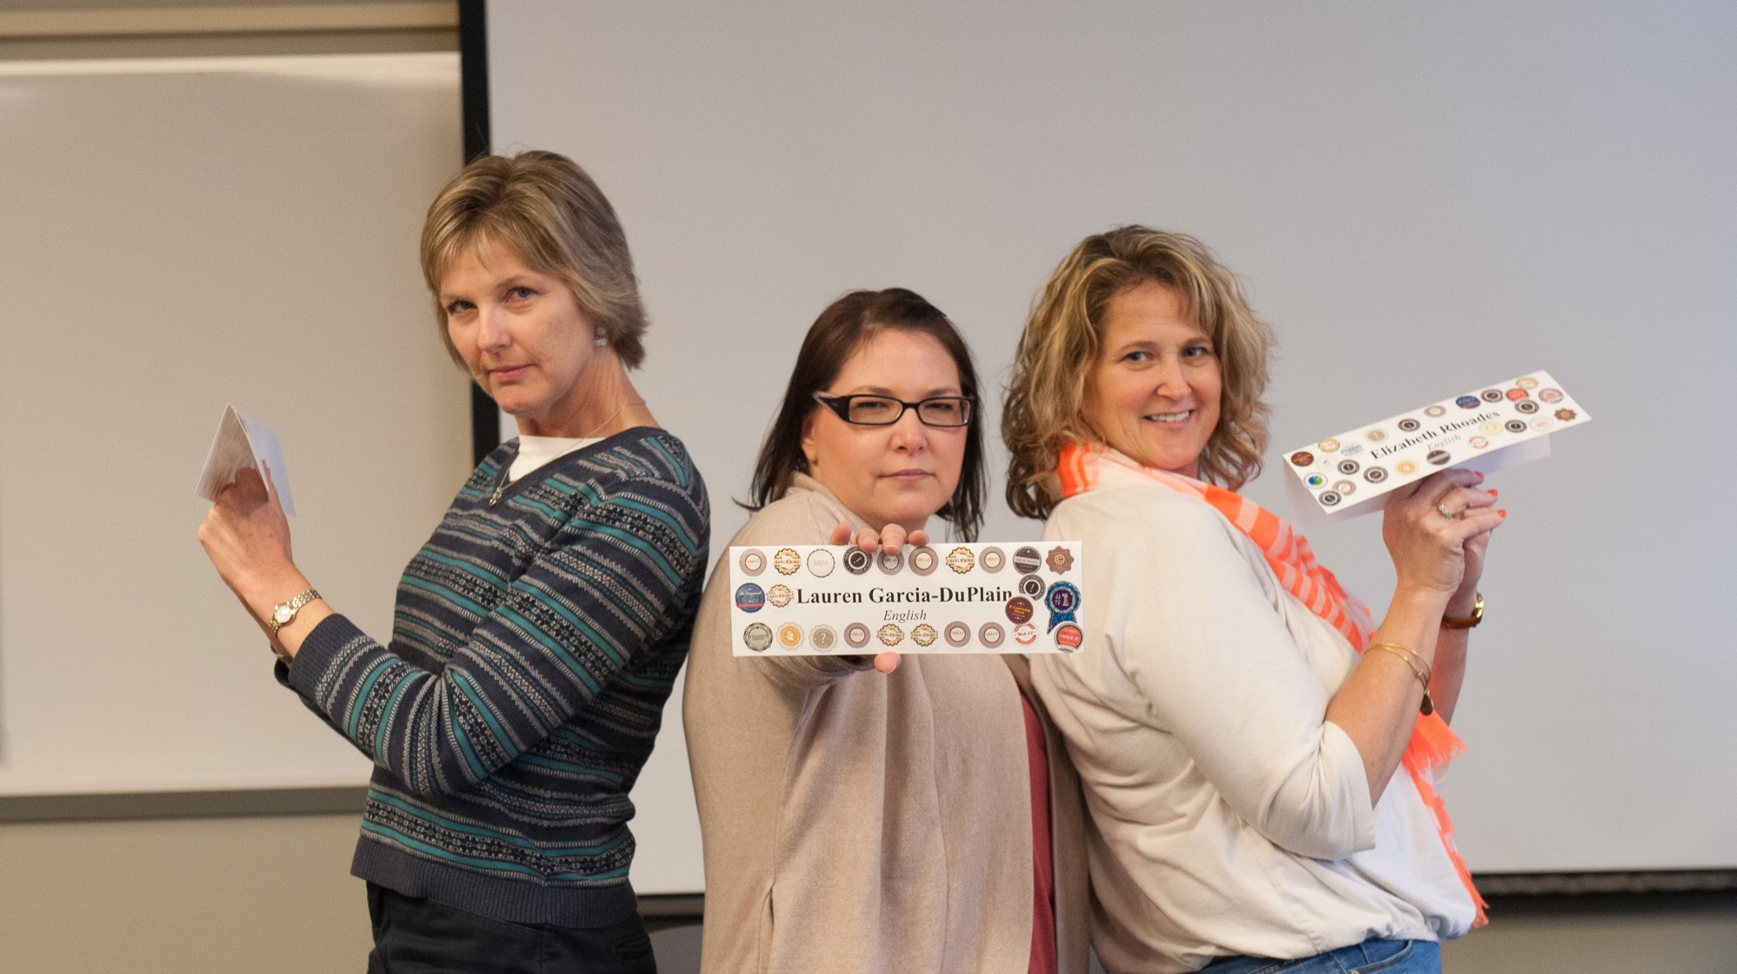
Notes:
Steve

Slide 42
The Benefit?
Notes:
Steve

Slide 43

The Benefit?
50-60%
MORE QUESTIONS
Notes:
Steve
This really can’t be understated. How wonderful would it be if your students asked you 50-60% more compelling, engaging, and thoughtful questions? The classroom conversation would get quite a bit more interesting.

Slide 44
Mastery Learning
“Our basic task in education is to find strategies which will take individual differences into consideration but which will do so in such a way as to promote the fullest development of the individual.” --Benjamin Bloom
Notes:
Jill
Benjamin Bloom coined the term "Learning for Mastery" and then later "Mastery Learning" in 1968 and 1971 to describe an educational method in which each student stays with a certain unit of learning material in a process of assessing and correcting until the objectives of that unit are mastered before moving on to the next unit.
Educate ALL Students to their potential.
We are going to take a look at two very popular games that they utilize mastery learning model:
Angry Birds and Candy Crush

Slide 45


Notes:
Jill

Slide 46
Mastery Learning
Unlimited attempts
Low-Risk Quizzing
  Ask the question: Why do we place so much value on quizzing?
  Sometimes, it’s just about exposure to the content
  Get them to read!!!
Notes:
One of the major factors you will find in these online games is the concept of unlimited attempts to succeed at any given level. You must master the “objectives” before you can move on to the next level or “unit.”

Slide 47
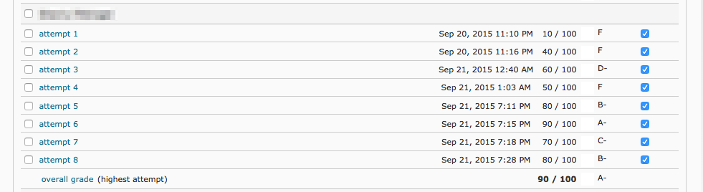
Unlimited Attempts & Low Risk
Notes:
Jill
Not just in gaming, but as you can see, students like having the opportunity to have multiple attempts for success. These are low risk reading quizzes that are generally ungraded (or represent a very small percentage of the final grade), but necessary to move on to the next module.
This helps our students get exposure to the content, the types of questions we ask, and most importantly… it gets them to actually read!

Slide 48
How is Mastery Learning like a game?
  Candy Crush
    We start with just simple matching
    New dynamics added in very quickly once you become proficient
      Scaffolding the levels helps build skills
    Eventually have to meet multiple criteria simultaneously in order to advance
Notes:
Jill

Slide 49
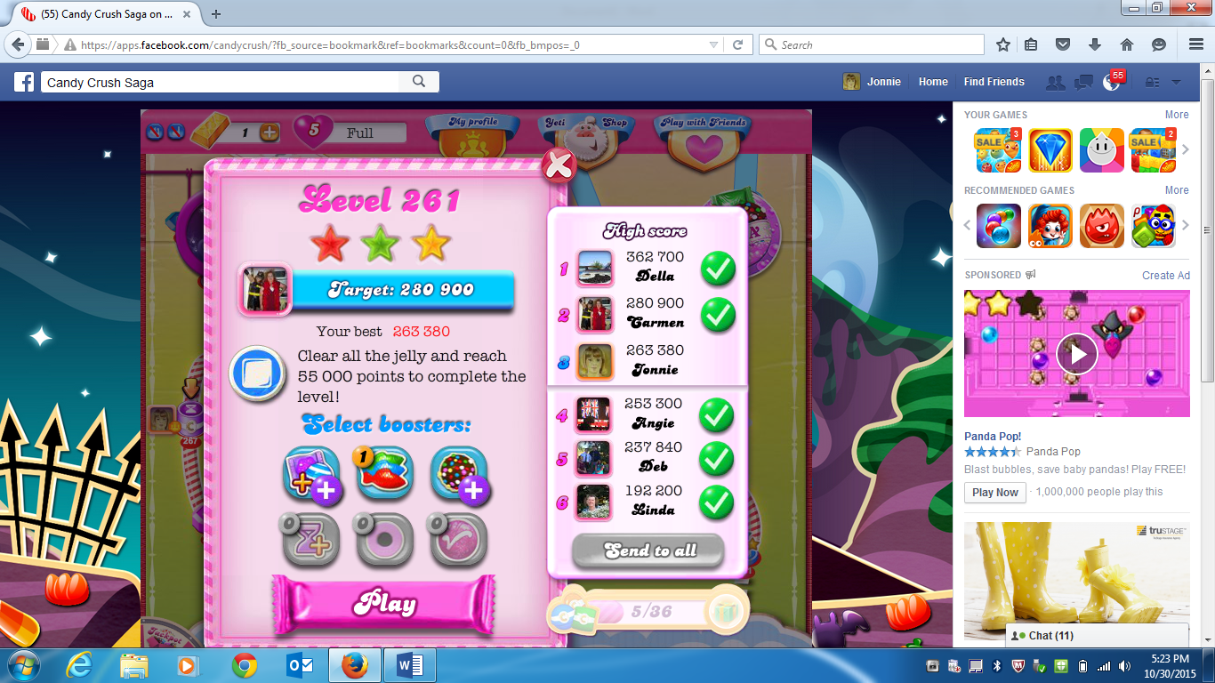
Notes:
Jill

Slide 50
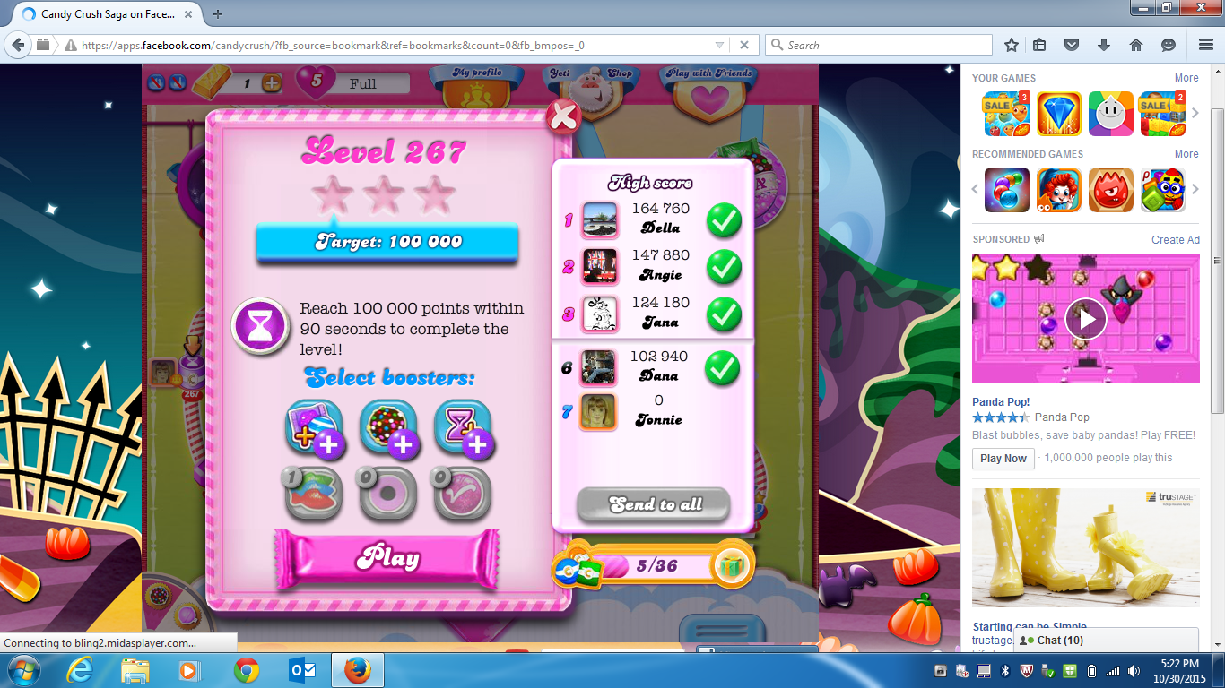
Notes:
Jill

Slide 51
Mastery Learning
Learning is scaffolded
  Easy, Medium, and Difficult Quizzing
  Objectives clearly stated “and they align to the assessment”
Notes:
Jill
Games provide very specific “objectives” for each level, such as Clear all of the Jellies, Bring down all of the ingredients, score 100,000 points in 60 seconds.

Slide 52
Elements from gaming that will work in designing educational materials
DECONSTRUCTING CANDY CRUSH: WHAT INSTRUCTIONAL DESIGN CAN LEARN FROM GAME DESIGN
by Evangeline (Litsa) Varonis and Maria E. Varonis
This paper identifies structural, social, cognitive, and emotional design strategies that motivate users to move through successively more difficult levels.
It continues to suggest how these strategies could be used in course design to motivate students to persist.
Notes:
Jill
DECONSTRUCTING CANDY CRUSH: WHAT INSTRUCTIONAL DESIGN CAN LEARN FROM GAME DESIGN
by Evangeline (Litsa) Varonis and Maria E. Varonis
This paper identifies structural, social, cognitive, and emotional design strategies that motivate users to move through successively more difficult levels.
It continues to suggest how these strategies could be used in course design to motivate students to persist.
Chunking
In gaming we call these Episodes and Levels
In education we use chunking as a strategy to systematically lead learners through the course. Using modules and sections by breaking down the content into smaller groups, the brain can process them easier and faster.
Timed releases
To help with the chunking process, timed releases can be utilized by scheduling new materials to be released at the beginning of each week, or for specific window when assessments can be accessed. Keeping all students “together” for conversation in the discussion boards can help to build the learning community itself and results in much deeper and richer discussion threads.
Optional materials can be provided for motivated learners who want to review materials for more clarity, or investigate the topic at a deeper level.
Again Kenneth Blanchard states in his book The One Minute Manager - clearly the number one motivator of people is feedback on results. In fact, we have another saying here that's worth noting: 'Feedback is the Breakfast of Champions.' Feedback keeps us going.
Immediate feedback is important, whether it is the number of stars earned during the level activity, or the out-of score on quiz, participants want to know how they performed as soon as the task is completed. This can be encouraging and motivate them to move to the next level and stay engaged in the learning process.

Slide 53
Elements from gaming that will work in designing educational materials
Chunked into episode and levels
Objectives for Each Level are Clearly Stated and Measurable
  Here’s what you have to do…
Immediate Feedback is Offered on Performance
Notes:
Jill
Chunking
In gaming we call these Episodes and Levels
In education we use chunking as a strategy to systematically lead learners through the course. Using modules and sections by breaking down the content into smaller groups, the brain can process them easier and faster.
Timed releases
To help with the chunking process, timed releases can be utilized by scheduling new materials to be released at the beginning of each week, or for specific window when assessments can be accessed. Keeping all students “together” for conversation in the discussion boards can help to build the learning community itself and results in much deeper and richer discussion threads.
Optional materials can be provided for motivated learners who want to review materials for more clarity, or investigate the topic at a deeper level.
Again Kenneth Blanchard states in his book The One Minute Manager - clearly the number one motivator of people is feedback on results. In fact, we have another saying here that's worth noting: 'Feedback is the Breakfast of Champions.' Feedback keeps us going.
Immediate feedback is important, whether it is the number of stars earned during the level activity, or the out-of score on quiz, participants want to know how they performed as soon as the task is completed. This can be encouraging and motivate them to move to the next level and stay engaged in the learning process.

Slide 54
Elements from gaming that will work in designing educational materials
Players Have Unlimited Opportunities to Repeat Levels
Information is Available in Multiple Modalities (devices)
Bonuses Are Offered for Surpassing Acceptable Performance
Notes:
Jill

Slide 55
Exemplary Work
Rewarding students who go above and beyond the minimum requirements
Concept of “Up Voting” the best discussion posts = reward
First 3 people who finish a quiz, or first three to submit to the discussion
Notes:
Jill
Bonuses can be offered for exemplary work.

Slide 56
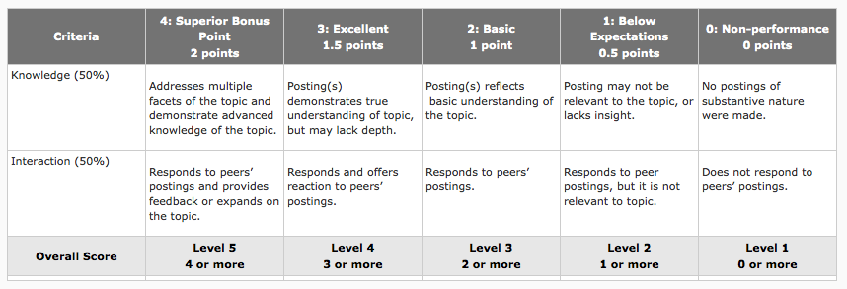
Notes:
Jill
Here’s an example of a discussion rubric we use that provides bonus points for superior posts.

Slide 57
How is Mastery Learning like a game?
We see the same thing in Angry Birds
  Introducing one game element at a time
    Angry Birds give you one bird with one skill at a time until you master
    Unlock the ability to use new birds
    After you become proficient, you can compete against your friends
    Imposing time limits
Notes:
Steve

Slide 58
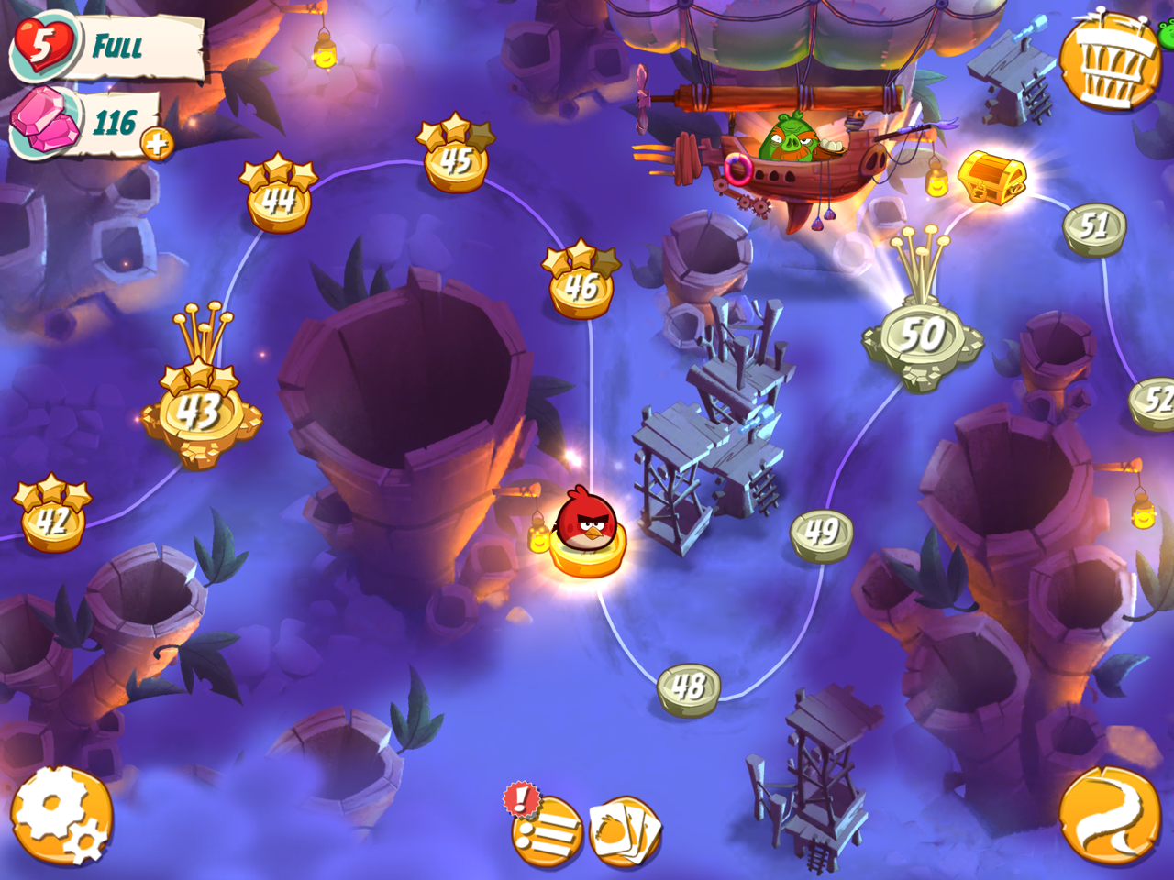
Notes:
Steve

Slide 59
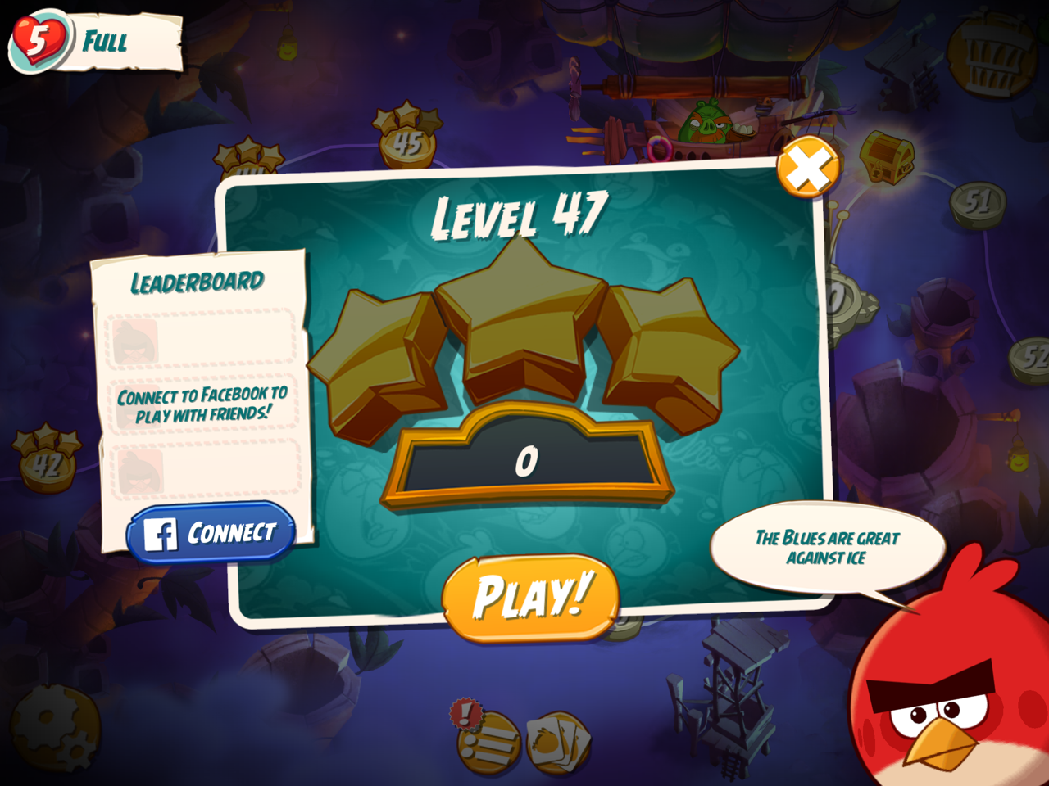
Notes:
Steve

Slide 60
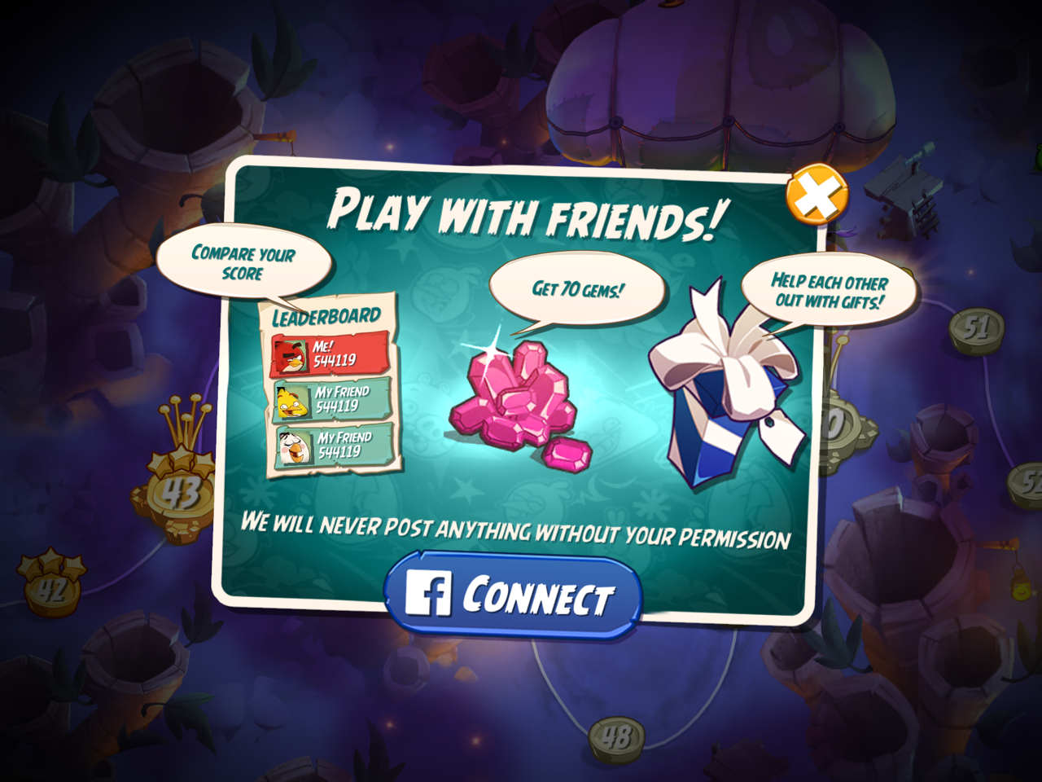
Notes:
Steve

Slide 61
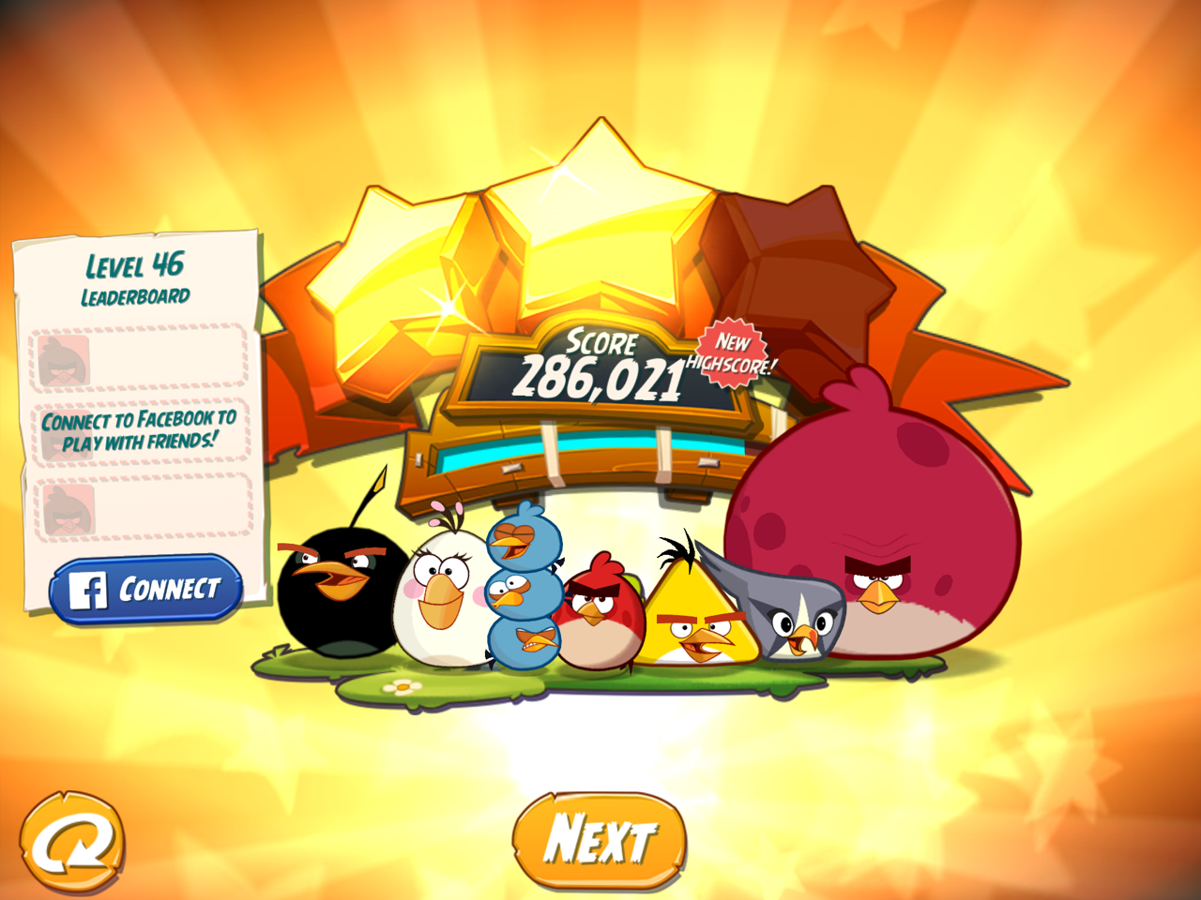
Notes:
Steve

Slide 62
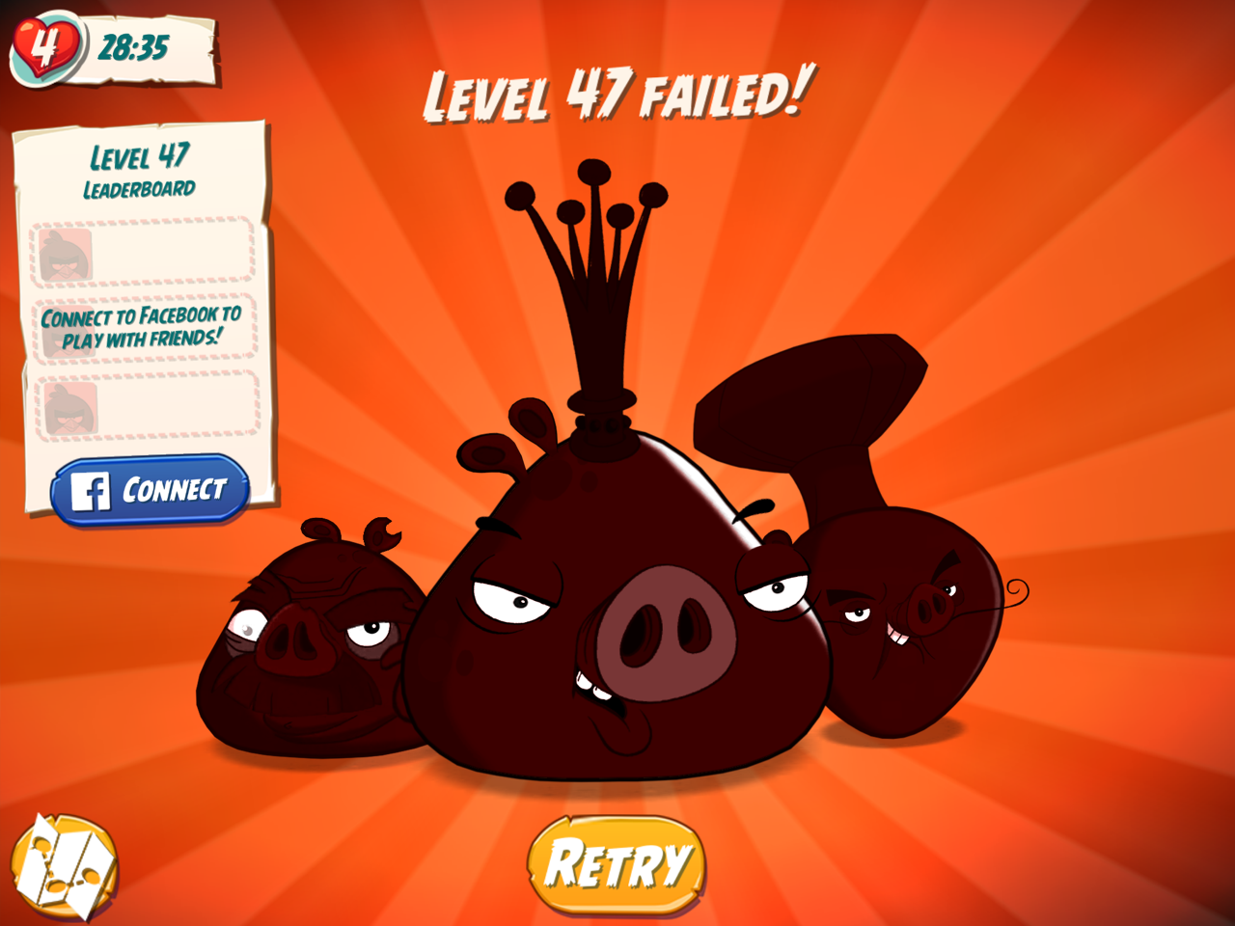
Notes:
Steve

Slide 63
The Results?
Shaun Iles, instructor at Mohawk College notes:
“When students are forced into a rigid, one-size-fits-all learning environment, their individual needs and interests aren’t taken into account.”
As children, we learn through games and simulations. As we get older, that model changes and learning becomes less “fun.”
Gated content – including readings, activities, reflections, and quizzes.
Allows students to own their personal learning paths by deciding how quickly or slowly they moved through the content.
Automated emails to students when they met specific criteria or conditions, providing surprises and rewards as they progressed through the course.
Notes:
Steve
http://www.brightspace.com/blog/gamification-makes-elearning-fun-for-college-students/#.VjT79aJtk6E
Results:
Since gamifying his sustainability course, Iles’ withdrawal rate has dropped by 25%. The gamified elements of the course are also impacting student engagement and success, with 20% more students achieving passing grades.

Slide 64

Prove to your students that they are good learners.
Notes:
Steve
Slowly ramping up content and assessments help to build the confidence of your students. Failing that first high-stakes exam can be a huge de-motivator and will shake the confidence of your students.

Slide 65
Self Assessment, Content Creation,
& Competition
Notes:
Jill
Introduce this.

Slide 66
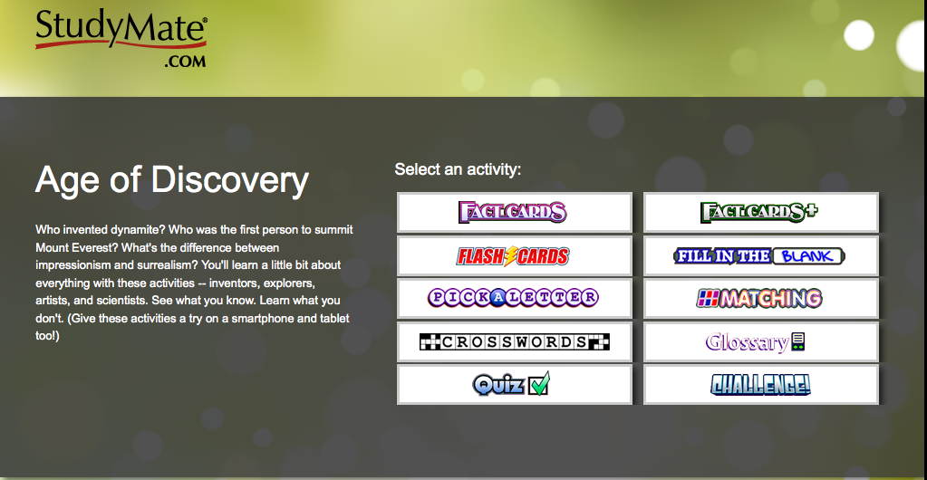
Notes:
Jill
StudyMate helps students "master the basics" of course material through learning activities, self-assessments, and games. A dozen activities – such as flash cards, crosswords and quizzes – engage students with course content in an individualized way.
Publishers provide test bank questions that can be imported into the StudyMate project.
Instructors can develop their own materials
Or, my favorite is to have the students create their own learning materials to study. For example, you can have each student write a definition for a vocabulary word.
Students access StudyMate activities using computers, smartphones and tablets.

Slide 67

Crowd-sourcing the Questions
Students generate their own study guide to share with their classmates
Can introduce a competition
Most LMS’ can handle group work
  Points awarded based on participation
Notes:
Steve
Law class example of stumping the other team with questions over the text

Slide 68
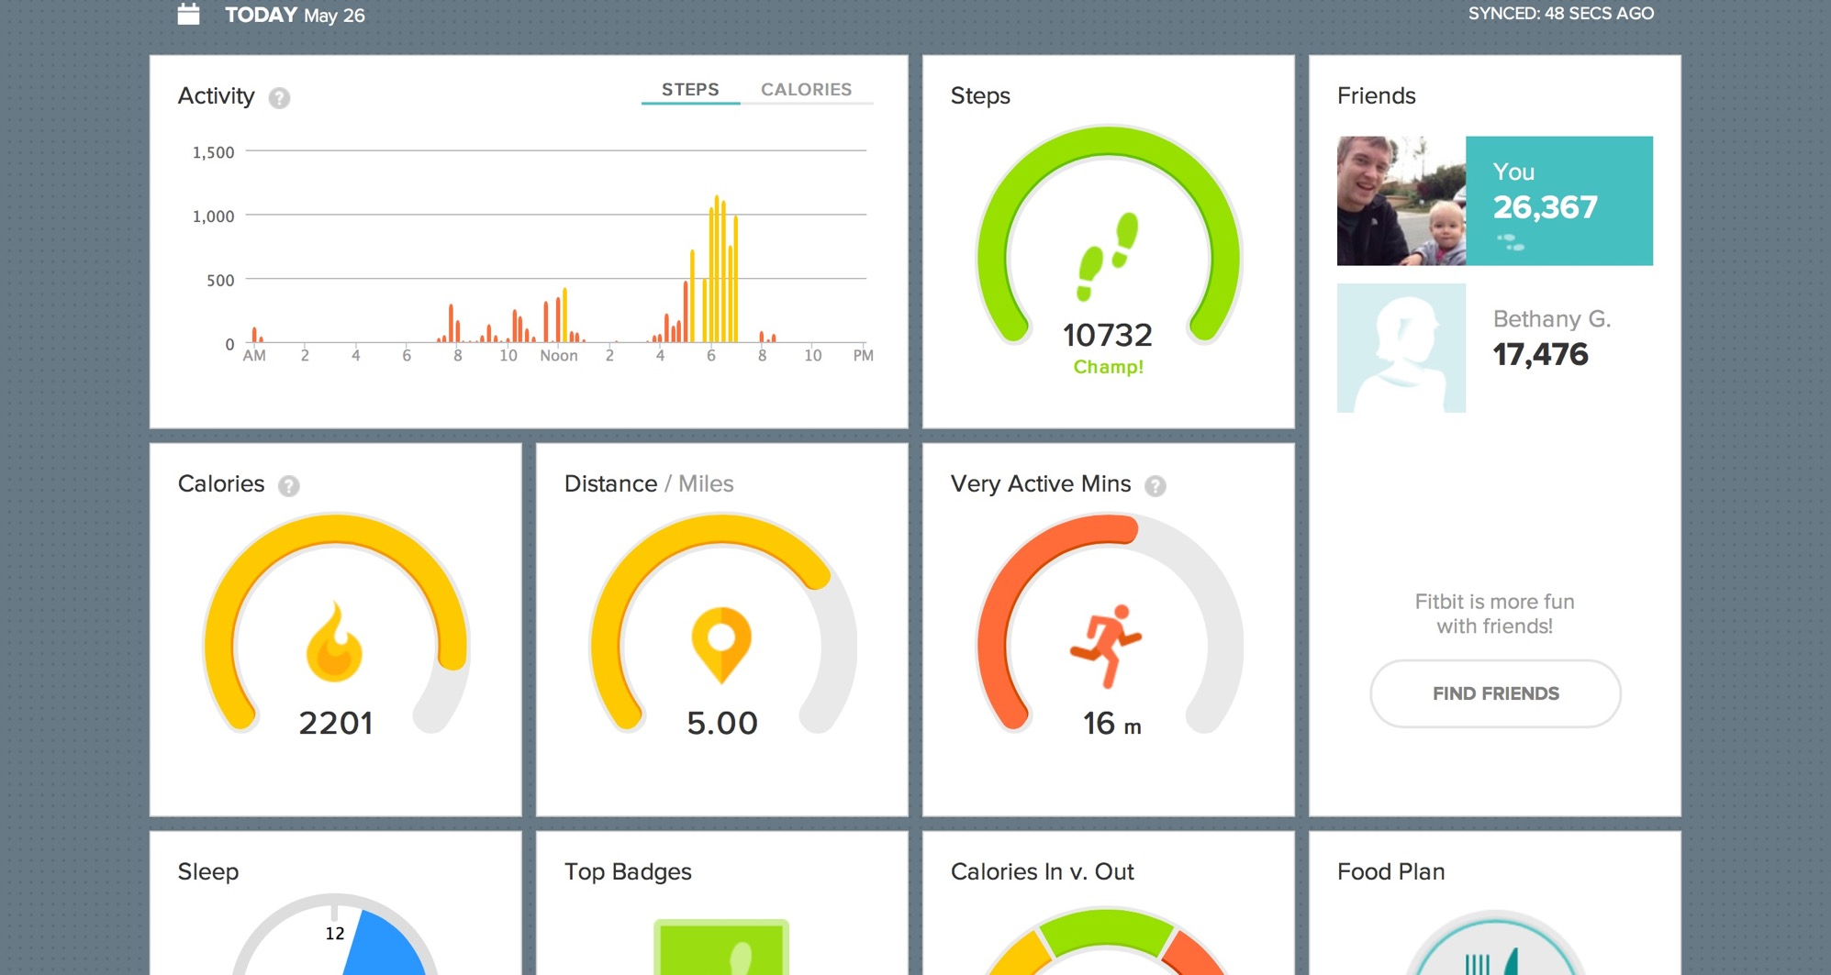
Notes:
Steve
How many people in here track the steps they walk each day?
Own a FitBit?
The goal is to compete with yourself. Get in more steps each day. Be active. Even, compete with your friends.
Earn badges!
Did you know that some insurance companies are now offering discounts on health insurance coverage if you share this data with them?

Slide 69
Immersive and Simulated Environments
Notes:
SICKO Stanford Project (Decision making / diagnosis simulation)
SimCity Glass Block Engine (Environmental simulation)
Earth Science (Tsunami simulation)
Murder at the Met (Scavenger hunt)
Klick-a-kloo (scavenger hunt)
Finance Program Simulation (Company Competition)

Slide 70
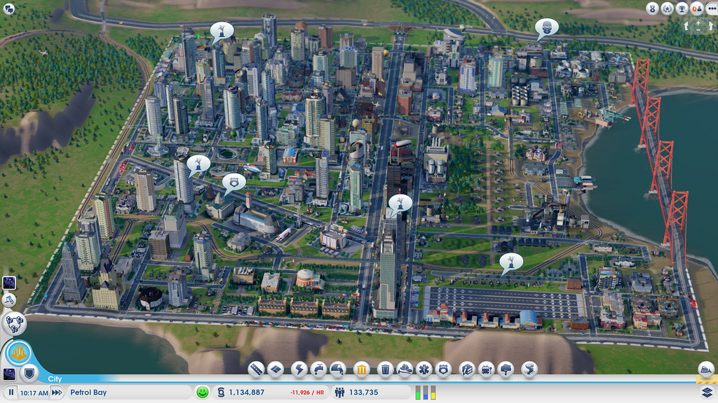
Notes:
Steve
Simulations allow us to see the cause and effect relationship that exists in the real world. We then make observations and take actions based on the information provided.
http://about.glasslabgames.org/
SimCityEDU, which is aligned to 21st Century skills framework and the Next Generation Science Standards, puts students in the mayoral office of a fictional city where they must balance its employment needs, the happiness of its citizens, and its environmental impact.
Interdependent relationships in ecosystems: resource allocation
Evaluate effect of resource changes on ecosystem population
Defining and delimiting the scope of a problem
Evaluate interdependent relationships in ecosystems
Optimizing solutions through systematic evaluation
Evaluating human impact on the environment
Studying factors of system stability and change

Slide 71
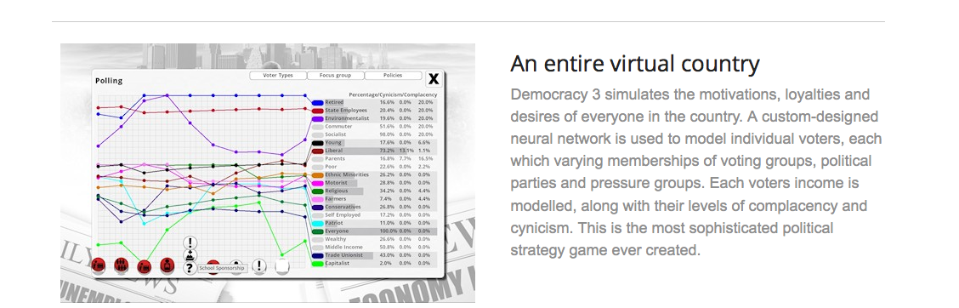
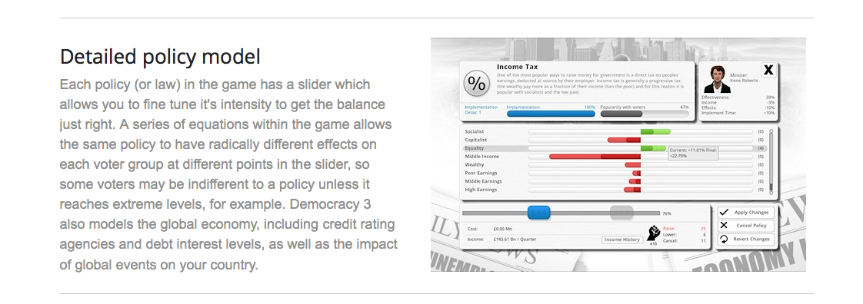
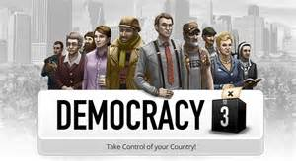
Notes:
Steve
Democracy 3 simulates the motivations, loyalties and desires of everyone in the country. A custom-designed neural network is used to model individual voters, each which varying memberships of voting groups, political parties and pressure groups. Each voters income is modelled, along with their levels of complacency and cynicism. This is the most sophisticated political strategy game ever created.
http://www.positech.co.uk/democracy3/

Slide 72
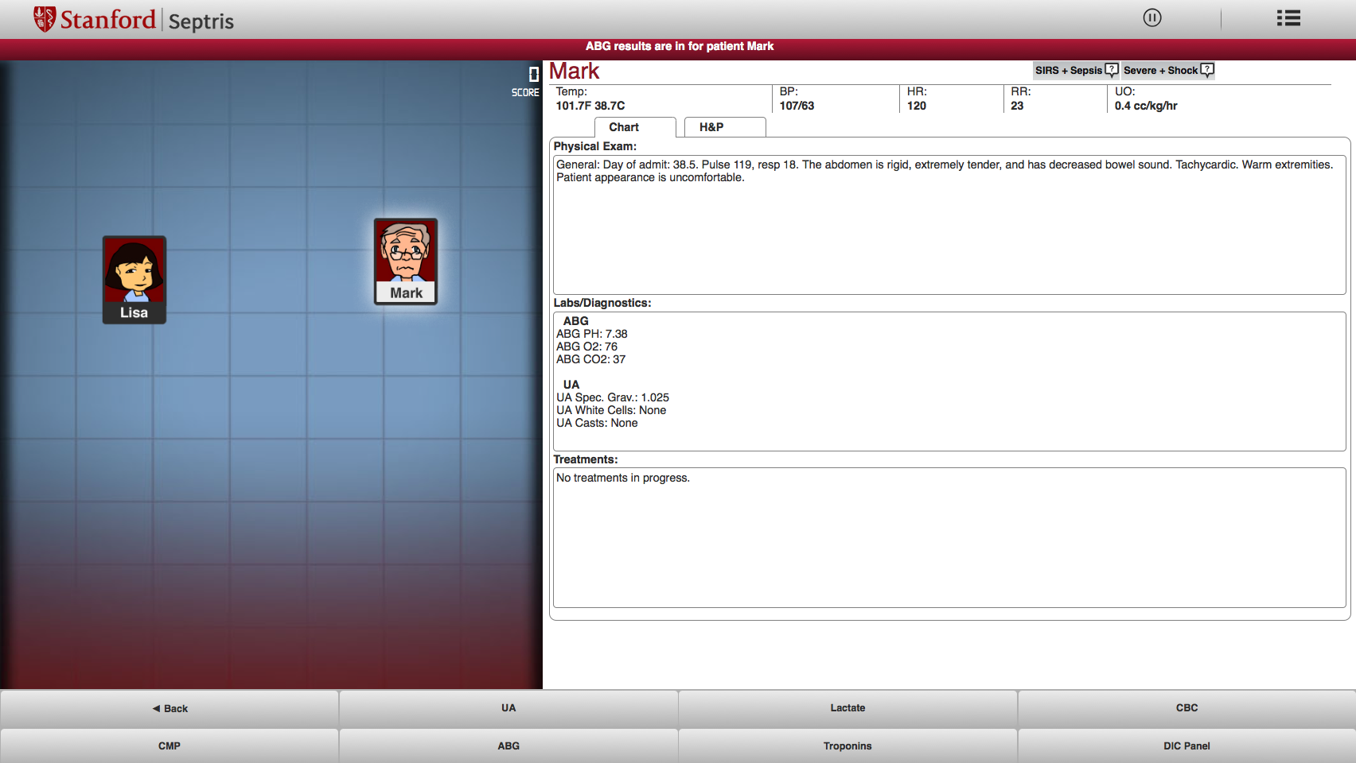
Notes:
Steve
Stanford’s
SICKO and Septris
http://med.stanford.edu/septris/

Slide 73
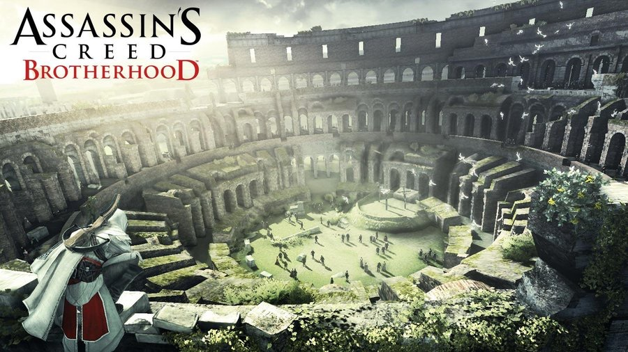
Notes:
Steve
Exploring an 3D world. If you took a moment to walk around the streets in ancient Florence, you would hear the conversations amongst the people regarding corruption, the Medici family, social strife. What an amazing way to explore history!

Slide 74
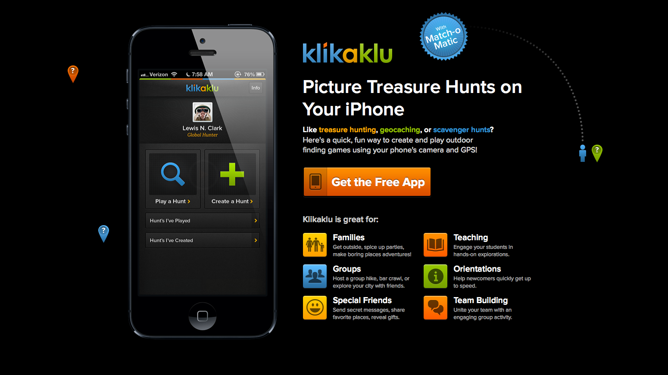
Notes:
Steve
http://www.klikaklu.com/
Nutrition and Dietetics student project

Slide 75
Shifting from “Grades” to Experience Points
Notes:
Jill
What if we changed our vocabulary to include terminology that might help our students view their scores in a different context?

Slide 76
From “Grades” to Experience Points
Why are our gradebooks only out of… 500 points?
What would happen if they were out of…
10,000 points?
  Games use Experience Points to “unlock” the next level of a character, or to access something new.
    Release conditions in your LMS
    Unlocking progressively more difficult content
Think about how games are structured…
  Every action is rewarded
Notes:
Jill

Slide 77
How it all fits together
Gamification
Badging
Mastery Learning
Self-Assessment
Competition
Simulation
Experience vs. Points
Notes:
Steve
All or some of these elements can greatly effect the retention rate and success rate of your students by employing techniques that increase engagement and plays to our love of games.

Slide 78

Questions?
Earn an Attendance Badge!
Go here:
http://tinyurl.com/QMattendance
Jonnie “Jill” Phipps, Ph.D. phipps@uakron.edu | Steve Kaufman, M.Ed. @steveekaufman
Notes:
Steve & Jill
Don’t forget to go to the address above to get your “Game On” Badge!

