Slide 1
Happy Trails:
Effects of QM Reviews
of 3 Courses at UWF

Slide 2
Sara McCool
June Watkins
University of West Florida
Faculty for 16 years
Instructional Designer
Certified QM Online Facilitator
2 courses reviewed
University of West Florida
Instructional Designer
Online Faculty for 9 years

Slide 3
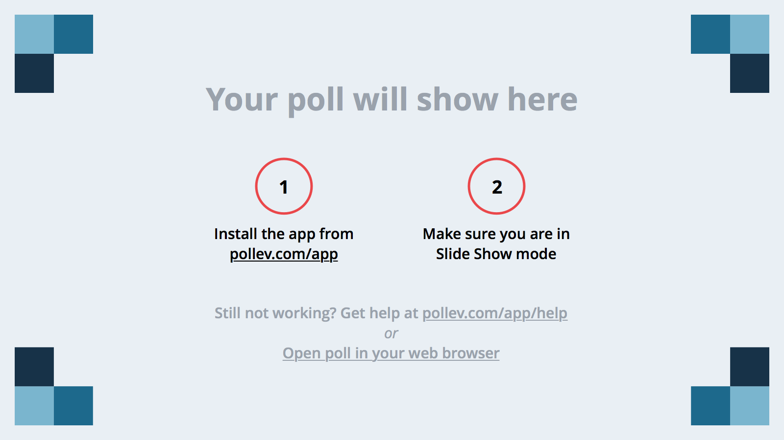
Notes:
Poll Title: What is your position?
https://www.polleverywhere.com/multiple_choice_polls/rTp5H6ZAPGaShLH

Slide 4
Notes:
Poll Title: Where are you from?
https://www.polleverywhere.com/clickable_images/fQqMnzWaqeLaKr6

Slide 5
Presentation Objectives
Discuss the results of a research study conducted at the University of West Florida involving 3 reviewed courses.
Discuss the effects of 3 QM reviews on grades, course completion rates, and learner satisfaction
Review the changes that were made resulting in clear alignment, easy navigation and excellent course/module objectives.

Slide 6

Background
Quality Matters since 2010.
Grew out of concern
about online quality.
Incentives for faculty.
Notes:
Undergraduate Headcount: 10,200
Graduate Headcount: 2,598
Total Headcount: 12,798
-- training reviewers and educating faculty on the benefits of a QM Review. We have had 80 courses successfully meet standards in a QM Review, and are now moving into a new phase focused on data analysis of results. This presentation is an initial review of four courses that have been tracked using data before and after a successful Quality Matters review.

Slide 7

Strategic Plan
Implementation
Faculty buy in
Analysis
Track reviewed courses
Analyze results
Refine and Revise
QM Fun Reviews
Train Reviewers
Rinse and Repeat

Slide 8
Implementation
Where we’ve been

Slide 9
implementation
Reluctant faculty
Developed Training Program
Offered Template
Decided on Incentives
Trained Reviewers
Review process
Notes:
Reluctant faculty: we decided on “QM Scholars” faculty representatives from each college, chosen by the Deans. Proficient in Online teaching. Given QM training, APPQMR and PRC . Stipend by semester to liaison with other faculty.
Developed two courses based on QM Standards. Designing a Quality Online course and Teaching a Quality Online Course. 6 weeks each.
Created a template that covered about 50% of the standards.
Incentives: training courses plus internal was $2000. External $1000.

Slide 10
Analysis
Where we are now

Slide 11
Hypothesis
A re-designed course will have a positive effect on grades, completion rates and student satisfaction.

Slide 12
Methodology
Chose 3 courses randomly
3 sections before the review
3 sections after the review
Measured:
  Grades
  Withdrawals
  “Muddiest Point” Discussion Threads

Slide 13
Analysis
NUR 4165
Reviewed 05-15-2015
95 points.
The major issues in this course were too many course and module level objectives (alignment was off)
The instructor simplified and aligned all objectives
Too few formative activities
instructor added rubrics and videos
Notes:
This course is well-designed with easy navigation, consistent look and feel, instructor narrated PowerPoint lectures (except Module 6) to guide participants on each module's readings and major concepts with examples and things to consider, and various resources in each module; however, it lacks diverse learning activities to enrich participants' broader experience in online teaching and online course development.

Slide 14
Analysis NUR 4165

Slide 15
Analysis NUR 4165

Slide 16
Analysis

Slide 17
Summary NUR 4165
Grades Increased
Questions on the Muddiest Point Forum Decreased= Student Satisfaction Increased
Withdrawals Decreased
Instructor reports emails also decreased dramatically, saving her time and frustration.

Slide 18
Analysis
Teaching A Quality Online Course
Reviewed 01-31-2014
99 points
Biggest improvement in the course was in added formative activities and cleaner alignment.
Notes:
This course is well-designed with easy navigation, consistent look and feel, instructor narrated PowerPoint lectures (except Module 6) to guide participants on each module's readings and major concepts with examples and things to consider, and various resources in each module; however, it lacks diverse learning activities to enrich participants' broader experience in online teaching and online course development.

Slide 19
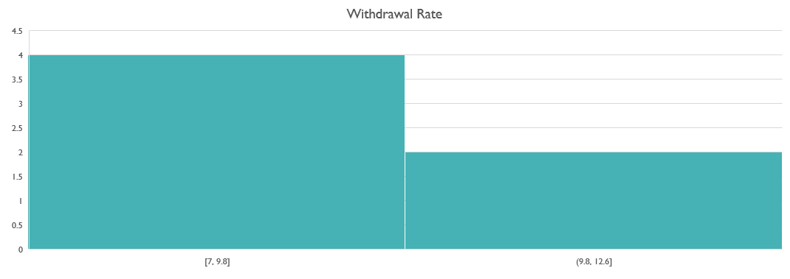
Withdrawal Rates

Slide 20
Number of Muddiest Point Threads

Slide 21
Summary ATC 102
Grades remained the same due to the nature of the course
Withdrawals decreased
Number of Muddiest Point Thread decreased = Student Satisfaction Increased

Slide 22
Analysis HSA 4340
Reviewed in January 2015
Major issues involved alignment, clear course objectives, and a new Begin Here section.

Slide 23
withdrawals

Slide 24
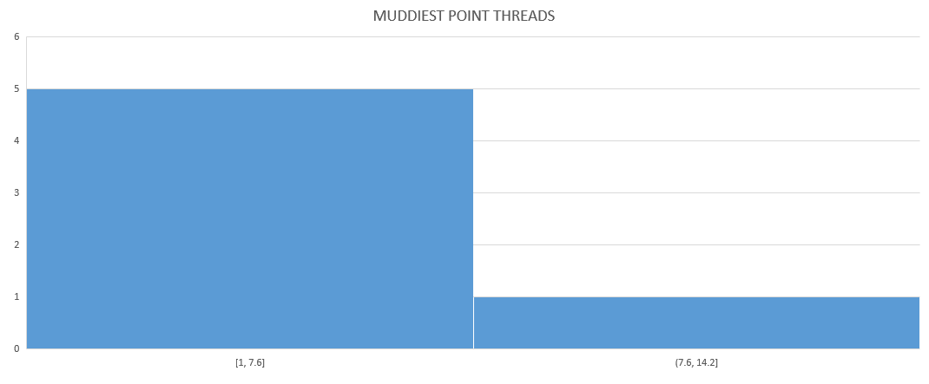
Muddiest Point Threads

Slide 25
Average Grades

Slide 26
Refine and revise
Where we are going

Slide 27
Changes at the State Level
Need to step up pace
Administration support
Pressure from the state
QM Fundamentals “Quick” Review
Deadline looming

Slide 28
Summary

Slide 29
Notes:
Poll Title: Was there anything surprising in the presentation today?
https://www.polleverywhere.com/free_text_polls/ZdciZG3c4rkj6re

Slide 30
Alignment
Formative Assessments
Accessibility
Measurable Alignments
Course Overview/
Introduction
Happy Learners

