Slide 1
Herding Cats: The Initial Roundup
Debbie Beaudry
Joy McDonald
Academic Technology Services

Slide 2
Context
Rutgers University
  Three campuses
  65,000 students and 9,000 faculty members
  Four learning management systems
Rutgers University-Newark
  12,000 students and 585 faculty members
  Blackboard learning management system

Slide 3
Classes in Blackboard
Spring 2014
Face-to-face: 1,430
Hybrid: 15
Online: 30

Slide 4
Quality Matters at Rutgers
Adopted in spring 2013
Some units developing course with QM focus
No courses have been through the formal QM review process

Slide 5
Designing Quality Online Courses (DQOC)
Goals
  Build a shell course based on selected QM standards
  Experience online course as a student
  Model QM-based course design
Format
  Nine weeks
  Completely online
  Offered through Blackboard

Slide 6
Pair & Share
What types of faculty development programs for QM…
Do you have?
Would you like to have?

Slide 7
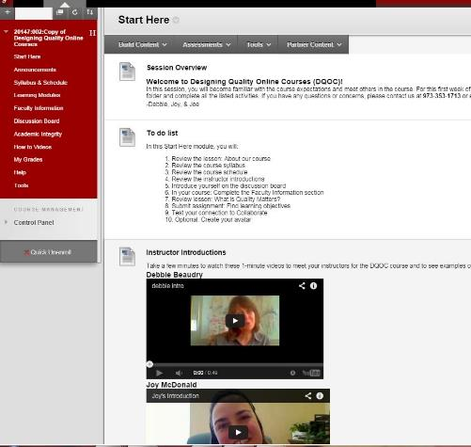
Start Here

Slide 8
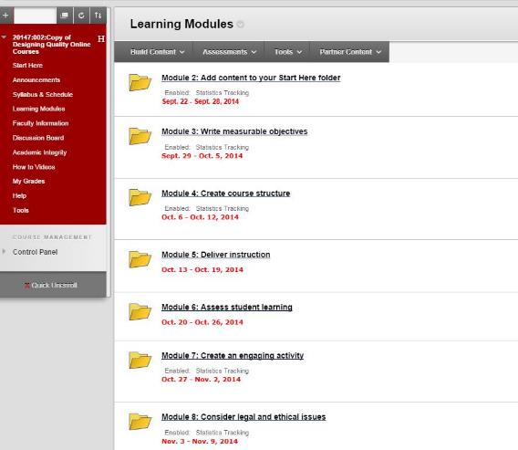
Nine Modules

Slide 9
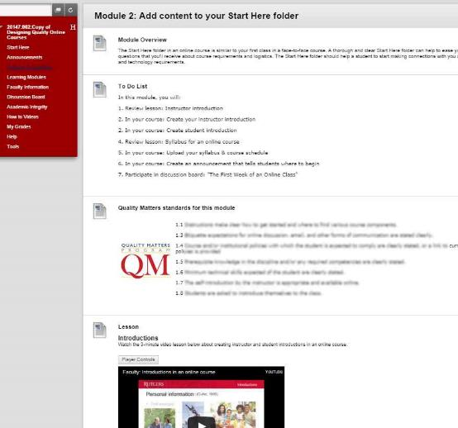
Module content

Slide 10
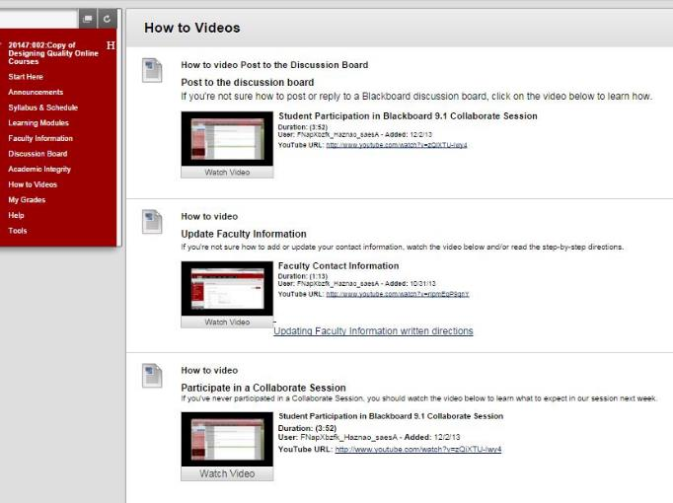
How to Videos

Slide 11
How to Measure Effectiveness of PD?
Calls for more rigorous evaluation of professional development in higher education.
  Brooks, Marsh, Wilcox, & Cohen, 2011
  Kucsera & Svinicki, 2010
Existing models suggested measuring program’s impact at a series of levels
  Guskey, 2000
  Kirkpatrick, 1994

Slide 12
Quality Transformation Faculty Development Assessment Framework (Ragan & McQuiggan, 2014)
Step 1: Participation metrics
Step 2: Faculty input & satisfaction metrics
Step 3: Attitude and knowledge metrics
Step 4: Instructor performance metrics
Step 5: Student performance
Step 6: Return on investment metrics

Slide 13
Pair & Share
How do you measure the effectiveness of your professional development?

Slide 14
DQOC Participants
Numbers
  Ten course participants
  Nine study participants
  Seven reported part of stipend program
Study participant status
  Full time faculty = 43%
  Part-time faculty = 43%
  Graduate assistant = 14%

Slide 15
Online Experience
Teaching
  57% never taught completely online
  43% taught hybrid course
  14% taught a course that was completely online
Learning
  43% took a completely online course
  43% took a hybrid course
  29% never took an online course before

Slide 16
Analysis of Data
Compared course to 82-point protocol
Tallied 43 possible points

Slide 17
Results by Stipend Status

Slide 18
Results by Completed vs. Not Completed

Slide 19
Pair & Share
What pieces of this course/evaluation method can you apply to your setting?

Slide 20
References
Brooks, D. Christopher, Marsh, L., Wilcox, K., & Cohen, B. (2011). Beyond satisfaction: Toward an outcomes-based, procedural model of faculty development program evaluation, Journal of Faculty Development, 25(3), 5-12.
Guskey, T.R. (2000). Evaluating professional development. Thousand Oaks, CA: Corwin Press.
Kirkpatrick, D. L. (1994). Evaluating Training Programs: The Four Levels. San Francisco: Berrett-Koehler.
Kucsera, J., & Svinicki, M. (2010). Rigorous evaluations of faculty development programs. Journal of Faculty Development, 24(2), 5-18.
Ragan, L.C. & McQuiggan, C.A. (2014) A model for determining the effectiveness and impact of faculty professional development. In K. Shattuck (Ed.), Assuring quality in online education (pp. 91-109). Sterling, VA: Stylus Publishing.

