Slide 1
Hot Topic Session
Fostering Student Engagement
Presenters:
Melissa Davis, Quality Assurance and Research Coordinator
Mia Murphy, Director of Outreach and Support

Slide 2
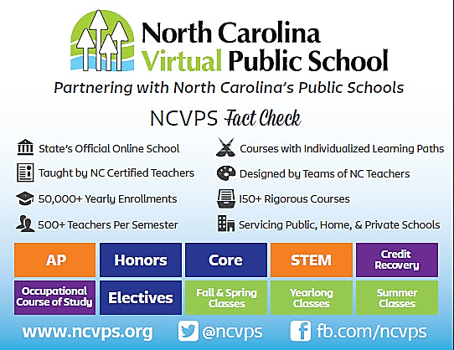
WHO ARE WE?

Slide 3
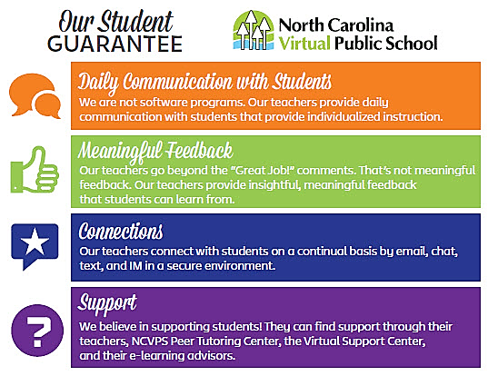

Slide 4


LEARNING
OBJECTS
Raptivity allows NCVPS to quickly and easily create learning interactions. Raptivity has over 180 learning templates including games, brainteasers, interactive diagrams, and more.
Articulate Studio allows NCVPS to quickly and easily create presentation interactions.
Articulate Studio offers many presentation options including Flipbooks, Flashcards, Tabs, Accordion Content, and the ability to add navigation to PowerPoint files, turning flat presentations into engaging videos.

Slide 5
WEB 2.0 TOOLS
A comprehensive list of acceptable Web 2.0 resources is updated weekly.
This list is distributed each week in the Virtual Connection, the NCVPS teacher newsletter.
A Web 2.0 tool is highlighted each week in the Virtual Connection providing teachers with specific examples of how the tool may be used inside the NCVPS course.

Slide 6







ADDITIONAL RESOURCES

