Slide 1


I Am NOT Teaching Public Speaking Online! Am I?
Quality Matters 7th Annual Conference
November 4, 2015

Slide 2


Slide 3
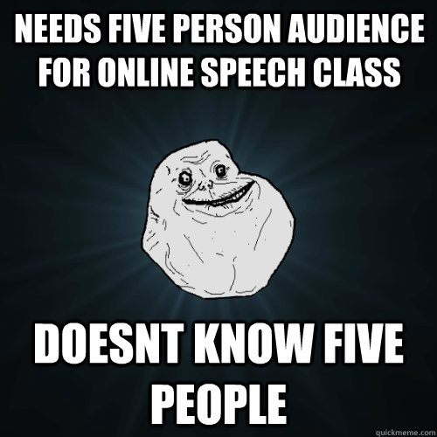

Slide 4
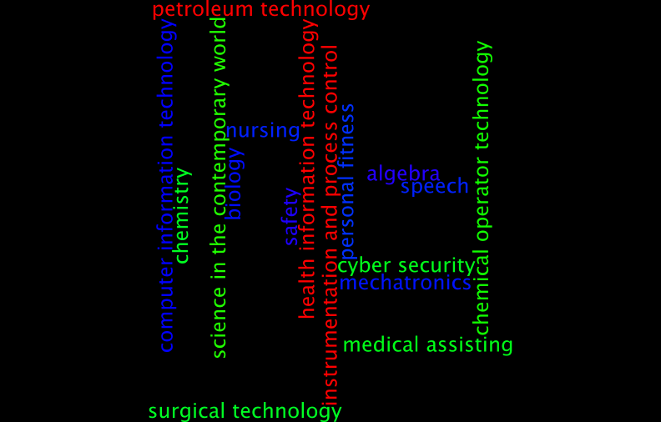

Slide 5
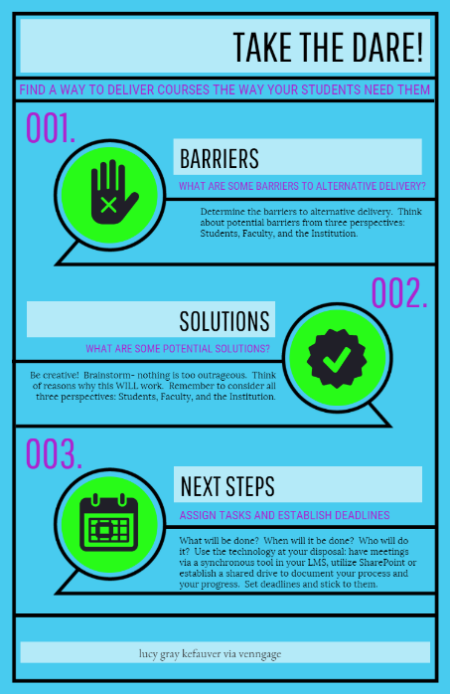

Slide 6
I Am NOT Teaching Public Speaking Online! Am I?
Lucy Gray Kefauver
lkefauver@wvncc.edu

