Slide 1
Implementing QM towards Program Certification

Slide 2
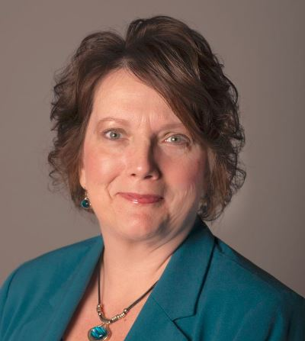
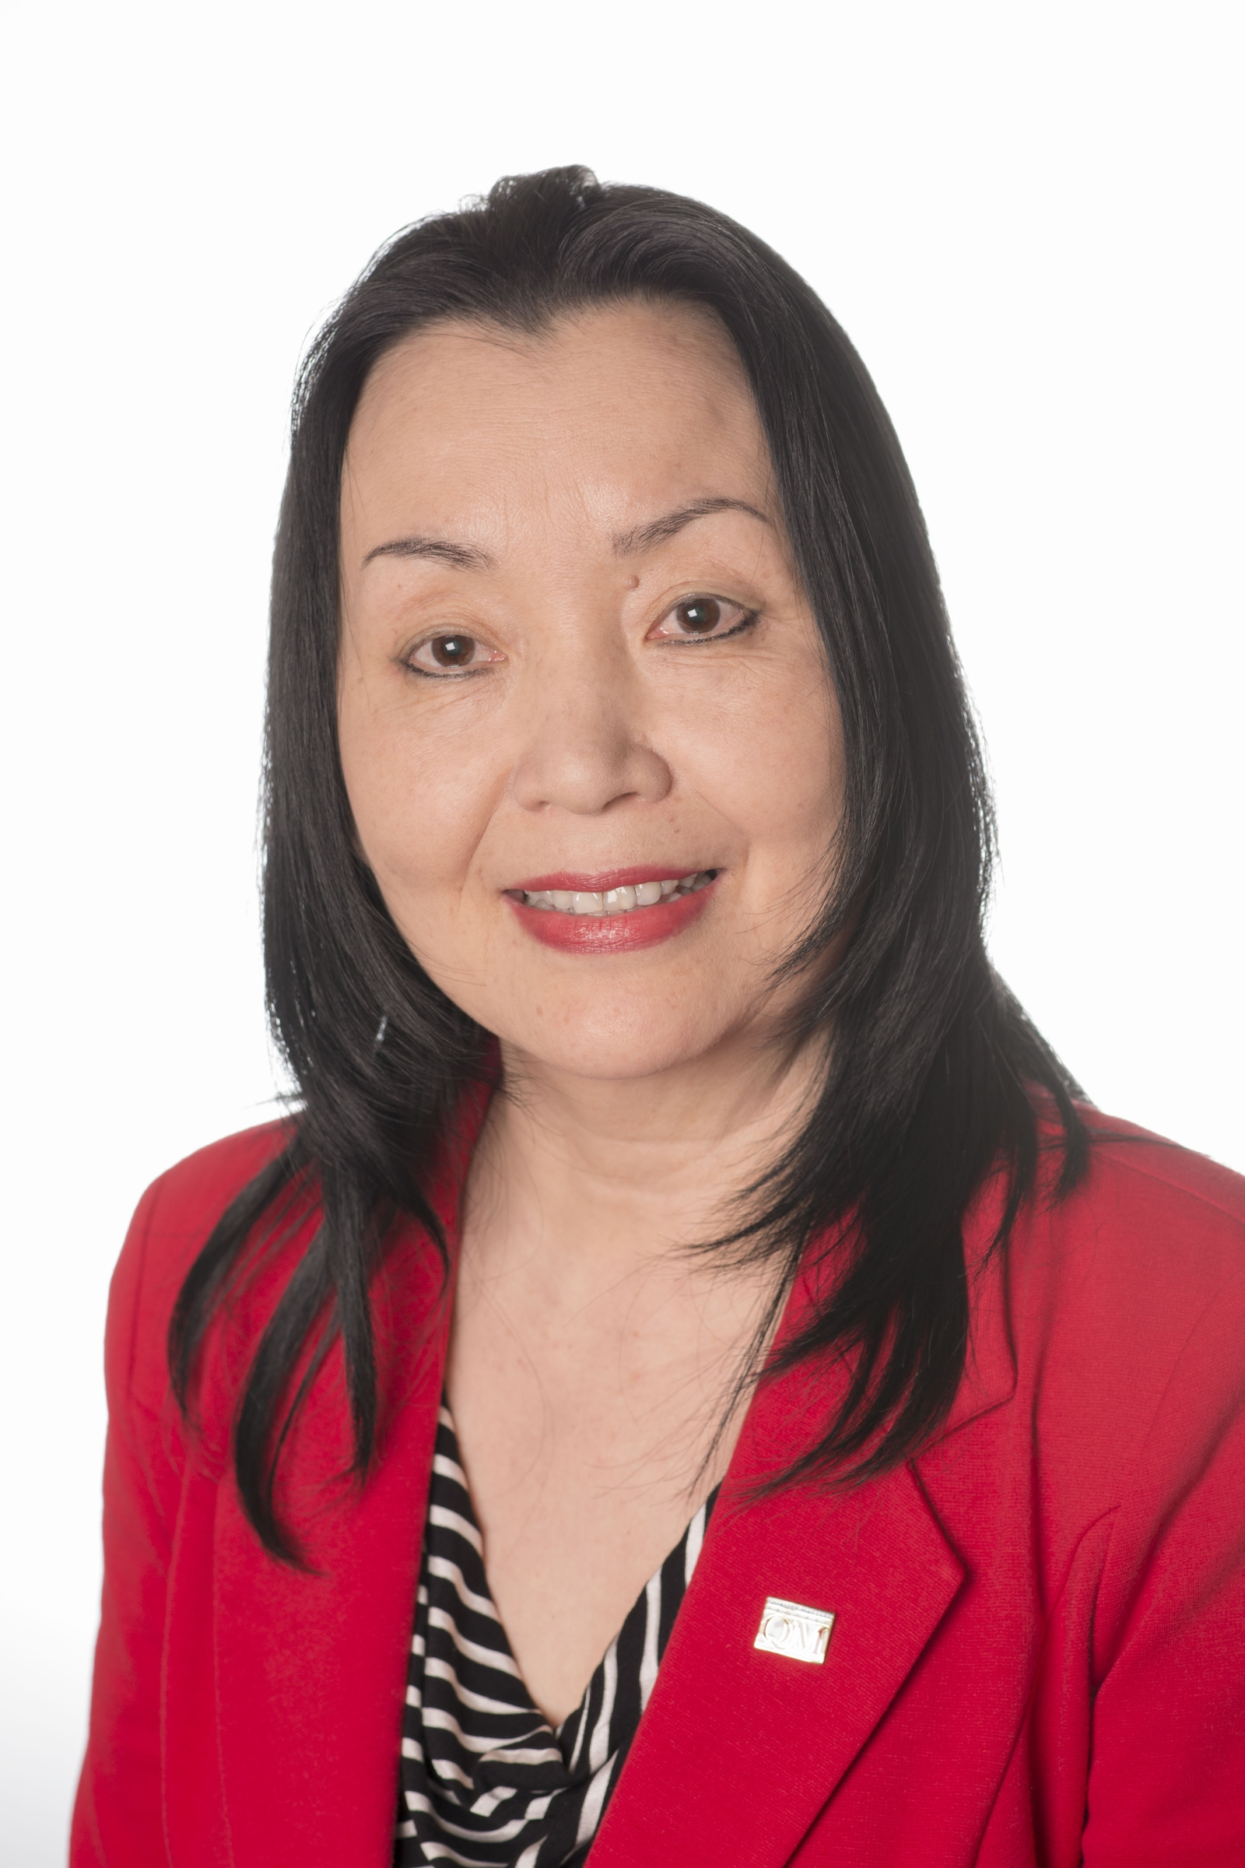
Melissa Poole
Director of Quality Assurance
Quality Matters
Yaping Gao
Senior Academic Director
Programs & Services
Quality Matters
©2016 MarylandOnline, Inc.

Slide 3

Continuous Improvement
Non-Profit
Academic
Peer-Based
©2016 MarylandOnline, Inc.
Notes:
QM is a non-profit organization with a peer-based approach to serving the education community. From K-12, to Higher Education, and Continuing and Professional Education, our underlying principle is continuous improvement, in all aspects of the education process, to improve student learning outcomes.

Slide 4


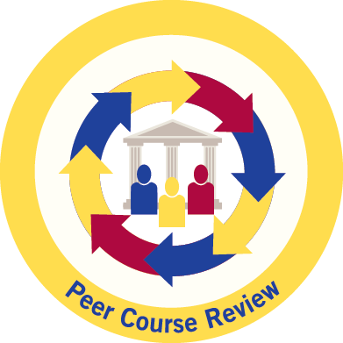
Enables Quality Assurance
Rubric Standards
Professional Development
Course/Program Reviews
©2016 MarylandOnline, Inc.
Notes:
QM enables and facilitates the quality assurance process through its Rubric Standards. The three primary components in QM are research supported Rubrics, professional development for faculty and staff, and peer reviews of courses and programs.

Slide 5

QM for Every Member Institution
What use to make of QM?
What to achieve in 1 year?
In 2 years? In 3 years?
How to maximize the value
of investment?
How to measure success?

Slide 6
Commitment to Implement QM
Reasons and Benefits:
  Become familiar with QM standards and procedures for quality assurance
  Introduce QM to a skeptical community
  Start an internal discussion on what constitutes quality in online education
  Build support for wider adoption of QM standards and practices
  Adapt to institutional goals and resources

Slide 7

Pathway to Quality Assurance
4. Program Review
& Certifications
3. Collect Required Data
2. Apply for Candidacy
1. Commit to implement QM
©2016 MarylandOnline, Inc.
Notes:
QM guides institutions and facilitates a pathway to quality assurance. Starting with commitment and a plan to implement QM, then apply for Candidacy, engage in QM activities and collect that can lead to Program Review and Certifications.

Slide 8




Program Certifications
Program Design
Teaching Support
Learner Support
Learner Success
©2016 MarylandOnline, Inc.

Slide 9

Candidacy as Pathway
Candidacy for Program Review
& Program Certification
QM member or not
Maximum of 3 years/phases
Choice of program review scope & type
3 check-in points with QM staff
Reasonable fee structure
Review ready at end of candidacy
©2016 MarylandOnline, Inc.

Slide 10
Principles of Program Certification
Definition of Program
3 Years of Activities
85% Rule
Data-Driven
Notes:
Explain 1) the definition of a “Program,” 2) why years of activities must precede application for Program Certification, 3) why 3 years of data are needed to establish trend lines and consistency, and 4) how the 85% principle works.
General Considerations;
A “Program” can be a single online degree program, all the online degree programs in a single academic unit, or all the online degree programs in an institution
Program Certification is a long-term goal – QM recommends at least 3 years of experience with QM before applying
Program Certification is data driven – QM asks for 3 years of data in support of applications for Program Review resulting in certification
Program Certification criteria are demanding, but the 85% principle is invoked to recognize the difficulty of full compliance, which remains a goal

Slide 11
Program Design Certification
Measurable LOOCs
Measurable at Course & Program Levels
Aligned between Courses and Program
5 Programs
Individual Programs or All Programs
Data from Maximum of 5 Programs
Compliance by All
Compliance by All Programs
QM for All Courses and Instructors
Notes:
Explain data limitation to five online programs, but the pledge that all programs included in the application reflect the same standards and practices. If this is not the case, the application should be confined to those programs that do comply fully with the Program Certification criteria.
Alignment is important at the program level, not just at the course level
Each program has measurable learning objectives, outcomes, or competencies (LOOC’s)
Course LOOC’s reflect program LOOC’s and sum up to program LOOC’s
If more than five programs are included in one application (e.g., all online program at an institution, data is only submitted for five representative programs
But all programs included in the application are expect to comply with the certification criteria
All new and revised courses in all included programs are designed consistently with the relevant QM Rubrics and input from QM trained faculty and staff

Slide 12
Teaching Support Certification
Exemplary
Online Teaching
Teaching Online Training
PD Opportunities
& Ongoing Support
Data Collection
Learner Feedback
Improved Policies
& Teaching Skills
Notes:
Explain importance of including support for part-time and adjunct faculty as essential to provide learners with consistent course quality.
The program supports all online instructors, both full-time and part-time
All online instructors receive training in online course delivery
All online instructors have access to ongoing support in their teaching roles
All online instructors are afforded professional development opportunities in their teaching roles
Learner feedback on online instructors’ teaching effectiveness is systematically collected and fed back into improvement efforts for online teaching policy and individual instructor improvement.

Slide 13
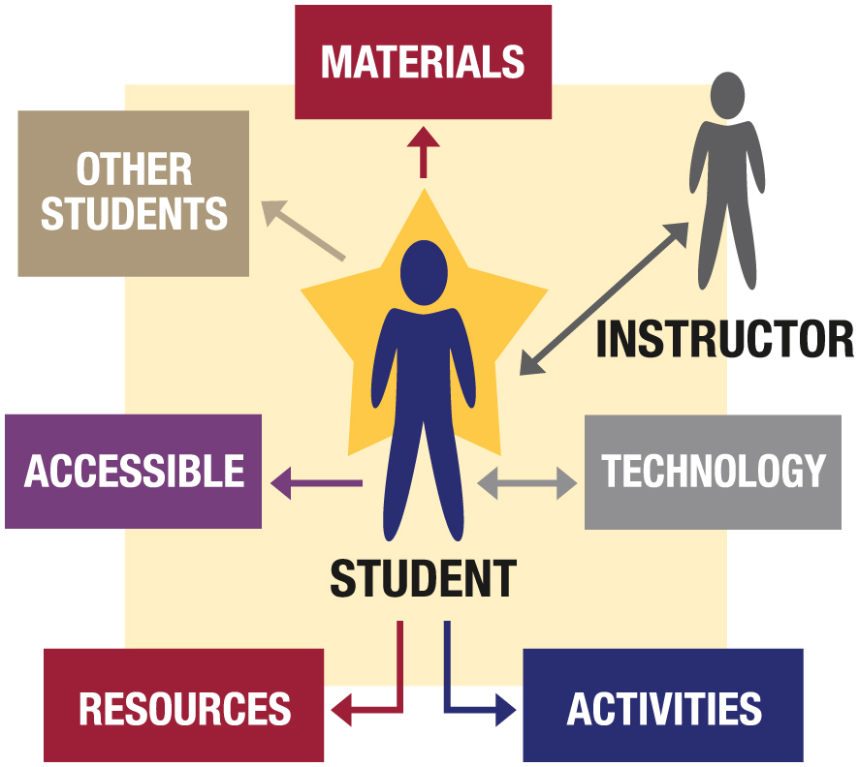
Learner Support Certification
Academic
Library
Advising
Tutoring
Bookstore
Grades
Support
  Registration
  Billing
  Financial Aid
  Accessibility
  HelpDesk
Notes:
Emphasize that there may be other services the program provides to online learners, e.g., student organizations. These should be reported too.
The program provides online learners with online technical, academic, and student support services including, but not limited to
Orientation to online study
Technical support
Academic advising
Tutoring
Grade appeals
Library resources
Accessibility services
Records and Registration services
Financial Aid services
Billing services
Access to Institutional and student policies
Learner feedback on online services effectiveness is systematically collected and fed back into improvement efforts

Slide 14

Learner Success Certification
SUCCESS
Completion
Retention
Satisfaction
(Students, Faculty, Employers)
Data Collection
Definition of Success
Program Competitiveness
Institutional Mission & Goals
Notes:
Explain QM’s willingness to let programs define learner success based on mission, resources, and the characteristics of their learner population.
How does your program define learner success?
Course retention, completion, grades, & graduation rates?
Capstone projects, standardized summative testing?
Transcript reviews and data collection rubrics based on published LOOK’s
Alumni surveys
Employer surveys
Civic engagement measures
Other
Are your program’s mission and goals factored into your definition of learner success?
Have you thought about what sets your program apart from competing programs?
Are you collecting data to document that your learner success is better than average for programs of your type?

Slide 15
Exemplary Program Recognition
Exemplary
Program!
Program Design
Teaching Support
Learner Support
Learner Success

Slide 16

Benefits of QM to Learners
Success
Completion
Retention
Satisfaction
(Instructor & Learner)
Facilitate Learner Success
©2016 MarylandOnline, Inc.
Notes:
QM certifications for faculty, staff, courses, and programs benefit the institution and students.
Faculty satisfaction increases with well-designed courses. This gives instructors more time to interact with students and provide personalized instruction and facilitation. Learner satisfaction with course design and interaction with instructors increases, which improves retention, completion and student success.

Slide 17

Benefits of QM to Institutions
Accreditation
Funding
Stakeholders
Accountability
©2016 MarylandOnline, Inc.
Notes:
With improved student success, the administration has positive and encouraging data to report to stakeholders which can include the state legislature, potential donors, and the accreditation bodies. This in turn generates more resources that can be invested back into teaching and learning.

Slide 18
Contact QM Today!
Membership
Marijane Hakun - 401.497.8001
mhakun@qualitymatters.org
Course Reviews
Melissa Poole - 401.497.8031
mpoole@qualitymatters.org
K-12 Membership & Services
Chris Voelker - 401.497.8037
christine.voelker@qualitymatters.org
Professional Development
Brenda Boyd - 401.497.8027
brenda.boyd@qualitymatters.org
Notes:
Please contact any of the QM staff listed here. We look forward to welcoming you to the QM community and working with you soon! Join the QM Community today. Thank you!

Slide 19
Thank You!

