Slide 1
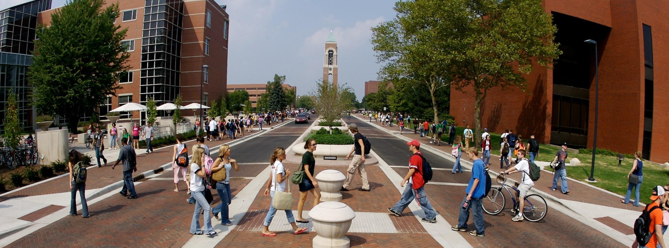
Innovative Approaches to Learner Success www.bsu.edu/ilearn

Slide 2

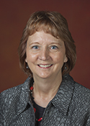
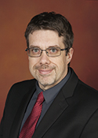
Today’s Speaker
Ryan Hornbaker, Instructional Designer
Dan Jones, Instructional Designer
Cindy Cash, Instructional Designer
Ryan
Cindy
Dan

Slide 3
Innovative approaches to learner success: Setting the standard for development of three distinctive online outreach programs
Professional Educators Initiative
Jumpstart (Software Skills)
Key Careers
Academic Integrity

Slide 4
iLearn Overview
Our Mission: To create high quality learning experiences for faculty and students
Part of the Division of Online and Distance Education at Ball State University
iLearn is collaborative team of
  Instructional Designers
  Learning Technologists
  Developers/Researchers
Institutional Member of QM since July 2012

Slide 5
Role of Instructional Designers
Work one-on-one with faculty consults to develop or redevelop online courses
Ensure quality by following QM and Institutional guidelines (Title 34 and FERPA)
Research and implement innovative technologies (Storyline, My Mediasite)
Help faculty determine best practices and technologies to fulfill course objectives

Slide 6
Expansion of Design Focus
Increased focus on institutional wide projects
  Professional Educators Initiative
  Jumpstart
  Key Careers
  Academic Integrity
Applying the Quality Matters Continuing and Professional Education (CPE) Rubric

Slide 7
Professional Educators Initiative
A collaborative, interdepartmental effort to fill a growing need for public teachers in primary and secondary schools to enhance their teaching skills
28 mini-courses (each mini-course is four-weeks and non-credit)
The courses were created in direct response to new legislation
The first attempt by a state institution to address these changes
The modules provide an opportunity for teachers to interact with their peers while learning best practices within their respective fields
As instructional designers, our unit worked directly with experts in education to ensure that content was current and appropriate

Slide 8
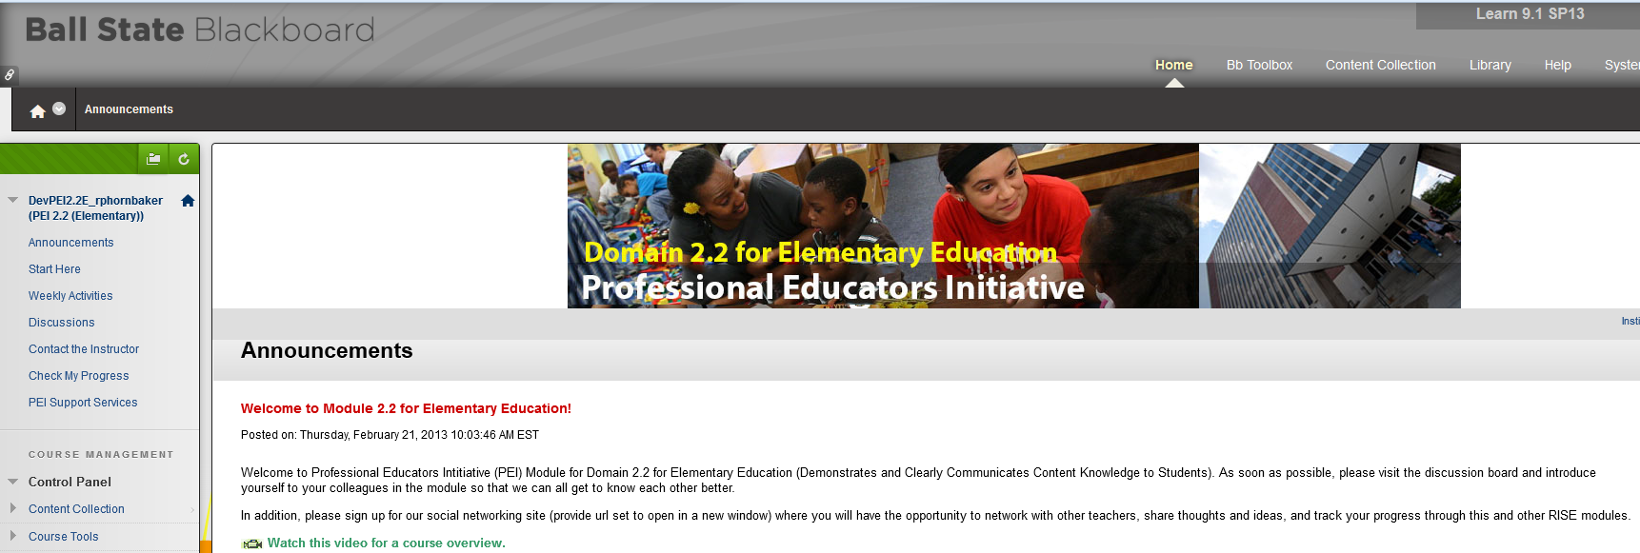
Demonstration of Program

Slide 9
Jumpstart
The university president requested an online program be made available to all students to help them learn software skills that would make them more marketable
The courses are online, self-paced, and instructor-less
Courses were also designed to be accessible to faculty members so that they could be included as assignments in their courses
Completion of a course rewards students with a digital badge as well as documentation on their transcript
57 courses were created in Desktop Productivity, Data Mining, and Web/Graphic Development
Courses could be offered to faculty, staff, alumni, and state residents in the future
Courses were designed utilizing the QM Continuing and Professional Education Rubric

Slide 10
Applying the CPE Rubric
CPE = Continuing and Professional Education
Jumpstart was the first program developed at BSU that used the CPE Rubric
Meet the following CPE criteria:
  pass/fail
  skills-based
  do not carry academic credit
  self-paced

Slide 11
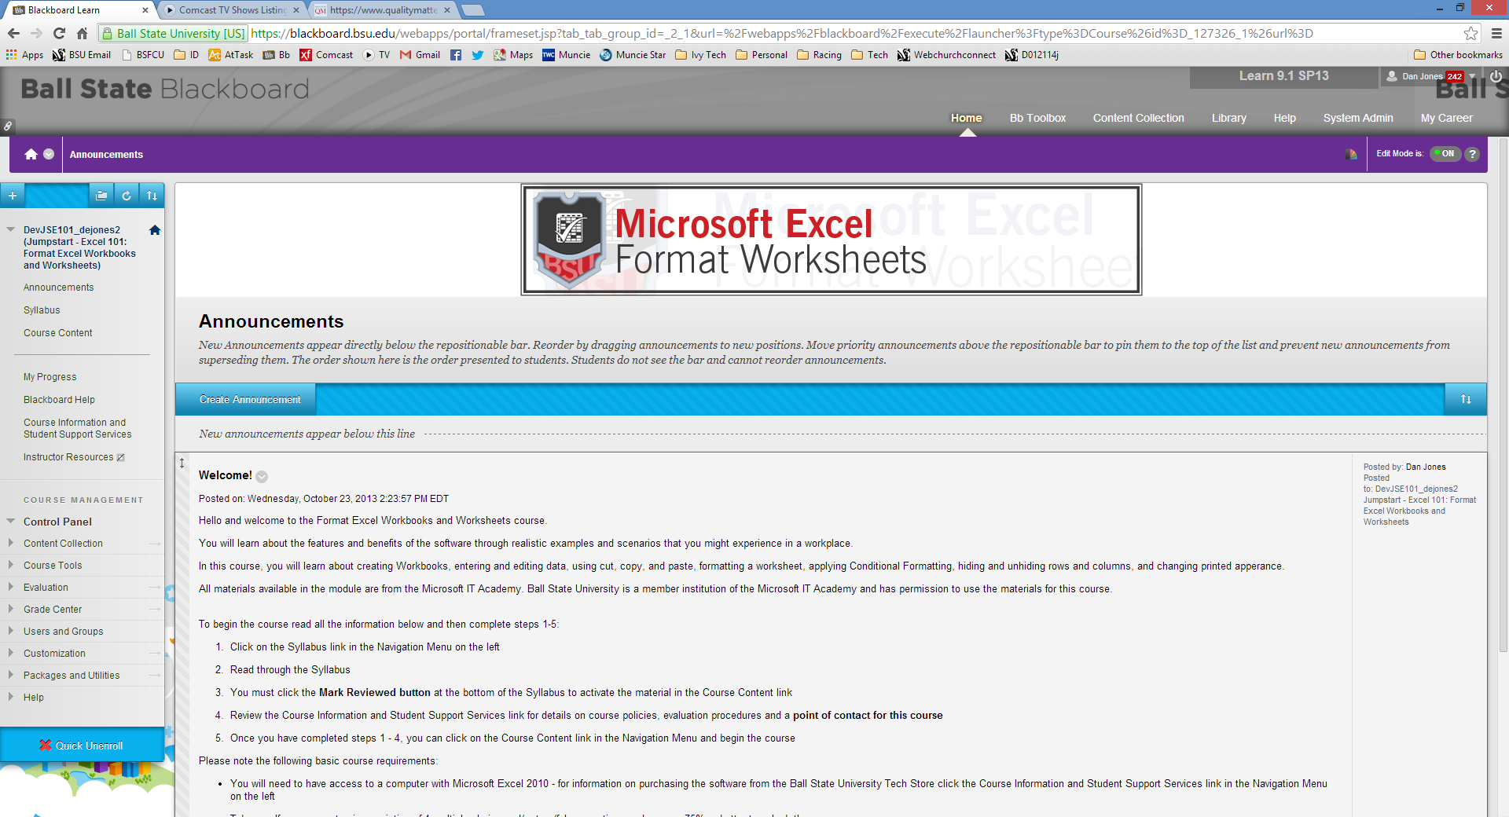
Demonstration of Program

Slide 12
Key Careers
The Career Center requested an interactive, self-paced career exploration workshop
Designed to help incoming freshmen find and determine a major/career path so that these students graduated within four years
This online resource is one way to help ensure students are on the correct track for their future
The online workshop is facilitated by career advisors assigned to monitor the students’ progress through the six, self-knowledge assessment units with a final evaluation paper submitted to an advisor
Students completing the course requested more interactivity

Slide 13
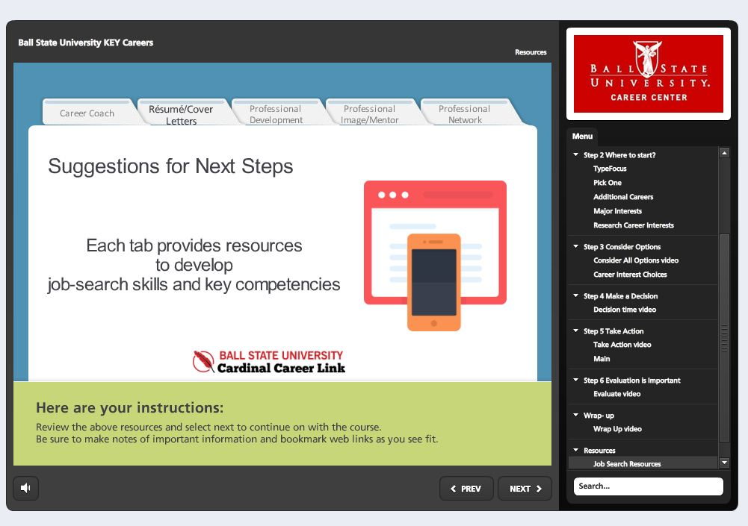
Demonstration of Program

Slide 14
Academic Integrity
Course was developed by a request from faculty that were concerned that students didn’t understand forms of academic dishonesty (particularly plagiarism)
Course is divided into 3 Units:
  Overview of BSU policy
  Types of academic dishonesty with a focus on plagiarism
  Tips on avoiding academic dishonesty
Course will be required for incoming online students and will be made available to all faculty to include in their courses
Content was developed using Articulate Storyline and completion progress will be tracked in Blackboard

Slide 15
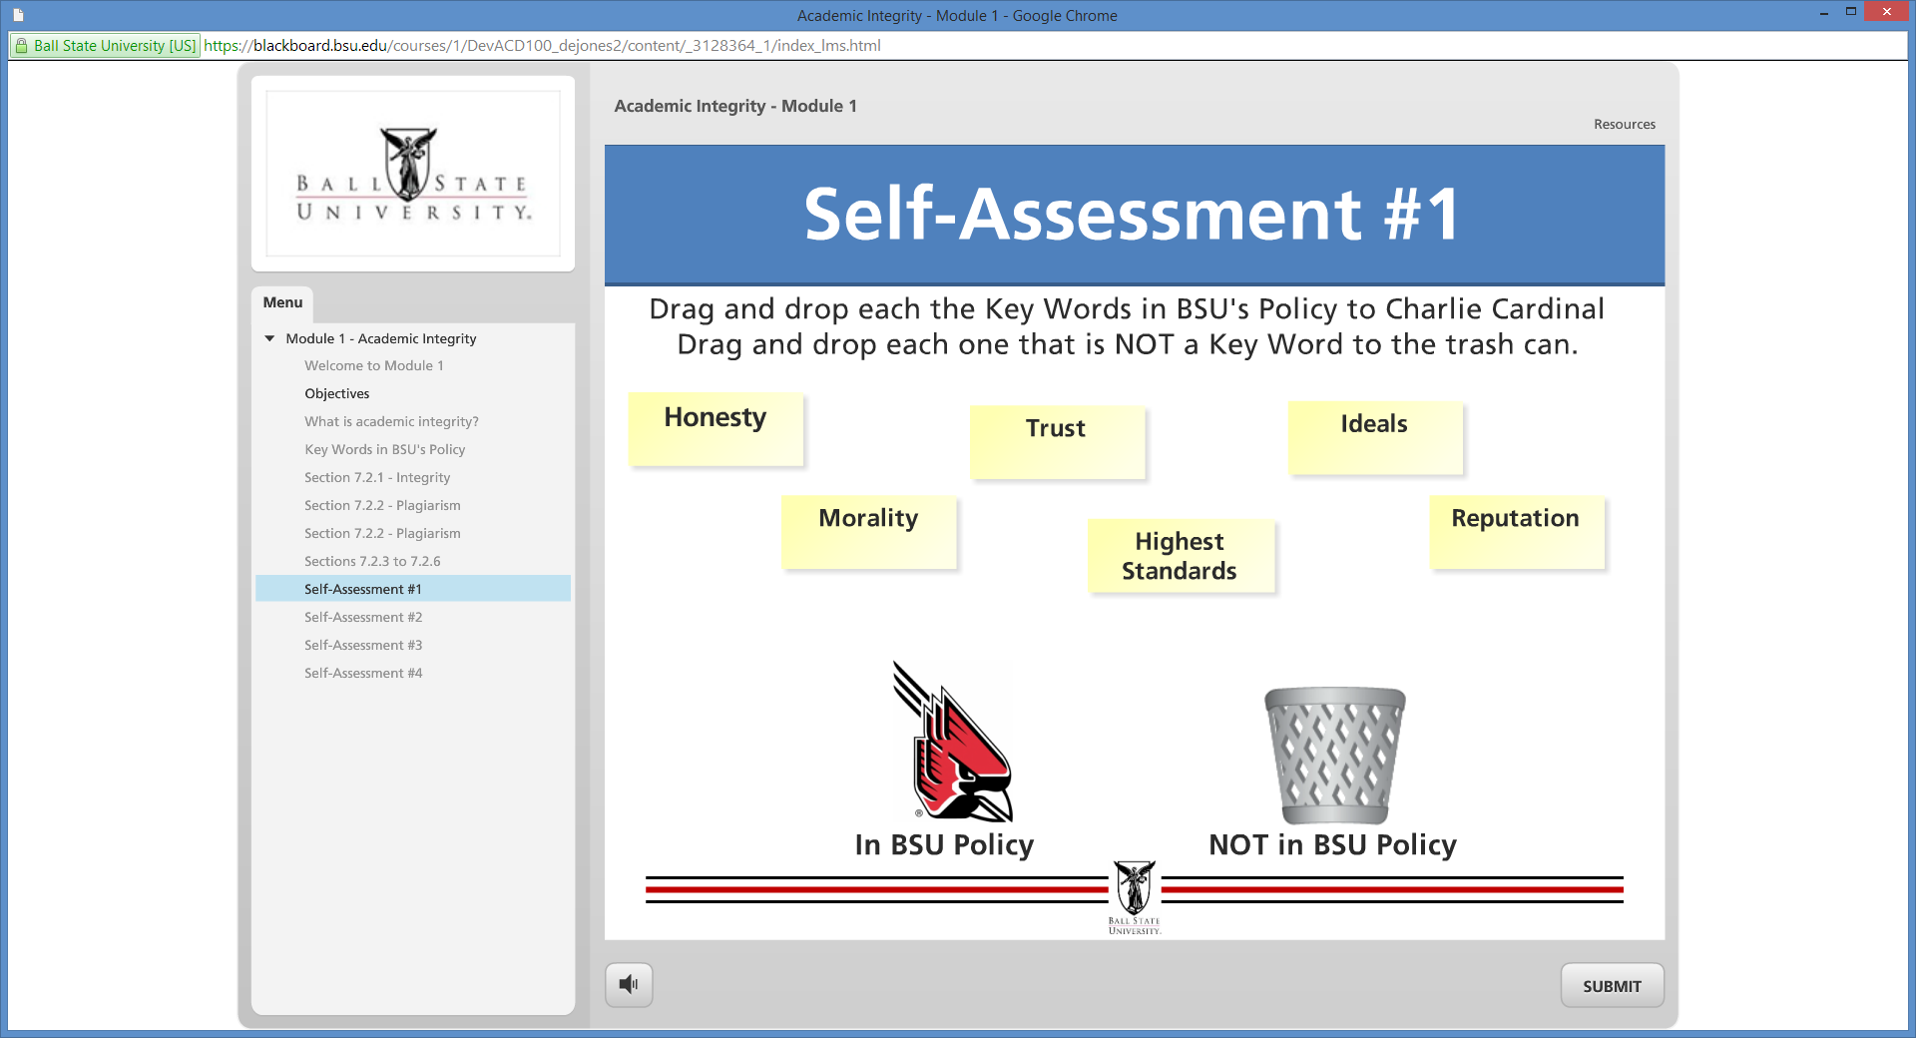
Demonstration of Program

Slide 16
Conclusion
The programs have helped enhance initiatives that reach beyond original expectations for iLearn.
Expansion of Design Focus:
Non-credit courses
Serving students outside the university
Using the CPE Rubric
Institutional wide projects

Slide 17
Questions?

