Slide 1

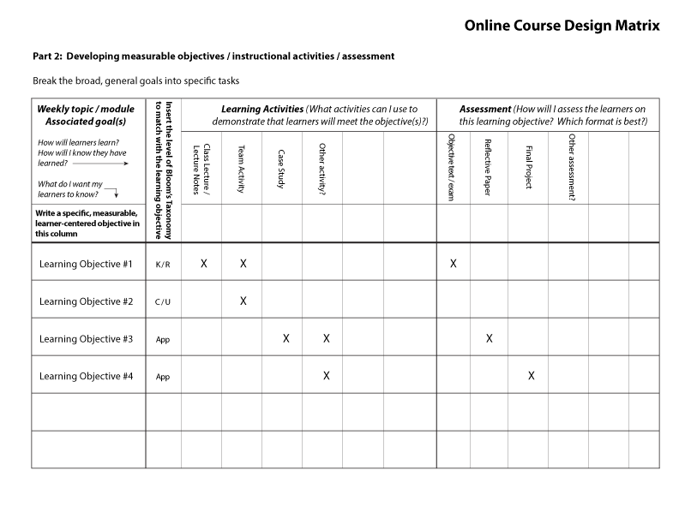
The Integration of Quality Matters™
It Began With a Mentoring Program & a Course Design Matrix
Sharon Stevens / Scott Switzer
Faculty Resource Center
Linda Button
College of Education

Slide 2

Session Objectives
Develop a mentoring relationship with participating faculty
Build an instructional design process using the Course Design Matrix
Integrate Quality Matters™ into the process and into the overall culture of faculty development

Slide 3
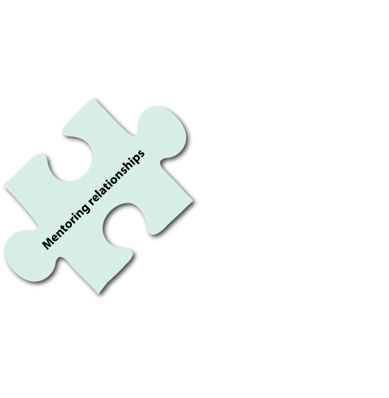
Faculty Development Framework
Mentoring
Mentoring relationship began as informal relationships and evolved to more structured interactions
We mentor faculty through the Online Course Enhancement Grants, Teaching Online Certificate Program, and all Quality Matters reviews
We developed a Course Design Matrix and structured “learning plan” to assist in the mentoring process

Slide 4
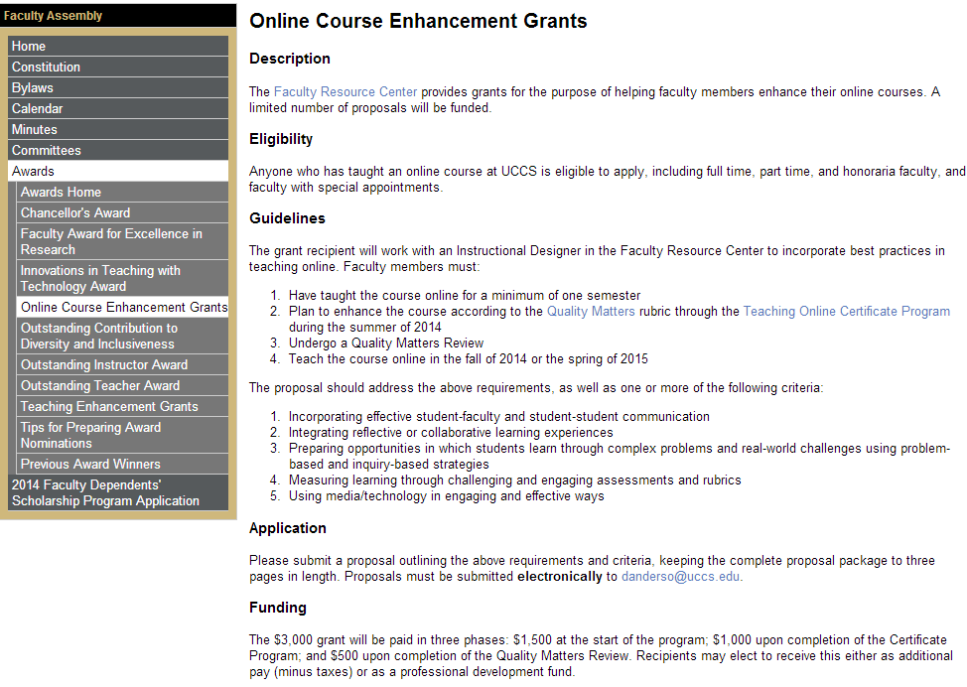
Faculty Development Framework
Online Course Enhancement Grant
To enhance online courses
  Reflective or collaborative learning experiences
  Problem-based and inquiry-based strategies
  Assessments and rubrics
  Media/technology in engaging ways
Assigned mentor from the beginning of the program
Work through QM rubric
Stipend
  $1,500 at the start of program
  $1,000 upon completion of certificate program
  $500 upon completion of Quality Matters Review

Slide 5
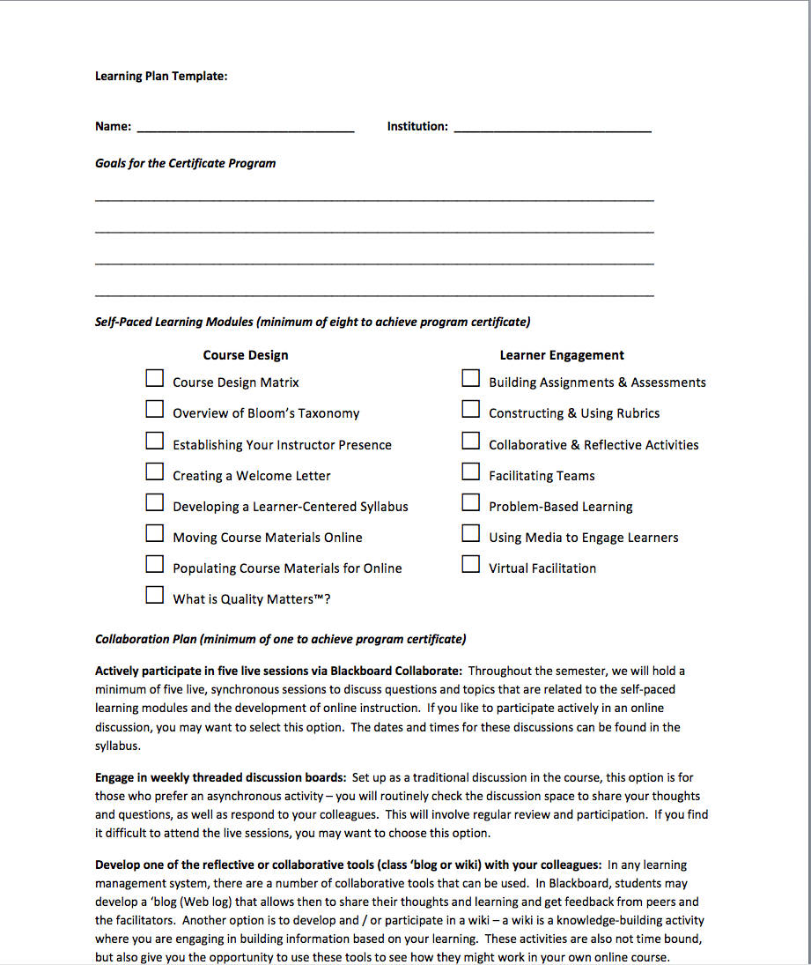
Faculty Development Framework
Teaching Online Certificate Program
Works closely with a mentor to create an individualized learning plan, based on your own unique goals
Gains valuable insight on a variety of topics from basic course design through collaborative techniques to integrating video, audio, and other media into their course
Based on solid instructional design process with Quality Matters standards integrated into all phases
We used the “learning plan” to determine goals, recommend course modules, and keep track of assignments

Slide 6
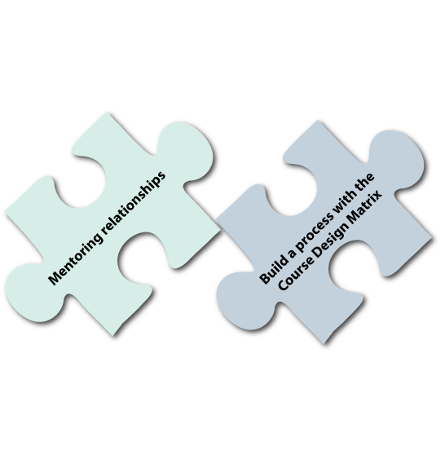
Faculty Development Framework
Course Design Matrix
The Course Design Matrix was developed for the Certificate Program
Based on sound instructional design principles
Integrated into Certificate program, grants, and Quality Matters™ program

Slide 7
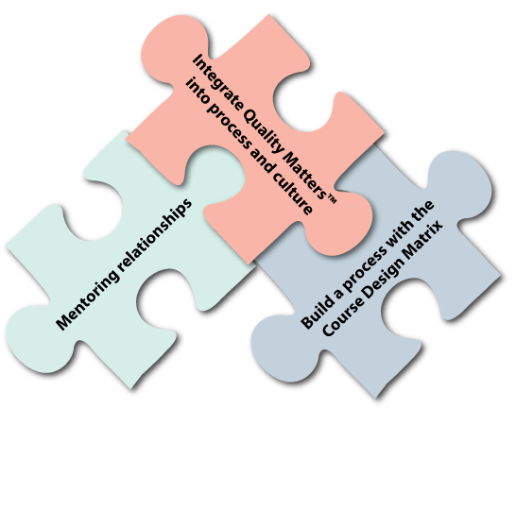
Faculty Development Framework
Quality Matters™ Program
The Quality Matters™ program was introduced to the Campus-wide Online Task Force in 2011
Our first full subscription began in July of 2012
We introduce the QM rubric in all of our programs and use the rubric to guide faculty in their course development
Integrated a mentorship component into the QM process

Slide 8
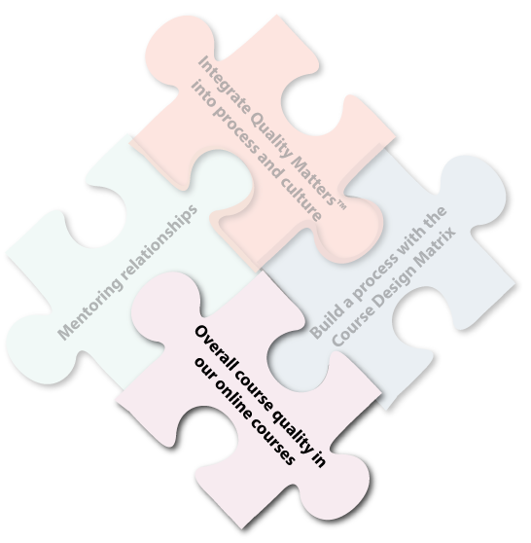
Faculty Development Framework
Overall Course Quality
The net effect of mentoring, the use of the Course Design Matrix, and the integration of Quality Matters™ is an overall increase in course quality
We have three faculty who have been recognized by the QM program
We have a full slate of upcoming reviews for the summer and fall semesters

Slide 9
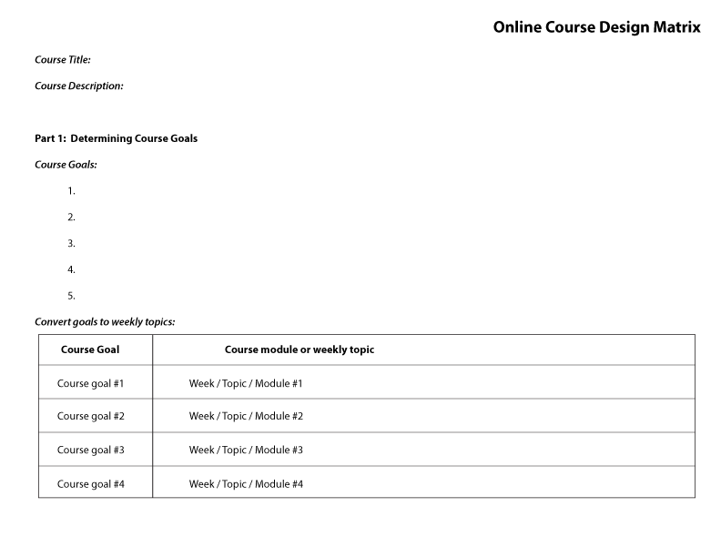
Process – Course Design Matrix

Slide 10
Process – Course Design Matrix

Slide 11
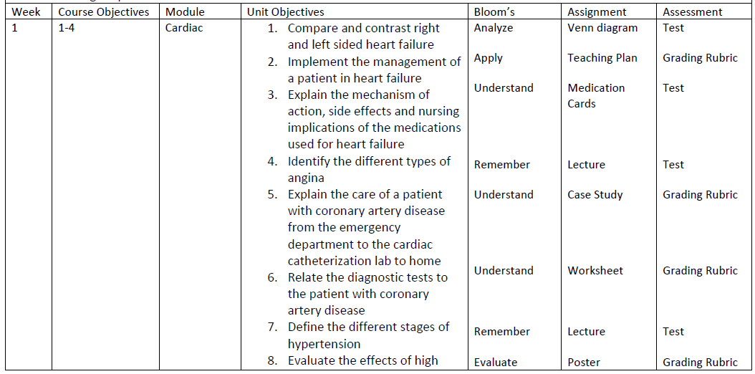
Process – Course Design Matrix
Competency-based Course Matrix

Slide 12


Faculty Perspectives
Linda Button, College of Education

Slide 13


???
Questions / Comments?

Slide 14
???
Thank you for joining us today!

