Slide 1
QM International Initiatives
& iQM Association
Notes:
Quality Matters (QM) is a quality assurance leader in online education. Its impact and influence is seen broadly across the U.S. and is expanding internationally.

Slide 2
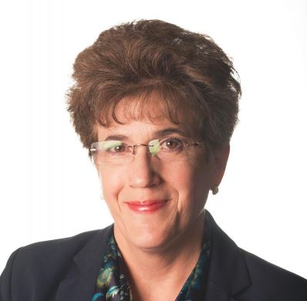
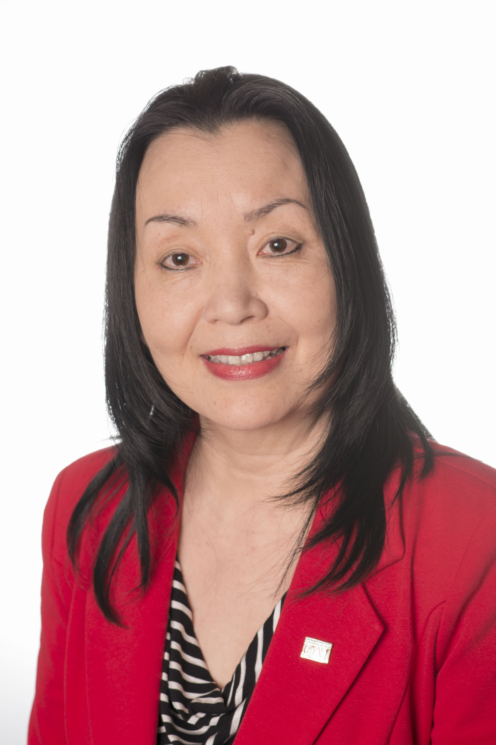
Deb Adair, Ph.D.
Executive Director
Quality Matters
Yaping Gao, Ed.D.
Senior Academic Director
Programs & Services
Quality Matters
©2016 MarylandOnline, Inc.

Slide 3

Background & Context
Increasing international interest
Variety of institutions and organizations
Desire to represent QM in non-English speaking countries and regions
Need to protect intellectual property

Slide 4
Current Membership Outside USA
7 countries outside USA
46 international member institutions
  35 institutions in Canada
  4 institutions in Saudi Arabia
  3 institutions in Australia
  1 in China, Fiji, Japan, & Mexico
Ongoing inquiries

Slide 5
QM Joins International Organizations
Member of Internal Council for
Open and Distance Education (ICDE)
Member of International Network for Quality Assurance Agencies in Higher Education (INQAAHE)
CHEA International Quality Group (CIQG) – in discussion

Slide 6
Ongoing Outreach & Collaboration
Updates on QM-Fudan
collaboration (China)
On-going conversations with such as:
  Middle-East organizations
  Mexican Society of Computing in Education (SOMECE, Mexico)
  International Board of Standards for Training, Performance, and Instruction (IBSTPI)

Slide 7
Goals for International Expansion
Contribute to international
quality assurance in online education
Generate revenues to support existing products and services
Develop new products and services
Grow international reputation of
QM brand

Slide 8
Constraints to Expand Internationally
Minimal capital dollars to invest
Limited internal human resources to manage the process
Need to protect intellectual property
Language and cultural barriers

Slide 9
Strategies to Overcome Constraints
QM International Expansion Policy
and Guidelines
  Strategic goals
  Principles of collaboration
  Strategies to overcome constraints
  Ways to evaluate potential collaborators

Slide 10
Strategies to Overcome Constraints
Two-Year Strategic Plan 2016-2017
  Target non-English speaking countries and regions: China, Mexico, Saudi Arabia and the Middle-East region
  Identify prestigious institutions & established service providers
  Start with Basic Membership & gradually build materials / tools
  Ways to protect intellectual property

Slide 11
Establishment of iQM Association
Collectively, the iQM Association will
serve as a special interest group to
discuss quality and quality assurance in online and blended learning outside of the United States, and to identify and/or to help evaluate international opportunities for QM in light of the QM goals, interests and capacity.

Slide 12
Establishment of iQM Association
Individually, iQM Association Members
assist QM in individual country or
regional initiatives where QM may need
such support. QM may turn to iQM members with relevant language, educational and cultural expertise to serve as advisers, translators, facilitators, and, in special circumstances, representatives in targeted international collaborations.

Slide 13
iQM Association Membership
51 iQM Association Members
(10/17/2016, application on-going)
  11 in Chinese
  10 in Arabic
  8 in Spanish
  5 in German
  4 in French
  Also in Russian, Italian, Hungarian, Dutch, Korean, Portuguese, Turkish, Thai etc.

Slide 14
iQM Membership Convening
Inaugural gathering in Portland
(Oct. 30 – Nov. 2)
Annual convening at QM Connect and Regional Conferences
Virtual meetings as needed
On-going communication and input gathering

Slide 15
iQM Membership Structure
Future Sub-Groups/Chapters
  iQM Arabic
  iQM Chinese
  iQM Spanish
  iQM French
  Etc.

Slide 16
iQM Members Can Help
Introduce QM to international institutions & organizations
Promote QM membership and
services in English
Identify and recommend potential collaborators
Volunteer for translating and consulting services when called upon

Slide 17
Questions or Comments?
Yaping Gao, Ed.D
Senior Academic Director
Programs & Services
ygao@qualitymatters.org
Skype: yaping.qm

Slide 18


