Slide 1
Internationalizing QM

Slide 2
Internationalizing Quality Matters: One Size Fits All vs. Cultural Adaptation
Yaping Gao, Ed.D
District Director, Instructional Design
Broward College
Ron Legon, Ph.D
Executive Director, Quality Matters

Slide 3
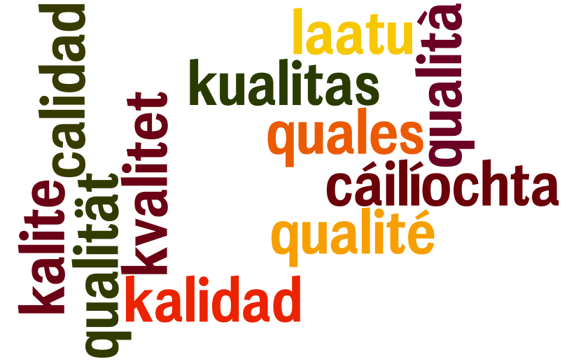

gehalte
质量
جودة
品質
качество
품질
איכות

Slide 4
The Problem
QM Attraction around the World
  Canada (11) Saudi Arabia (3)
  Australia (4) Singapore (1)
  Ireland (1) Fiji (1)
Current Subscriptions: limited to English
New Frontier: Translating QM into other major world languages, e.g., Spanish, Arabic, Chinese
Literal Translation Enough?
  QM rubric is intended to build an environment for effective online learning

Slide 5
The Case for Literal Translation
QM works – Don’t tamper with it
QM is based on accumulated best practice, research, and feedback from subscribing institutions; should not enter uncharted territory
QM is grounded in US culture and academic traditions
  QM would need to start over to address the needs of other cultural settings
  Other cultures should use QM as is, if it suits their needs

Slide 6
The Case for Cultural Adaptation
Every major world culture has its own educational traditions, practices, and goals
  Abandoning long-standing beliefs and practices may encounter stiff resistance
  Imposed change might not work if it contradicts deeply-held beliefs and habits
  Harnessing the strengths of the existing pedagogy and incorporating them into online course design should work much better

Slide 7
Would the same pedagogy work regardless of the answers to these questions?
Are teachers seen as
Facilitators or evaluators?
Helping all learners reach their potential or winnowers in search of the best students?
Remote authority figures (sage on stage) or
approachable guides (guide on the side)?
Is this standard equally relevant?
(1.8) The self-introduction of the instructor

Slide 8
… and these questions?
Are learners expected to
Listen and memorize or interact and question?
Accept authority or engage in critical thinking?
Conform to social norms or express their individuality?
Conform to social pressure to excel above all else or seek a balance among their priorities?
Are these standards equally relevant?
(1.9) Learner self-introductions
(5.3) Instructor response time
(5.4) Requirements for learner interaction

Slide 9
… and these?
What value does the educational system place on
Academic honesty? Avoided, assumed, or required?
Group / collaborative work? Prohibited or required?
Self discipline? Expected or coached?
Accessibility for all? Legally mandated, good practice, or not applicable?
Are these standards equally relevant?
(1.4) Course and/or institutional policies
(5.2) Learning activities / interaction / active Learning
(8.2 & 8.3) Accessibility and alternative content

Slide 10
Collaborating with a Major
Chinese University to Fine Tune and Adapt the QM Rubric to the Chinese HE System

Slide 11
Features of the Test Course
Subject: Law and Ethics
Students: Freshman course for all Chinese undergraduates
Format: Blended MOOC
  Thousands of students from multiple institutions
  Facilitators provided to run 6 face-to-face sessions at home institutions
Content: Extensive reading material; full-length videos
Instructors: One lead faculty with multiple instructors

Slide 12
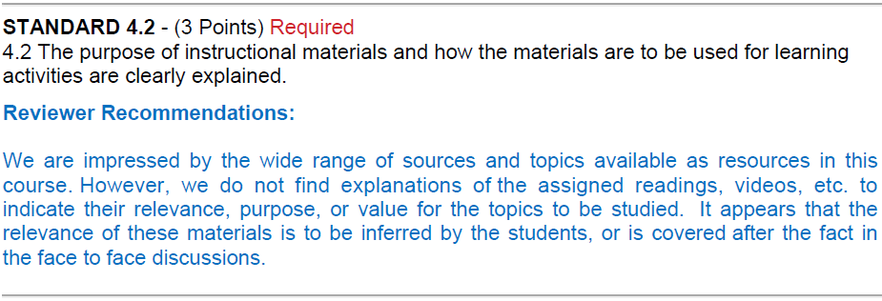
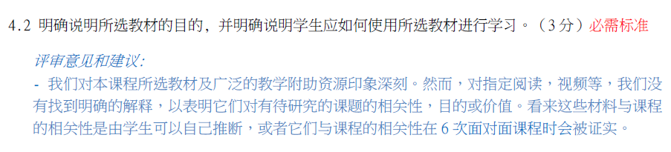
How We Reviewed the Course

Slide 13
Indications from Course Review
GS 1 – Unmet Overview and Introduction Standards
  1.3 Netiquette expectations
      Comment: Respect for others, particularly for teachers, may be too ingrained in the culture to need repeating
  1.8 Instructor self-introductions
      Bio information is provided in third person.
      Comment: May be necessary for MOOC, but is this a general practice?
  1.9 Learner self-introductions
      Comment: May not be applicable for MOOC, but probably not considered appropriate in other courses

Slide 14
Indications from Course Review
GS 2 – Unmet Learning Objectives Standards
  2.1 & 2.2 Measurable learning objectives
      Comment: Are students expected to learn everything with no differentiation of relative importance?
  2.3 Clearly stated from learner’s perspective
      Comment: Learning objectives are stated from the instructor’s point of view
The following slide indicates how we tried to convey the value of having measurable objectives …

Slide 15
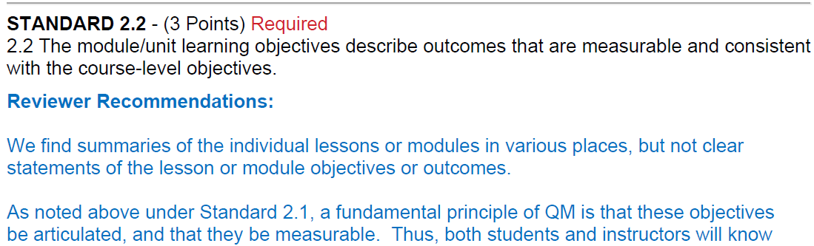
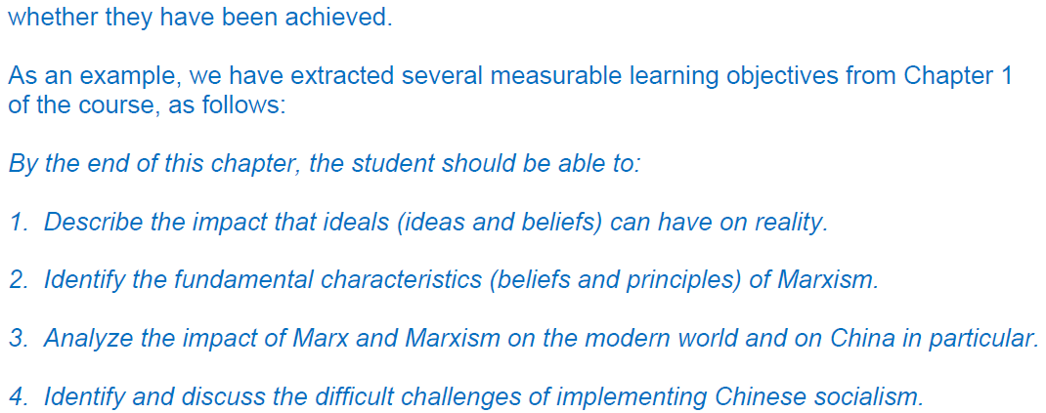

Slide 16
Indications from Course Review
GS 3 – Unmet Assessments & Measurement Standard
  3.3 Specific/descriptive criteria for evaluation
      Comment: Assignment instructions may be considered sufficient. Explicit criteria might be considered too helpful to students.
  3.5 Multiple opportunities for Students to track their learning
      No evidence of practice tests and assignments.
      Comment: May not consider it necessary to provide extra incentives or help to students

Slide 17
Indications from Course Review
GS 4 – Unmet Instructional Materials Standard
  4.2 Purpose of materials and how to use them
  (See slide 12 above)
  Comment: Is the effort to instruct learners on the use of materials considered unnecessary or too helpful?

Slide 18
Indications from Course Review
GS 5 – Course Activities & Learner Interaction
  5.2 Opportunities for interaction and active learning
      Met through online discussions and six f-2-f meetings.
      Comment: Is this common in Chinese online courses?
  5.3 Instructor response time
      Partially met. Instructor feedback provided in this MOOC, but response time not found.
      Comment: Is this common in Chinese online courses?
  5.4 Unmet requirement for learner interaction
      Comment: Discussion participation in online or in f-2-f meetings does not appear to contribute toward final grades.

Slide 19
Indications from Course Review
GS 6 – Unmet Course Technology Standards
  6.5 Privacy policies available
      Comment: Are there laws or customs protecting student privacy?
GS 7 – Unmet Learner Support Standards
  7.2 Accessibility policies
      Comment: It appears that special-need students are tracked to separate schools
  7.3 & 7.4 Academic and student services
      Students are grouped in self-sufficient cohorts.
      Support information on “MyHome” website.
      Comment: There may be less need to have links inside course, but we recommend both.

Slide 20
Indications from Course Review
GS 8 – Unmet Accessibility & Usability Standards
  8.1 Information about accessibility
      Comment: It appears that special-need students are tracked to separate schools
  8.2 Alternative means of access to materials
      Comment: It appears that special-need students tracked to separate schools

Slide 21
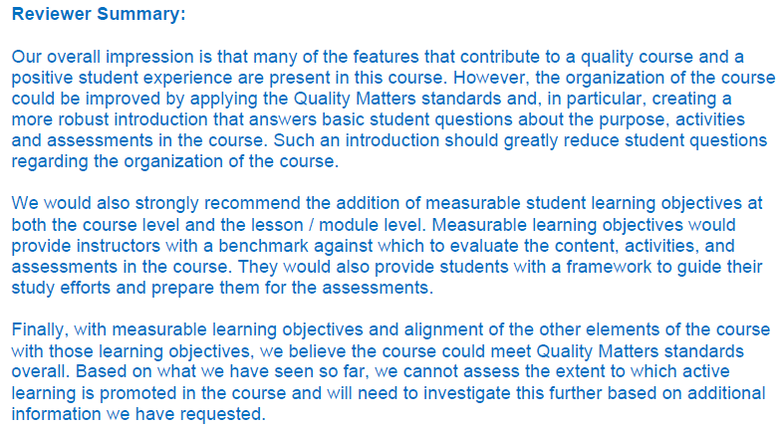
Keeping the Dialog Going

Slide 22
Conclusion?
QM adoption by other cultures and translation into other language is not a black/white issue. In order for QM to have the desired and intended positive impact on course design, many cultural issues need to be taken into consideration.

Slide 23
gehalte
质量
جودة
品質
качество
품질
איכות

