Slide 1
It’s Not You
Strategies for Engaging Faculty Around Alignment
Stephanie Diemel @ProfDiemel
Professor of Physics & Astronomy
eLearning Faculty-in-Residence
Shoreline Community College

Slide 2

How do YOU conceptualize alignment?
Two sentences max
Share with two neighbors

Slide 3

My Hybrid Perspective
@ProfDiemel

Slide 4
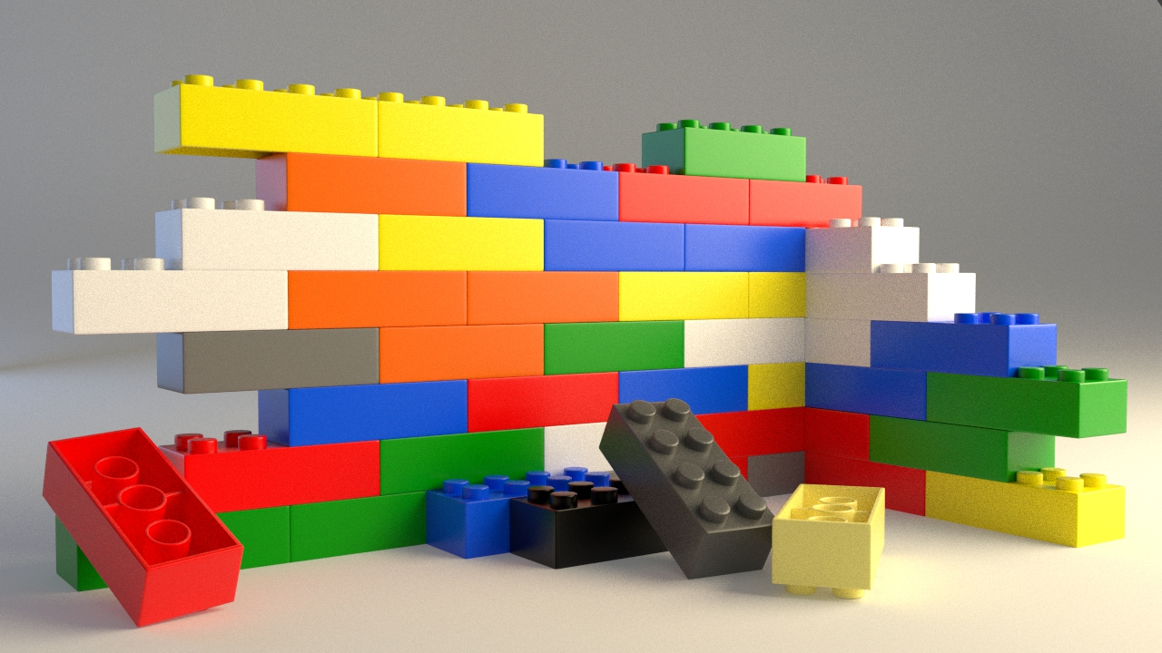
Both instructional designers and faculty practice alignment

Slide 5


…but I think they practice it differently

Slide 6
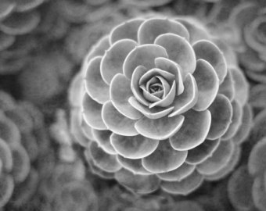
Faculty as Artist
Attached

Slide 7
Faculty as Artist
Attached
Why do faculty tend to identify so strongly with their courses?

Slide 8
Faculty as Artist
Attached
Instinctive

Slide 9
Faculty as Artist
Attached
Instinctive
Inside-out

Slide 10
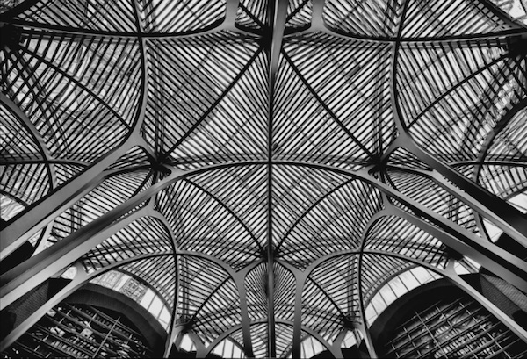
I.D. as Technician
Objective

Slide 11
I.D. as Technician
Objective
Protocol-based

Slide 12
I.D. as Technician
Objective
Protocol-based
Linear Process

Slide 13
Both perspectives are
real

Slide 14
Both perspectives are
real
valuable

Slide 15
Both perspectives are
real
valuable
required for a truly exceptional learning experience

Slide 16

How can we leverage the strengths of both?

Slide 17
How can we leverage the strengths of both?
Promote leadership within the faculty

Slide 18
How can we leverage the strengths of both?
Celebrate faculty that practice strong alignment

Slide 19
How can we leverage the strengths of both?
Promote the use of master course shells

Slide 20
How can we leverage the strengths of both?
Integrate both into a collaborative alignment process

Slide 21
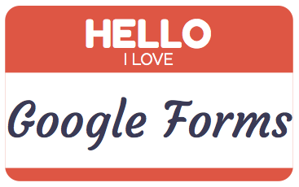
Build custom alignment worksheets for faculty

Slide 22
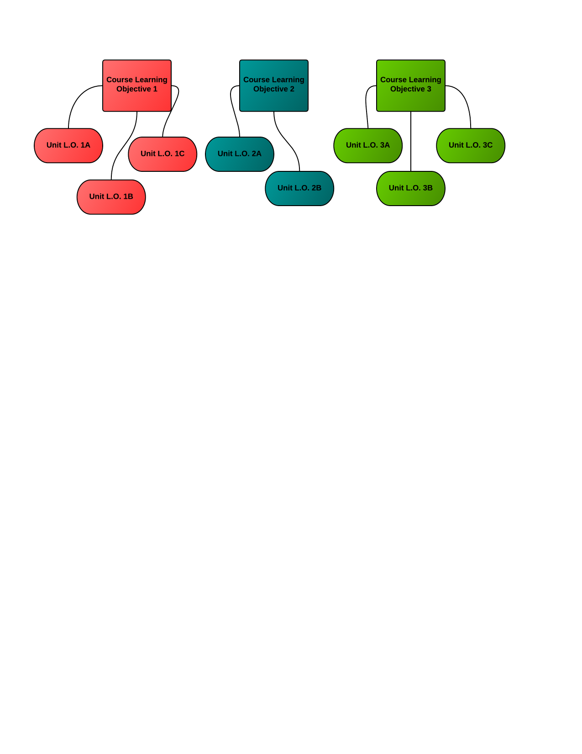
Consider the Following Case

Slide 23

Consider the Following Case
When talking with the faculty member, they mention
“richness”
“transformation”
“engagement”

Slide 24
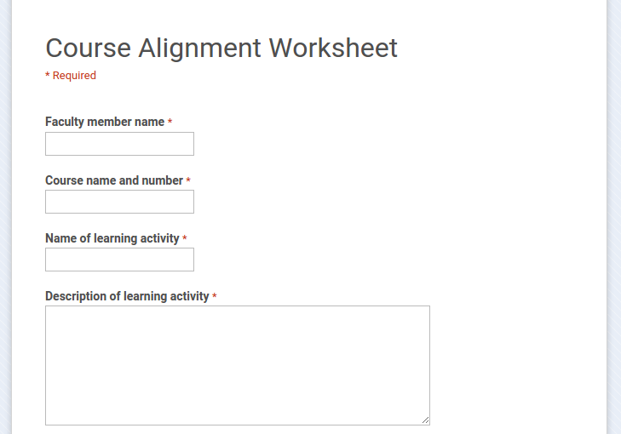

Slide 25
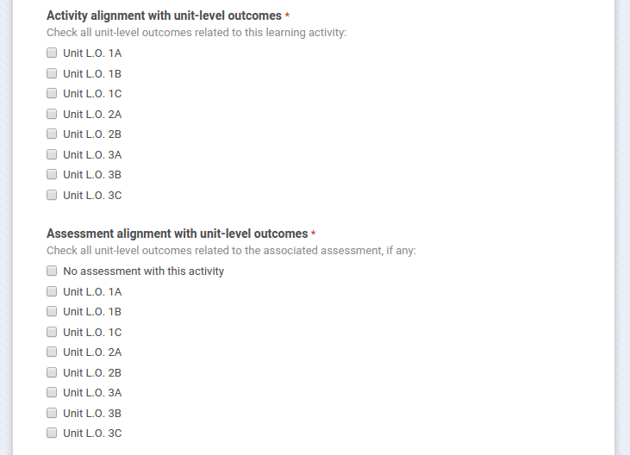

Slide 26
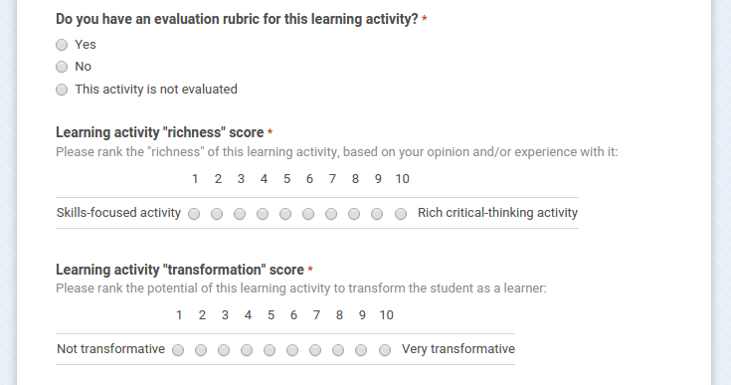

Slide 27
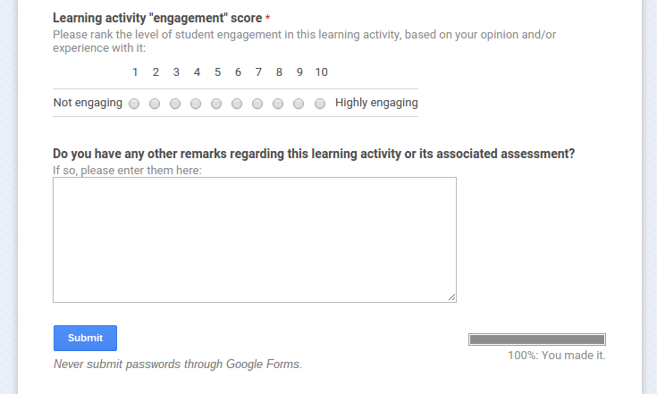

Slide 28
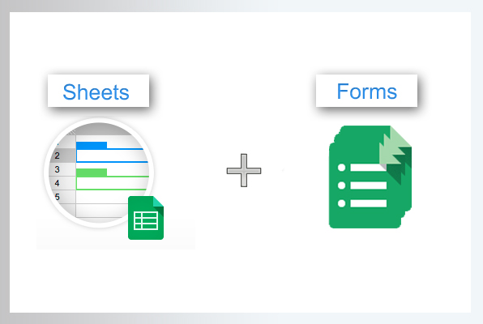

search
sort
analyze
share

Slide 29
Discussion
Now it’s time for

Slide 30
Discussion
Now it’s time for

Slide 31
Images sourced from the web
http://parallellineslesson.weebly.com/example.html
http://epicrapbattlesofhistory.wikia.com/wiki/Spock
http://imgkid.com/legos.shtml
http://sayheyjanaye.com/wp-content/uploads/2015/01/mbbrushes.jpg
http://www.dreamstime.com/stock-photo-engineering-tools-technical-drawing-image22027900
https://www.etsy.com/market/white_succulent
http://www.newscientist.com/blogs/culturelab/2011/08/olympic-sculpture-is-a-marvel-of-mathematics.html
http://imgkid.com/super-happy-dog-face.shtml

