Slide 1
Please take out your devices to participate in the conversation
Browser: PollEv.com/gpedraza
or
Phone: Text GPEDRAZA to 37607

Slide 2

Mapping the Journey of Alignment
Developing a template tool that facilitates course alignment mapping
By Sharon Mainka and Gerry Pedraza

Slide 3
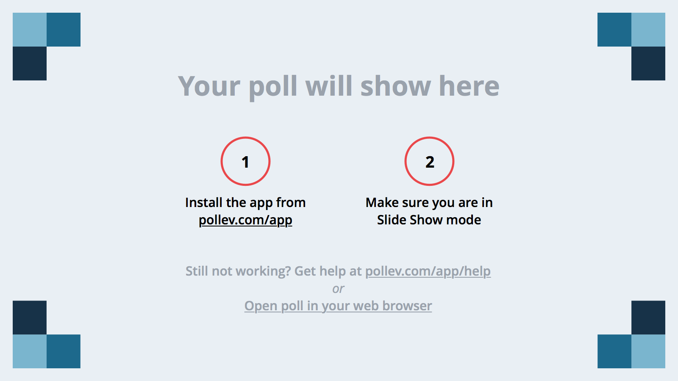
Notes:
Poll Title: Have you been involved in a QM course review?
https://www.polleverywhere.com/multiple_choice_polls/Cni1LMZ8sFvyTrS

Slide 4
Notes:
Poll Title: When reviewing a course how do you infer which assignments, assessments, and materials are linked to which objectives to determine alignment?
https://www.polleverywhere.com/multiple_choice_polls/3zMFjmY8RrC5sdT

Slide 5
Let’s say you are performing a course review on course X
You are evaluating the alignment of a module, in this case, a week…

Slide 6
Which QM Standards Address Alignment?
2.1 Course objectives are measurable
2.2 Module objectives are measurable
3.1 Assessments measure objectives?
4.1 Materials contribute to the objectives.
5.1 Activities promote achievement of objectives.
6.1 Tools used support the objectives.

Slide 7
Now Locate the Following:
Course objectives
Module objectives
Materials
Assignments
Assessments
Notes:
Give handouts…

Slide 8
How do I Know the Intended Alignment?
GOALS
Which assessments, materials and activities connect with each of the weekly objectives and these with the course level objectives?

Slide 9
Notes:
Poll Title: As a reviewer would you like to see filled alignment sheet that will let you know the alignment intentions of the course development?
https://www.polleverywhere.com/multiple_choice_polls/oWnwvWPEQx4UYy1

Slide 10
Review with Template
Which assessments, materials and activities connect with each of the weekly objectives and these with the course level objectives?

Slide 11
Week 12
Alignment
Review the trends in E-Commerce, Procurement Process and trends in Supply Chain Management.
TXTBK: Chapter 11
Case Presentation
Lecture Notes
Distinguish between net marketplaces and private industrial networks.
TXTBK: Chapter 11
Case Presentation
Lecture Notes
Demonstrate how companies can leverage investments in IT both operationally and strategically.
TXTBK: Chapter 11
Case Presentation
Video Lecture
Lecture Notes
Another objective that I need to add to for this week.
Summative Week Paper
Case Presentation
Notes:
Modify this one to look like Sharon’s handout

Slide 12
Audience Findings
Which assessments, materials and activities connect with each of the weekly objectives and these with the course level objectives?

Slide 13
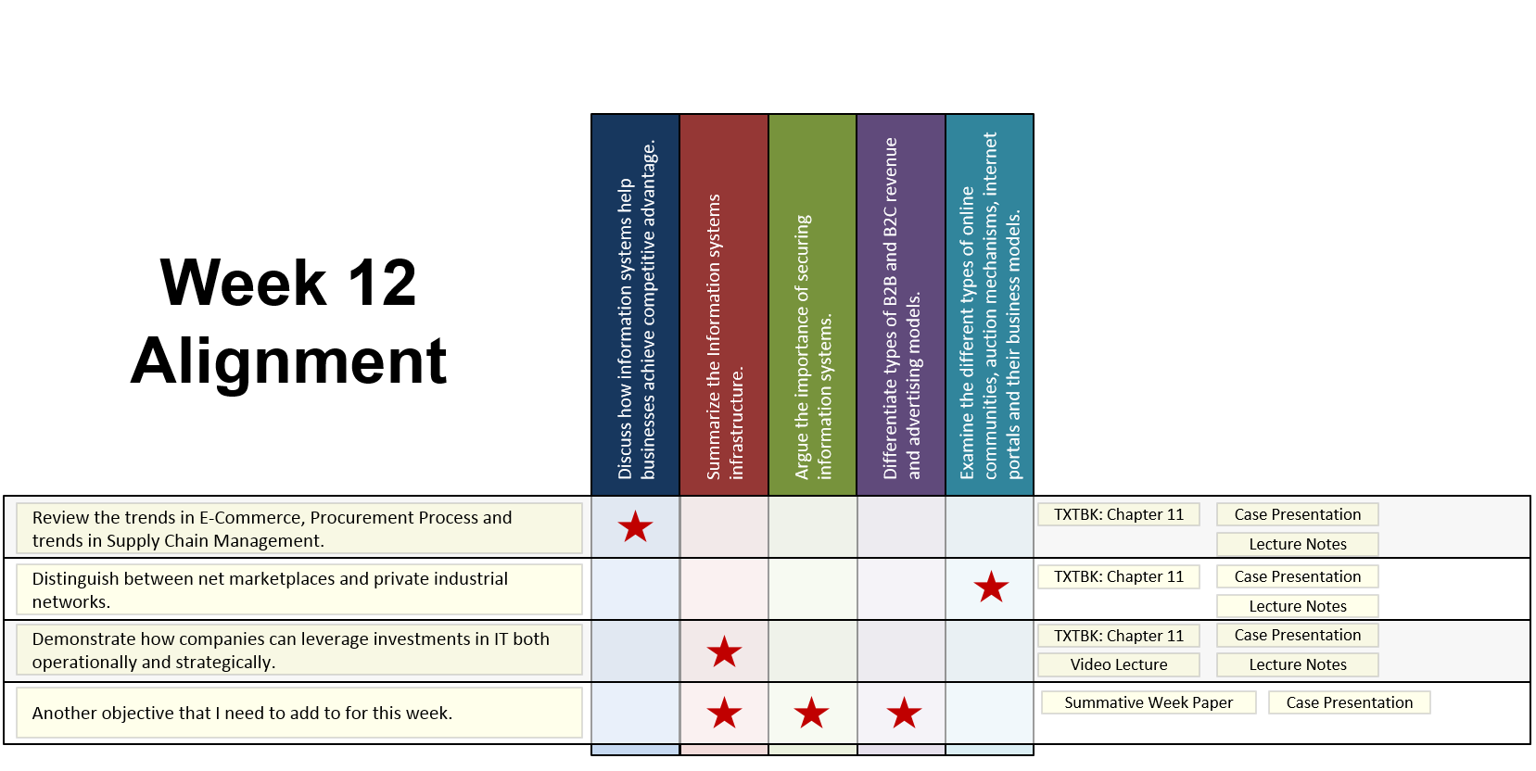
Pros of Using the Alignment Template
Helps the reviewers be aware of the designer’s intentions.
Helps the SME and Designer create cohesive course.
Helps to have a more efficient communication.

Slide 14
Cons of Using the Alignment Template
Reviewers can rely to heavily on the template and not thoroughly review the items in the course.
Needs to be updated every time there is meaningful changes in the course.

Slide 15
Questions?
smainka@tamu.edu
gpedraza@tamu.edu

